Slide 1
CSSE 220
Files & Exceptions
The git projects for today are:
PracticeFilesAndExceptions
PracticeFilesAndExceptionsSolution
PracticeFilesAndExceptionsTooManyScoresSolution
Notes:
Timing is good on this day, plenty of time to work on the exercises and work on the project.
1

Slide 2
Reminders
Use your UML design when you code!
That’s why you did it!
…but DON’T let it dictate the order that you code
Instead always do the next thing you can TEST.
Start with a Level then a Hero and whatever you need to make them display.
There is ZERO benefit to creating empty Monster classes at this point!

Slide 3
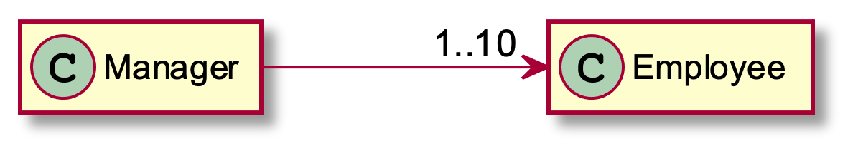
Review and Expand UML Notation: Cardinality
When no number appears, then implicitly 1
Each manager has between 1 and 10 employees. Maybe stored in an ArrayList
Plant UML Code to generate this diagram:
Manager ->"1..10" Employee

Slide 4
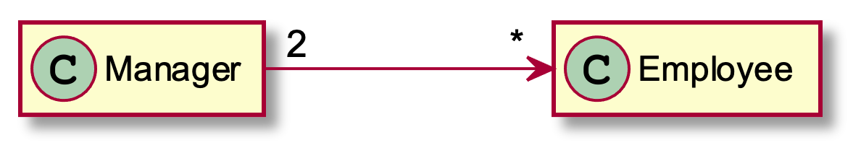
More Cardinality
Managers have any number of employees.
The '*' means “zero to infinity” – any arbitrary number. You can also occasionally see something like 4..* to mean 4 or more.
Every employee has exactly 2 managers. Note that this can be used even if there is no reference from Employee to Manager
Plant UML Code to generate this diagram:
Manager "2"->"*" Employee

Slide 5
What does this diagram mean?
EventParser
How many EventParser objects?
How many EventType objects?
How many Event objects?
*
EventType
2
0..1
Where are the references to these objects stored?
Event

Slide 6
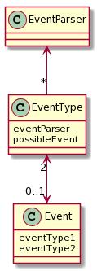
What does this diagram mean?
EventParser
EventParser
Only a single parser object is used by the entire system
EventType
*
EventType
All EventType instances use the same EventParser. Each EventType can have AT MOST 1 Event
2
Event
0..1
Event
An Event always has two EventTypes
E.g., maybe there is are:
National level EventType (large categories like entertainment/conference/etc.)
Regional level EventType (more specific to local area: parade, county fair, etc.)
Notes:
http://www.plantuml.com/plantuml/uml/SoWkIImgAStDuKhEIImkLd0jIyqh2KWiAaujgkRYvAhbGXOFgIn8hUPIK518HQW2SGloYuipat9ImOhGz01DIONfDUHIW0Aua158EHVST0KbBINTqW9TEsI784iRATdefkINv-dQAHdewHagGTHnEQJcfG0z0G00

Slide 7
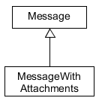
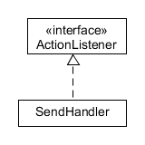
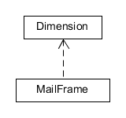
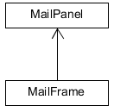



Summary of
UML Class Diagram Arrows
Interface
Implementation
(is-a)
Association
(has-a-field)
Inheritance
(is-a)
Dependency
(depends-on)
Two-way Association
Two-Way Dependency
Cardinality
(one-to-one, one-to-many)
One-to-many is shown on left
Q1
Notes:
Questions 2 will be done before question 1.
7

Slide 8
Files
Notes:
8

Slide 9
File I/O: Key Pieces
Classes used for opening files:
File A File object represents an actual file/directory on the disk
FileReader Convenience class for reading character files
Notes:
9

Slide 10
File I/O: Key Pieces
A Class used for reading an open file:
Scanner A simple text scanner which can parse primitive types and strings using regular expressions
Notes:
10

Slide 11
File I/O: Key Pieces
A Class that allow a user to pick a file:
JFileChooser JFileChooser is a part of java Swing package. When invoked, it pops up a dialog box which allows the user to choose a file or a directory.
Notes:
11

Slide 12
File I/O: Key Pieces
A Class used for writing to an open file:
PrintWriter Prints formatted representations of objects to a text-output stream including a file
Notes:
12

Slide 13
File I/O: Key Pieces
Invoking the close method on:
FileReader objects
PrintWriter objects
Scanner objects
Example:
private void readFile(String filename) {
File iFile = new File(filename);
Scanner s1 = null;
try {
s1 = new Scanner(iFile);
} catch (FileNotFoundException e) {
e.printStackTrace();
return;
}
while (s1.hasNextLine()) {
String line = s1.nextLine();
System.out.println(line);
} // end while
s1.close();
} // readFile
Invoke close when finished reading/writing
Notes:
13

Slide 14
Exceptions
Notes:
14

Slide 15
Exception – What, When, Why, How?
What:
Used to signal that something in the code has gone wrong
When:
An error has occurred that cannot be handled in the current code
Why:
Breaks the execution flow and passes exception up the stack

Slide 16
Exception – How?
Java code for throwing an exception: throw new EOFException(“Missing column”);
Java code for handling (catching) an exception:
try {
// Caller makes call(s) to operation(s)
// that can throw an exception(s)
}
catch (ExceptionType ex) {
// Caller code that attempts to recover
// from the exception
} // end try
Q5
Notes:
Try to read from file when the file does not exist
16

Slide 17
Exception Handling – How?
When you write code in the catch part of a try-catch block, you can attempt to:
Recover from the error discovered in the caller
Not recover, and have the app exit gracefully, e.g., close all open scanners, files, etc., then exit the app
Q5
Notes:
Try to read from file when the file does not exist
17

Slide 18
What happens when no exception is thrown?
If this line is successful
Scanner s1;
try {
s1 = new Scanner(new File(“test.txt”));
// code for reading lines
} catch (IOException ex) {
JOptionPane.
showMessageDialog("File not found.");
} finally {
s1.close();
} // end try-catch-finally
Code continues on
The catch never executes
This runs after code in try completes
Execution Progression: try block, then finally block
Notes:
18

Slide 19
What happens when exception is thrown?
Scanner s1;
try {
s1 = new Scanner(new File(“test.txt”);
// code for reading lines
} catch (IOException ex) {
JOptionPane.
showMessageDialog("File not found.");
} finally {
s1.close();
} // end try-catch-finally
If this line throws exception
Code after exception never executes
Code in catch is executed next
After catch is executed, this runs
Execution Progression: try block, catch block , then finally block
Notes:
19

Slide 20
When exception is not handled?
public String readData(String filename)
throws IOException {
Scanner s1 = new Scanner(new File(filename));
// code for reading lines
s1.close();
}
main -> readAllFiles -> readData
If this line throws exception
Client code after the call
does not execute
If exception is unhandled in readData, then it bounces to
the calling method, and then on up the call stack to main
If main does not catch it, then program crashes with
an exception error
Notes:
20

Slide 21
Two Kinds of Exceptions
Checked exceptions: compiler checks that calling code has try-catch to catch the exception
Used for expected problems – e.g., opening files
Unchecked exceptions: compiler lets us ignore these if we want
Used for fatal or avoidable problems
Are subclasses of RunTimeException or Error

Slide 22
A Tale of Two Choices
Dealing with checked exceptions
Can propagate the exception
By declaring that our method will pass any exceptions along… public void loadGameState() throws IOException
Used when our code isn’t able to rectify the problem
Can handle the exception
Used when our method can rectify the problem
By including a try-catch in our method
Q6
Notes:
IOException Signals that an I/O exception of some sort has occurred. This class is the general class of exceptions produced by failed or interrupted I/O operations.

Slide 23
Handling Exceptions
Use try-catch statement:
try {
// potentially “exceptional” code
} catch (ExceptionType var) {
// handle exception
}
Related, try-finally for clean up:
try {
// code that requires “clean up”
} // then maybe some catch blocks
finally {
// runs even if exception occurred
}
Can repeat this catch part for as many different exception types as you need.
Q7
Notes:
Add exception handling code to GameOfLifeMain around call to loadGameState().
Demonstrate crasher first, e.g
- use the name of a file that does not exist
- demo a bad input file (See FilesAndExceptiosn/badInput.txt)
Note: There is a file FilesAndExceptions/AcornInput.txt
23

Slide 24
Exception Activity
Look at the code in FileAverage, focusing on the use of exceptions
Solve the problems in FileBestScore

Slide 25
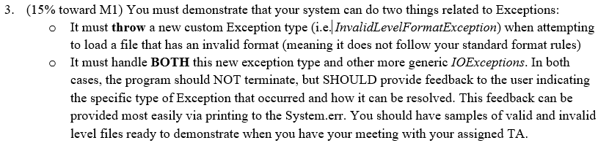
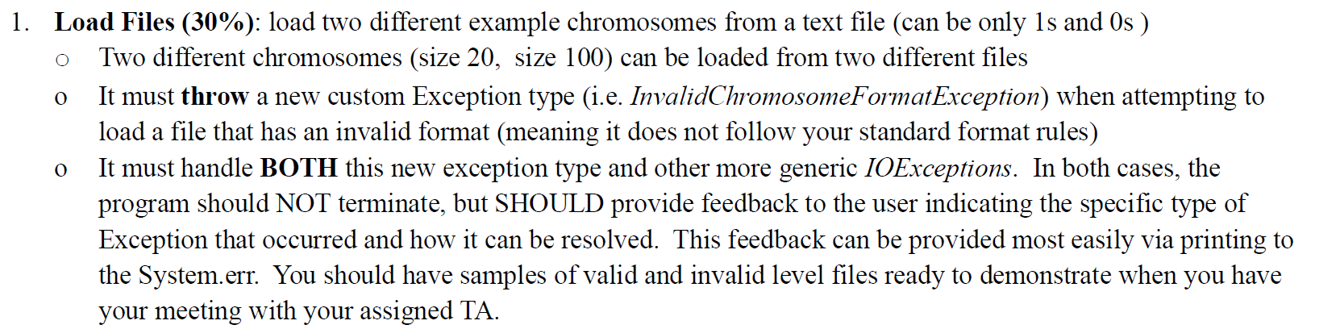
Milestone 1 – Final Projects

