Slide 1
CSSE 220
Recursion Introduction
The git projects for today are:
PracticeRecursion
PracticeRecursionSolution

Slide 2
Review
Encapsulation
Collocate within a class data fields and the methods that work on those fields
Use private keyword for most data fields, this is called compiler enforced encapsulation

Slide 3
Review
Minimize Dependencies by (low coupling):
  Using tell don’t ask – when a client of a class has an algorithm that could be located within that class (this is an ask algorithm), move that algorithm/method from client into the class (so it becomes a tell algorithm)
  Don’t use message chains – instead instrument the called-on classes to provide methods to do the work
  Low coupling means dependencies are minimized

Slide 4
Review
High Cohesion Rule for Classes
Make each class do one thing well
Micro-Cohesion Rules for Class Implementations
Make each operation do one thing well
Make each loop do only one thing

Slide 5
Questions about DPs thus far?
Make sure your design allows proper functionality
  Must be able to store required information (one/many to one/many relationships)
  Must be able to access the required information to accomplish tasks
  Data should not be duplicated (id/identifiers are OK!)
Structure design around the data to be stored
  Nouns should become classes
  Classes should have intelligent behaviors (methods) that may operate on their data
Functionality should be distributed efficiently
  No class/part should get too large
  Each class should have a single responsibility it accomplishes
Minimize dependencies between objects when it does not disrupt usability or extendibility
  Tell don't ask
  Don't have message chains
Don't duplicate code
  Similar "chunks" of code should be unified into functions
  Classes with similar features should be given common interfaces
  Classes with similar internals should be simplified using inheritance

Slide 6
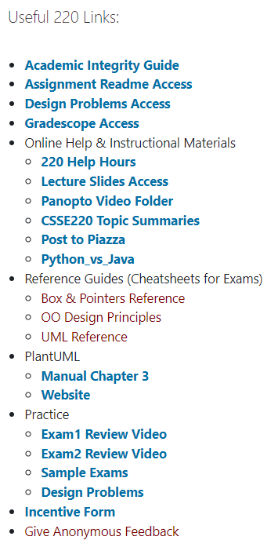
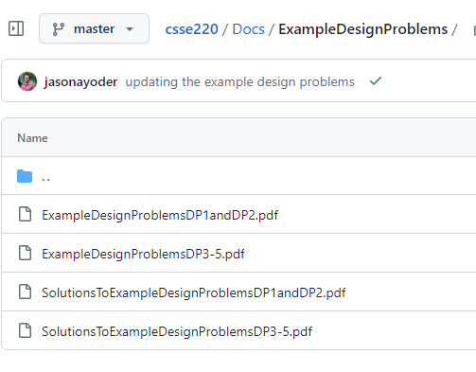

Example DPs for Practice!
https://github.com/RHIT-CSSE/csse220/tree/master/Docs/ExampleDesignProblems

Slide 7
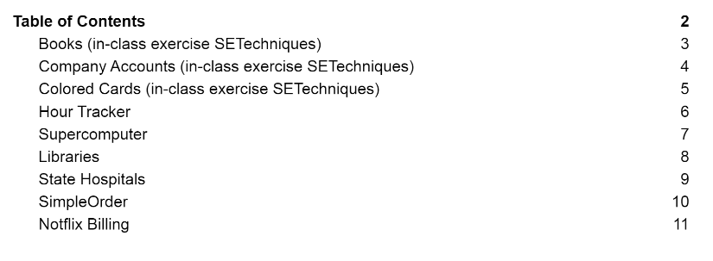
DP1 and DP2
There are a number of DP for you to practice and review (first three)

Slide 8
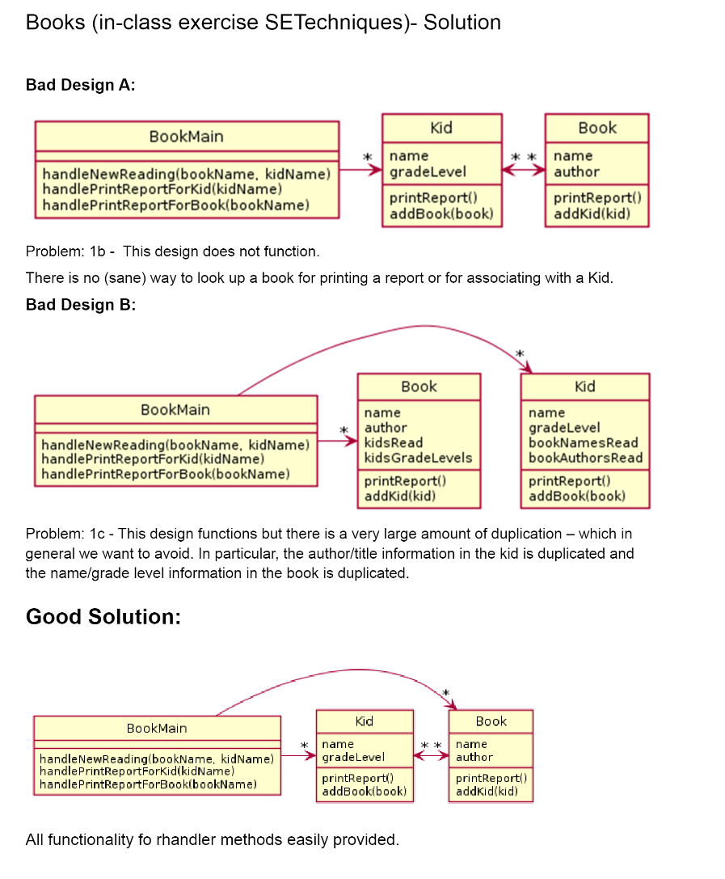
We provide explanations
in the solutions document
To maximize your benefit we recommend trying to work through the problem yourself first and then review the solution afterward.

Slide 9
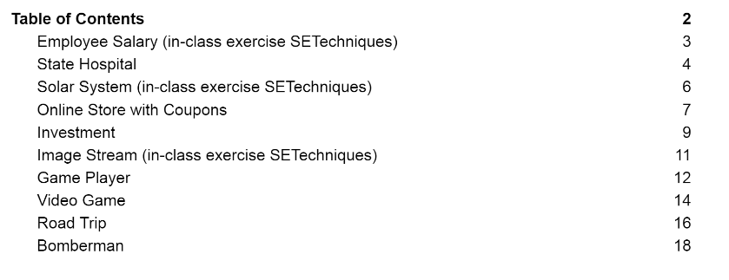
DP 3, 4, 5

