Slide 1
CSSE 220
Presentation Details
Notes:
No quiz today.
Bring printouts from the MergeSortSimpleSolution.

Slide 2
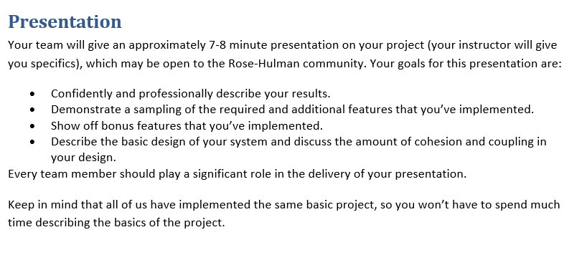
From the project specification document (ArcadeGame.docx)
Recommended:
Script your live demo and follow the script during presentation
Or, prerecord you live demo and insert recording into slides
Notes:
Dress 1 step up form your normal dress level

Slide 3
Your Presentations - Specifics
7 minutes long (Rehearse! Aim to be within 30 seconds +/- )
~3 min. Showing off your extra features
(Preferably record a video! (live demo “Acceptable”) )
~2 min. Explaining your overall design (major classes, NOT all)
“Coupling/Cohesion” or other “Good/Bad” aspects of design
~2 min. Design decision, feature implementation, or tricky bug
Be careful about code examples (good – but in moderation)
Should include prepared slides usually including diagrams
Notes:
3

Slide 4
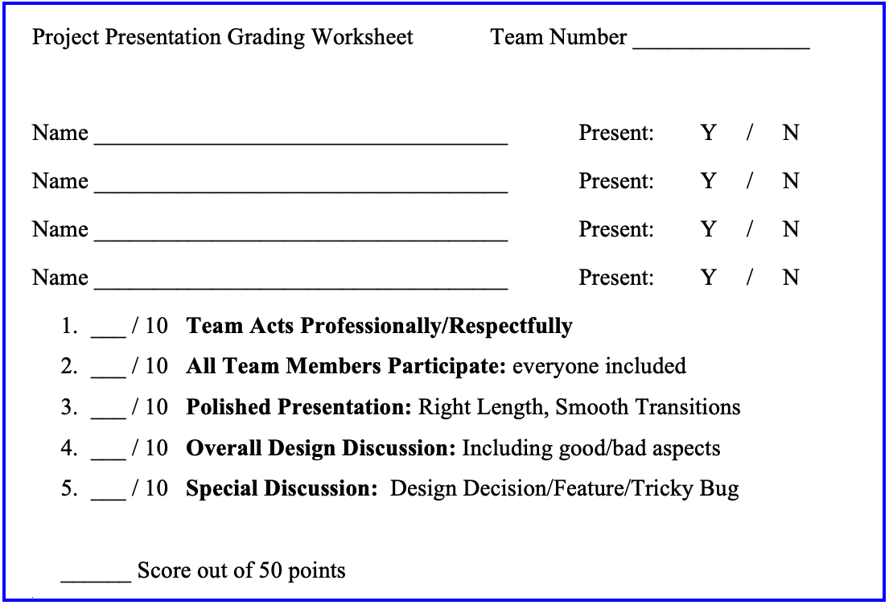
Notes:
4

Slide 5
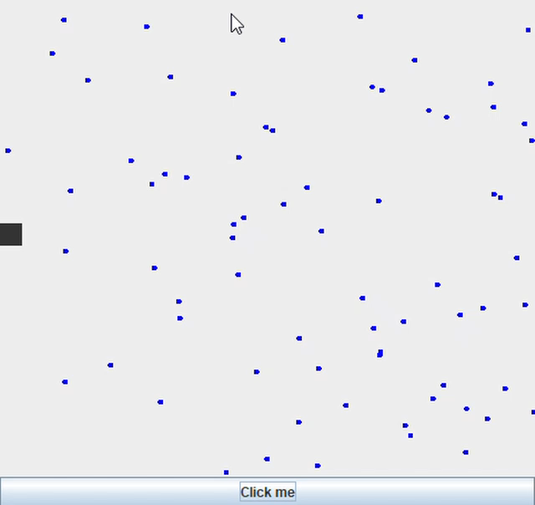
How to Make Screen Recordings
Link: record your screen on Windows 10 using Game Bar (Windows Key + g)
https://www.businessinsider.com/how-to-record-screen-on-windows-10

