Slide 1
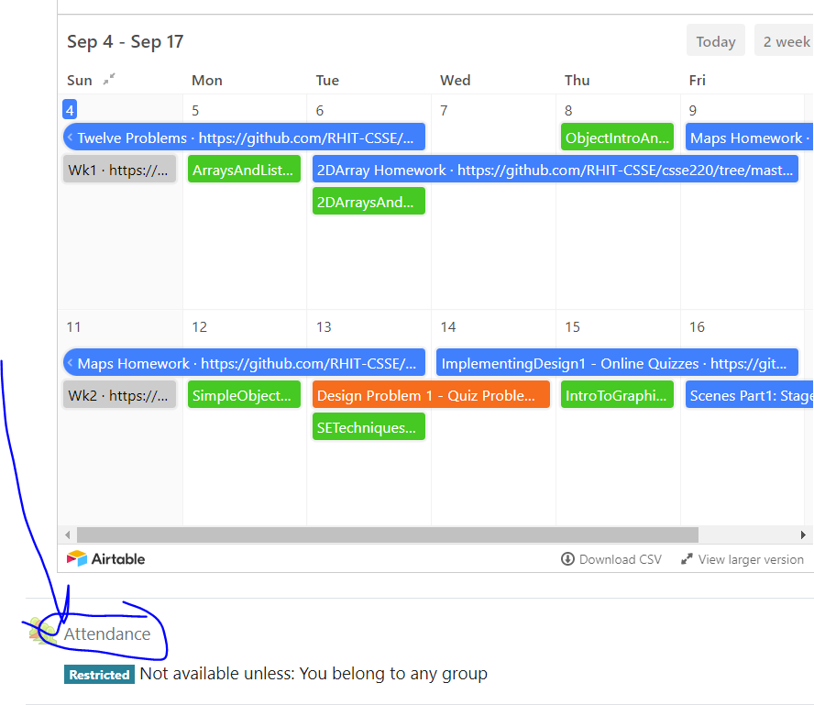
Today’s Attendance password
__________
CSSE 220
Intro to Java Graphics
The git projects for today are:
PracticeIntroToJavaGraphics
PracticeIntroToJavaGraphicsSolution
The Quiz for today is:
GraphicsQuiz
Notes:
Bring hard copy of code from IntroToJavaGraphics solution.
QUIZ TODAY is GraphicsQuiz
1

Slide 2
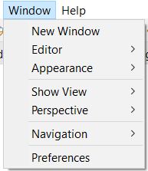
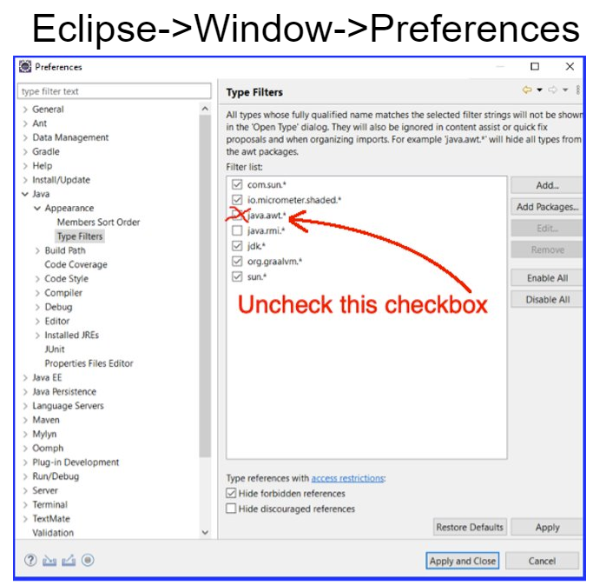

Java Graphics
The default option in Eclipse as of recent is to IGNORE suggestions from the primary library we use (SWING). You need to enable the suggestions for importing and methods by UNCHECKING the box on the right: java.awt.*
To find this checkbox go to
Java->Appearance->Type Filters
Notes:
See code in IntroToJavaGraphicsSolution , just draw a simple box initially. Then add a loop to draw multiple boxes.
Discuss conceptual difference between Zelle's graphics in Python and Swing's Graphics2D:
Zelle: objects on window, change object state and display changes
Swing Graphics2D:
Painting on a surface (component – an instance of a class that is used like (extends) a JComponent)
Is used inside the method paintComponent(Graphics g) that is automatically called whenever component needs to be painted
g is a graphics object that stores the graphics state --- current color, font, etc.
A Graphics2D object is like a Graphics object, but with more features than the Graphics object.
Will see more Zelle-like graphics in Swing later
2

Slide 3
Simplest Java Graphics Program
This code is already in your project for today
import javax.swing.JFrame;
/**
* From Ch 2, Big Java.
* @author Cay Horstmann
*/
public class EmptyFrameViewer {
/**
* Draws a frame.
* @param args ignored
*/
public static void main(String[] args) {
JFrame frame = new JFrame();
frame.setSize(300,400);
frame.setTitle("An Empty Frame");
frame.setDefaultCloseOperation(JFrame.EXIT_ON_CLOSE);
frame.setVisible(true);
}
}
Creates a graphics frame object
Configures it
Tells Java to exit program when user closes the frame
Display the frame
Notes:
Note that code is already in today’s project as a reference.
aqua callouts are shown one at a time
a frame is a window with a title bar
You cannot draw directly onto a frame – “think of it like a picture frame, you shouldn’t draw on a frame, you have to place a canvas IN it… then you draw/paint something.”
You have to construct a component and add it to a frame, if you wish to show something inside the frame – “a component is like a canvas”
3

Slide 4
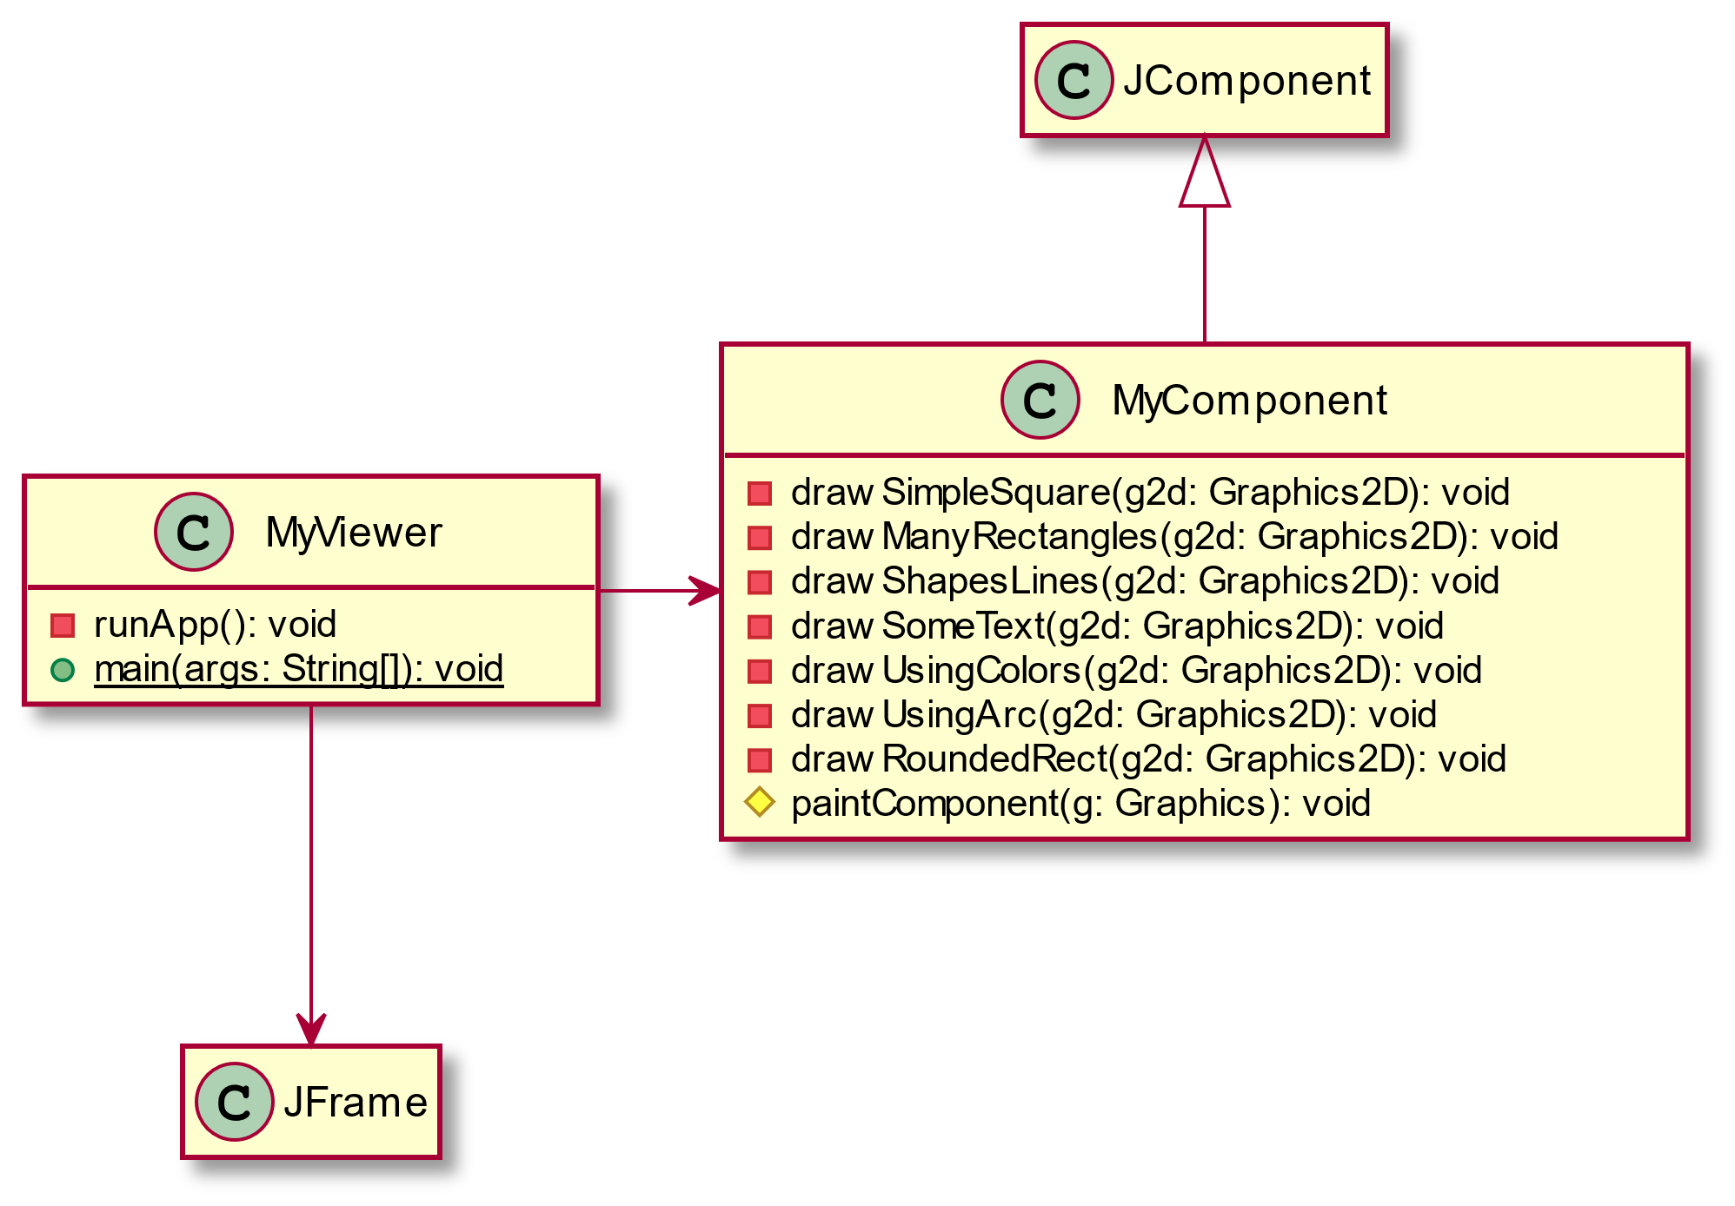
MyViewer and MyComponent (Based on RectangleViewer and RectangleComponent from Big Java)
Live Coding
Notes:
See code in IntroToJavaGraphicsSolution , just draw a simple box initially. Then add a loop to draw multiple boxes.
Discuss conceptual difference between Zelle's graphics in Python and Swing's Graphics2D:
Zelle: objects on window, change object state and display changes
Swing Graphics2D:
Painting on a surface (component – an instance of a class that is used like (extends) a JComponent)
Is used inside the method paintComponent(Graphics g) that is automatically called whenever component needs to be painted
g is a graphics object that stores the graphics state --- current color, font, etc.
A Graphics2D object is like a Graphics object, but with more features than the Graphics object.
Will see more Zelle-like graphics in Swing later
4

Slide 5
Other Shapes
new Ellipse2D.Double(double x, double y, double w, double h)
new Line2D.Double(double x1, double y1, double x2, double y2)
new Point2D.Double(double x, double y)
new Line2D.Double(Point2D p1, Point2D p2)
new Arc2D.Double(double x, double y, double w, double h,double start, double extent, int type)
new Polygon(int[] x, int[] y, int nPoints);
Try some of these!
Add an ellipse and both kinds of lines to MyComponent
Notes:
Give some time to work on this.
Note that the angle for arcs increase in the counter clockwise direction.
They are also measured in degrees.
5

Slide 6
How to draw a shape at different positions?
Notes:
Ask students how they could draw these with their current knowledge.
-Will suggest mathematics to calculate the position (x,y)
Manageable, but we can do it.

Slide 7
How to draw a rotated shape?
Notes:
Ask students how they could draw these with their current knowledge.
-Will suggest mathematics to calculate the position based on trig functions…
TOO HARD – LAZINESS IS A VIRTUE!

Slide 8
Using translate & rotate successfully
Translate and rotate to adjust the “state” of the frame
It is usually easier to
adjust the frame's location and rotation
then draw the object at (0,0)
then move the frame back to its original location and rotation
Make (0,0) your center of rotation
can change the point of origin using translate() so you can rotate different portions of the component

Slide 9
Translate
Originally, origin of 0,0
at top left of screen (with (50,50)
marked below)
X
X
(0,0)
XX
(-50,-50)
If we called g2.translate(50, 50),
here‘s what would happen:
(0,0)
XX
X
(0,0)
Always want to make sure we
reset the pen, so when we’re done,
we need to translate back to where
we started, in this case:
g2.translate(-50,-50)
XX
(50,50)

Slide 10
Rotate
Let’s say we’ve already translated
to put the origin at (50,50)
If we draw a rectangle like this:
int xLoc = 0;
int yLoc = 0;
int width 50;
int height = 10;
g2d.drawRect(xLoc, yLoc, width, height);
We get
(0,0)
What would happen if we called:
// Math.PI/4 is in radians
g2d.rotate(Math.PI/4);
then call :
g2d.drawRect(xLoc, yLoc, width, height);
We get
Remember:
y-axis is positive down instead of up,
o the rotate will go reverse of what you might expecting

Slide 11
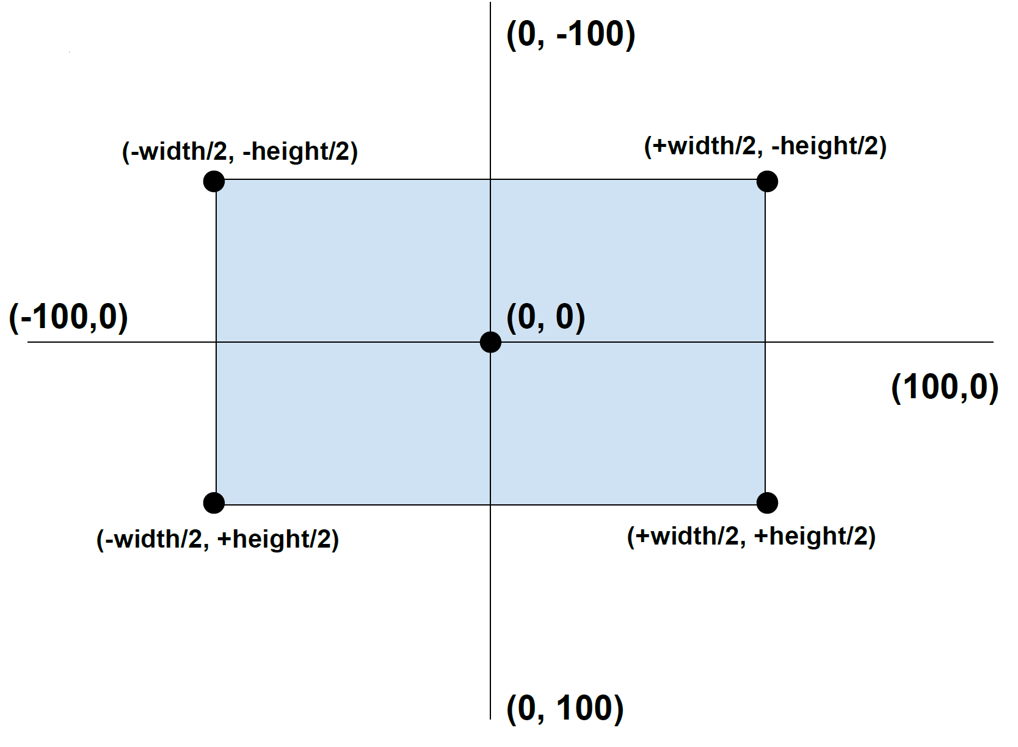
Math for Drawing Rect Centered at (0,0)
https://tinyurl.com/csse220graphics

Slide 12
Rotate About Center
int xLoc = 0;
int yLoc = 0;
int width 50;
int height = 10;
int xForCentering = (xLoc – (width / 2));
int yForCentering = (yLoc – (height / 2));
g2d.drawRect(xForCentering, yForCentering, width, height);
g2d.rotate(Math.PI/4);
g2d.drawRect(xForCentering, yForCentering, width, height);

Slide 13
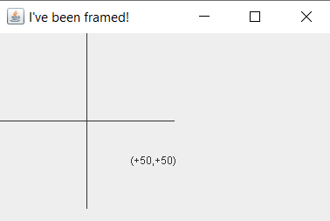
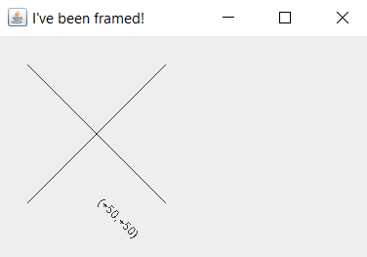
The Crosshairs Technique
Draw an x/y axis to see where pen is currently located on the canvas
public void drawCrosshairs(Graphics2D g2) {
g2.drawLine(-100, 0, 100, 0); // x-axis
g2.drawLine(0, -100, 0, 100); // y-axis
// show where (50,50) is located
g2.drawString("(+50,+50)", 50, 50);
} // drawCrosshairs
Notes:
Optional slide if showing how to make sure to undo translate and rotate

Slide 14
Work
Work on the 3 todos in the translationrotation package (TranslateComponent, RotateComponent)
Then solve the HourTimer Problem
Details of HourTimer are in the PDF within your repo
Remember to use the crosshairs technique
Copy and paste drawCrosshairs operation into your project

Slide 15
Graphics Debugging & Process
Debugging tips:
Test each step as you go!
First make sure you get something visible
Step by step process:
1. translate
2. rotate
3. draw
4. un-rotate
5. un-translate
Notes:
Optional slide if showing how to make sure to undo translate and rotate

Slide 16
Graphics Technique for Elimination of Undoing
1. translate
2. rotate
3. draw
4. un-rotate
5. un-translate
//create copy of graphics context to avoid undo translate/rotate
Graphics2D g2 = (Graphics2D) g.create();
// 1. now translate
// 2. then rotate
// 3. finally draw
// 4. return back to caller
Notes:
Optional slide if showing how to make sure to undo translate and rotate

Slide 17
Warning: JavaFX is
not taught in CSSE220
and you will not receive credit for solutions produced using it
Scene project
Scene Introduction
Notes:
17

Slide 18
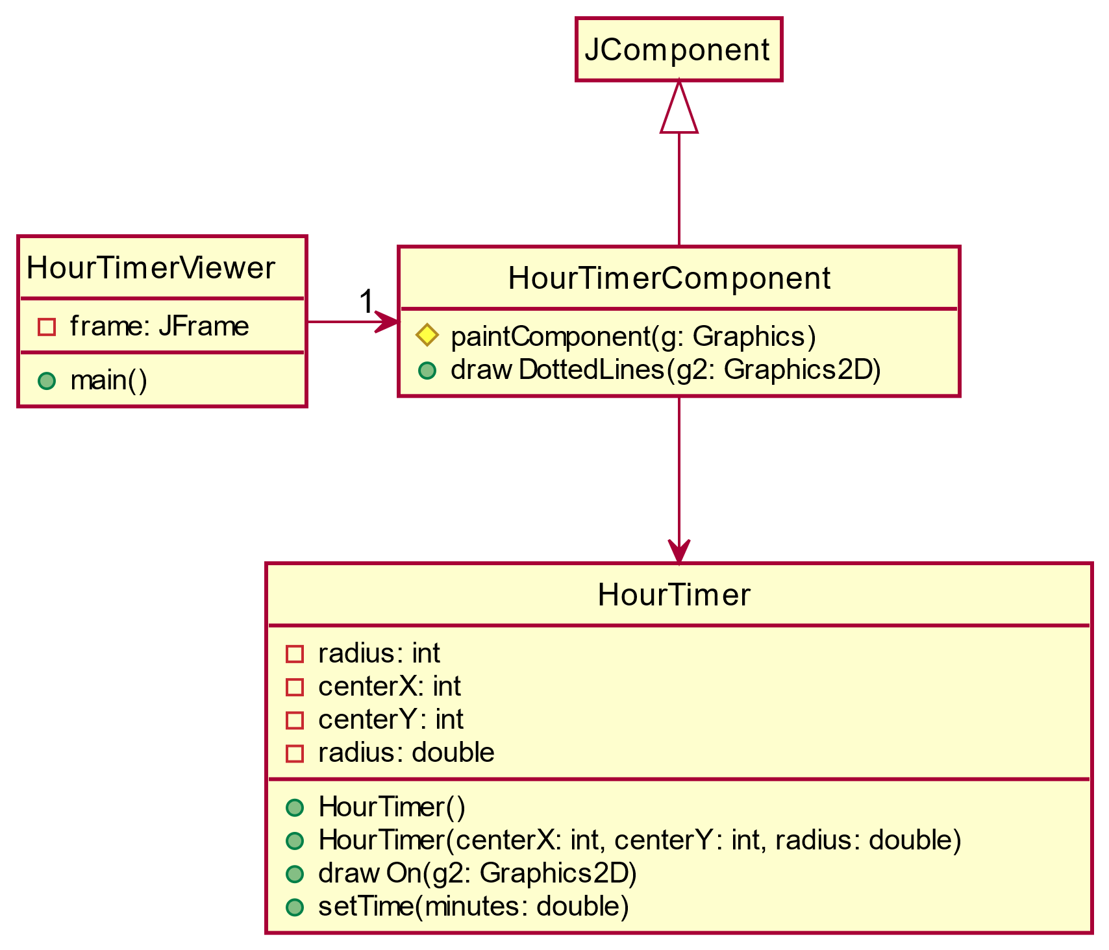
General Design of Java Swing Graphics app
__Viewer.java
creates a JFrame (window)
main method located here, run this file
__Component.java
This extends JComponent (isA relationship)
Has a paintComponent(Graphics g) method that determines what gets drawn on canvas
__.java
This is the class that represents something
Has a drawOn(Graphics2D g) method to draw itself
Instances look different based on properties (instance vars)

