Slide 1
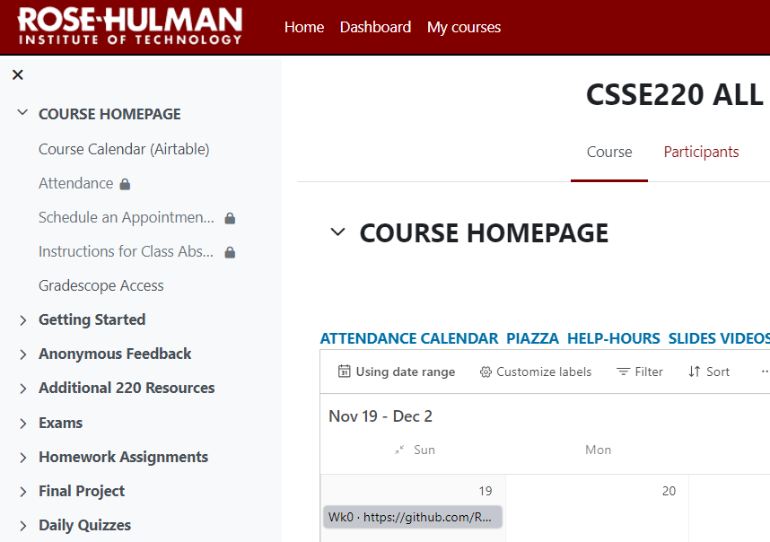
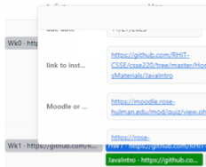





Welcome to CSSE 220
Today’s Attendance Password:
intro
Today’s Quiz:
JavaIntroQuiz
We are excited that you are here:
Hopefully you followed the instructions in the welcome email, installed eclipse and imported all the Eclipse Projects and set up “Working Sets”
Start your computer & Eclipse
Every day:
There is a daily attendance on Moodle
Time limited (+/- 10 min)
There is a daily quiz on Moodle
Notes:
The code/project we’re working in today will be in JavaIntro and HW1. The solution has a number of different examples that may be used if desired.

Slide 2
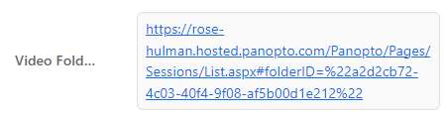
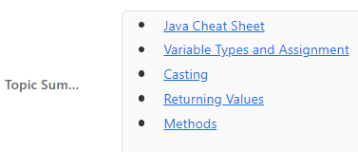

Useful Links in “Airtable” (colorful) Calendar
Pre-recorded lectures of content. Useful for reviewing confusing material, when you miss part or all of a class.
Various Topic Summaries for CSSE220 Topics. Useful for checking your understanding, review daily material preparing for exams.
Direct link to the Moodle Quiz for the Day

Slide 3
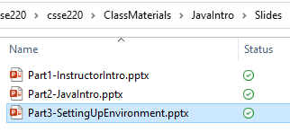
If you didn’t follow emailed instructions
https://tinyurl.com/csse220setup

Slide 4
Course Introduction, Starting with Java
CSSE 220—Object-Oriented Software Development
Rose-Hulman Institute of Technology
Notes:
Bring textbook to show to the class.

Slide 5
Goals for this course
Move from Python to Java
Lots of little programs in the first few weeks
Move from writing method bodies to writing whole classes from scratch
Learn how to design programs
Break up larger programs into multiple classes
Arcade Game project
Learn algorithms and data storage
Maps, Sorting, mixed patterns and problem solving

Slide 6

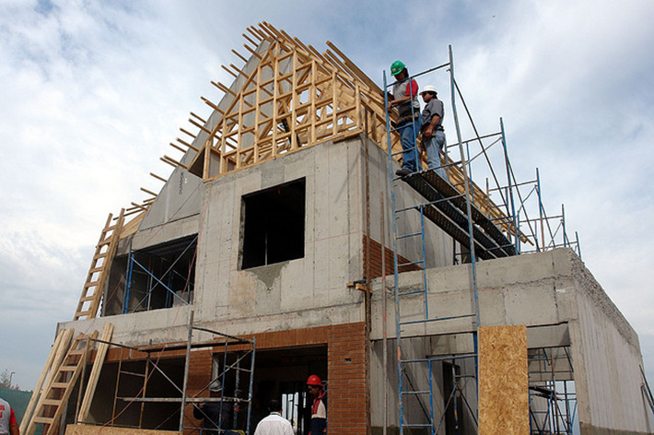
How we visualize learning has changed over time
Notes:
Distinguish passive and active learning. Briefly motivate all the active learning activities we will use in class.

Slide 7
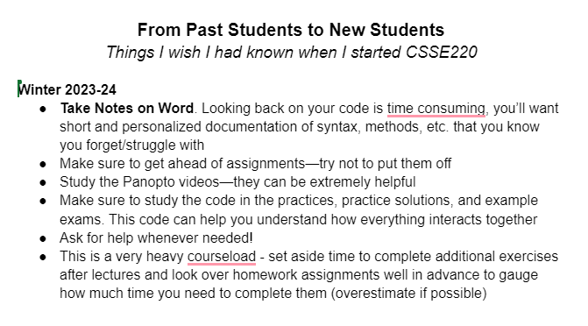
Advice from Former Students
https://docs.google.com/document/d/1gWrR8fe7Qs5B9MgRkFW4wBa-tnRdFXGTDRnqi2ps1i4/edit

Slide 8
Agenda
Instructor intro
Critical logistics
We write some java code
Conditionals
Strings
Loops

Slide 9
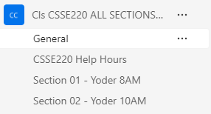
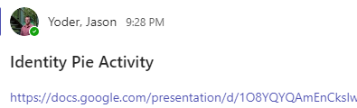
Let’s get to know each other

Slide 10
Instructor Info
Jason Yoder
Feel free to call me:
Dr. Yoder
Jason (if you prefer first name)
Degree from Indiana University:
Computer Science, Cognitive Science
Only on campus Mon, Tue, Thu (normally)
Piazza/Email/Teams anytime!

Slide 11
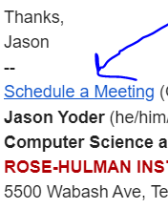
Instructor Info
Meetings with me 1 on 1
Calendly: a service to schedule
appointments (in my email signature)
Helps me plan my time effectively
Email me if you can’t find a time and we can discuss options:
Wednesdays/Fridays: Teams

Slide 12
Instructor Info
More about me
I live in Bloomington Fri-Sun
I like to “work hard and play hard”
I am rejuvenated by sports/physical challenges:
Ultimate Frisbee, rock climbing, hockey,+
I think its important to have a hobby or activity that helps keep you “sane” ☺
Interested in working with students on research
Feel free to stop by or email if you have interest in research
I developed a project for this course in place of the Arcade Game Project to give students an early opportunity to develop some research skills

Slide 13
Instructor Info
Ian Ludden
Feel free to call me:
Ian, Professor Ludden, or Professor Ian
If you call me just “professor”, I may call you just “student” ☺
B.S. in CPE/MA from Rose-Hulman, Fall 2016
Ph.D. in CS from the University of Illinois Urbana-Champaign
Originally from Tampa, Florida (the Midwest is better)
Industry experience: FitzMark (Indy), Garmin (KC), LGS (Tampa), PilotFish (Tampa)
Wrote lots of Java code at PilotFish!

Slide 14
Instructor Info
General questions (HW, course logistics):
Please use Piazza
TAs or other students may be able to respond faster
Personal questions:
Email
Office hours
1-1 meeting, scheduled via link in email signature
Helps me plan my time effectively
Email me if you can’t find a time

Slide 15
Instructor Info
More about me
When I was a student here:
Cross Country, Engineers Without Borders, symphony orchestra, musicals, improv club, St. Joseph’s University Ministry
Friends & activities helped me make it through Rose
Find your people!
Interested in working with students on research
Feel free to schedule appt. or email if you have interest in research
Graph theory, algorithmic game theory, operations research
Most projects require CSSE 473, but we can talk before then

Slide 16
Introductions
TA
Students (briefly! ☺ it’s a big class)
What should we call you?
What you do for fun/rejuvenation?
Notes:
Introduce TA find something each student does for rejuvenation…

Slide 17
Instructor Info
Amanda Stouder
Assistant Professor for the Practice of Computer Science and Software Engineering
You can call me:
Amanda
Professor Stouder
Don’t call me:
Mrs. Stouder (please not this)
Dr. Stouder (not this either, I’ll explain)

Slide 18
Instructor Info
Education
Rose-Hulman Institute of Technology 2008
B.S. in Computer Science and Software Engineering
Experience:
Amadeus Consulting, 2008-2010
Software Engineering Professionals (SEP), 2010-2014
Stouder Software Consulting, LLC (2014-present)
RHIT: Visiting Professor CSSE (2013-2016)

Slide 19
Instructor Info
Office Hours:
MWF 7:30am – 8:30am, 1:30pm – 4:30pm
OFF CAMPUS: Tuesdays and Thursdays
Always by my email!
If you need a different time, email me and we’ll work something out
Notes:
My reviews are consistent:
Not around as often as I’d like, but responds very quickly to email.

Slide 20
Instructor Info
Laptop Policy
I’m trying something new this quarter
Why?
I will ask you to close/open laptops as we move through the class
When closed, I need you to pay attention
This also means no phones/other devices
Closing far enough so you can’t see the screen is fine
What if I take notes on my laptop?
Notes:
Why am I doing this?
I don’t like repeating myself, and laptops are distracting. When I allow them to be open throughout class, I end up repeating myself and have students who have no idea what’s going on. For example, one year, I had a student who, three weeks into the class said he didn’t know what the schedule page was… There was more going on, but he was never forced to watch what was going on. Also, I know how tempting it is to turn on a game in the middle of class… don’t, 1) you won’t get the most out of this class… 2) You’re not as fast as you think you are at switching out of that game!
We will do a lot of live-coding, so you will need your laptops, and for those portions of the class, no problem! But during lecture, when we’re not live-coding, I’ll ask you to close / lower your laptop lids so I know I have your attention
Phones / other devices: I’m not blind, I can see you’re texting someone… You’re looking down, not up, easy to spot.
Since we will open and close our laptops a lot, I’m okay if you only close it so you can’t see the screen, rather than all the way, but barely tilted doesn’t cut it.
I know some people take notes on their laptops… If that’s you, I would ask that you come to my office after class and show me an example of the notes that you typically take on your laptop and I’ll make an exception. However, a lot of the notes taken in here should be on the daily quizzes, which we’ll get to shortly.
With all that said… please close (or at least lower) your laptop screens for the moment.

Slide 21
Instructor Info
Mike Hewner
Call me Buffalo
I love object oriented programming & weird programming languages
I’ve worked at Amazon, GroupOn, Progressive Insurance, and many other places
Contact info on the course polcies document

Slide 22
Should I really call my Professor Buffalo?
Consult this handy chart…
Situation Type | Informal | Semi-Formal/Kissing up | Highly Formal
Example Situation | asking questions in class, saying hi in the hallway | requesting things like re-grades or recommendation letters | funerals, addressing heads of state
Correct form of address | Buffalo | Dr. Buffalo | Dr. Hewner
Example | “Yo Buffalo, when is that assignment due?” | “So I think you’ll agree, Dr. Buffalo, that I deserve an extension…” | “In accepting this Turing Award, I’d like to first and foremost thank Dr. Hewner…”

Slide 23
Instructor Info
Chandan Rupakheti - Call me Chandan
I enjoy learning and teaching Software Engineering courses
My particular favorites are Object-Oriented Programming, Software Design, and Software Architecture
I’ve worked at ESRI, DASS, and on many software engineer research projects at graduate school
Contact info on the syllabus

Slide 24
Instructor Info
Aaron Wilkin

Slide 25
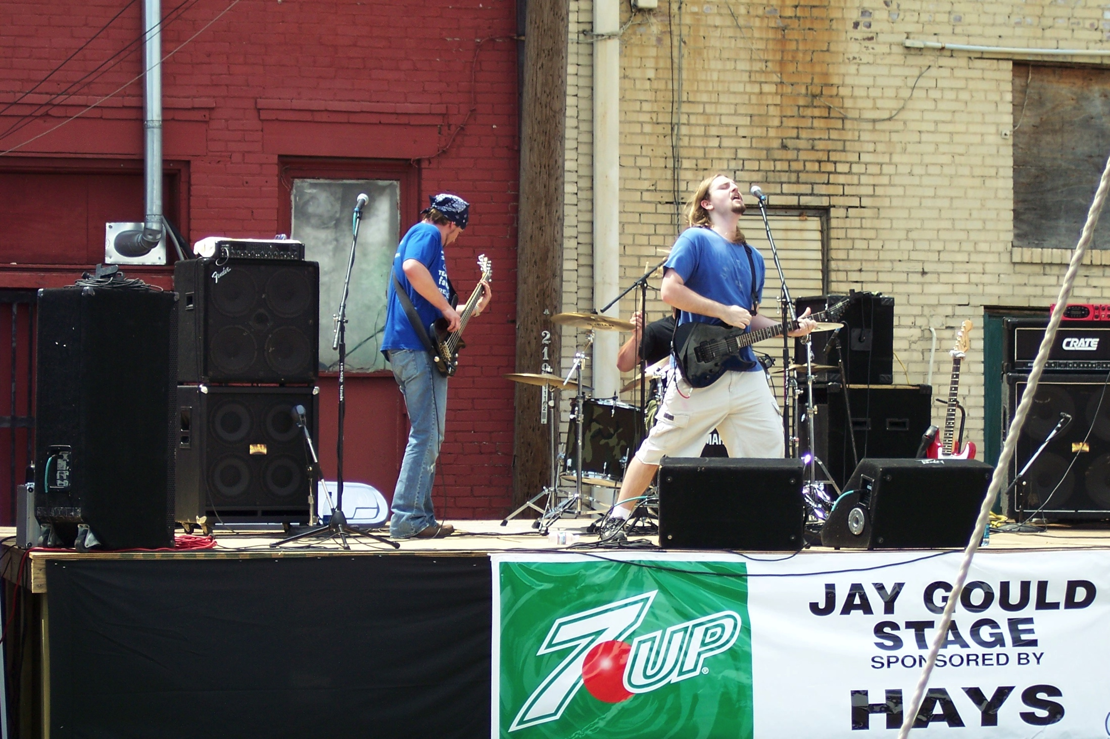

Slide 26
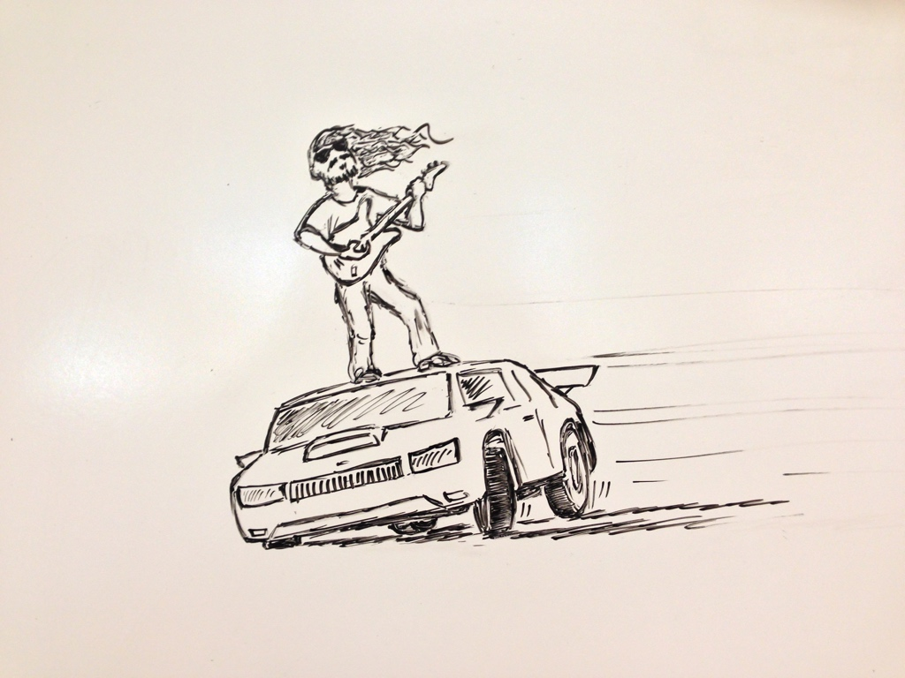

Slide 27
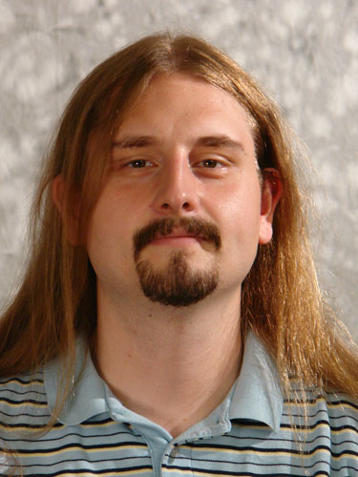

Slide 28
Instructor Info (continued)
On Campus every day
Office Hours (F203)
…
Email – wilkin@rose-hulman.edu
If you need another time, let me know and I’ll do my best

Slide 29
Instructor Info
Delvin Defoe
PhD, Washington University in St Louis 2007
Computer Science and Engineering
Tenured Associate Professor
Fall 2013
SEP
June 2014 – July 2015
Christian
Knightsville Church of Christ

Slide 30
Instructor Info (continued)
On Campus Mon., Tues., Wednes., Fri.
Office Hours (M240D)
See my schedule page
http://www.rose-hulman.edu/~defoe/schedule.html
Email – Always by my phone/computer
If you need another time, let me know and I’ll do my best

