Slide 1
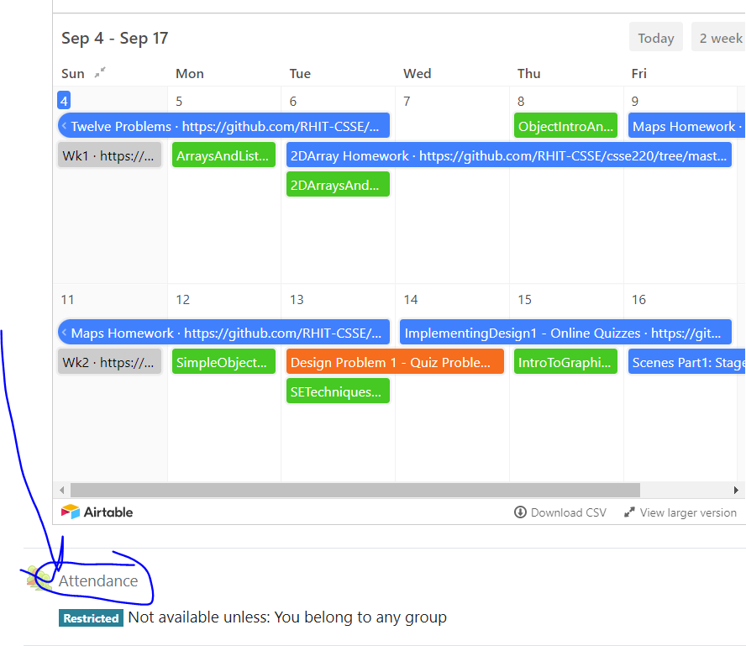
CSSE 220
Today’s Attendance password
___________
Linked List Implementation
The git projects for today are:
PracticeLinkedListSimple
PracticeLinkedListSimpleSolution
The Quiz for today is:
LinkedListQuiz
Notes:
Timing: Aim to finish I the first hour so that the teams can do project work and meet with a TA in the second hour.
Quiz given in next slide (give them lots of time to work on this and do it on the board,
Print this out for them to work on paper before coding first few in-class exercises
https://docs.google.com/document/d/14JZQNpy_uZlawvqma7su3AO1nOjfe89xqSGUwgt7kWM/edit?usp=sharing

Slide 2
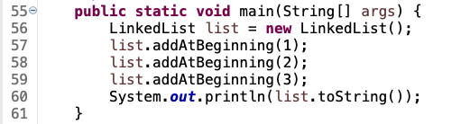
Quiz
Get into pairs
Look at/run the code in LinkedList.java main
Draw a box-and-pointer diagram of what’s happening in the main code.
To figure it out, you’ll have to look at the LinkedList constructor and addAtBeginning.
If you’ve forgotten how to do box-and-pointer diagrams, checkout the next slide
Q1
Notes:
This diagram is their quiz for the day
JAY: I like to use different colored markers (4) for 4 different lines of code executed that change the box-n-pointer diagram
LinkedList list = new LinkedList();
list.addAtBeginning(1);
list.addAtBeginning(2);
list.addAtBeginning(3);

Slide 3
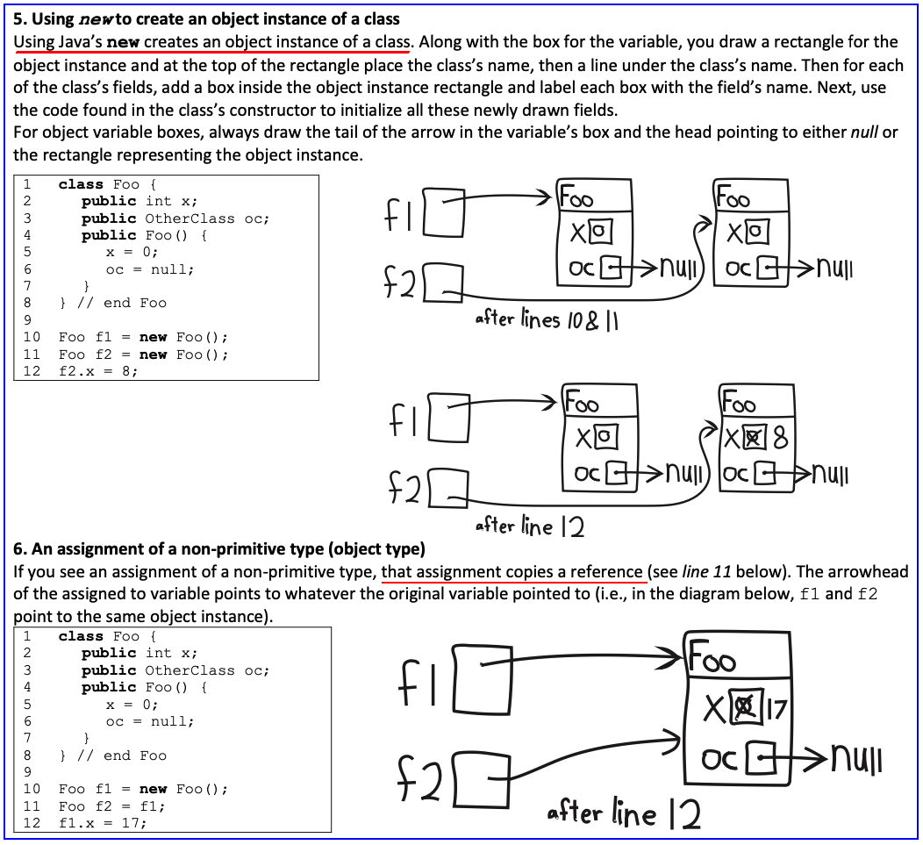

Slide 4
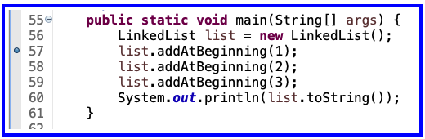
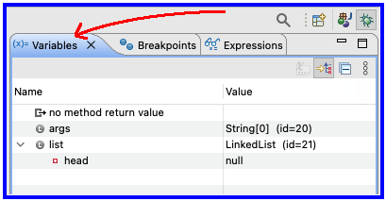
Optional - Now Walk Through Together
Set a breakpoint at first addAtBeginning
Execute in the debugger
Step over and keep an eye on debugger’s Variables tab

Slide 5
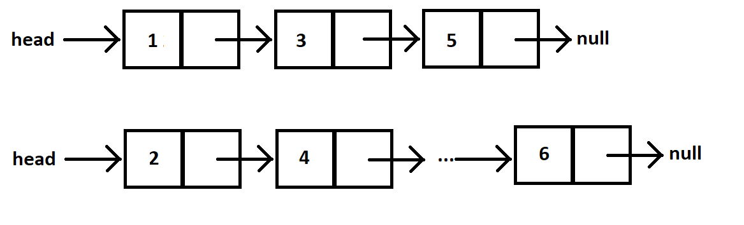
Shorthand Diagramming Notation
Using pictures will be extremely helpful
We can use System.out.println( this ) to see what the current list looks like (does it match diagram?)

Slide 6
Loops in Arrays vs. LinkedLists
int[] nums = ……
for (int k = 0; k < nums.length; k++) {
// do stuff with
// arbitrary element nums[k]
}
Equivalent in while loop
int k = 0;
while ( k < nums.length ) {
// do stuff with
// arbitrary element nums[k]
k++;
}
LinkedList list = ……
//Another Day!
Node current = this.head;
while ( ? ) {
//do stuff with
//arbitrary element
?
}
For an array, use a ‘for’ because we know exact length of array at the outset.
This is known as a definite loop

Slide 7
Loops in Arrays vs. LinkedLists
int[] nums = ……
for (int k = 0; k < nums.length; k++) {
// do stuff with
// arbitrary element nums[k]
}
LinkedList list = ……
Node current = this.head;
while ( current != null ) {
// do stuff with
// arbitrary element
current.value++;
current = current.next;
}
For linked lists, use a ‘while’ because we do not know exact length of a linked list at outset.
This is known as an indefinite loop

Slide 8
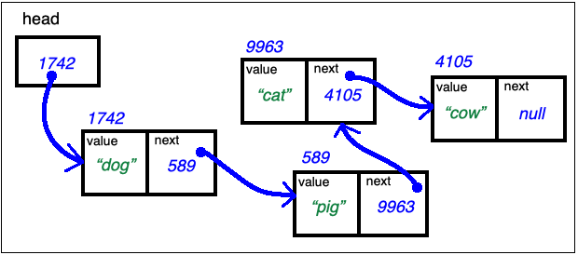
Traverse Linked List Stop at the End
LinkedList list = …… current's values:
Node current = this.head; _1742_____________
while ( current.next != null ) { __________________
// do stuff with __________________
// arbitrary element __________________
current = current.next; __________________
} // end while
current.next = new Node(vToAdd, null); // adds new node at end

Slide 9
Traverse Linked List With Trailer
LinkedList list = …… current trailer:
Node trailer = null; _0__________
Node current = this.head; _1742_______ ____________
while ( current != null ) { ____________ ____________
// do stuff w/ node values ____________ ____________
trailer = current; ____________ ____________
current = current.next; ____________ ____________
} // end while

Slide 10
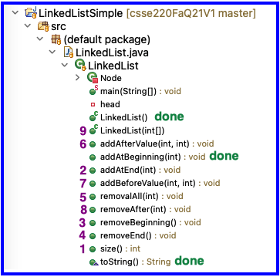
Solve the Other Problems in LinkedListSimple
Look at toString to get an idea of how to do size, then go from there
Recommended order
This numerical is the same as the methods are listed from top to bottom
Get help if you get stuck!

Slide 11
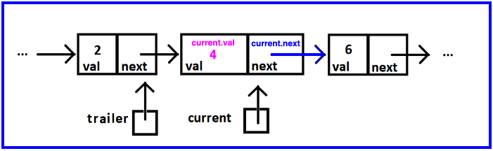
Reminder: Shorthand Diagramming Notation
Use arrows:
To represent the references stored in:
a node’s next
the variables current, and trailer
To connect the list’s nodes

Slide 12
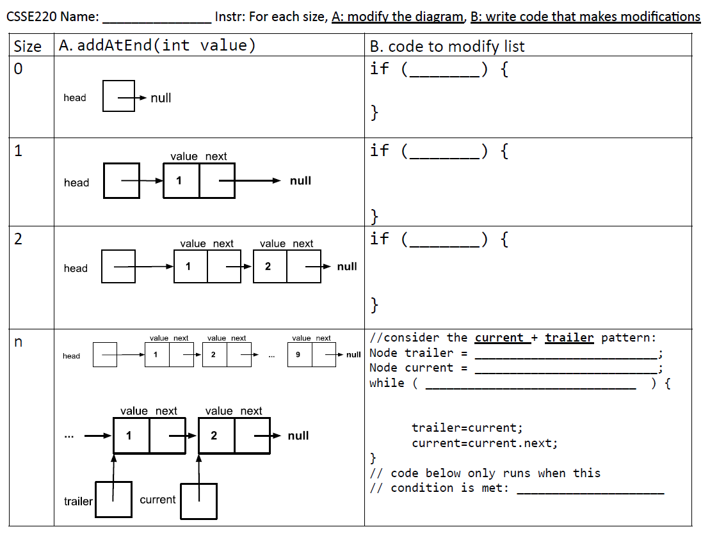
https://docs.google.com/document/d/14JZQNpy_uZlawvqma7su3AO1nOjfe89xqSGUwgt7kWM/edit
Notes:
Optional Modify Diagram and Write Code Exercise:
https://docs.google.com/document/d/14JZQNpy_uZlawvqma7su3AO1nOjfe89xqSGUwgt7kWM/edit?usp=sharing

Slide 13
Think before you code!
Coding without a plan may waste a lot of time
It’s easy to make mistakes without a plan
It’s easy to get confused when randomly changing things
We strongly encourage you to be more intentional about planning before you code
A.) First, think through how to make changes to the LL
B.) Second, determine the code to cause the desired changes
Be sure to execute one line at a time
Update the structure as you go
With assignments, code evaluates on the right side of FIRST and
then updates the variable on the left side AFTER:
this.head = new Node(this.head.next, null);

Slide 14
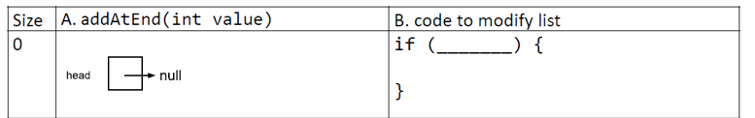






How to Use

Slide 15
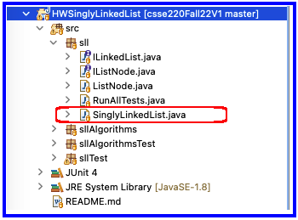
Homework
SinglyLinkedList
Requires you to implement a SinglyLinkedList
Additional Optional algorithm questions which make use of the SinglyLinkedList (recommended)

