Slide 1
CSSE 220
UsingObjectsAndAPIs
The git projects for today are:
PracticeUsingObjectsAndAPIs
PracticeSolutionUsingObjectsAndAPIs
Notes:
JAY: Introduce SECOND row today (Identity Pie)

Slide 2
Strings – What, When, Why, How?
What:
They are an array of characters but written in a class that come with operations
… so we can worry about using them
When:
  When you need “strings” of characters
    We won’t use char arrays much otherwise

Slide 3

Possible etymology(?)
Notes:
Image source: https://www.pinterest.com/pin/beads-kit-and-300pcs-alphabet-letter-beads-for-name-bracelets-etsy-in-2022--1121818588404789699/
For the real etymology, see https://en.wikipedia.org/wiki/String_(computer_science)#History

Slide 4
Strings – What, When, Why, How?
Why:
Sooooo much easier than char arrays!
How:
String myString = “hello”;
String otherString = new String(“hello2”);
String combinedString = myString + “ “ + otherString + “!”;
Retrieving data
  Need the API

Slide 5
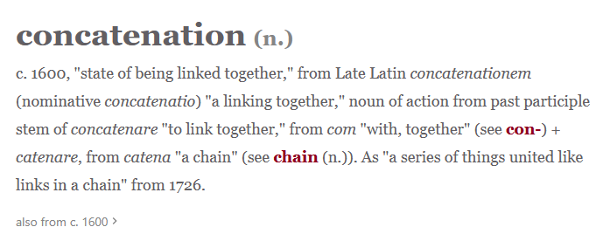
Strings – Concatenation
String firstString = “Hello”;
String secondString = “CSSE220”;
String concatenatedResult = firstString + secondString;
System.out.println(concatenatedResult);
// Output:
// HelloCSSE220
Notes:
https://www.etymonline.com/word/concatenation

Slide 6
Java API Documentation
What’s an API?
  Application Programming Interface
The Java API on-line
  Google for: java api documentation 8
  Or go to: https://docs.oracle.com/javase/8/docs/api/
Notes:
Find the documentation for the String class from one of the above links, as follows:
Click java.lang in the top-left pane
Then click String in the bottom-left pane
Describe the parts of the String API documentation:
- description of the class
- summaries of all the fields, constructors, and method
detailed descriptions of everything

Slide 7
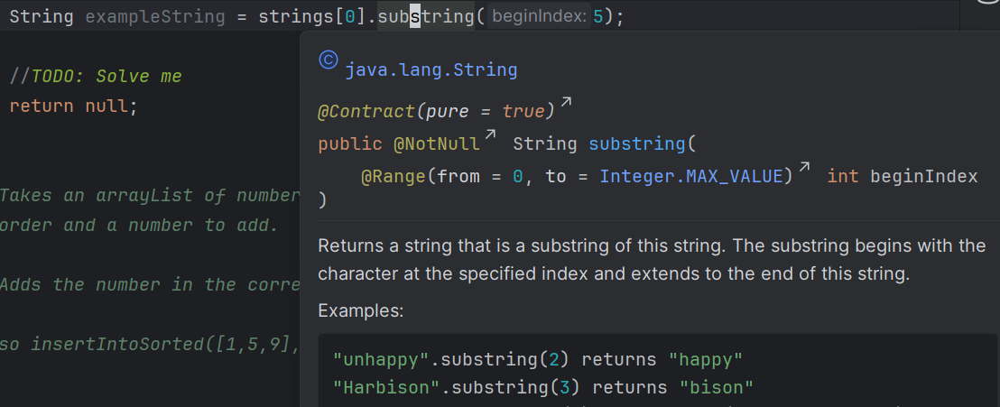
Java Documentation in IntelliJ
Using the API documentation in IntelliJ
  Hover text (e.g., substring screenshot below)
  Open in Documentation Tool Window (click vertical three dots in hover dialog, then select top option)
Notes:
Point students to the link in the homework if everyone does not have the docs setup.
Demo hover text, F2 to focus on hover text, icon to open in web browser.
Shift-F2 to open external browser immediately.

Slide 8
Quick Rule for Comparisons
Fast rule for now:
Use .equals() for comparing Strings
  String alpha = “aaa”;
  if (alpha.equals(“bbb”) {
  System.out.println(“Yes!”)
  }
  Use == for comparing for primitives
  boolean a = (5 == 6);
  boolean b = (‘T’ == ‘F’ );
Notes:
Can decide to say this for next class or mention it now at least…

Slide 9
Work Time
Let’s work in StringProbs.java

