Slide 1
CSSE 220
Unit Testing
The git projects for today are:
PracticeConsoleAndUnitTesting
PracticeConsoleAndUnitTestingSolution
Notes:
Start Second Hour with this
Bring hard copy of code from UnitTesting

Slide 2
Unit Testing
Idea: Test “small pieces” of larger program
Do the expected values match what you ACTUALLY get?
How to test in this manner?
Could make a main method that calls all the methods
Use Java's JUnit testing framework
Creating a Tester JUnit class
Q2

Slide 3
Why Unit Testing?
There are several goals of unit testing:
Make sure your code works (as specified!)
Keep it working
Confirm understanding of the specification
Confirm pieces of code in isolation
Provide Documentation
Q3

Slide 4
Unit Tests (as done in CSSE120)
Construct one or more objects of the class that is being tested
Invoke one or more methods
Print out one or more results
Print the expected results
Do 3 and 4 match?
(Pages 102-103 in book)

Slide 5
Why JUnit?
Provides a Framework
Framework: Collection of classes to be used by another program
Provides easy-to-read output in Eclipse
Printouts require you to analyze all lines
What if it scrolls off the page?
What if it’s only 1 character different?

Slide 6
What are quality unit tests?
Unit tests should be small pieces that test:
The most common cases
The edge cases or boundary cases (minimum, maximum, switching from positive to negative, etc.)
All specific/special cases (e.g., when 0 or null the behavior is different than for any other value)
When you find and fix a defect, then at that same time, create a unit test that would have revealed that defect. Then in future modifications to the code, if that defect gets reintroduced, the new unit test you created will reveal its presence
Any overly complex code that 1-4 above don’t cover
Q4

Slide 7
What is a poor quality test case?
A test case that provides illegal input to the operation
For example, the deposit method from the BankAccount class
It has a requires clause that states the depositAmount > 0
Testing it with a negative number is a poor test case because it requires non-negative input
Q4

Slide 8
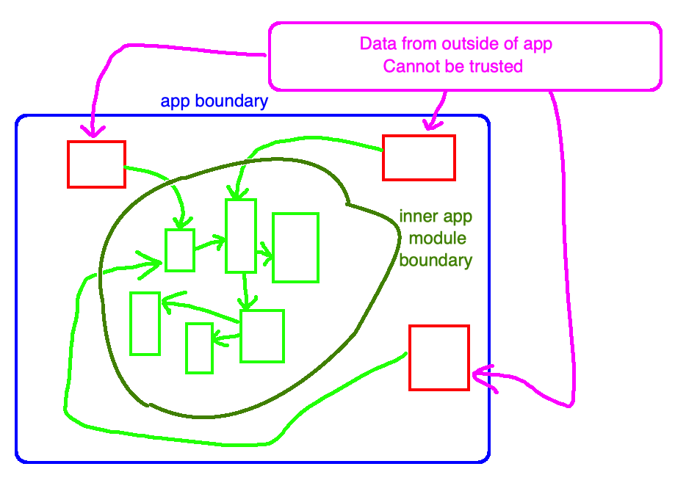
Writing JUnit Tests for the green modules
We write unit test cases with certain “requirements”
If a problem states that something is “required” then you should trust it
If the data is NOT trustworthy then you are NOT at fault
Notes:
Explanation of diagram in Figure 1:
the app's boundary from outside data is in blue
the red modules are responsible for handling incoming (and possibly malformed data)
the green modules never see raw data from outside the app, they only see data that has made it past the red module
red modules must be written to hand "unintentional" mistakes (or intentional malicious incoming data)
once the data gets past the red modules, it has crossed the inner app module boundary, and made its way to the green modules
the green modules can be written to have "requirements" on their incoming data (passed in by parameter)
all calls to green modules are from other green modules or the red modules

Slide 9
Writing JUnit Tests for the green modules
This allows the code in a green module method to be
Simpler
More efficient
Always written consistently (assumes requirements met)
Notes:
Here is where the rubber meets the road - and the basis for what is known as Design by Contract
we write the code for a green module assuming that the callers of a green module have met the requirements placed on the parameters being passed to the green module
this allows the code in a green module method to be: (1) simpler because it doesn't have to check that the incoming data meets the requirements; (2) more efficient; (3) always written in a consistent manner, i.e., where it is written assuming the requirements have been met
if a caller (a red module or another green module) is written so that it violates a green module's requirements, then that caller is defective (not the called operation)
Since green module methods assume the caller meets the requirements, it doesn't make sense to write JUnit test cases where the requirements are violated
#2 above says green module methods will be more efficient, why?
Example, suppose your method is binary search of an array. You have to write that method assuming the array meets the requirement of being sorting. Otherwise, you'd have to include code in your binary search method to check that it is sorted each time that method gets called. If you did this, you just took your O(log(n)) method and turned it into an O(n) method

Slide 10
Unit Testing
Use JUnit “assert” to make sure results match https://junit.org/junit4/javadoc/latest/org/junit/Assert.html
Let’s look at BadFrac.java and BadFracTest.java
Let’s make some unit tests and figure out why this project has been yielding some strange results
Notes:
You can decide whether you want to show the students how to generate the toString and equals methods when testing the addFrac method to do an assertEquals(), or if you want to reduce the amount of time taken, you can also choose to simply compare the actual numerator and denominator as in the solution code.

Slide 11
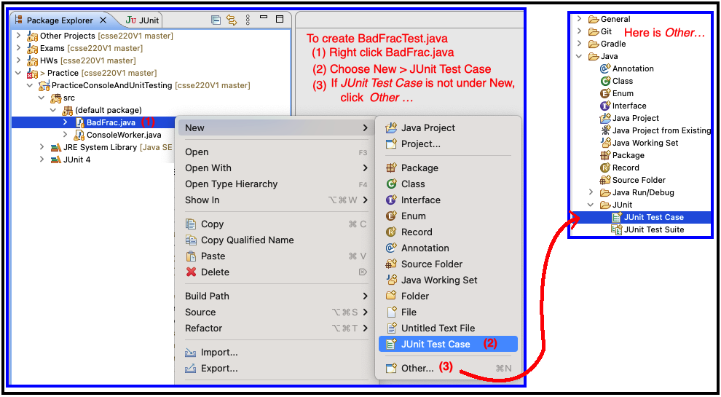
Unit Testing
Create BadFracTest.java – then create test cases
Notes:
You can decide whether you want to show the students how to generate the toString and equals methods when testing the addFrac method to do an assertEquals(), or if you want to reduce the amount of time taken, you can also choose to simply compare the actual numerator and denominator as in the solution code.

Slide 12
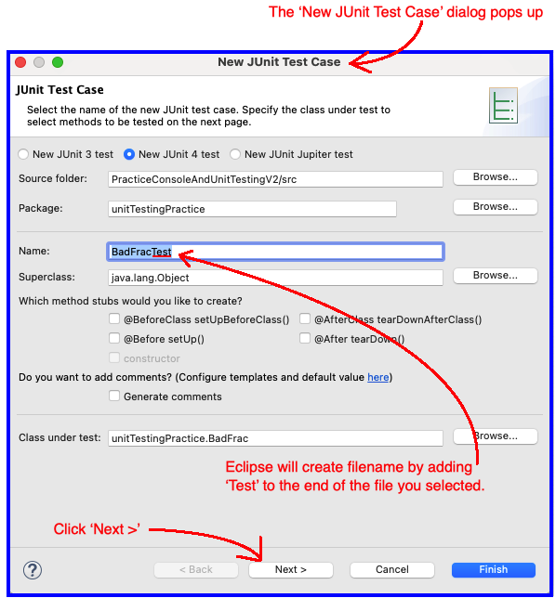
JUnit Test Case Dialog

Slide 13
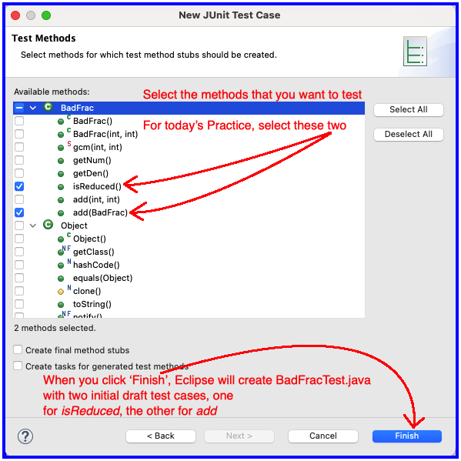
JUnit Test Case Dialog

Slide 14

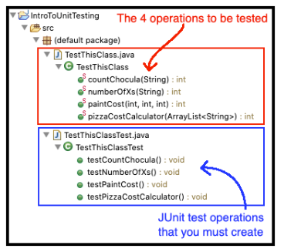
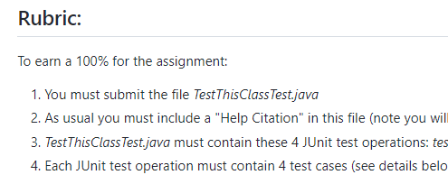
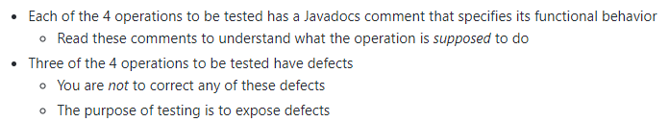

UnitTesting Homework

