Slide 1
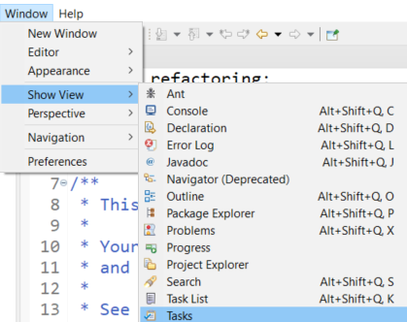
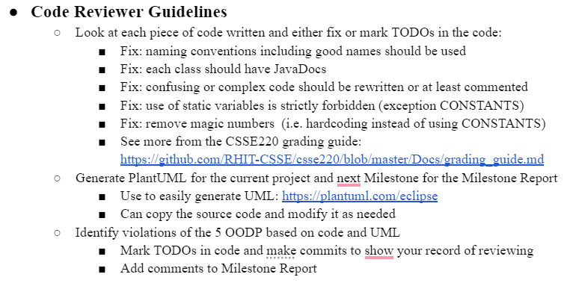


Code Review Guidelines

Slide 2


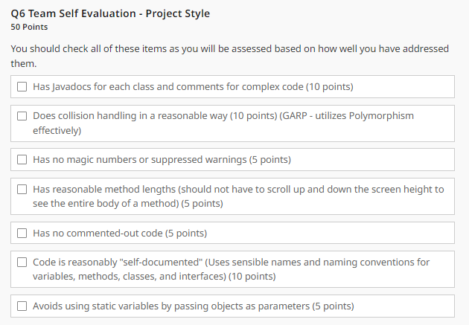
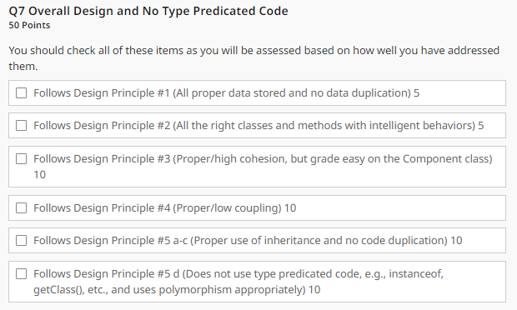
Final Style and Design Rubric

Slide 3
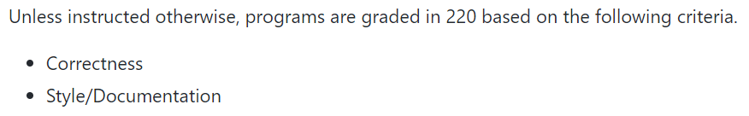
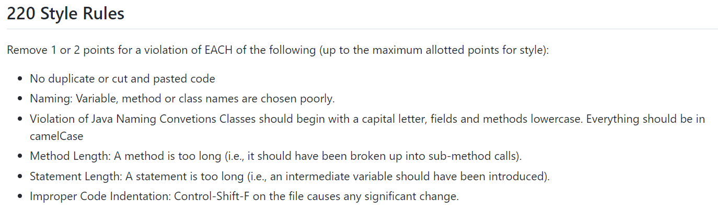
CSSE220 Grading Instructions
https://github.com/RHIT-CSSE/csse220/blob/master/Docs/grading_guide.md

Slide 4
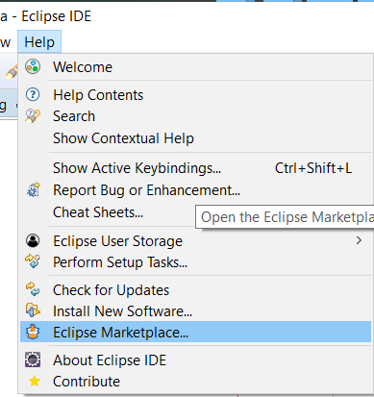
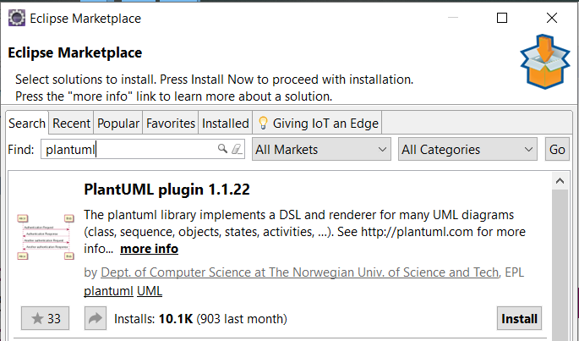
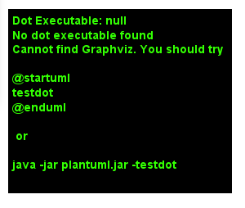
PlantUML Eclipse Plugin
https://plantuml.com/eclipse
https://graphviz.gitlab.io/download/
Windows Stable Installed (msi)
Install Graphviz

Slide 5
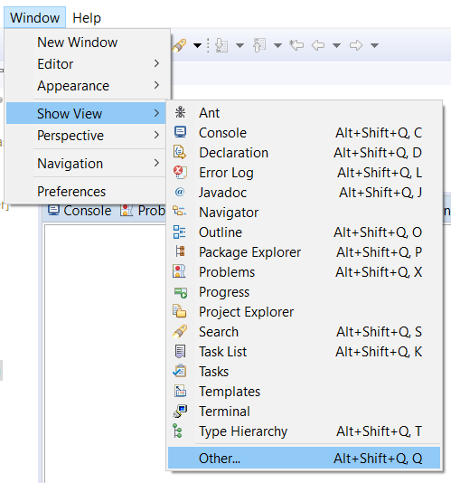
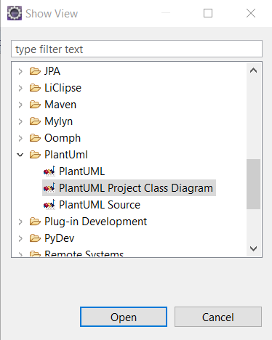
PlantUML Eclipse Plugin

Slide 6
Generating the UML from Existing Classes

Slide 7
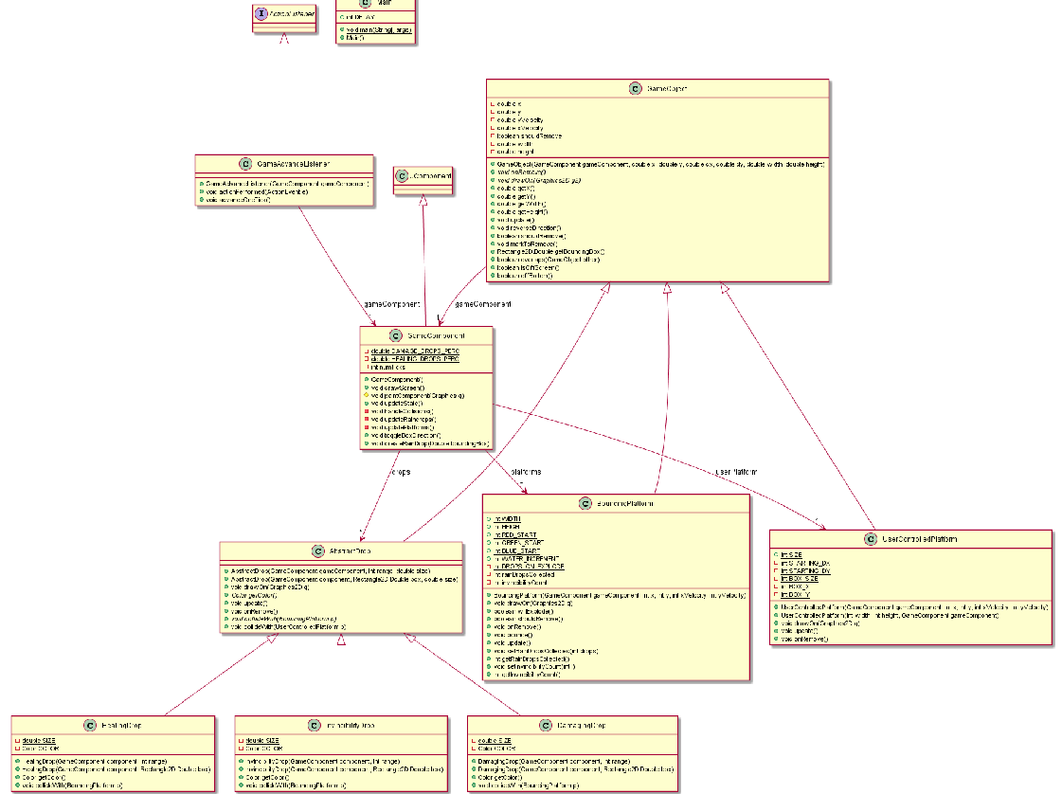
Information Overload
As project gets larger
It becomes too hard to understand from a giant UML
You can modify it easy…
(Next Slide)

Slide 8
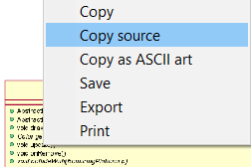
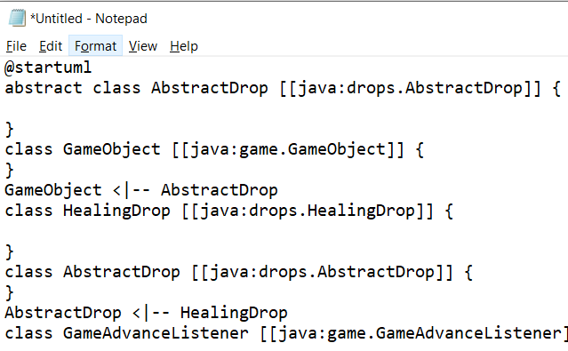
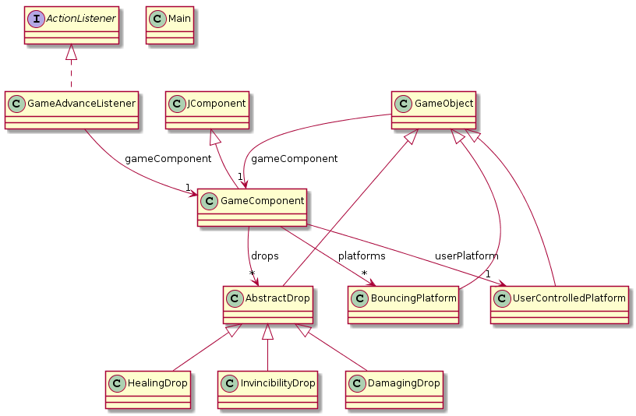
<- Copy UML source and
then remove extra ->
PlantUML
Eclipse
Plugin

