Slide 1
Meeting with TA as time allows
Feedback on your UML
You can ask general questions
You can ask for advice
If you have not defined your RND roles yet, do that now!
TA should your first point of contact to ask questions or request extensions
If you have trouble contacting your TA let your instructor know

Slide 2
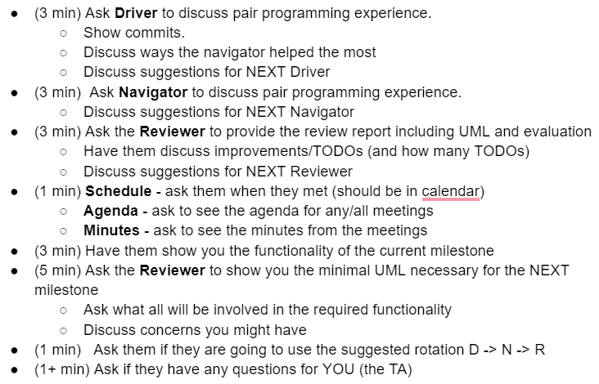
Next Meeting (Milestone 1) with your TA
Agenda and Plan
Make sure you are ready to show the TA everything you are responsible for
Must have UML for current and next milestone (in the Milestone Report)
Have your code ready to run
Have your git commits ready to show

