Slide 1
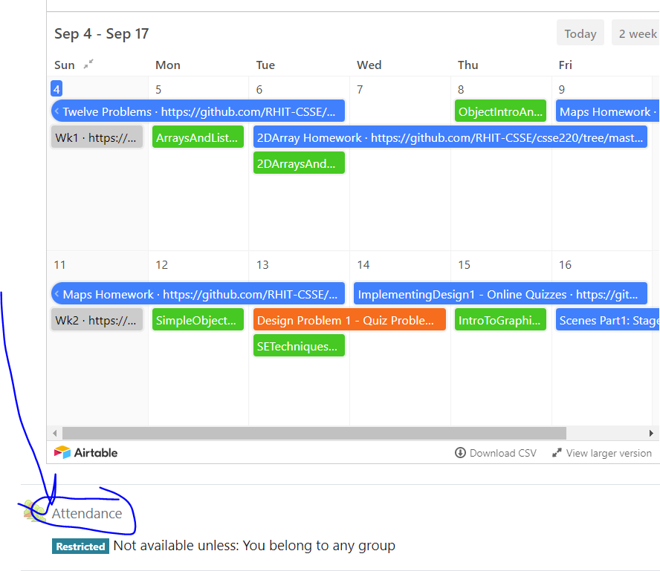
CSSE 220
Today’s Attendance password
____________
Main Game Loop with Timers
File IO
Exception Introduction
The git projects for today are:
PracticeEventBasedGameLoop
PracticeEventBasedGameLoopSolution
The Quiz for today is:
EventBasedGameLoopQuiz

Slide 2
Objectives
Final Project Preparation/Kickoff
Learn how to avoid common project errors
Learn how to setup a timer to create events
Practice with live-coding
Practice interaction between game elements
Learn how to read and write from files
Practice with live-coding
Required for Milestone 1

Slide 3
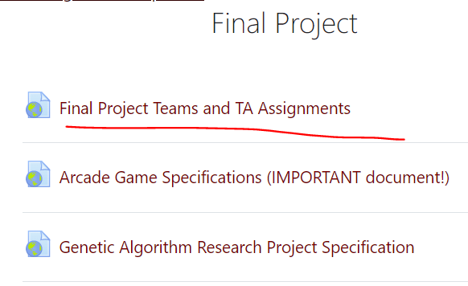
Final Project Introduction
Spring 24 Team Sheet:
https://docs.google.com/spreadsheets/d/1B26gr2dff9sHD9c6V-wobnzmtHhlOW47XuqyXpQ77ys/edit#gid=968264463

Slide 4
Final Project Introduction - 01

Slide 5
Final Project Introduction - 02

Slide 6
Final Project Introduction - 03

Slide 7
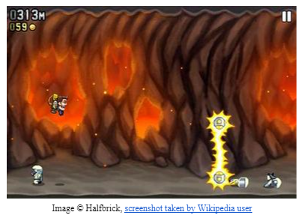
Project Specifications (Link on Moodle)
Jetpack Joyride Game Specification
CSSE220 Genetic Algorithm Research Project

Slide 8
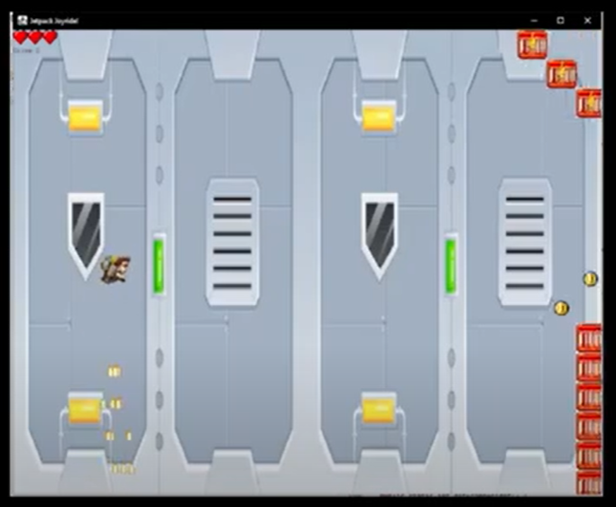
https://youtu.be/NVFNg7ysCgg

Slide 9
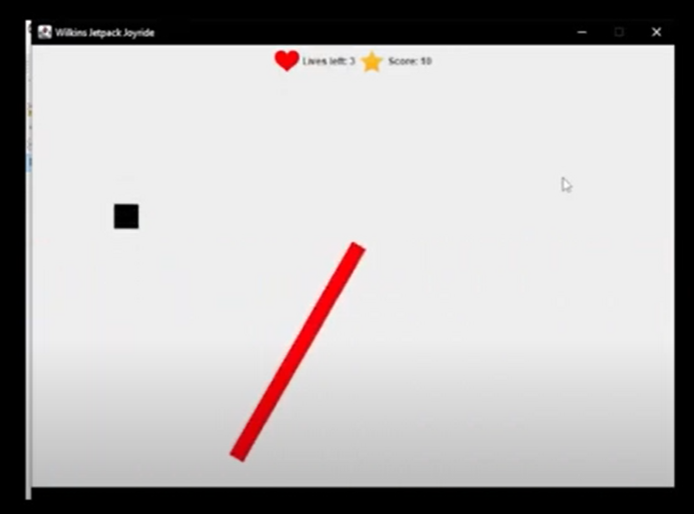
https://youtu.be/_777kvznYCA

