Slide 1
CSSE 220: Object Design
SE Techniques Principles
Principles 1 & 2
The git projects for today are:
PracticeFirstOODesign
PracticeFirstOODesignSolution

Slide 2
1. Make sure your design allows proper functionality
Must be able to store required information (one/many to one/many relationships)
Must be able to access the required information to accomplish tasks
Data should not be duplicated (id/identifiers are OK!)

Slide 3
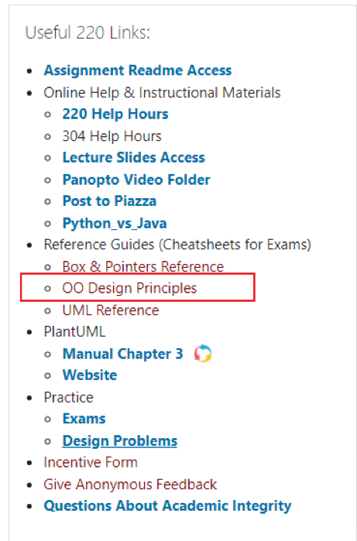
Overview: Principles of Design (for CSSE220)
Make sure your design allows proper functionality
Must be able to store required information (one/many to one/many relationships)
Must be able to access the required information to accomplish tasks
Data should not be duplicated (id/identifiers are OK!)
Structure design around the data to be stored
Nouns should become classes
Classes should have intelligent behaviors (methods) that may operate on their data
Functionality should be distributed efficiently
No class/part should get too large
Each class should have a single responsibility it accomplishes
Minimize dependencies between objects when it does not disrupt usability or extendibility
Tell don't ask
Don't have message chains
Don't duplicate code
Similar "chunks" of code should be unified into functions
Classes with similar features should be given common interfaces
Classes with similar internals should be simplified using inheritance

Slide 4
1. Make sure your design allows proper functionality
Must be able to store required information (one/many to one/many relationships)
Must be able to access the required information to accomplish tasks
Data should not be duplicated (id/identifiers are OK!)

Slide 5
An object oriented design must work!
Make sure all the data that you need is stored somewhere
Think as a client programmer: Can you access all the necessary data from the new Class? If not, then the design of the new class “doesn’t work”
The solution is not to keep 2 copies of the same data, one in the client and one in the new Class, change the new Class
Notes:
Maybe mention in passing there are other design approaches that divide things differently, but we’ll be focusing on OO in this course

Slide 6
2. Structure design around the data to be stored
Nouns should become classes
Classes should have intelligent behaviors (methods) that may operate on their data

Slide 7
A good object oriented design is structured around the data
Look for the nouns in your problem, consider making each of them a Class
…if work related to that now is complex enough
Put the data stored as fields in the Class
Add operations to the Class to accomplish what your need, i.e., manipulate the internal class fields
Avoid Plural Nouns – i.e., Class name singular and know that client can always make multiple object instances of this class
Notes:
Maybe mention in passing there are other design approaches that divide things differently, but we’ll be focusing on OO in this course

Slide 8
Learning to Design
PAUSE HERE for a couple minutes!
Try to see what you can think might be wrong
When you have an idea, then continue
You will be given “story problem” for a program(s) that you need to imagine coding
The story problem provides a list of requirements for necessary features that you will need to provide
You will practice designing in two ways:
1) Identifying problems with designs we give you (Red popups)
2) Developing your own design for problems (Blue popups)
You will have a number of opportunities to do practice designing:
In-class exercises/ daily quizzes (many!)
Homework Assignments (5)
Exam Questions (1+ on each exam)
Final Project Design (design from scratch)
PAUSE HERE for 5-10 minutes!
Try to make your own improved design
Either paper or using plantuml is OK!

