Slide 1
Design Problem – Company Accounts

Slide 2
Do the in-class activity
A particular company keeps a variety of different accounts for its projects. Each account has an account number and a balance. When a deposit or withdrawal occurs, the transaction occurs immediately, and the current balance should be updated. The system should support getting the current balance.
The system should also support getting the balance as it existed at any date/time in the past. Note the input historical date/time may not correspond to a particular transaction time - e.g., if the system had a balance of $1 at 1 p.m. and then was changed to $2 at 3 p.m., a request for the balance at 2 p.m. should return $1.
To Do #1 Identify all the primary nouns
A primary noun is a noun in the problem that has attributes (other nouns)
Nouns that designate actors of the system (i.e. The user can click…) can be excluded
To Do #2 Write down the attributes (other nouns) associated with the primary nouns
To Do #3 Identify all the verbs
To Do #4 Identify which primary nouns are worked on by the verbs
To Do #5 Design a system using UML to handle this problem

Slide 3
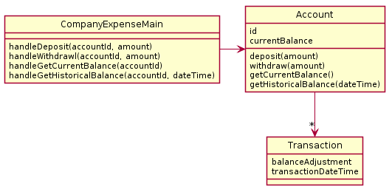
What is wrong with this design? This design?
PAUSE HERE for a couple minutes!
Try to see what you can think might be wrong
When you have an idea, then continue
A particular company keeps a variety of different accounts for its projects. Each account has an account number and a balance. When a deposit or withdrawal occurs, the transaction occurs immediately and the current balance should be updated. The system should support getting the current balance.
The system should also support getting the balance as it existed at any date/time in the past. Note the input historical date/time may not correspond to a particular transaction time - e.g. if the system had a balance of $1 at 1 pm and then was changed to $2 at 3 pm, a request for the balance at 2 pm should return $1.
Bad Design A
Quiz question
#6
Note:
Don’t read more into the English text than is there, e.g., “there ought to be a way to create accounts!”
6

Slide 4
This design does not function correctly. Why?
Main has only one account, but the system needs to support many. How do we know that from this diagram?
Also, computing the data for historic balances is moderately hard.

Slide 5
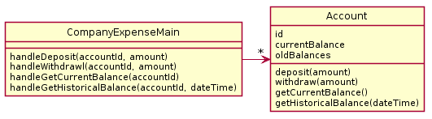
Questions #7 & #8 on today’s quiz
A particular company keeps a variety of different accounts for its projects. Each account has an account number and a balance. When a deposit or withdrawal occurs, the transaction occurs immediately and the current balance should be updated. The system should support getting the current balance.
The system should also support getting the balance as it existed at any date/time in the past. Note the input historical date/time may not correspond to a particular transaction time - e.g. if the system had a balance of $1 at 1pm and then was changed to $2 at 3pm., a request for the balance at 2pm should return $1.
Find the problem with this design
PAUSE HERE for a couple minutes!
Try to see what you can think might be wrong
When you have an idea, then continue
Bad Design B
7-8

Slide 6
This design does not function correctly.
Account does not have enough data to make getHistoricalBalance work. oldBalances stores perhaps a list of balances? But the date of the transactions is not stored, so we can't look up the balance on a particular day/time.

Slide 7
Questions #7 & #8 on today’s quiz
A particular company keeps a variety of different accounts for its projects. Each account has an account number and a balance. When a deposit or withdrawal occurs, the transaction occurs immediately and the current balance should be updated. The system should support getting the current balance.
The system should also support getting the balance as it existed at any date/time in the past. Note the input historical date/time may not correspond to a particular transaction time - e.g. if the system had a balance of $1 at 1pm and then was changed to $2 at 3pm., a request for the balance at 2pm should return $1.
Propose your own design
PAUSE HERE for 5-10 minutes!
Try to make your own improved design
Either paper or using plantuml is OK!
7-8

Slide 8

Here is a potential solution

Slide 9
Here is a potential solution
Note: balances & transactionDateTimes – are parallel ArrayLists
The 's' at the end of the names balances and transactionDateTimes this is an indicator that each stores multiple values – these are really parallel ArrayLists
Alternative to parallel ArrayLists: Create a single new class to capture balance and transactionDateTime, then create a single ArrayList of this new class

Slide 10
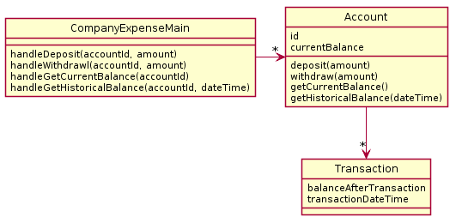
Here is second potential solution
Technically, this class is just a “dumb” data holder and has no methods that work on the data stored with the objects of this class.
Consider: is this design more flexible if we get new requirements, like for instance needing a transactionReport() method?

