Slide 1
Design Problem – Book Tracker
On the next slide is a story problem
To be successful at solving these types of problems you must first read the story problem and do the following “To Do”s
To Do #1 Identify all the primary nouns
A primary noun is a noun in the problem that has attributes (other nouns)
Nouns that designate actors of the system (i.e. The user can click…) can be excluded
To Do #2 Write down the attributes (other nouns) associated with the primary nouns
To Do #3 Identify all the verbs
To Do #4 Identify which primary nouns are worked on by the verbs
To Do #5 Design a system using UML to handle this problem
If you do this all well, then you should hopefully be able to make classes where:
Each primary noun becomes a Class
Each attribute (other noun) becomes a field for its respective class
Each verb becomes the method for the respective class

Slide 2
A website tracks books and the kids that read them. For each book the system stores the name and author. For each kid the system stores name and grade level. The teacher enters when a kid reads a particular book. It should be possible to print a report on a book that includes all kids who have read a particular book (with their grade level). It should be possible to print a report on a kid that includes the books (with authors) a particular kid has read.
To Do #1 Identify all the primary nouns
A primary noun is a noun in the problem that has attributes (other nouns)
Nouns that designate actors of the system (i.e. The user can click…) can be excluded
To Do #2 Write down the attributes (other nouns) associated with the primary nouns
To Do #3 Identify all the verbs
To Do #4 Identify which primary nouns are worked on by the verbs
To Do #5 Design a system using UML to handle this problem

Slide 3
A website tracks books and the kids that read them. For each book the system stores the name and author. For each kid the system stores name and grade level. The teacher enters when a kid reads a particular book. It should be possible to print a report on a book that includes all kids who have read a particular book (with their grade level). It should be possible to print a report on a kid that includes the books (with authors) a particular kid has read.
To Do #1 Identify all the primary nouns
A primary noun is a noun in the problem that has attributes (other nouns)
Nouns that designate actors of the system (i.e. The user can click…) can be excluded
To Do #2 Write down the attributes (other nouns) associated with the primary nouns
To Do #3 Identify all the verbs
To Do #4 Identify which primary nouns are worked on by the verbs
To Do #5 Design a system using UML to handle this problem

Slide 4
A website tracks books and the kids that read them. For each book the system stores the name and author. For each kid the system stores name and grade level. The teacher enters when a kid reads a particular book. It should be possible to print a report on a book that includes all kids who have read a particular book (with their grade level). It should be possible to print a report on a kid that includes the books (with authors) a particular kid has read.
To Do #1 Identify all the primary nouns
A primary noun is a noun in the problem that has attributes (other nouns)
Nouns that designate actors of the system (i.e. The user can click…) can be excluded
To Do #2 Write down the attributes (other nouns) associated with the primary nouns
To Do #3 Identify all the verbs
To Do #4 Identify which primary nouns are worked on by the verbs
To Do #5 Design a system using UML to handle this problem

Slide 5


A website tracks books and the kids that read them. For each book the system stores the name and author. For each kid the system stores name and grade level. The teacher enters when a kid reads a particular book. It should be possible to print a report on a book that includes all kids who have read a particular book (with their grade level). It should be possible to print a report on a kid that includes the books (with authors) a particular kid has read.
To Do #1 Identify all the primary nouns
A primary noun is a noun in the problem that has attributes (other nouns)
Nouns that designate actors of the system (i.e. The user can click…) can be excluded
To Do #2 Write down the attributes (other nouns) associated with the primary nouns
To Do #3 Identify all the verbs
To Do #4 Identify which primary nouns are worked on by the verbs
To Do #5 Design a system using UML to handle this problem

Slide 6
A website tracks books and the kids that read them. For each book the system stores the name and author. For each kid the system stores name and grade level. The teacher enters when a kid reads a particular book. It should be possible to print a report on a book that includes all kids who have read a particular book (with their grade level). It should be possible to print a report on a kid that includes the books (with authors) a particular kid has read.
To Do #1 Identify all the primary nouns
A primary noun is a noun in the problem that has attributes (other nouns)
Nouns that designate actors of the system (i.e. The user can click…) can be excluded
To Do #2 Write down the attributes (other nouns) associated with the primary nouns
To Do #3 Identify all the verbs
To Do #4 Identify which primary nouns are worked on by the verbs
To Do #5 Design a system using UML to handle this problem

Slide 7



A website tracks books and the kids that read them. For each book the system stores the name and author. For each kid the system stores name and grade level. The teacher enters when a kid reads a particular book. It should be possible to print a report on a book that includes all kids who have read a particular book (with their grade level). It should be possible to print a report on a kid that includes the books (with authors) a particular kid has read.
To Do #1 Identify all the primary nouns
A primary noun is a noun in the problem that has attributes (other nouns)
Nouns that designate actors of the system (i.e. The user can click…) can be excluded
To Do #2 Write down the attributes (other nouns) associated with the primary nouns
To Do #3 Identify all the verbs
To Do #4 Identify which primary nouns are worked on by the verbs
To Do #5 Design a system using UML to handle this problem

Slide 8
A website tracks books and the kids that read them. For each book the system stores the name and author. For each kid the system stores name and grade level. The teacher enters when a kid reads a particular book. It should be possible to print a report on a book that includes all kids who have read a particular book (with their grade level). It should be possible to print a report on a kid that includes the books (with authors) a particular kid has read.
To Do #1 Identify all the primary nouns
A primary noun is a noun in the problem that has attributes (other nouns)
Nouns that designate actors of the system (i.e. The user can click…) can be excluded
To Do #2 Write down the attributes (other nouns) associated with the primary nouns
To Do #3 Identify all the verbs
To Do #4 Identify which primary nouns are worked on by the verbs
To Do #5 Design a system using UML to handle this problem

Slide 9



A website tracks books and the kids that read them. For each book the system stores the name and author. For each kid the system stores name and grade level. The teacher enters when a kid reads a particular book. It should be possible to print a report on a book that includes all kids who have read a particular book (with their grade level). It should be possible to print a report on a kid that includes the books (with authors) a particular kid has read.
To Do #1 Identify all the primary nouns
A primary noun is a noun in the problem that has attributes (other nouns)
Nouns that designate actors of the system (i.e. The user can click…) can be excluded
To Do #2 Write down the attributes (other nouns) associated with the primary nouns
To Do #3 Identify all the verbs
To Do #4 Identify which primary nouns are worked on by the verbs
To Do #5 Design a system using UML to handle this problem

Slide 10


A website tracks books and the kids that read them. For each book the system stores the name and author. For each kid the system stores name and grade level. The teacher enters when a kid reads a particular book. It should be possible to print a report on a book that includes all kids who have read a particular book (with their grade level). It should be possible to print a report on a kid that includes the books (with authors) a particular kid has read.
To Do #1 Identify all the primary nouns
A primary noun is a noun in the problem that has attributes (other nouns)
Nouns that designate actors of the system (i.e. The user can click…) can be excluded
To Do #2 Write down the attributes (other nouns) associated with the primary nouns
To Do #3 Identify all the verbs
To Do #4 Identify which primary nouns are worked on by the verbs
To Do #5 Design a system using UML to handle this problem

Slide 11
A website tracks books and the kids that read them. For each book the system stores the name and author. For each kid the system stores name and grade level. The teacher enters when a kid reads a particular book. It should be possible to print a report on a book that includes all kids who have read a particular book (with their grade level). It should be possible to print a report on a kid that includes the books (with authors) a particular kid has read.
To Do #1 Identify all the primary nouns
A primary noun is a noun in the problem that has attributes (other nouns)
Nouns that designate actors of the system (i.e. The user can click…) can be excluded
To Do #2 Write down the attributes (other nouns) associated with the primary nouns
To Do #3 Identify all the verbs
To Do #4 Identify which primary nouns are worked on by the verbs
To Do #5 Design a system using UML to handle this problem

Slide 12
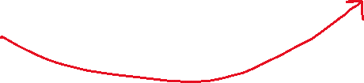
A website tracks books and the kids that read them. For each book the system stores the name and author. For each kid the system stores name and grade level. The teacher enters when a kid reads a particular book. It should be possible to print a report on a book that includes all kids who have read a particular book (with their grade level). It should be possible to print a report on a kid that includes the books (with authors) a particular kid has read.
To Do #1 Identify all the primary nouns
A primary noun is a noun in the problem that has attributes (other nouns)
Nouns that designate actors of the system (i.e. The user can click…) can be excluded
To Do #2 Write down the attributes (other nouns) associated with the primary nouns
To Do #3 Identify all the verbs
To Do #4 Identify which primary nouns are worked on by the verbs
To Do #5 Design a system using UML to handle this problem

Slide 13
A website tracks books and the kids that read them. For each book the system stores the name and author. For each kid the system stores name and grade level. The teacher enters when a kid reads a particular book. It should be possible to print a report on a book that includes all kids who have read a particular book (with their grade level). It should be possible to print a report on a kid that includes the books (with authors) a particular kid has read.
To Do #1 Identify all the primary nouns
A primary noun is a noun in the problem that has attributes (other nouns)
Nouns that designate actors of the system (i.e. The user can click…) can be excluded
To Do #2 Write down the attributes (other nouns) associated with the primary nouns
To Do #3 Identify all the verbs
To Do #4 Identify which primary nouns are worked on by the verbs
To Do #5 Design a system using UML to handle this problem

Slide 14
A website tracks books and the kids that read them. For each book the system stores the name and author. For each kid the system stores name and grade level. The teacher enters when a kid reads a particular book. It should be possible to print a report on a book that includes all kids who have read a particular book (with their grade level). It should be possible to print a report on a kid that includes the books (with authors) a particular kid has read.
Is this a class to represent or just a command that needs to be run? Like printing to a screen for instance?
To Do #1 Identify all the primary nouns
A primary noun is a noun in the problem that has attributes (other nouns)
Nouns that designate actors of the system (i.e. The user can click…) can be excluded
To Do #2 Write down the attributes (other nouns) associated with the primary nouns
To Do #3 Identify all the verbs
To Do #4 Identify which primary nouns are worked on by the verbs
To Do #5 Design a system using UML to handle this problem

Slide 15


A website tracks books and the kids that read them. For each book the system stores the name and author. For each kid the system stores name and grade level. The teacher enters when a kid reads a particular book. It should be possible to print a report on a book that includes all kids who have read a particular book (with their grade level). It should be possible to print a report on a kid that includes the books (with authors) a particular kid has read.
To Do #1 Identify all the primary nouns
A primary noun is a noun in the problem that has attributes (other nouns)
Nouns that designate actors of the system (i.e. The user can click…) can be excluded
To Do #2 Write down the attributes (other nouns) associated with the primary nouns
To Do #3 Identify all the verbs
To Do #4 Identify which primary nouns are worked on by the verbs
To Do #5 Design a system using UML to handle this problem

Slide 16
A website tracks books and the kids that read them. For each book the system stores the name and author. For each kid the system stores name and grade level. The teacher enters when a kid reads a particular book. It should be possible to print a report on a book that includes all kids who have read a particular book (with their grade level). It should be possible to print a report on a kid that includes the books (with authors) a particular kid has read.
Is this a class to represent or just a command that needs to be run? Like printing to a screen for instance?
To Do #1 Identify all the primary nouns
A primary noun is a noun in the problem that has attributes (other nouns)
Nouns that designate actors of the system (i.e. The user can click…) can be excluded
To Do #2 Write down the attributes (other nouns) associated with the primary nouns
To Do #3 Identify all the verbs
To Do #4 Identify which primary nouns are worked on by the verbs
To Do #5 Design a system using UML to handle this problem

Slide 17


A website tracks books and the kids that read them. For each book the system stores the name and author. For each kid the system stores name and grade level. The teacher enters when a kid reads a particular book. It should be possible to print a report on a book that includes all kids who have read a particular book (with their grade level). It should be possible to print a report on a kid that includes the books (with authors) a particular kid has read.
To Do #1 Identify all the primary nouns
A primary noun is a noun in the problem that has attributes (other nouns)
Nouns that designate actors of the system (i.e. The user can click…) can be excluded
To Do #2 Write down the attributes (other nouns) associated with the primary nouns
To Do #3 Identify all the verbs
To Do #4 Identify which primary nouns are worked on by the verbs
To Do #5 Design a system using UML to handle this problem

Slide 18
A website tracks books and the kids that read them. For each book the system stores the name and author. For each kid the system stores name and grade level. The teacher enters when a kid reads a particular book. It should be possible to print a report on a book that includes all kids who have read a particular book (with their grade level). It should be possible to print a report on a kid that includes the books (with authors) a particular kid has read.
To Do #1 Identify all the primary nouns
A primary noun is a noun in the problem that has attributes (other nouns)
Nouns that designate actors of the system (i.e. The user can click…) can be excluded
To Do #2 Write down the attributes (other nouns) associated with the primary nouns
To Do #3 Identify all the verbs
To Do #4 Identify which primary nouns are worked on by the verbs
To Do #5 Design a system using UML to handle this problem

Slide 19
A website tracks books and the kids that read them. For each book the system stores the name and author. For each kid the system stores name and grade level. The teacher enters when a kid reads a particular book. It should be possible to print a report on a book that includes all kids who have read a particular book (with their grade level). It should be possible to print a report on a kid that includes the books (with authors) a particular kid has read.
To Do #1 Identify all the primary nouns
A primary noun is a noun in the problem that has attributes (other nouns)
Nouns that designate actors of the system (i.e. The user can click…) can be excluded
To Do #2 Write down the attributes (other nouns) associated with the primary nouns
To Do #3 Identify all the verbs
To Do #4 Identify which primary nouns are worked on by the verbs
To Do #5 Design a system using UML to handle this problem

Slide 20









A website tracks books and the kids that read them. For each book the system stores the name and author. For each kid the system stores name and grade level. The teacher enters when a kid reads a particular book. It should be possible to print a report on a book that includes all kids who have read a particular book (with their grade level). It should be possible to print a report on a kid that includes the books (with authors) a particular kid has read.
To Do #1 Identify all the primary nouns
A primary noun is a noun in the problem that has attributes (other nouns)
Nouns that designate actors of the system (i.e. The user can click…) can be excluded
To Do #2 Write down the attributes (other nouns) associated with the primary nouns
To Do #3 Identify all the verbs
To Do #4 Identify which primary nouns are worked on by the verbs
To Do #5 Design a system using UML to handle this problem

Slide 21

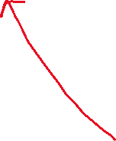

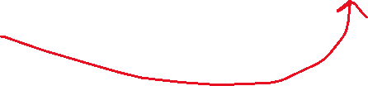


A website tracks books and the kids that read them. For each book the system stores the name and author. For each kid the system stores name and grade level. The teacher enters when a kid reads a particular book. It should be possible to print a report on a book that includes all kids who have read a particular book (with their grade level). It should be possible to print a report on a kid that includes the books (with authors) a particular kid has read.
To Do #1 Identify all the primary nouns
A primary noun is a noun in the problem that has attributes (other nouns)
Nouns that designate actors of the system (i.e. The user can click…) can be excluded
To Do #2 Write down the attributes (other nouns) associated with the primary nouns
To Do #3 Identify all the verbs
To Do #4 Identify which primary nouns are worked on by the verbs
To Do #5 Design a system using UML to handle this problem

Slide 22
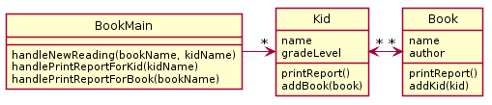
A website tracks books and the kids that read them. For each book the system stores the name and author. For each kid the system stores name and grade level. The teacher enters when a kid reads a particular book. It should be possible to print a report on a book that includes all kids who have read a particular book (with their grade level). It should be possible to print a report on a kid that includes the books (with authors) a particular kid has read.
Bad Design A
If you do this all well, then you should hopefully be able to make classes where:
Each primary noun becomes a Class
Each attribute (other noun) becomes a field for its respective class
Each verb becomes the method for the respective class
Notes:
There is no (sane) way to lookup a book to either lookup a book to add to a kid or print a report
Duplication of data

Slide 23



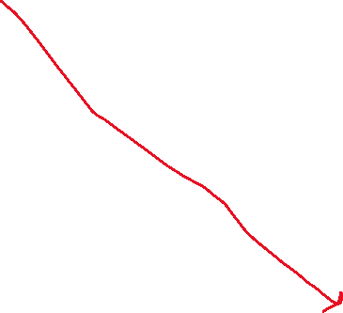
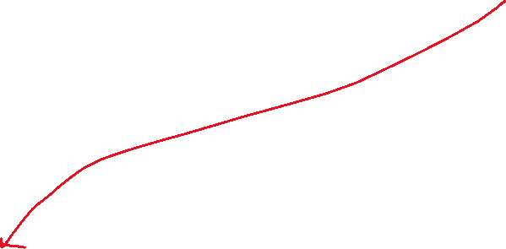
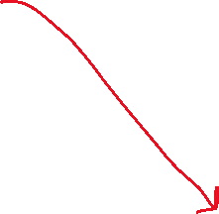
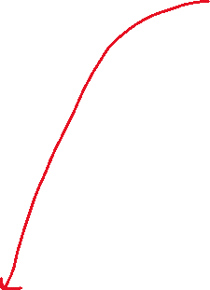
A website tracks books and the kids that read them. For each book the system stores the name and author. For each kid the system stores name and grade level. The teacher enters when a kid reads a particular book. It should be possible to print a report on a book that includes all kids who have read a particular book (with their grade level). It should be possible to print a report on a kid that includes the books (with authors) a particular kid has read.
Bad Design A
If you do this all well, then you should hopefully be able to make classes where:
Each primary noun becomes a Class
Each attribute (other noun) becomes a field for its respective class
Each verb becomes the method for the respective class
Notes:
There is no (sane) way to lookup a book to either lookup a book to add to a kid or print a report
Duplication of data

Slide 24
Good parts of the design - Main class
Every program starts somewhere, and any design should make clear where the starting point is. In our class, we will name the starting point class SomethingMain
We implicitly assume there exists:
constructors as needed
getters and setters as needed

Slide 25
Good parts of the design – “handle” methods
In our very simple designs, this class also deals with user input
handle methods will have special meaning for us, as they will represent places where user commands enter the system
Examine the UML diagram and use your analysis skills in order to determine:
If what is required by the story problem can be stored by the design presented in the UML diagram
If you can implement the handle methods in the UML Main class given the data stored in the different UML class diagram

Slide 26
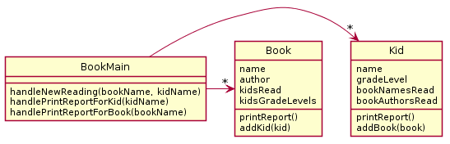
A website tracks books and the kids that read them. For each book the system stores the name and author. For each kid the system stores name and grade level. The teacher enters when a kid reads a particular book. It should be possible to print a report on a book that includes all kids who have read a particular book (with their grade level). It should be possible to print a report on a kid that includes the books (with authors) a particular kid has read.
PAUSE HERE for a couple minutes!
Try to see what you can think might be wrong
When you have an idea, then continue
Bad Design A
Bad Design B
Notes:
There is no (sane) way to lookup a book to either lookup a book to add to a kid or print a report
Duplication of data

Slide 27
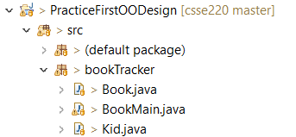


This design does not function. There is no (sane) way to look up a book for printing a report or for associating with a Kid.
See the code here for this POOR design!
Warning it is buggy and the code is UGLY!

Slide 28




This design functions but there is a very large amount of duplication – which in general we want to avoid.
In particular, the author/title information in the kid is duplicated and the name/grade level information in the book is duplicated.
Notes:
@startuml
skinparam style strictuml
class Book {
name
author
printReport()
addKid(kid)
}
class Kid {
name
gradeLevel
printReport()
addBook(book)
}
class BookMain {
handleNewReading(bookname,kidname)
printReportForBook(bookname)
printReportForKid(kidname)
}
Kid "*" <-> "*" Book
BookMain -> "*" Book
BookMain -> "*" Kid
@enduml

Slide 29
What would be a better design?
PAUSE HERE for 5-10 minutes!
Try to make your own improved design
Either paper or using plantuml is OK!
A website tracks books and the kids that read them. For each book the system stores the name and author. For each kid the system stores name and grade level. The teacher enters when a kid reads a particular book. It should be possible to print a report on a book that includes all kids who have read a particular book (with their grade level). It should be possible to print a report on a kid that includes the books (with authors) a particular kid has read.
Problematic designs for reference:
Bad Design A
Bad Design B

Slide 30
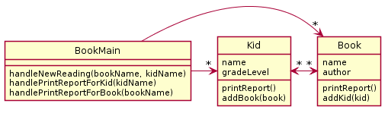
A Potential Solution
A website tracks books and the kids that read them. For each book the system stores the name and author. For each kid the system stores name and grade level. The teacher enters when a kid reads a particular book. It should be possible to print a report on a book that includes all kids who have read a particular book (with their grade level). It should be possible to print a report on a kid that includes the books (with authors) a particular kid has read.
If you do this all well, then you should hopefully be able to make classes where:
Each primary noun becomes a Class
Each attribute (other noun) becomes a field for its respective class
Each verb becomes the method for the respective class

Slide 31
In most cases non-workable design is caused by…
Not carefully analyzing the story problem.
Not carefully mapping the story problem to the proposed design (e.g., not noticing that each kid reads several books, not just one)
Not thinking about how specific required features might be implemented (e.g., how can we print a book report if we don’t have access to the book objects?)
Duplicating data (e.g., what does it matter if we store a copy of the author and title for every kid that reads the book)

Slide 32
As times allows
If there is enough time during class you can work through an example of Refactoring
This is a great way to see ugly code and the improvements that come with an improve design
The solution will be:
More efficient
Fewer lines of code
Easier to understand
Easier to re-use or extend
Offer improved functionality (existing code has bugs)
Notes:
There is likely not enough time to complete this during the class time,
but this is a great exercise for students to complete outside of class

Slide 33
Refactoring Coding Exercise
This design does not function. There is no (sane) way to look up a book for printing a report or for associating with a Kid.
We gave you this starting code
Refactor it to improve it!
#1. Store list of Books
#2. Update methods in BookMain

Slide 34
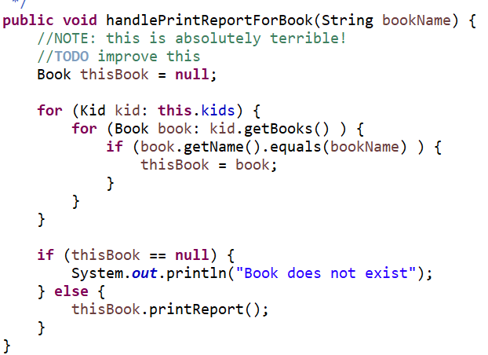
How bad is it? To print a book report…

