Slide 1
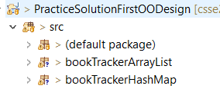
Design Problems 1 Homework
Solve the Design Problem 1 Homework (Moodle links to GradeScope)
We will reveal the solution shortly after the deadline
You cannot get an extension if the solution has been revealed
You WILL implement the solution as a future homework
We’ll discuss more design principles in the coming weeks
Two more example Design Problem you can practice on your own or with classmates on the slides that follow
Consider studying the Books and Kids code
Solution with different implementations is provided
Notes:
Briefly show the website description and how points are awarded on gradescope

Slide 2
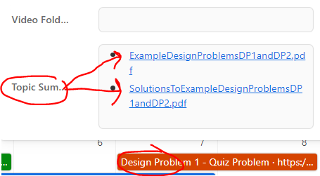
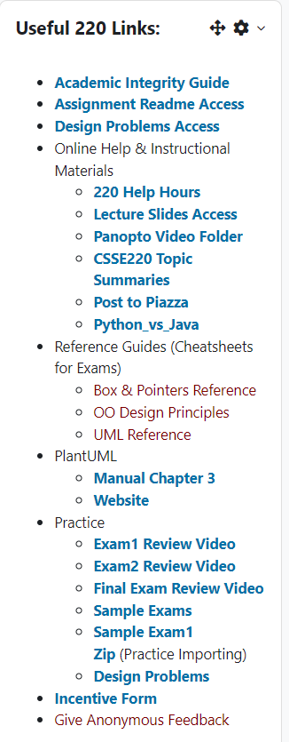
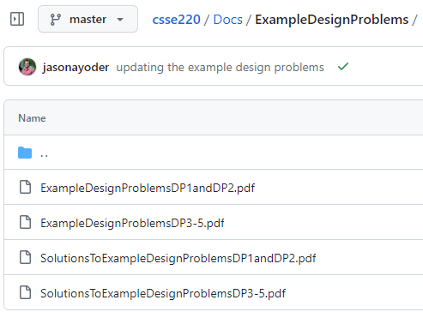


Extra Practice – Complete on Your own
The next two sets of slides have an example problems, but we have additional collections of exam problem with solutions for you to review here

