Slide 1
CSSE 220
Inheritance
The git projects for today are:
PracticeInheritance
PracticeInheritanceSolution
Notes:
Bring hard copy of CheckingAccount, ChessPiece, King, Queen, etc.
Bring photocopy of Big Java, Figure 3, page 422

Slide 2

Inheritance
Sometimes a new class is a special case of the concept represented by another
Can “borrow” from an existing class, changing just what we need
The new class inherits from the existing one:
all methods
all instance fields
Q1

Slide 3
Examples
class SavingsAccount extends BankAccount
adds interest earning, keeps other traits
class Employee extends Person
adds pay information and methods, keeps other traits
class Manager extends Employee
adds information about employees managed, changes the pay mechanism, keeps other traits
Notes:
- animated bullets

Slide 4
Notation and Terminology
class SavingsAccount extends BankAccount { // added fields // added methods }
Say “SavingsAccount is a BankAccount”
Superclass: BankAccount
Subclass: SavingsAccount
Notes:
Draw a Venn diagram here showing the set of all SavingsAccounts is a subset of the set of all BankAccounts. Subclass is like subset.
(Also inheritance flows down, so subclasses are below superclasses.)

Slide 5
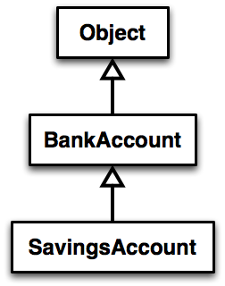
Inheritance in UML
The “superest” class in Java
Solid line shows inheritance
Still means “is a”
Q2
Notes:
[Show code example here, just looking at code for BankAccount and SavingsAccount (not writing it live)]

Slide 6
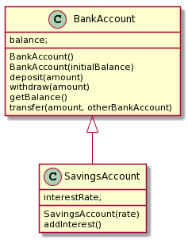
Look at Code
BankAccount
SavingsAccount
Plantuml source
SavingsAccount -up-|> BankAccount
Notes:
Add a main method:
public static void main(String[] args) {
SavingsAccount sa = new SavingsAccount(5);
sa.deposit(100);
System.out.println(sa.getBalance() );
sa.addInterest();
System.out.println(sa.getBalance() );
}
Ask students, “How does sa know its starting balance?”

Slide 7
Interfaces vs. Inheritance
class ClickHandler implements MouseListener
ClickHandler promises to implement all the methods of MouseListener
class CheckingAccount extends BankAccount
CheckingAccount inherits (or overrides) all the methods of BankAccount
For client code reuse
For implementation code reuse
Notes:
We will implement CheckingAccount in a little while.

Slide 8
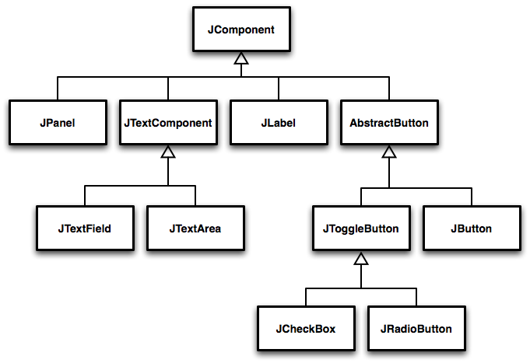
Inheritance Run Amok?
Notes:
Advanced code sometimes has deep inheritance hierarchies
Trace through a few paths asking students what might be inherited and what might be added at each level (See Figure 1 - 3, pages 422 - 3)
Every JComponent has a width and a height, so the JComponent class has a getWidth() and a getHeight() method.
Every JButton can have text or an icon on it, so the AbstractButton class has a setText() and a setIcon() method.

Slide 9
With Methods, Subclasses can:
Inherit methods unchanged
Override methods
Declare a new method with same signature to use instead of superclass method
Add entirely new methods not in superclass
Q3

Slide 10
With Fields, Subclasses:
ALWAYS inherit all fields unchanged
Only have access to protected, public, and package level fields
Can add entirely new fields not in superclass
DANGER! Don’t use the same name as a superclass field!
Q4
Notes:
Start to implement CheckingAccount, just create class, but do not add methods yet.
Draw UML diagram with details (See Figure on page 443) on board first [keep this, you’ll need it later]
Use no-arg constructor initially. We’ll add the argument later.

Slide 11
Super Calls
Calling superclass method:
super.methodName(args);
Calling superclass constructor:
super(args);
Must be the first line of the subclass constructor
Q5
Notes:
Discuss super method calls.
Add CheckingAccount(double) constructor

Slide 12
Let’s Code CheckingAccount
A special type of BankAccount
Has 3 free transactions each month
Withdraw
Deposit
Every additional transaction (beyond) costs $1.50
4 cost $1.50
5 cost $3.00
At end of each month fees are deducted (all together)
Transaction count is reset at this time
Notes:
Override:
deposit( amount )
withdraw( amount )
deductFees()

Slide 13
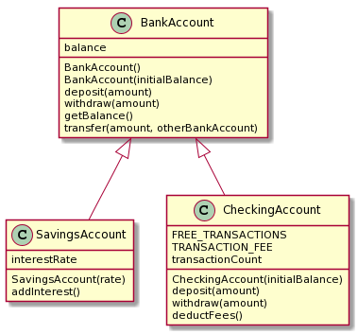
Design to Implement
plantuml

Slide 14
Polymorphism and Subclasses
A subclass instance is a superclass instance
Polymorphism still works!
BankAccount ba = new CheckingAccount(); ba.deposit(100);
But not the other way around!
CheckingAccount ca = new BankAccount(); ca.deductFees();
Why not?
BOOM!
Q6
Notes:
Draw B&P diagrams. Show calls.
Why not? Because BankAccount doesn’t have an deductFees() method!

Slide 15
Another Example
Can use:
public void transfer(double amount, BankAccount o){ this.withdraw(amount); o.deposit(amount); } in BankAccount
To transfer between different accounts:
SavingsAccount sa = …;
CheckingAccount ca = …;
sa.transfer(100, ca);
Notes:
Suggest drawing B&P diagram and trace calls as practice for the exam.

Slide 16
Access Modifiers
public—any code can see it
protected— package and subclasses can see it
default—anything in the package can see it
private—only the class itself can see it
Notes:
default (i.e., no modifier)—only code in the same package can see it
good choice for classes
protected—like default, but subclasses also have access
sometimes useful for helper methods
Bad for fields!
Q7

Slide 17
Live coding
Let’s look at chessPieces/chessSupport
Let’s Look at King and ChessPiece
StandardBoardProvider (uncomment King lines)
Notes:
Walk through the Chess example in Inheritance project. Start by showing the King and ChessPiece interface. Implement the queen, and note to the students how we end up copying a lot of code from the King into the Queen, there has to be a better way…
It works well to just make the ChessPiece a class first and put in a System.err.println(“Implement this method!”) then show them if we forget to implement a method (Queen’s checkMove) we see that message at runtime.
At this point, they should see the justification for an abstract class, show that on next slide

Slide 18
Abstract Classes
Also look at the code in the shapes package, especially ShapesDemo (during or after class)
Hybrid of superclasses and interfaces
Like regular superclasses:
Provide implementation of some methods
Like interfaces
Just provide signatures and docs of other methods
Can’t be instantiated
Example:
public abstract class BankAccount { /** documentation here */ public abstract void deductFees(); … }
Elided methods as before
Notes:
The main reason for using Abstract classes is to force programmers to create subclasses. Declaring certain methods abstract prevents you from coming up with useless default methods that others might inherit by accident.
This also allows code reuse when only a few methods of an interface differ in implementation.
Make the ChessPiece abstract, and pull the items that don’t change into the new abstract class, and leave the other methods abstract (see solution code). Walk students through this refactor for King/Queen, then have them implement the other pieces. Remind them that the Pawn is actually the hardest, and to do that LAST.

Slide 19
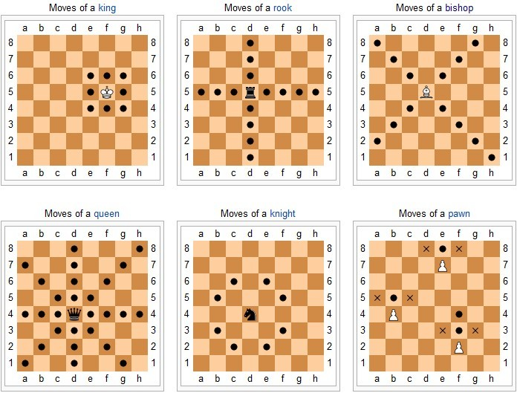
Notes:
Emphasize doing Pawn last it requires several things (hasMoved field) and needs to override the checkAttack method which is not obvious without looking at more code than they usually have to look at for the rest of the classes.
@Override
public boolean checkAttack(int dx, int dy, ChessPiece piece) {
if (this.isWhite() == piece.isWhite()) {
return false;
}
if (!movedCorrectDirection(dy)) {
return false;
}
dx = Math.abs(dx);
dy = Math.abs(dy);
return dx == 1 && dy == 1;
}

Slide 20
Work Time
Chess
ByoGUI
It's a solo project, but feel free to talk with others as you do it.
And to ask instructor/assistants for help
Q8-Q9

Slide 21
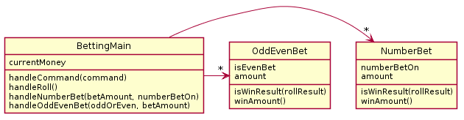
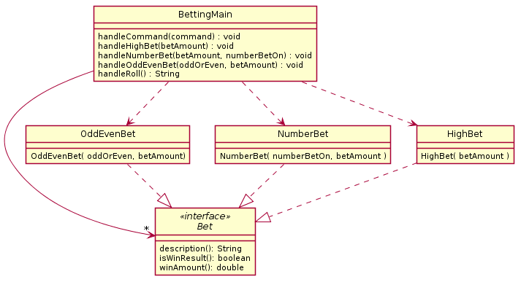
If time allows: Review from yesterday

