Slide 1
CSSE 220
Linked List Implementation
The git projects for today are:
PracticeLinkedListSimple
PracticeLinkedListSimpleSolution
Notes:
Doing everything in LinkedListSimple today
Quiz given in next slide

Slide 2
Quiz
Get into pairs
Look at/run the code in LinkedList.java main
Draw a box-and-pointer diagram of what’s happening in the main code.
To figure it out, you’ll have to look at the LinkedList constructor and addAtBeginning.
If you’ve forgotten how to do box-and-pointer diagrams, checkout the handout on Day 5 of the schedule
Q1
Notes:
This diagram is their quiz for the day

Slide 3
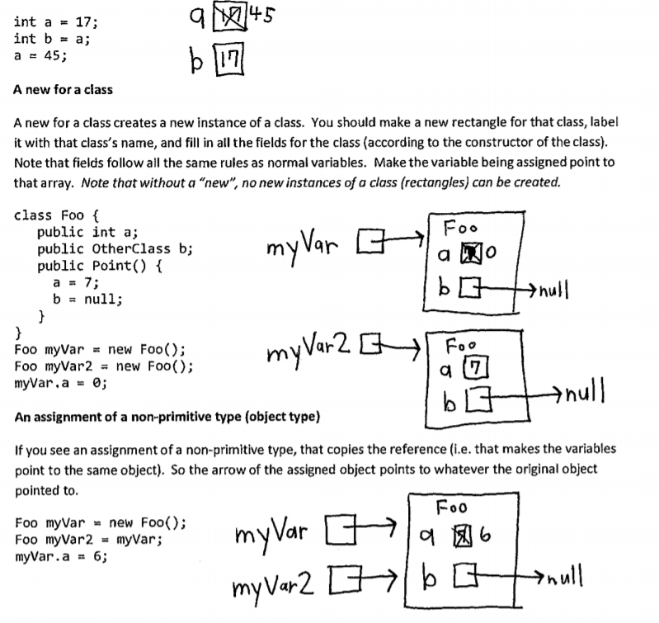

Slide 4
Solve the Other Problems in LinkedListSimple
Look at toString to get an idea of how to do size, then go from there
They are in approximate difficulty order
Get help if you get stuck!
Hold on to your quiz today, we will finish it next class period.

Slide 5
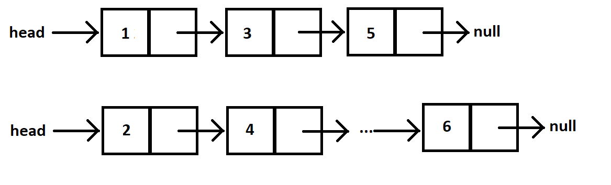
Shorthand Notation
Using pictures will be extremely helpful
Can use System.out.println( this ) to see what the current list looks like (does it match diagram?)

Slide 6
Loops in Arrays vs. LinkedLists
int[] nums = ……
for (int i=0; i< nums.length; ++) {
//do stuff with
//arbitrary element nums[i]
}
Equivalent in while loop
int i=0;
while ( ? ) {
//do stuff with
//arbitrary element nums[i]
?
}
LinkedList list = ……
//Another Day!
Node current = this.head;
while ( ? ) {
//do stuff with
//arbitrary element
?
}

Slide 7
Loops in Arrays vs. LinkedLists
int[] nums = ……
for (int i=0; i< nums.length; ++) {
//do stuff with
//arbitrary element nums[i]
}
Equivalent in while loop
int i=0;
while ( i < nums.length ) {
//do stuff with
//arbitrary element nums[i]
i++;
}
LinkedList list = ……
//Another Day!
Node current = this.head;
while ( ? ) {
//do stuff with
//arbitrary element
?
}

Slide 8
Loops in Arrays vs. LinkedLists
int[] nums = ……
for (int i=0; i< nums.length; ++) {
//do stuff with
//arbitrary element nums[i]
}
Equivalent in while loop
int i=0;
while ( i < nums.length ) {
//do stuff with
//arbitrary element nums[i]
i++;
}
LinkedList list = ……
//Another Day!
Node current = this.head;
while ( ? ) {
//do stuff with
//arbitrary element
current = current.next;
}

Slide 9
Loops in Arrays vs. LinkedLists
int[] nums = ……
for (int i=0; i< nums.length; ++) {
//do stuff with
//arbitrary element nums[i]
}
Equivalent in while loop
int i=0;
while ( i < nums.length ) {
//do stuff with
//arbitrary element nums[i]
i++;
}
LinkedList list = ……
//Another Day!
Node current = this.head;
while ( current != null ) {
//do stuff with
//arbitrary element
current = current.next;
}

Slide 10
Solve the Other Problems in LinkedListSimple
Look at toString to get an idea of how to do size, then go from there
They are in approximate difficulty order
Get help if you get stuck!
size()
add…
remove…

Slide 11
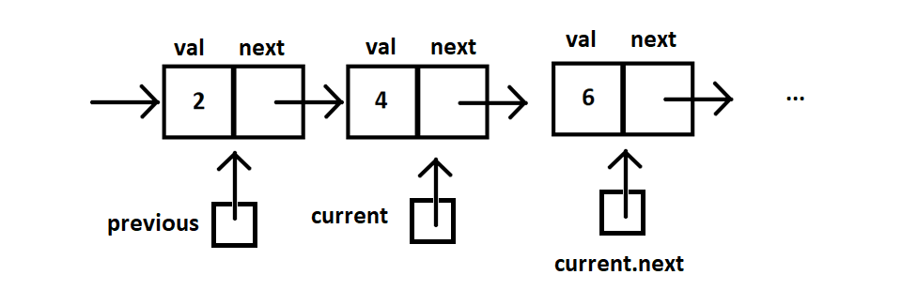
Shorthand Notation

Slide 12
Homework
SinglyLinkedList
Requires you to implement a SinglyLinkedList
Additional algorithm questions which make use of the SinglyLinkedList
Will give time in next class to work on it

Slide 13
Team Project Work TiMe
Move into your groups if not already
Review comments from Milestone 0 feedback
Be prepared to ask question of the grader
You will have ~5 minutes, so use it well
Notes:
This is the end of Monday’s class, pick up from here on Wednesday to complete quiz

Slide 14
Project advice
When done with MIlestone1 (or beyond)
Add “final Milestone1 Commit”
To your commit message so graders will know to check out that version
Build an end-to-end solution
Build the next thing you can TEST
Don’t focus on cool graphics and other extra items early in the project, focus on basic functionality
Complete the milestone and keep moving forward!
Notes:
This is the end of Monday’s class, pick up from here on Wednesday to complete quiz

Slide 15
FINAL SLIDE FOR TODAY

Slide 16
FRIDAYs material

Slide 17
Data Structures + BiG-O Notation
CSSE 220
Understanding the engineering trade-offs when storing data
Checkout LinkedListSimple project from git
Checkout SinglyLinkedList homework from git
Notes:
If students get through things quickly we can move into this material in the first hour, but if not- that is OK, we have the next class period to go through it and give them time to work on the rest of the quiz and the homework problems.

Slide 18
Data Structures
Efficient ways to store data based on how we’ll use it
The main theme for the rest of the course
So far we’ve seen ArrayLists
Fast addition to end of list
Fast access to any existing position
Slow inserts to and deletes from middle of list
Notes:
Q: Have to move all the other elements up or down to make/use room. O(n)

Slide 19
Big-O Notation
Describes the limiting behavior
How slow it can possibly run?
Describes the worst case
Used for Classifying Algorithm Efficiency
“O” for “Order”
O(n) → said as “Order n”
O(n^2) → said as “Order n-squared”

Slide 20
Big-O Notation (continued)
Don’t Care About Constants
O(2n + 7) → O(n)
Don’t Care About Smaller Powers
O(6n^2 + 7n) →O(n^2)
Algorithm grows asymptotically no faster than n^2
If constant value, we say O(1) → “Order 1”
O(48) → O(1)
Q2
Notes:
We care about which part of the expression grows the fastest as n, the input size, grows.

Slide 21
ArrayList Performance (Revisited)
Fast addition to end of list:
Fast access to any existing position – O(1) (like array)
Keep extra capacity for list growth
Fast access includes items in capacity not yet filled – O(1)
Capacity management is best left for CSSE230
Slow inserts to and deletes from middle of list
Can get to insert/delete location quickly
For insert, shift all items right to accommodate -O(n)
For delete, shift all items left to fill gap – O(n)
Q3

Slide 22
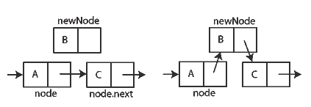
Another List Data Structure
What if we have to add/remove data from a list frequently?
LinkedLists support this:
Fast insertion and removal of elements
Once we know where they go
Slow access to arbitrary elements
data
data
data
data
null
data
Insertion, per Wikipedia
Q4-5
Notes:
- Examples: employee list, music play list
Sketch a linked list on the board for “two more weeks” (quiz #3)
Then show insertion and deletion.

Slide 23
LinkedList<E> Methods
void addFirst(E element)
void addLast(E element)
E getFirst()
E getLast()
E removeFirst()
E removeLast()
Notes:
Big-Oh of each?
All of the operations perform as could be expected for a doubly-linked list.
Thus, these operations all take O(1) time.

Slide 24
Complete Quiz
Turn in quiz today

Slide 25
Homework
SinglyLinkedList
Requires you to implement a SinglyLinkedList
Additional algorithm questions which make use of the SinglyLinkedList
Will give you remaining class time to work on it
If you complete it, work on the project!

Slide 26
Optional Homework: Genetic Algorithm
https://moodle.rose-hulman.edu/mod/assign/view.php?id=1711587
https://rednuht.org/genetic_cars_2/
https://www.tutorialspoint.com/genetic_algorithms/genetic_algorithms_introduction.htm
Can replace a homework assignment grade
A more open-ended assignment
Room to explore ideas
Grade based on completion, design and creativity

