Slide 1
CSSE 220
More interfaces More recursion
More fun?
The git projects for today are:
PracticeBettingInterfaces
PracticeBettingInterfacesSolution
PracticeRecursiveHelperFunctions
PracticeRecursiveHelperFunctionsSolution
Notes:
SPECIAL TA INSTRUCTIONS:
BE SURE TO WALK AROUND while students work on recursion examples and NUDGE in the right direction
INSTRUCTOR:
Be sure to start quiz BEFORE the break
Leave 15+ minutes at the end AFTER showing UML for the refactoring of the code

Slide 2
Exercise time
Solve the sumArray function recursively
It’s in the RecursiveHelperFunctions project
You can work with friends, but each of you should get the code working on your own computer

Slide 3
Recursive Helper Functions – What, When, Why, How?
What:
A recursive function that is called by another (non-recursive) function
The non-recursive function (the caller) doesn’t do much
When:
Additional parameters are needed
Often the initial function you’re given is not in the ideal form for a recursive solution
Return values need to be updated

Slide 4
Recursive Helper Functions – What, When, Why, How?
Why:
Makes function called by external code cleaner/easier to use
Does not rely on caller to understand how to initialize the information for the helper
Easier to understand by breaking problem down to smaller pieces
How:
Methods named coolFunction & coolFunctionHelper
90% of the code is in coolFunctionHelper

Slide 5
RecursiveHelperFunctions
Solve the remaining problems
all the problems will require you to create a recursive helper function
You can work with a friend but make sure both of you write the code

Slide 6
What if the recursive call isn’t in the return?
Let’s start the quiz problem together, then you can finish it on your own.

Slide 7
Frames for Tracing Recursive Code
1. Draw box when method starts
6. Add box for next recursive call frame. Add blank for unknown value
2. Fill in name
5. Check Condition(s)
7. Add blank for unknown value, if needed (may be box from #6)
parameters and local variables
method name (args)
base case condition(s)
return statement
4. List every local variable declared in the method, but no values yet
3. List every parameter and its argument value.
8. Step through the method, update variable values, draw new frame for new calls
Thanks to David Gries for this technique

Slide 8
Recursive Fibonacci Number
Calculate f(4) …where
If n > 2 f(n) = f(n-1) + f(n-2)
Else if n is 1 or 2, then f(n) = 1
f(5) = f(4) + f(3)…
f(6)
f(4)
Repeated calculations!
f(3)
f(2)
f(2)
f(1)
f(5)
f(4)
f(3)
f(2)
f(2)
f(1)
f(3)
f(2)
f(1)

Slide 9
Recursive Fibonacci Number
f(40) ?
f(400) ?
Open up Fibber.java
(memoization package)

Slide 10
Memoization
Save every solution we find to sub-problems
Before recursively computing a solution:
Look it up
If found, use it
Otherwise do the recursive computation
Study the memoization code in the RecursiveHelperFunctions project
Notes:
[Probably should point out that the slide title is not a typo. They’ll read it as “memorization”.]
I draw out a tree of Fibonacci calls on this slide for when it’s implemented as F(n) = F(n-1) + F(n-2), usually for F(5) or something like that. Then I explain that you would create an array/hashmap/something to contain the values you’ve previously found and each time you find one save it, then check for that first. After the explanation, I show how it would reduce the tree by leaving only one calculation of each value left in the tree.

Slide 11
BettingInterfaces
Get in groups of 2-3…no one working alone
Understand the given code, the duplication, plus the additional features you will be adding. Look at 3 TODOs in BettingMain.
Design a solution for all 3 TODOs using interfaces and make a UML diagram describing it
Get myself or a TA to check out your UML
Once we sign off – start coding
You only need 1 computer for this one.
I recommend you do each TODO one by one rather than doing everything in one go

Slide 12
BettingInterfaces
If you can, work with a classmate (some have been arranged, others not yet)
Understand the given code, the duplication, plus the additional features you will be adding. Look at 3 TODOs in BettingMain.
Design a solution for all 3 TODOs using interfaces and make a UML diagram describing it
Compare your UML solution to the final solution BEFORE you start coding
I recommend you do each TODO one by one rather than doing everything in one go

Slide 13
UML as it currently stands
What do you need to add?
What do the Bet classes have in common?
Notes:
Can ask students to draw this out themselves to make sure they can translate from code to UML and then show this to verify they understood what they needed to write.
@startuml
class BettingMain {
currentMoney
handleCommand(command)
handleRoll()
handleNumberBet(betAmount, numberBetOn)
handleOddEvenBet(oddOrEven, betAmount)
}
class NumberBet {
numberBetOn
amount
isWinResult(rollResult)
winAmount()
}
class OddEvenBet{
isEvenBet
amount
isWinResult(rollResult)
winAmount()
}
BettingMain -> "*" NumberBet
BettingMain -> "*" OddEvenBet
@enduml

Slide 14
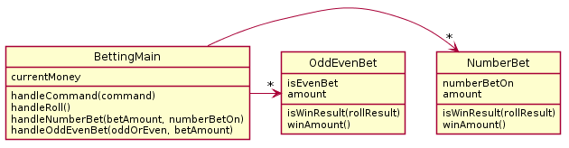
UML as it currently stands
What do you need to add?
What do the Bet classes have in common?
Notes:
Can ask students to draw this out themselves to make sure they can translate from code to UML and then show this to verify they understood what they needed to write.
@startuml
class BettingMain {
currentMoney
handleCommand(command)
handleRoll()
handleNumberBet(betAmount, numberBetOn)
handleOddEvenBet(oddOrEven, betAmount)
}
class NumberBet {
numberBetOn
amount
isWinResult(rollResult)
winAmount()
}
class OddEvenBet{
isEvenBet
amount
isWinResult(rollResult)
winAmount()
}
BettingMain -> "*" NumberBet
BettingMain -> "*" OddEvenBet
@enduml

Slide 15
Hints
Your interface will likely be called Bet
You should have 3 classes implementing Bet, one for each of the current types of bets in the code, one for the new one you’re being asked to implement
You’ll need to update the lists in main to a single ArrayList<Bet> (or some other storage method to main)

Slide 16
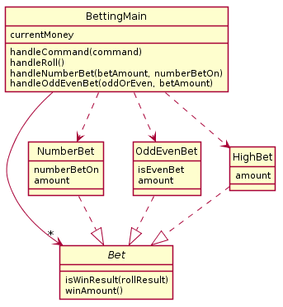
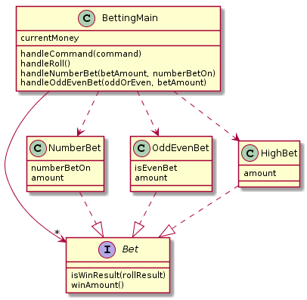
UML Solution
Using:
skinparam style strictuml
Notes:
@startuml
skinparam style strictuml
class BettingMain {
currentMoney
handleCommand(command)
handleRoll()
handleNumberBet(betAmount, numberBetOn)
handleOddEvenBet(oddOrEven, betAmount)
}
interface Bet {
isWinResult(rollResult)
winAmount()
}
class NumberBet {
numberBetOn
amount
}
class OddEvenBet{
isEvenBet
amount
}
class HighBet{
amount
}
BettingMain ->"*" Bet
BettingMain .-> HighBet
BettingMain .-> NumberBet
BettingMain .-> OddEvenBet
HighBet .-|> Bet
NumberBet .-|> Bet
OddEvenBet .-|> Bet
@enduml

