Slide 1
Object Intro and Miscellaneous
The git projects for today are:
PracticeObjectIntroAndMisc
PracticeObjectIntroAndMiscSolution

Slide 2
Agenda
Coding Conventions, Style, Grading
Debugging
Objects and Classes

Slide 3
Writing clean code
Comments are only the last resort

Slide 4
Functions
Give functions descriptive names
Don’t make functions too long
Rather than commenting an unclear function, modify the code so it is clear

Slide 5
Naming in Java
Having good names for functions and variables is one of the best things you can do to make your program understandable
The conventions:
variableNamesLikeThis
methodNamesLikeThis(…)
ClassNamesLikeThis
You should follow the conventions!

Slide 6
Javadoc comments
/**
* Has a static method for computing n!
* (n factorial) and a main method that
* computes n! for n up to Factorial.MAX.
*
* @author Mike Hewner & Delvin Defoe
*/
public class Factorial {
/**
* Biggest factorial to compute.
*/
public static final int MAX = 17;
/**
* Computes n! for the given n.
*
* @param n
* @return n! for the given n.
*/
public static int factorial (int n) {
...
}
...
}
Java provides Javadoc comments (they begin with /**) for both:
Internal documentation for when someone reads the code itself
External documentation for when someone re-uses the code
Notes:
We require Javadoc comments for classes and any “significant” method. If Javadoc comments are already provided for methods (e.g., instructions…) they do not need to add any further.
Most “conventions” mention that you should have Javadoc comments for each class member variable, but we DON’T require that.
Students often have trouble distinguishing between these and regular comments, it is good to take a bit and explain that there are different types of comments, and they each are used for different reasons.

Slide 7
Writing Javadocs
Written in special comments: /** … */
Can come before:
Class declarations
Field declarations
Constructor declarations
Method declarations
Eclipse is your friend!
It will generate Javadoc comments automatically
It will notice when you start typing a Javadoc comment
Notes:
We can continue to repeat this by modeling the idea whenever we write code.
That requires discipline on our part. It’s easy to blow off writing the docs in class in the interest of time, but this may be modeling bad behavior.

Slide 8
In all your code:
See: https://github.com/RHIT-CSSE/csse220/blob/master/Docs/grading_guide.md
Write appropriate comments:
Javadoc comments primarily for classes.
Explanations of anything else that is not obvious in any spot.
Give self-documenting variable and method names:
Use name completion in Eclipse, Ctrl-Space, to keep typing cost low and readability high
Use Ctrl-Shift-F in Eclipse to format your code.
Q1

Slide 9
Agenda
Coding Conventions, Style, Grading
Debugging
Objects and Classes

Slide 10
Debugging
Notes:
Breakpoint: tells debugger where to pause the program
Single stepping: moving through a program one line at a time
Inspecting variables: using debugger to examine values of variables at a particular point in the execution

Slide 11
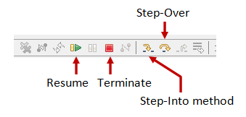
Debugging—Demo
Debugging Java programs in Eclipse:
Set a breakpoint where you want to start
Launch using the bug icon
Single stepping: step over and step into
Inspecting variables
Q2-4
Notes:
[Demonstrate the techniques in Eclipse by solving a problem or two from DebugMeTest together, give them time to answer the quiz question, then have them complete DebugMeTest.]
[You can also point them to WhackABug to get more practice when running a Java Application instead of JUnit)]
DebugMeTest make sure to demo:
uppercaseIfExclaimation which ends up showing the gotcha “string are immutable” in two slides

Slide 12
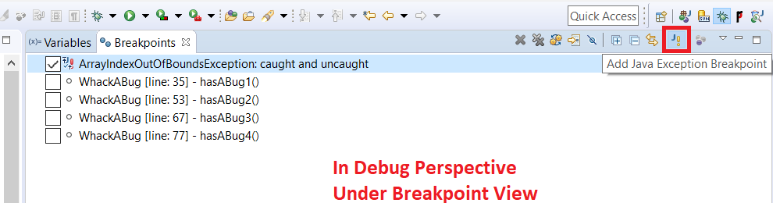
Exception Breakpoint
Very useful when an exception is happening but you don’t know where or why
Exception Tab
Exclamation point button
Find the exception type you want
Add a breakpoint
Notes:
Only spend time on this if you want to show the DebugMeTest examples, in particular the final test which you can use to demonstrate this approach.

Slide 13
Important gotcha: Strings in java are immutable
No method on the string class will modify the content of a string
All methods instead return a new string
Notes:
uppercaseIfExclaimation ends up showing this

Slide 14
Agenda
Coding Conventions, Style, Grading
Debugging
Objects and Classes

Slide 15
Object Basics

Slide 16
Class – What, When, Why, & How?
What:
A blueprint for a custom type
When:
Define a class when you’re representing a concept (think nouns)
When no other existing type can do what you want/need

Slide 17
Class – What, When, Why, & How?
Why:
Keep similar concepts together
Encapsulation (we’ll expand on this next time)
How:
public class ClassName {
//fields
//methods
}

Slide 18
Using Objects and Methods
“Who does what, with what?”
Works just like Python:
object.method(argument, ...)
You’ve been using this in Java:
Implicit argument
Explicit arguments
HashMap<String, Integer> scores = new HashMap<>();
scores.put(“Bob”, 78);
String name = "Bob Forapples";
int nameLen = name.length();

Slide 19
Constructors – What, When, Why, How?
What:
Special method called when a new instance of a class is created
Initializes the new instance
Like the __init__ method in Python
When:
Define a constructor when special initialization of a class is required
Otherwise, Java implicitly creates a no-argument constructor if you don’t add one

Slide 20
Constructors – What, When, Why, How?
Why:
Allows you to ensure that a new instance of a class is a setup exactly how it needs to be before use of other methods/fields
Puts it in a good state
How: always has the same name as the class.
public class MyClass {
public MyClass() {
//initialization code
}
public MyClass(ParamType paramName) {
//initialization code
}
}

Slide 21
Object Constructors
int num = 5;
This works for primitive typed data
What about “objects” (made from classes)?

Slide 22
Using Constructors
The constructor arguments specifies that the new rectangle called box should be at the origin with a height and width of 5.
In Java, all variables must have a type
Rectangle box = new Rectangle(0, 0, 5, 5);
Every variable must have a name.
The new operator is what actually makes the new object, in this case a new rectangle.
Q5
Notes:
Argument for main is not optional. Must be there.

Slide 23
Object Constructors
Open BankAccount.java
Let’s do the first few, then work on your own
When you’re done and it works, solve the last quiz question

Slide 24
Practice
Work in SmallClassProbs filling out ClassA.java, ClassB.java and ClassC.java
should work with the tests provided in ClassTests.java

Slide 25
Now code the StudentAssignments class yourself
Uncomment the stuff in StudentAssignmentsMain to see what the class ought to do
Then create the class and add the constructors and methods you need
If you finish early, add a function to compute the student’s average grade
Notes:
Do not spend too much time on this since students will need time outside of class to complete this. Be sure to reserve time for the rest of the material and for students to complete the quiz.

