Slide 1
CSSE 220
Object & Polymorphism
The git projects for today are:
PracticeIPolymorphism
PracticeIPolymorphismSolution
Notes:
Bring code for all the classes in PolymorphismSolution that have TODO items. Highlight the TODO items so you can keep moving.
Bring code for Ball and Pulsar from BallWorldsSolution.
Bring BallWorlds DesignQuestions Quiz. The UML design is linked from the instructions page.

Slide 2
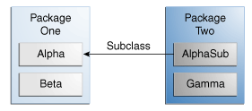
Access Levels: Review
Modifier | Class | Package | Subclass | World
public | Y | Y | Y | Y
protected | Y | Y | Y | N
no modifier | Y | Y | N | N
private | Y | N | N | N
Notes:
This can be used to help demonstrate that instance variables/methods INSIDE Alpha will be accessible by various other classes

Slide 3
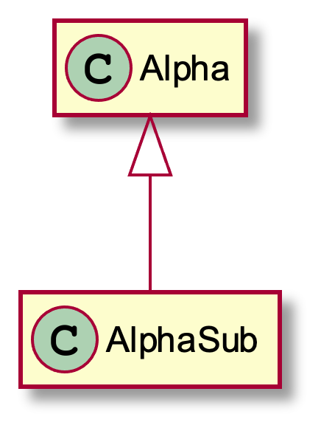
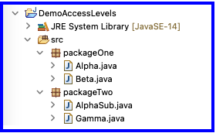
Access Levels: Review
Modifier used in Alpha | Alpha | Beta's access to Alpha | AlphaSub's access to Alpha | Gamma's access to Alpha
public | Y | Y | Y | Y
protected | Y | Y | Y | N
no modifier | Y | Y | N | N
private | Y | N | N | N
Notes:
This can be used to help demonstrate that instance variables/methods INSIDE Alpha will be accessible by various other classes

Slide 4
Abstract Classes: Review
Hybrid of superclasses and interfaces
Like regular superclasses:
Provide implementation of some methods
Like interfaces
Just provide signatures and docs of other methods
Can’t be instantiated
Notes:
PARTIALLY COMPLETED (CANNOT INSTANTIATE ABSTRACT CLASS)
BETWEEN INTERFACE AND ACTUAL SUPERCLASS
The main reason for using Abstract classes is to force programmers to create subclasses. Declaring certain methods abstract prevents you from coming up with useless default methods that others might inherit by accident.
This also allows code reuse when only a few methods of an interface differ in implementation.

Slide 5
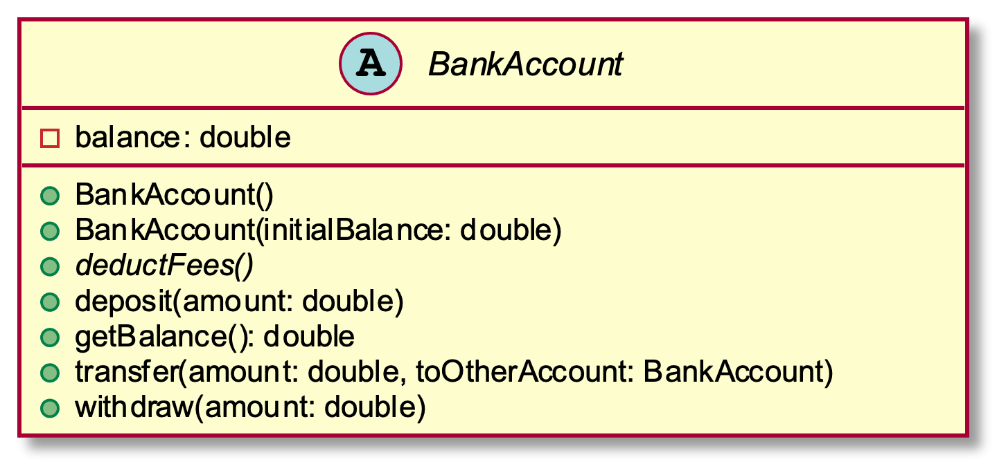
Abstract Class Example - UML
As appears in class diagram
UML code for abstract class
abstract class BankAccount {
-balance: double
+BankAccount()
+BankAccount(initialBalance: double)
+deposit(amount: double)
+getBalance(): double
{abstract}+deductFees()
+transfer(amount: double, toOtherAccount: BankAccount)
+withdraw(amount: double)
}

Slide 6
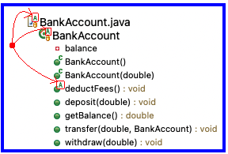
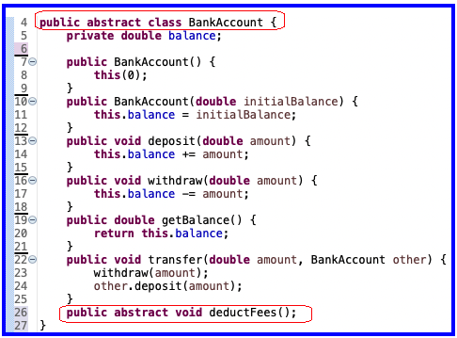
Abstract Class Example - Eclipse
Eclipse Package Explorer
Java code for abstract class

Slide 7
UML Class Diagram Review
Inheritance, Associations, and Dependencies

Slide 8
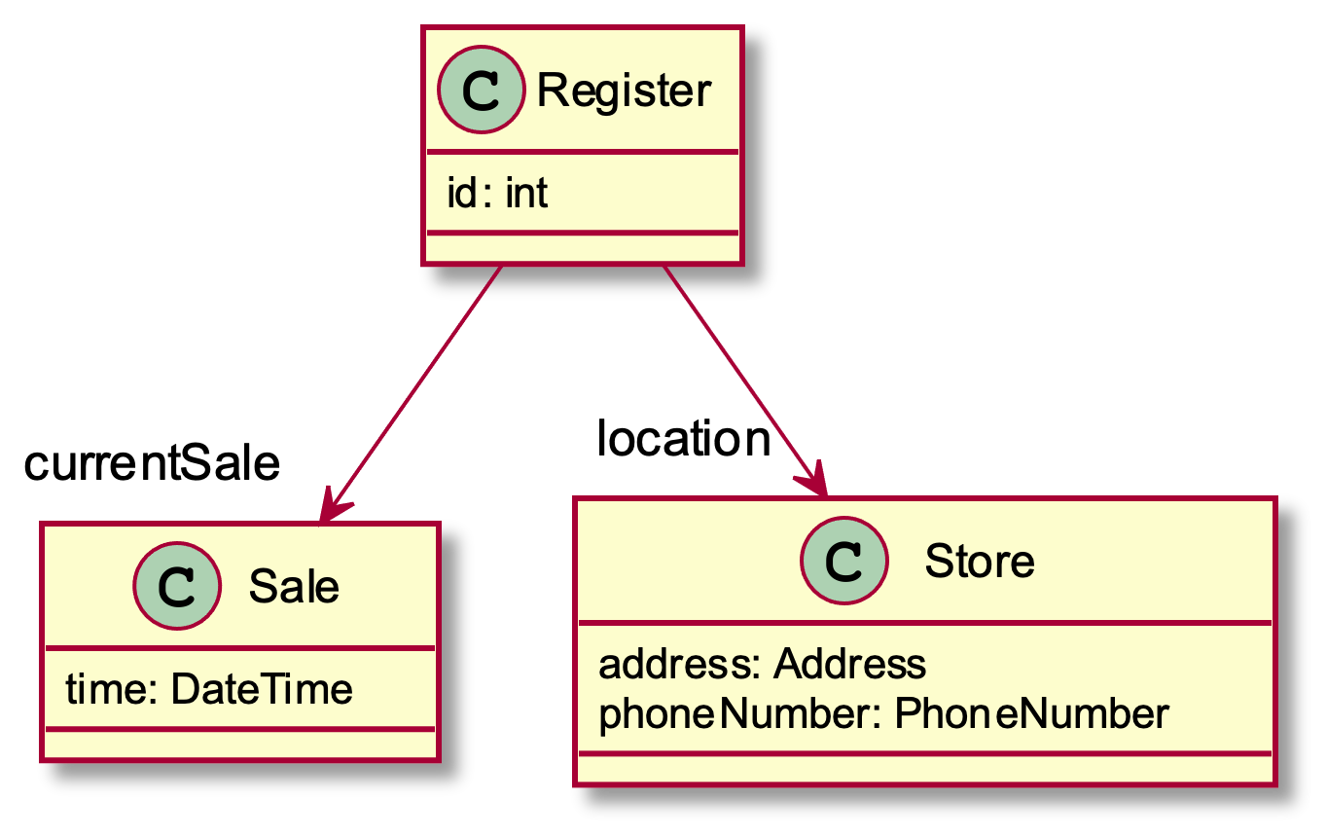
Recall UML: Associations
Solid line, open arrowhead = “has-a”
Answer me this:
Register has how many fields?
What are their names?
PlantUML code for placing field name at arrowhead:
Register -down->"currentSale" Sale
Register -down->"location" Store
Notes:
Showing Sale & Store attributes as associations visually emphasizes relationships important in object collaboration
[How many attributes does Register have? 3
What are their names? Id, currentSale, and location]

Slide 9
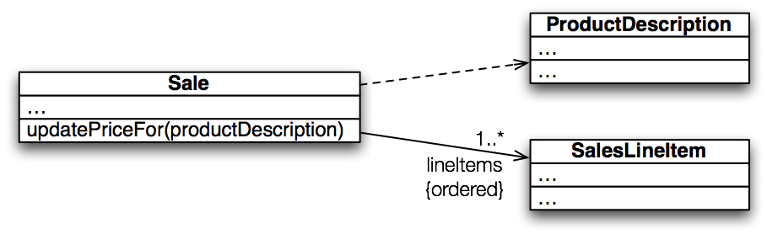
Recall UML: Dependencies
Dependency lines are dashed
Field association lines are solid
Use association lines only when an item is stored as a field. Solid = stronger rel.
Two types of open arrowheads
Notes:
A dependency is a “using relationship” that states a change in specification of one thing may affect another thing that uses it
>>>On board (and quiz): global variable, parameter, local variable, static method call
[Which of these are we showing here? Parameter]
• labels

Slide 10
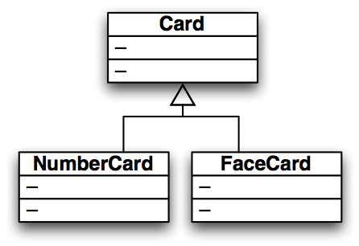
Recall UML: Inheritance
Generalization (superclass)
Specialization (subclass)
Closed arrowhead = “is-a”. Two types: solid line= inherits, dotted line = implements. Solid = stronger rel.

Slide 11
I, Object
The superest class in Java

Slide 12
Object
Every class in Java inherits from Object
Directly and explicitly:
public class String extends Object {…}
Directly and implicitly:
class BankAccount {…}
Indirectly:
class SavingsAccount extends BankAccount {…}
Q1
Notes:
Q1: If a class doesn't have an "extends" in its declaration, does it have a superclass? If not, why not? If so, what is its superclass? [Yes, Object]

Slide 13
Object Provides Several Methods
String toString()
boolean equals(Object otherObject)
Class getClass()
Object clone()
…
Often overridden
Sometimes useful
Often dangerous!
Q2
Notes:
Q2: Which of the methods provided by Object is considered dangerous by many programmers? [clone()]
Effective Java includes a seven page description on overriding clone():
“[You] are probably better off providing some alternative means of object copying or simply not providing the capability.”

Slide 14
Overriding toString()
Return a concise, human-readable summary of the object state
Very useful because it’s called automatically:
During string concatenation
For printing
In the debugger
getClass().getName() OR getClass().getSimpleName() comes in handy here…
Q3
Notes:
Q3: What method(s) provide the name of the class that an object was created as? [ getClass().getName() ]
See TODO 1-3 in banking package, use getClass().getSimpleName(), show in debugger also.
getName() includes package name while getSimpleName() does not.
@Override
public String toString() {
return String.format("%s with a balance of %6.2f",
getClass().getName(), this.balance);
}

Slide 15
Overriding equals(Object o)
equals(Object foo) – should return true when comparing two objects of same type with same “meaning”
How?
Must check types—use instanceof OR getClass().isAssignableFrom(foo.getClass())
Must compare state—use cast
Recall casting a variable: Taking an Object of one particular type and “turning it into” another Object type
Q4
Notes:
Q4: If a class doesn’t override the equals() method, what does the inherited equals() do? [It works just like ==, comparing references.]
Discuss: does it make sense to compare state on BankAccounts? Not unless we have an account ID.
Implement equals() for SafeDepositBox (TODO 4)
Leaving code for today. Could mention the provided sample code for using inheritance to build a GUI, plus using text input. But to give more time for BallWorlds, we aren’t going through that example.

Slide 16
Polymorphism
Review and Practice

Slide 17
Recall: Polymorphism and Subclasses
A subclass instance is a superclass instance
Polymorphism still works!
BankAccount ba = new SavingsAccount(); ba.deposit(100);
But not the other way around!
SavingsAccount sa = new BankAccount(); sa.addInterest();
Why not?
BOOM!
Notes:
Don’t draw this one again, just discuss briefly.

Slide 18
Summary
If B extends or implements A, we can write
A x = new B();
Declared type tells which methods x can access. Compile-time error if try to use method not in A.
The actual type tells which class’ version of the method to use.
Can cast to recover methods from B:
((B)x).foo()
Now we can access all of B’s methods too.
If x isn’t an instance of B, it gives a run-time error (class cast exception)
Notes:
[4 stage build]

Slide 19
Determining Method at Runtime
Step 1: Identify the Declared/Casted Type
This is the item to the left of the variable name when the variable was declared:
BankAccount sa = new SavingsAccount();
Declared Type may be changed due to a cast:
((SavingsAccount)sa).addInterest();
If there is a casted type, record that, otherwise use the declared type.
Declared Type
Casted Type

Slide 20
Determining Method at Runtime
Step 2: Identify the Instantiation/Actual Type
This is the type on the right hand side of the equal sign the last time the variable was assigned to:
BankAccount sa = new SavingsAccount();
Record the instantiation type
Instantiation Type

Slide 21
Determining Method at Runtime
Step 3: Check for Compilation Errors
Calling a method that is not available based on the declared or casted type of the object
BankAccount sa = new SavingsAccount();
sa.addInterest();
Compiler Error: BankAccount does not have addInterest
Incompatible type assignment
SavingsAccount x = new BankAccount();
Compiler Error: BankAccounts can not be stored in SavingAccount typed variables
Invalid cast: casting to a type that isn’t in the tree below the declaration type.
BankAccount sa = new SavingsAccount();
((SafetyDepositBox)sa).depositItem();
SafetyDepositBox is not below BankAccount.
Cannot instantiate interfaces or abstract classes!
Notes:
Draw UML on the board for accounts
Account
|
/ \
SafetyDepositBox BankAccount
/ \
SavingsAccount CheckingAccount

Slide 22
Determining Illegal Type Casts
Step 4: Check for Runtime Errors
Runtime errors are caused by invalid casting
A legal type cast is one where:
The instantiation type matches the casted type
The casted type is in the inheritance hierarchy below class Object and above the instantiation type
All other type casts are illegal and will cause a runtime error
Notes:
Draw UML on the board for accounts
Account
|
/ \
SafetyDepositBox BankAccount
/ \
SavingsAccount CheckingAccount

Slide 23
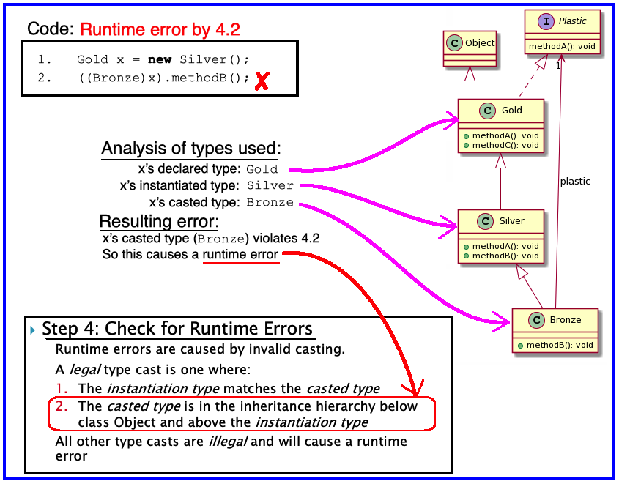
Example: Determining Illegal Type Casts
Step 4: Check for Runtime Errors
Notes:
Draw UML on the board for accounts
Account
|
/ \
SafetyDepositBox BankAccount
/ \
SavingsAccount CheckingAccount

Slide 24
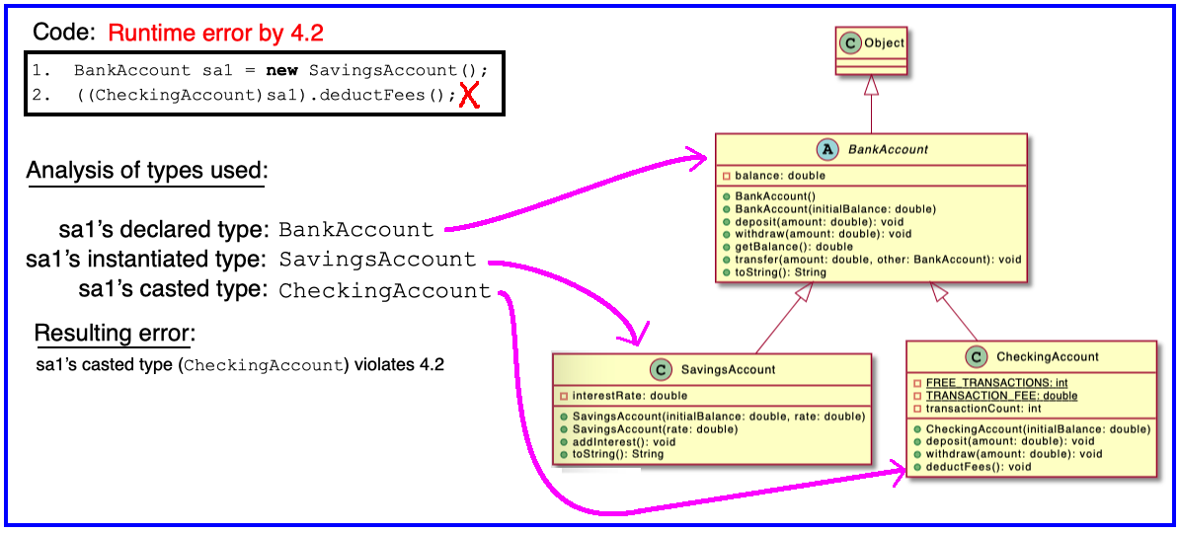
Example: Determining Illegal Type Casts
Step 4: Check for Runtime Errors
Notes:
Draw UML on the board for accounts
Account
|
/ \
SafetyDepositBox BankAccount
/ \
SavingsAccount CheckingAccount

Slide 25
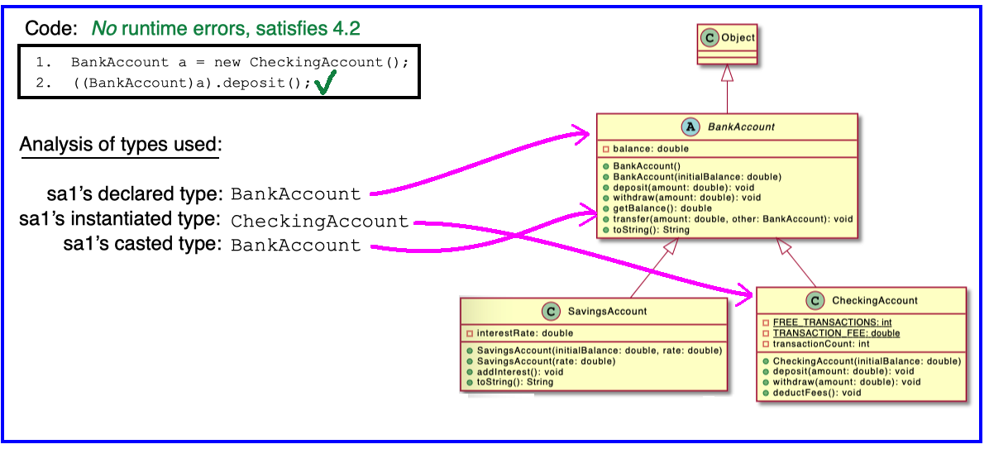
Example: Determining Illegal Type Casts
Step 4: Check for Runtime Errors
Notes:
Draw UML on the board for accounts
Account
|
/ \
SafetyDepositBox BankAccount
/ \
SavingsAccount CheckingAccount

Slide 26
Determining Method at Runtime
Step 5: Find Method to Run
Find the instantiation type in the hierarchy.
If that type implements the given method, then use that implementation.
Otherwise, move up to the parent type and see if there’s an implementation there.
If there is an implementation, use that.
Otherwise, repeat step 2 until an implementation is found.
Notes:
Draw UML on the board for accounts
Account
|
/ \
SafetyDepositBox BankAccount
/ \
SavingsAccount CheckingAccount

Slide 27

Exercise
Do questions 5 through 7 from Quiz.
Please hand them in when done and then start reading the BallWorlds specification on your schedule page.
Q5-7, hand in when done, then start reading BallWorlds spec
Notes:
Changes to the “depended on” thing may necessitate changes to the dependent thing. So we want to (1) minimize dependencies and (2) structure dependencies to point to the more stable pieces.

Slide 28
Determing Method at Runtime
Step 1: Identify the Declared/Casted Type
DeclaredType var = …. (can change!)
CastedType var2 = (CastedType)var;
Step 2: Identify the Instantiation/Actual Type
(Never changes! To the right of original “= new *”)
…= new InstantiatedType();
Step 3: Check for Compilation Errors
Method not available based on declared/casted type
Incompatible type assignment: Dog x = new Cat()
Invalid cast: casting to type not below declaration type
Step 4: Check for Runtime Errors
Instantiation type must matches casted type OR
Casted type is between declaration and instantiation type
Step 5: Find Method to Run
Start with instantiation type and look to super class!
Notes:
Optional: look in solution code for sample of create 4 minimal classes and playing around with what happens when you add and remove methods at different levels.

Slide 29
ByoGUI Worktime
Notes:
[Live code Pulsar together.]

