Slide 1
CSSE 220
Java Primitive Types
Java Wrapper Types

Slide 2
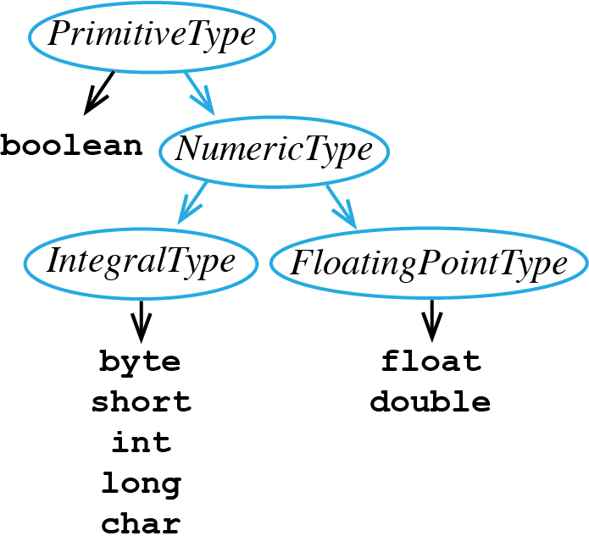
Review of Java’s Primitive Types
Here is the breakdown:
boolean – used for storing true or false
IntegralType – used for storing Integer numbers
FloatingPointType - used for storing numbers with digits to right of decimal point

Slide 3
Declaring a Primitive Variable
Use these Java keywords

Slide 4
A Client Program Using boolean
Notice the following lines:
#4 variable b1 declared and initialized
#6 (5 < 10) evaluates to true, so true is assigned to b1
#7 if evaluates b1 and sees it stores true, so then branch is taken
#8 outputs "b1 = true"
1 public class BooleanClient {
2
3 public static void main(String[] args) {
4 boolean b1 = false;
5
6 b1 = (5 < 10);
7 if(b1) {
8 System.out.println("b1 = true");
9 } else {
10 System.out.println("b1 = false");
11 } // end if
12 } // main
13 } // end class BooleanClient

Slide 5
A Client Program Using int
Notice the following lines:
#4 variables x1 and x2 declared
#6 x1 is set to 17
#7 x2 gets result of x1 divided by 2, this is integer division, so the result is truncated
#8 outputs "x1 = 17"
#9 outputs "x2 = 8"
1 public class IntClient {
2
3 public static void main(String[] args) {
4 int x1, x2;
5
6 x1 = 17;
7 x2 = x1 / 2;
8 System.out.println("x1 = " + x1);
9 System.out.println("x2 = " + x2);
10 } // main
11 } // end class IntClient

Slide 6
A Client Program Using double
Notice the following lines:
#4 variables f1 and f2 declared
#6 f1 is set to 17.5
#7 f2 gets result of f1 divided by 2, this is floating point division, so the result is a double
#8 outputs "f1 = 17.5"
#9 outputs "f2 = 8.75"
1 public class DoubleClient {
2
3 public static void main(String[] args) {
4 double f1, f2;
5
6 f1 = 17.5;
7 f2 = f1 / 2;
8 System.out.println("f1 = " + f1);
9 System.out.println("f2 = " + f2);
10 } // main
11 } // end class DoubleClient

Slide 7
IntegralType Values
Below are the ranges of legal values for all IntegralTypes:
byte [-128, 127]
short [-32768, 32767]
int [-2147483648, 2147483647]
long [-9223372036854775808, 9223372036854775807]
char [0, 65535] for representing UTF-16 code units from '\u0000' to '\uffff'
Source: Java Language Specification, Java SE 14 Edition

Slide 8
IntegralType Sizes
Question:
Why can a variable of type long store bigger numbers than an int?
int [-2147483648, 2147483647]
long [-9223372036854775808, 9223372036854775807]
Answer:
Storing a number requires computer memory, each primitive variable is allocated a different amount of memory
int 32 bits are allocated
long 64 bits are allocated
Source: Java Language Specification, Java SE 14 Edition

Slide 9
Wrapper Classes
primitive type | wrapper class
boolean | Boolean
byte | Byte
char | Character
short | Short
int | Integer
long | Long
float | Float
double | Double
Java is an object-oriented language
A primitive type is not an object in Java
Sometimes, Java requires us to use objects, not primitive types
So Java provides object versions of each primitive type
These are called wrapper classes

Slide 10
Wrapper Class Example
primitive type | wrapper class
boolean | Boolean
byte | Byte
char | Character
short | Short
int | Integer
long | Long
float | Float
double | Double
Line #4 declares an Integer object x1 which stores (and wraps) int values
Line #5 declares the a1 (an object instance) to be an ArrayList that holds Integer objects
Line #7 calls an ArrayList method add x1 to insert x1 at the right end of a1
Line #8 outputs "Location zero of a1 = 31"
Finally it is illegal to declare an ArrayList to hold type int, so Integer must be used
1 import java.util.ArrayList;
2 public class WrapperClient {
3 public static void main(String[] args) {
4 Integer x1 = 31;
5 ArrayList<Integer> a1 = new ArrayList<Integer>();
6
7 a1.add(x1);
8 System.out.println("Location zero of a1 = " + a1.get(0));
9 } // main
10 } // end class WrapperClient

Slide 11
Terminology Review
client – uses the services of a primitive type or class by declaring variables from these types and then calling operations to manipulate these variables
object – a variable that stores a reference to an object instance
primitive type – boolean, byte, character, short, int, float, double variables of these these types are not objects in Java
variable – stores either primitive data (e.g., from type int) or reference data (i.e., a reference to an object instance)
wrapper class – a built-in Java class that turns a Java primitive type into an object version of the primitive type, e.g., Integer wrapper class is an object version of the primitive type int

