Slide 1
Making a Runnable JAR
CSSE220 - Final Project

Slide 2
How to Demo/Share Your Project with Others
Can share your source code (forces people to compile/run)
Easier to share a RUNNABLE file
You can EXPORT your Eclipse project as a Runnable file
Java uses JARs that can be run from anywhere with Java support
Code runs on a Virtual Machine that is translated to whatever hardware the host machine is running
Portability (write once run everywhere) is one great features of Java

Slide 3
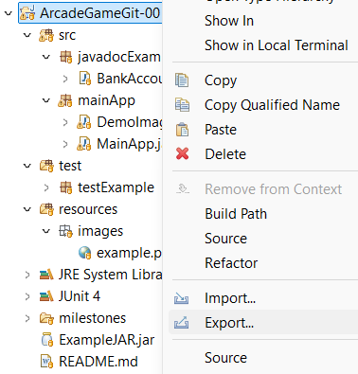
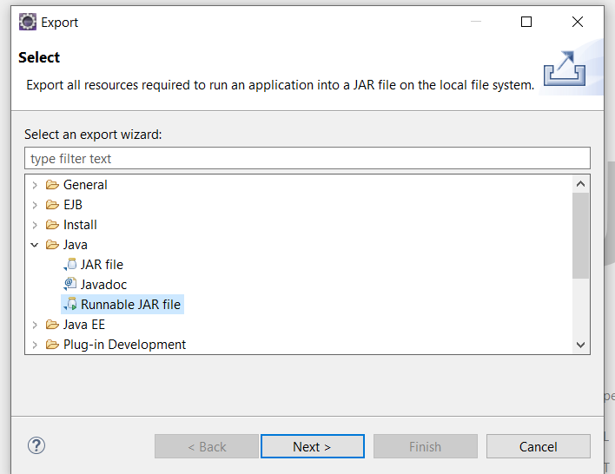
How To Do This in Eclipse
Right Click ->
Export
Java ->
Runnable JAR File

Slide 4
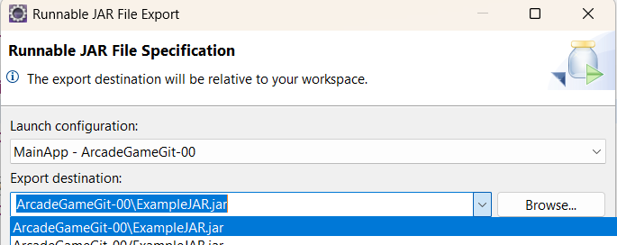
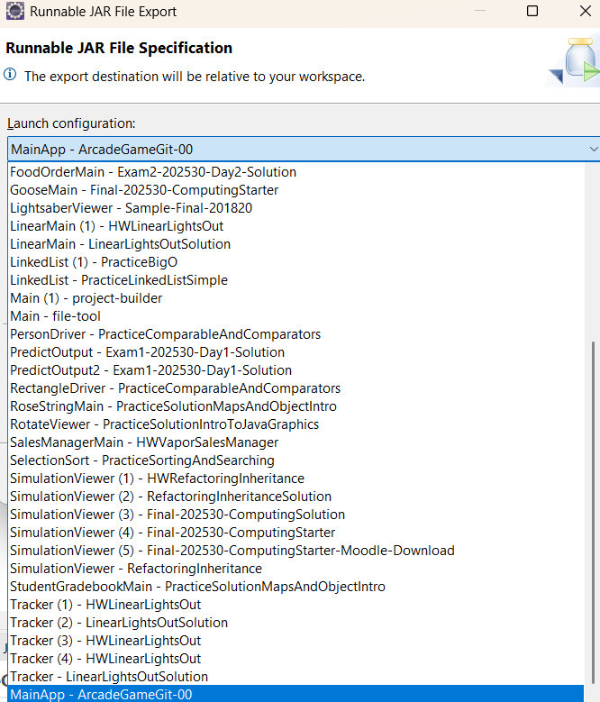
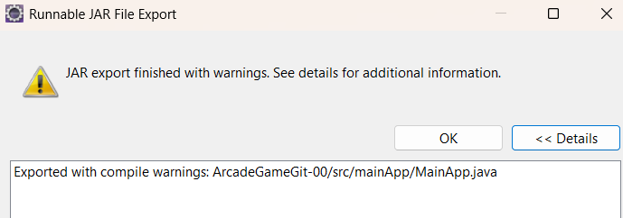
If you have run the final project you should be able to select it to run here.
Don’t worry about warnings…

Slide 5
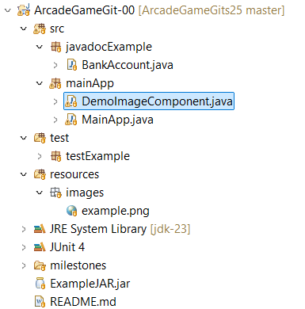
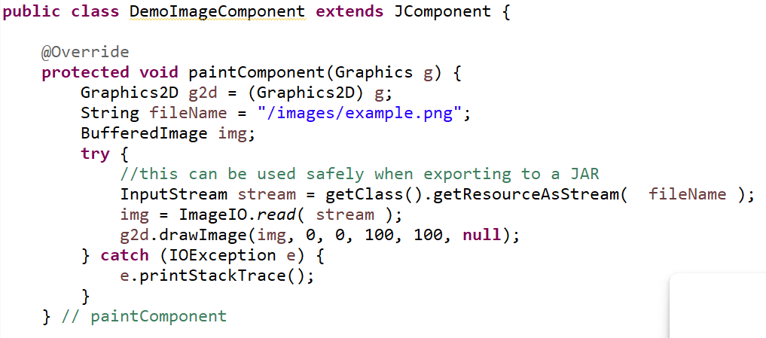



Example In Starter Repo

Slide 6
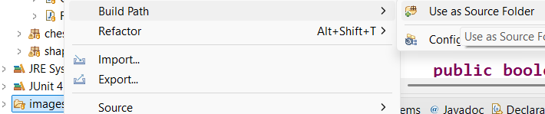
Added folders but they aren’t on the build path?
Add the images folder to the build path (.classpath)
Right click on the Folder->Build Path->Use as Source Folder
Now the files are considered part of the root and you don’t need to reference the folder:
String fileName = "/" + name.toLowerCase() + "-";

Slide 7
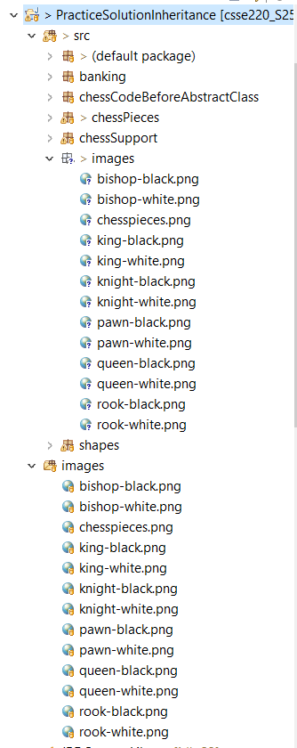
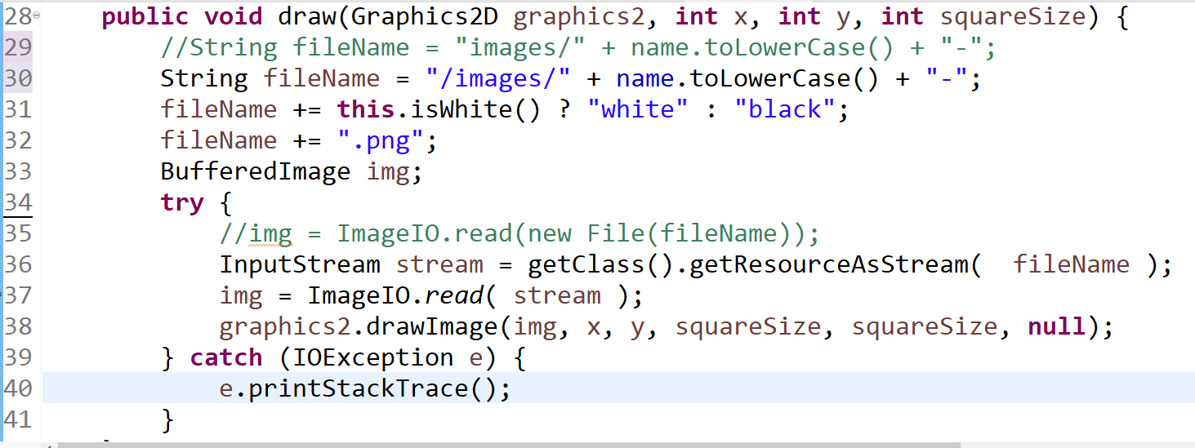







Another way to make sure you have access to all your resources (images/audio/etc) is to copy them into the src folder.

Slide 8
Demo Code – ChessPiece.java
//String fileName = "images/" + name.toLowerCase() + "-";
String fileName = "/images/" + name.toLowerCase() + "-";
fileName += this.isWhite() ? "white" : "black";
fileName += ".png";
BufferedImage img;
try {
//img = ImageIO.read(new File(fileName));
InputStream stream = getClass().getResourceAsStream( fileName );
img = ImageIO.read( stream );
graphics2.drawImage(img, x, y, squareSize, squareSize, null);
} catch (IOException e) {
e.printStackTrace();
}

