Slide 1
! IMPORTANT NOTE !
Role are defined to provide structure as much as is helpful
These do NOT need to be rigid roles, they can be flexible
e.g. Adam might cover some work for Becky, Becky for Adam
e.g. Someone might have an emergency and unable to contribute briefly
Most important is to work as a TEAM
Everyone should have a chance to speak their ideas
Everyone should respect one another and listen to new ideas with openness
Everyone should have an opportunity to make contributions
Everyone should make contributions (to code and otherwise)
Everyone should be helping one another

Slide 2
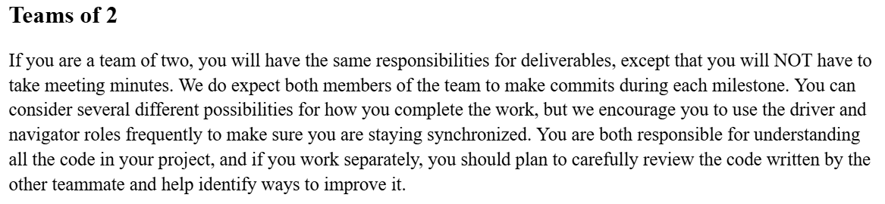
RND+T – Reviewer, Navigator, Driver, Tester

Slide 3
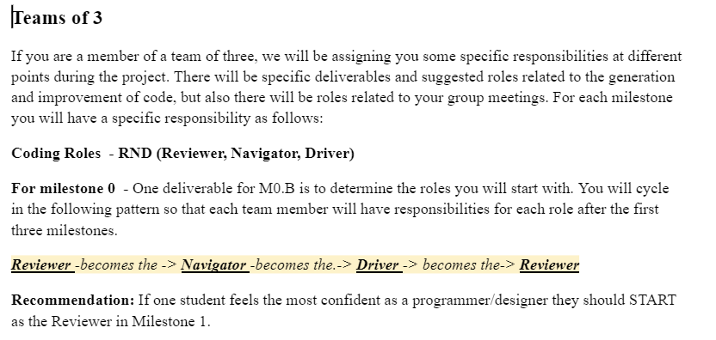
RND+T – Reviewer, Navigator, Driver, Tester

Slide 4
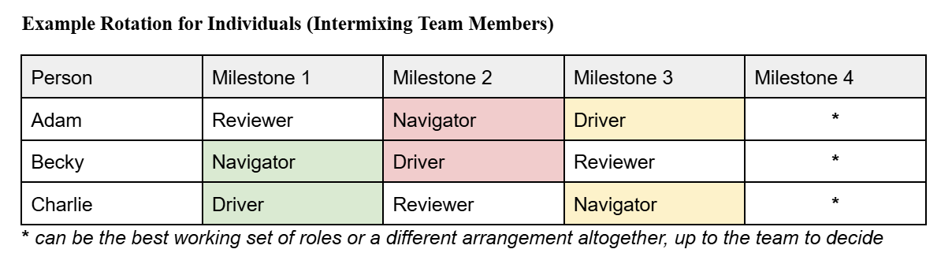
Rotations for Teams of 3

Slide 5
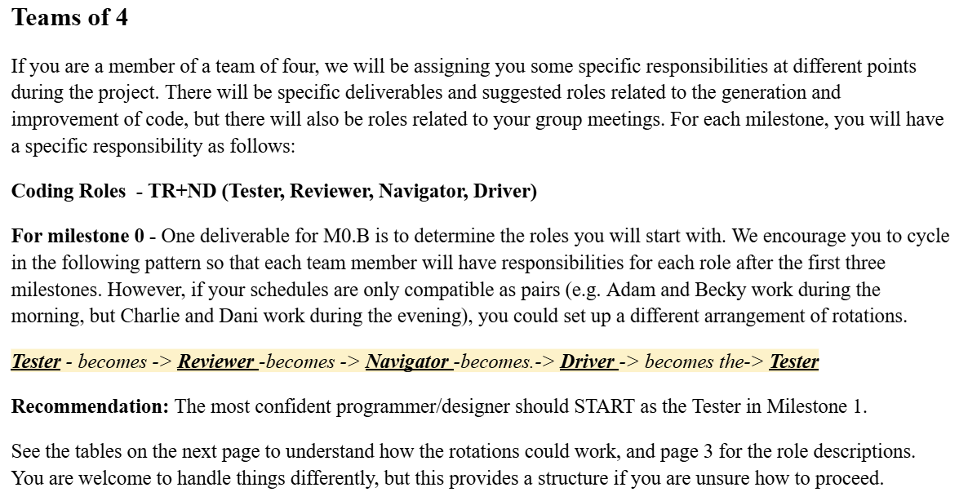
RND+T – Reviewer, Navigator, Driver, Tester

Slide 6
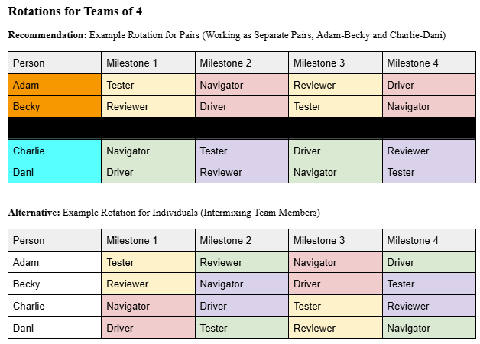
Possible Rotations for Teams of 4

Slide 7
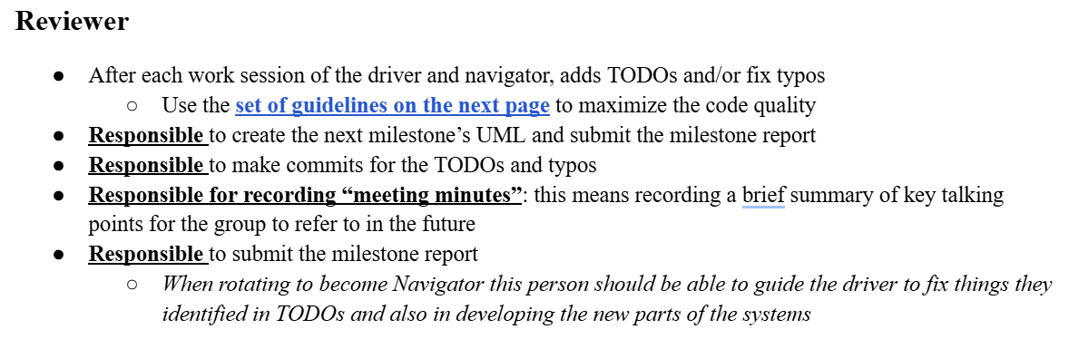

Reviewer

Slide 8
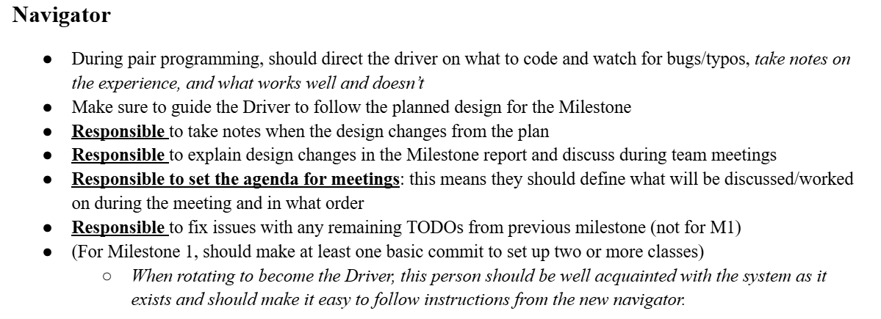

Navigator

Slide 9
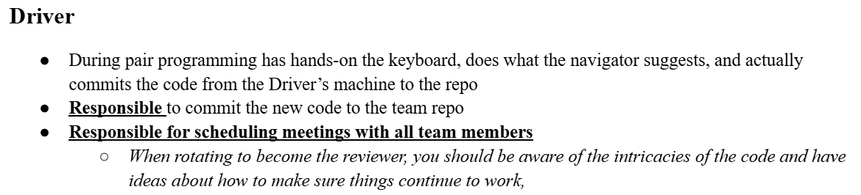

Driver

Slide 10
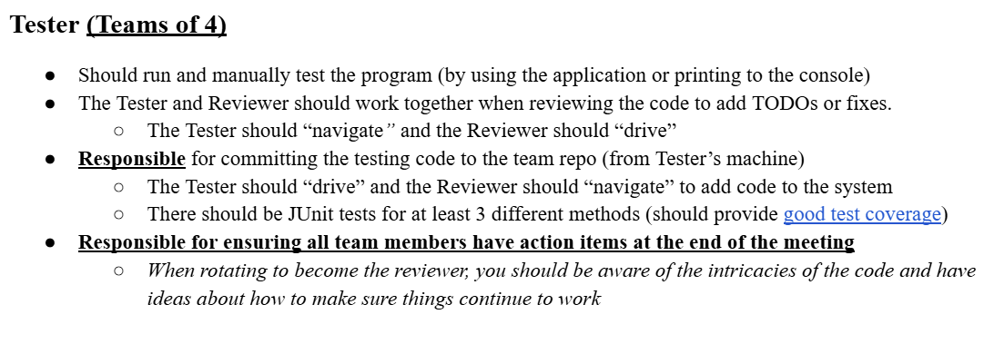


Tester (Teams of 4)

