Slide 1
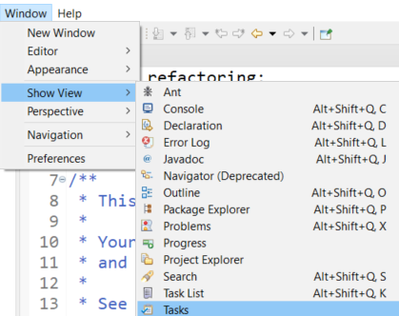
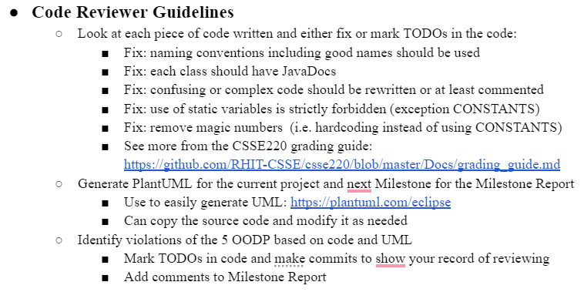


Code Review Guidelines

Slide 2


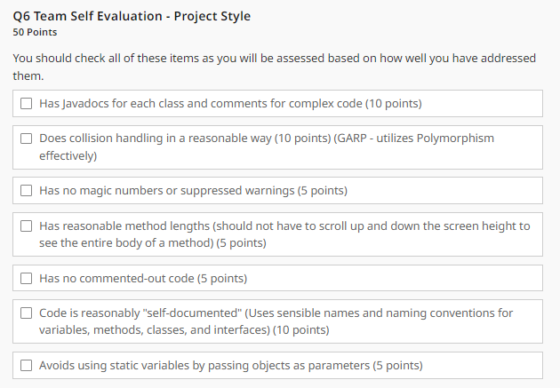
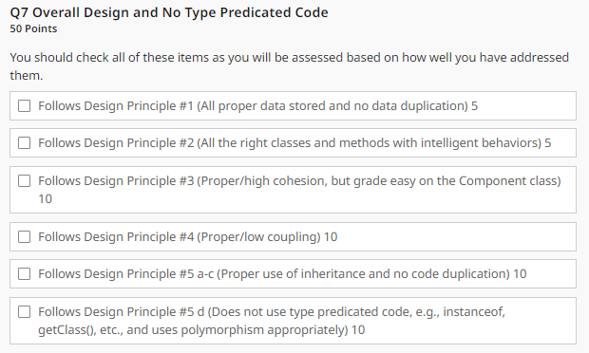
Final Style and Design Rubric

Slide 3
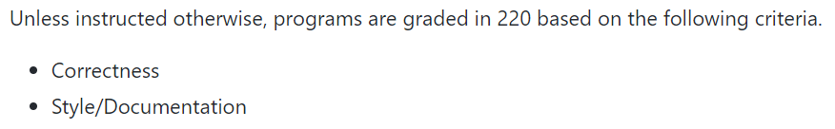
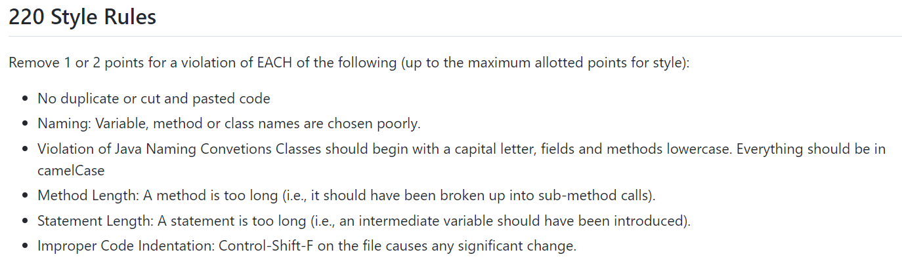
CSSE220 Grading Instructions
https://github.com/RHIT-CSSE/csse220/blob/master/Docs/grading_guide.md

Slide 4
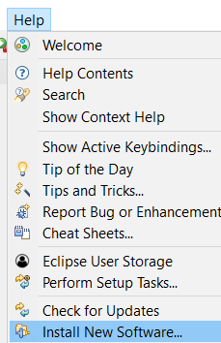
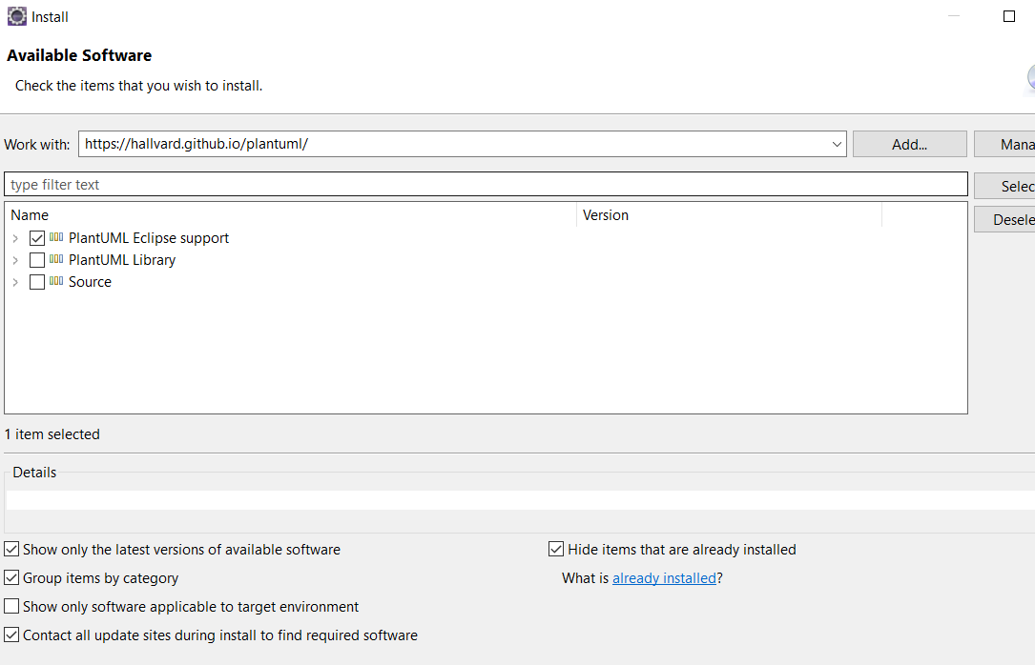

https://hallvard.github.io/plantuml/

Slide 5
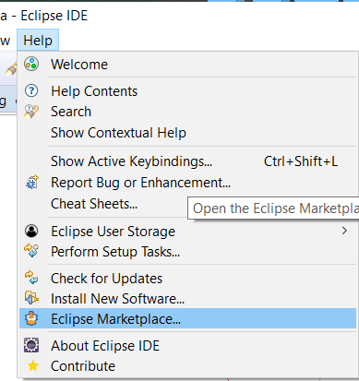
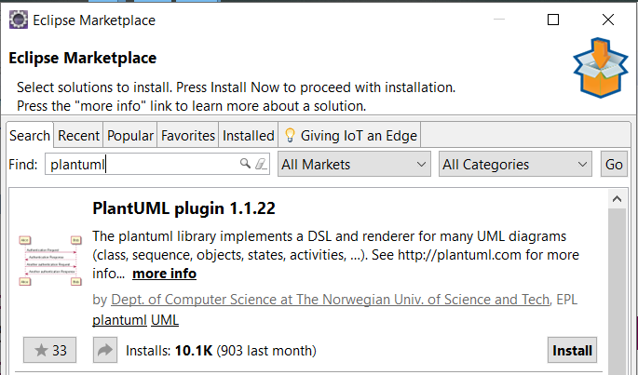
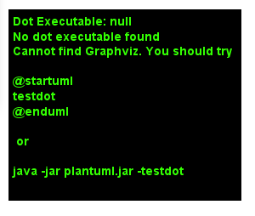


PlantUML Eclipse Plugin
https://plantuml.com/eclipse
https://graphviz.gitlab.io/download/
Windows Stable Installed (msi)
Install Graphviz
Notes:
This functionality broke in Spring 2025, it might work, but hiding it in the slides for now

Slide 6
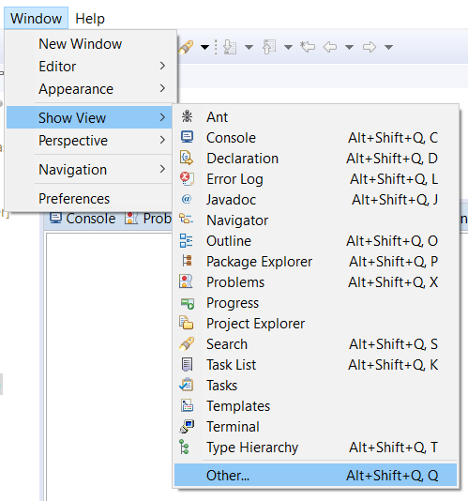
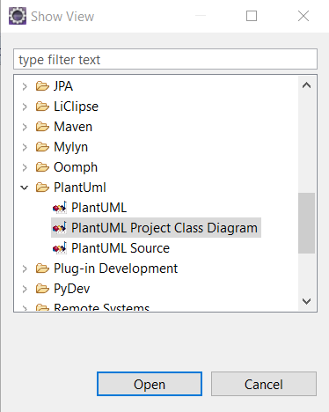
PlantUML Eclipse Plugin

Slide 7
Generating the UML from Existing Classes

Slide 8
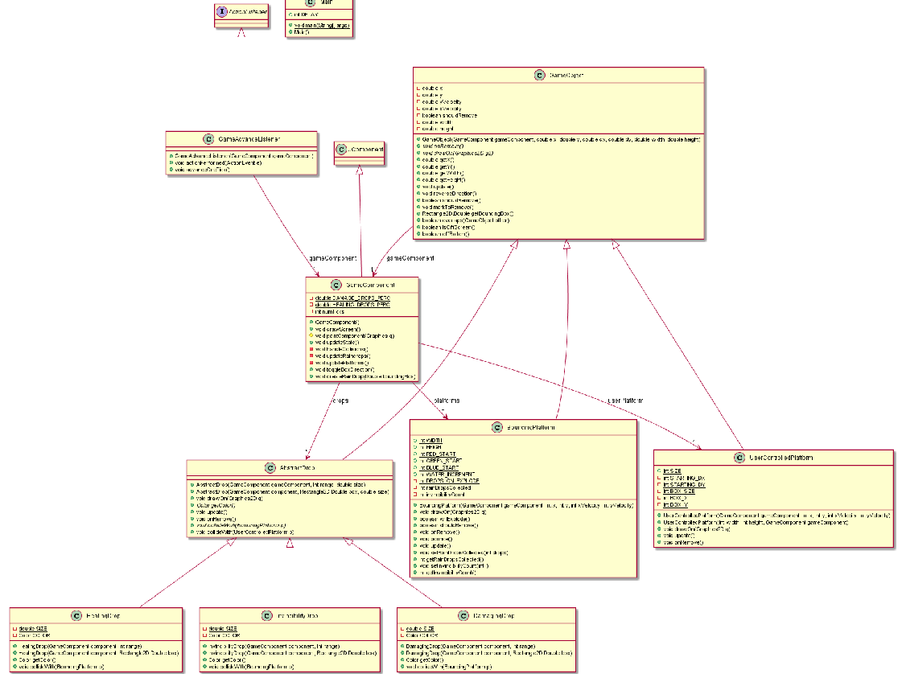
Information Overload
As project gets larger
It becomes too hard to understand from a giant UML
You can modify it easy…
(Next Slide)

Slide 9
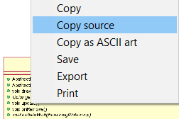
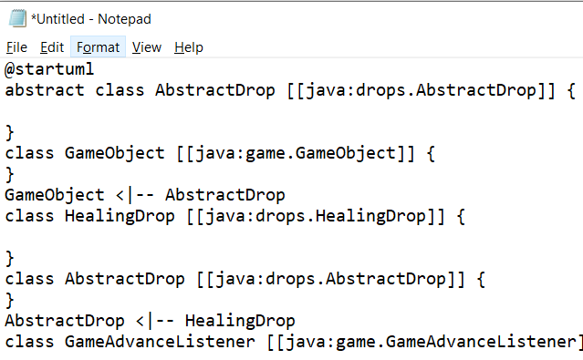
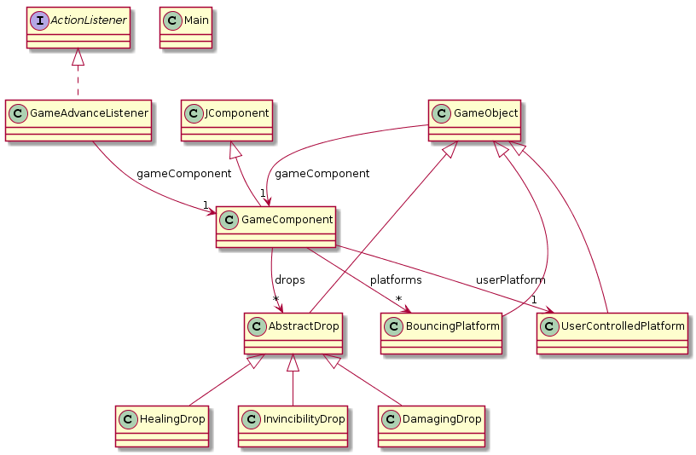
<- Copy UML source and
then remove extra ->
PlantUML
Eclipse
Plugin

Slide 10
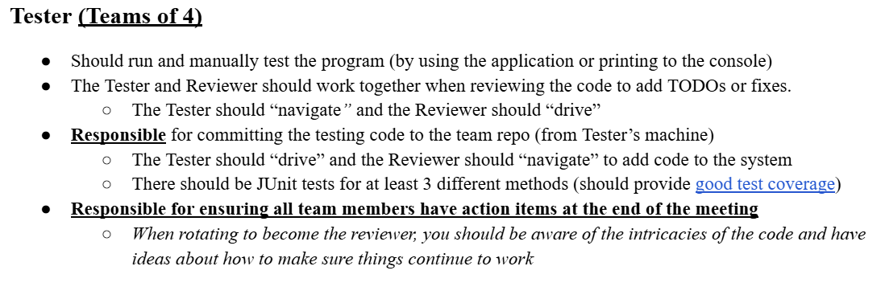
Tester (Teams of 4)

Slide 11
Code Testing Guidelines
Review slides from the class session on Unit Testing
Include assert statements to cover:
The most common cases
The edge cases or boundary cases (minimum, maximum, switching from positive to negative, etc.)
All specific/special cases (e.g., when 0 or null the behavior is different than for any other value)
When you find and fix a defect, then at that same time, create a unit test that would have revealed that defect.
Any overly complex code that the items above don’t cover

Slide 12
Code Testing Guidelines
You should decide which code would be most helpful to test. The tests should be useful for your project and nontrivial. Here are some suggestions, but similarly scoped tests could be used instead:
Milestone 1 - Make sure that a file is read in properly, correctly instantiates objects, and confirms their correct properties. (e.g., load level1.txt and make sure a Hero is created and positioned properly at (20,40)).
Milestone 2 - Make sure that the Hero obeys Gravity and collisions with platforms (e.g., create a Hero that is created at position (20,40), falls at the rate of gravity until hitting a platform below it (20, 400). Make sure the Hero’s position is correct at each step and that the Hero’s position is correct after calling the relevant collision and update code.)
Milestone 3 - Verify that a collision between a Hero and an Enemy is processed correctly as desired. (e.g., You can create a Hero and an Enemy, and then call the relevant code to handle their collision and make appropriate updates to each object, i.e., killing the Hero or killing the Enemy and increasing the score, etc.)
Milestone 4 - Pick one of your bonus additional features and create tests to make sure that they work as desired.
Although not required, one approach to software development is Test Driven Development (TDD).
We encourage you to employ TDD for at least one of these unit tests, Milestone 4 might be a good one since you will need to define how things should operate for a special feature.

