Slide 1
Note
These Slides are duplicates of Slides from the ClassMaterials/MergeSort/Slides
If the instructions differ, you should ask your instructor for clarification
These were added here for convenience for students looking for presentation guidelines

Slide 2
CSSE 220
Presentation Details

Slide 3
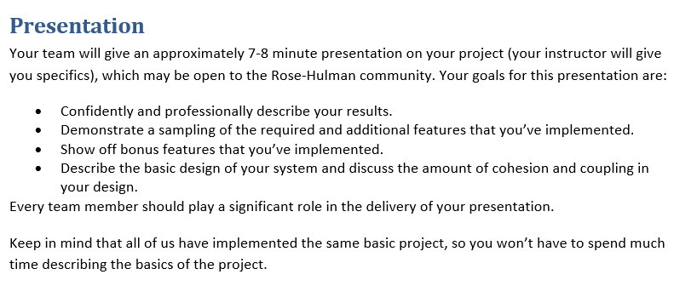
From the project specification document (ArcadeGame.docx)
Recommended:
Script your live demo and follow the script during presentation
Or, prerecord you live demo and insert recording into slides
Notes:
Dress 1 step up form your normal dress level

Slide 4
Your Presentations - Specifics
7 minutes long (Rehearse! Aim to be within 30 seconds +/- )
~3 min. Showing off your extra features
Preferably record a video!
Live demo is “Acceptable” (but beware Murphy’s law!)
~2 min. Explaining your overall design (major classes, NOT all)
“Coupling/Cohesion” or other “Good/Bad” aspects of design
Discuss OODP explicitly in your presentation
OK to say your design is BAD and what you would do differently
~2 min. Design decision, feature implementation, or tricky bug
Be explicit in stating your “Special Item” (decision/feature/bug)
Be careful about code examples (good – but in moderation)
Be sure to include prepared slides usually including diagrams
Be sure to EXPLAIN the item, not just mention it!
Notes:
4

Slide 5
From the project specification document (GARP Spec.)
7. Presentation
Your team will give an approximately 7-8 minute presentation on your project (your instructor will give you specifics), which may be open to the Rose-Hulman community. Your goals for this presentation are:
Confidently and professionally describe your results
Give a very short introduction to the basic idea of your evolutionary simulator
Demonstrate a sampling of the required and additional features that you’ve implemented
Explain and show the results of any new experiments you conducted
Explain your success/progress/failure to reproduce the result from the scientific paper - As applicable relate this to your code’s reusability and extensibility
Describe the basic design of your system and relate any or all of the 5 OODPs as they apply to your code
Every team member should play a significant role in the delivery of your presentation.
Again: Keep your explanation of the basic idea of a genetic algorithm very short (60 seconds max!)

Slide 6
From the project specification document (GARP Spec.)
I would expect the following approximate lengths of time for different parts:
1 minute: introduction yourself, your simulator, and the basic idea of the project
1-2 minutes: Demonstrate the basic functionality of your simulator including how a user can change parameters at run-time
1-2 minutes: Describe the basic design of your system and relate any or all of the 5 OODPs as they apply to your code (please use simplified UML diagrams as show here @7:00)
2-3 minutes: Explain at least 1 of your ORIGINAL fitness functions OR ORIGINAL experiments, show the results of simulation and your interpretation of those results
1-2 minutes: Explain your success/progress/failure to reproduce the result from the scientific paper from M4, even if you did not succeed you can still relate this to your code’s reusability and extensibility
- For example, perhaps you had a great deal of trouble refactoring your code to try to reproduce the M4 Scientific paper result, what ways could your design be improved to make this easier?

Slide 7
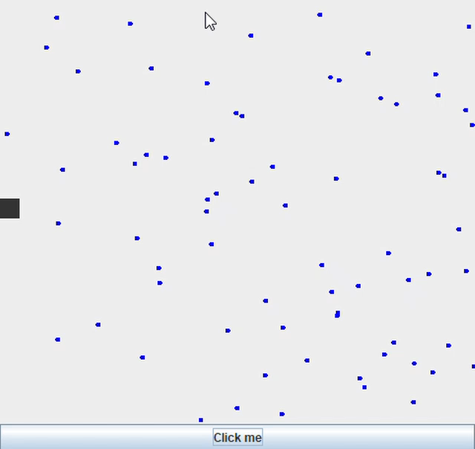
How to Make Screen Recordings (Windows 10)
Old Way: record your screen on Windows 10 using Game Bar (Windows Key + g)
https://www.businessinsider.com/how-to-record-screen-on-windows-10

Slide 8


Windows 11
Press Print Screen
Or
Window + Shift + S

Slide 9
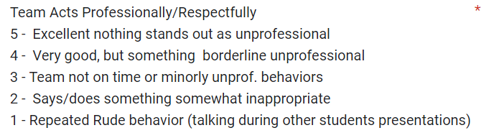
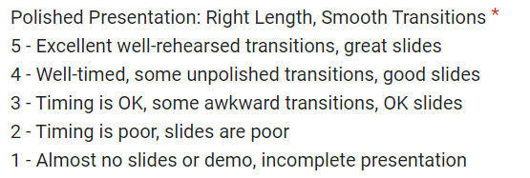
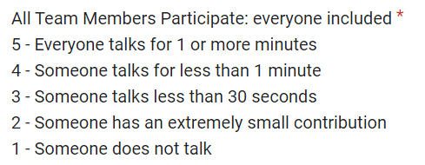
Rubric for Scoring Presentations

Slide 10
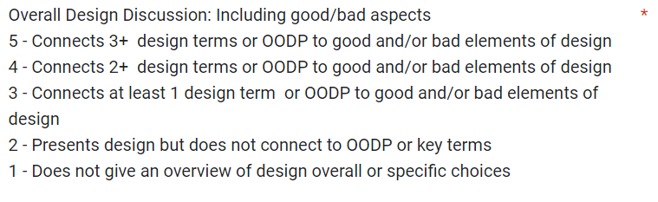
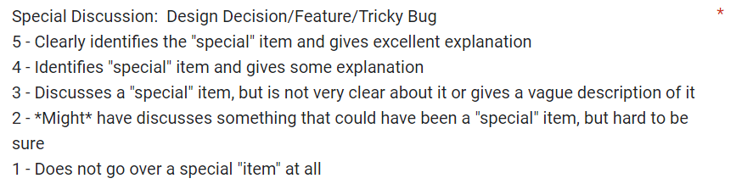
Rubric for Scoring Presentations

Slide 11



Student Voted Awards!
+5 Incentive Points Each!
Experiment Explanation for GARP

Slide 12

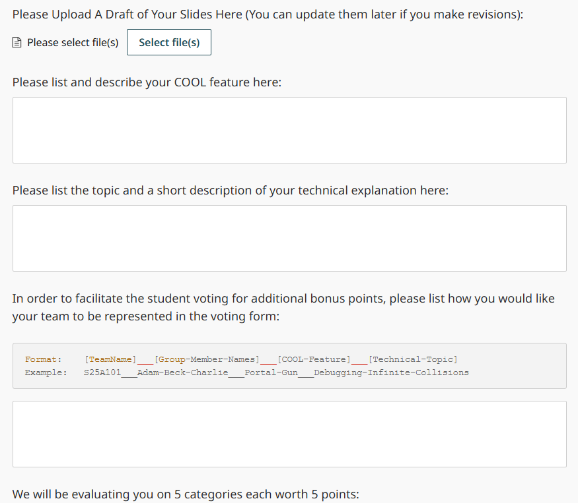
Submit Slides on GradeScope

Slide 13
Fun Only
as time and interest allows

Slide 14

Just for fun.. for making it through the end of term

Slide 15
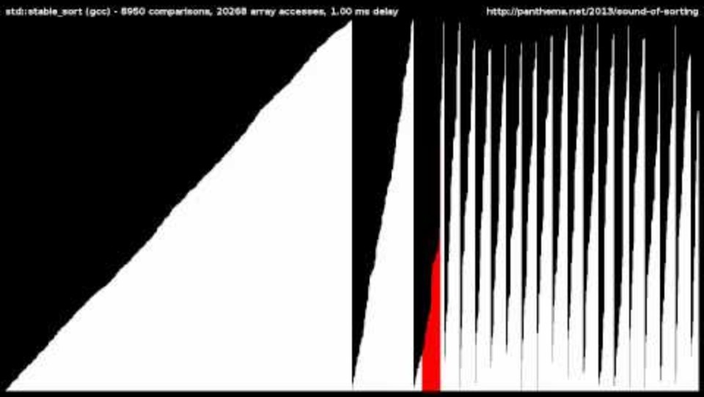
15 Sorting Algorithms in 6 Minutes

Slide 16

Select-sort with Gypsy folk dance

Slide 17

Insert-sort with Romanian folk dance

Slide 18

Merge-sort with Transylvanian-saxon (German) folk dance

Slide 19
CSSE 220
Eclipse PlantUML Plugin
Notes:
No quiz today.
Bring printouts from the MergeSortSimpleSolution.

Slide 20
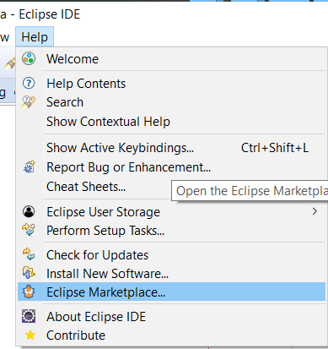
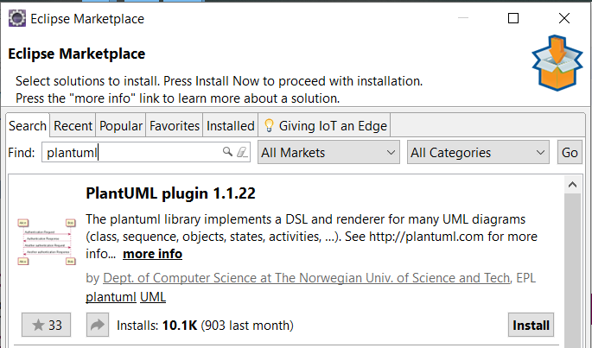
PlantUML Eclipse Plugin
https://plantuml.com/eclipse

Slide 21
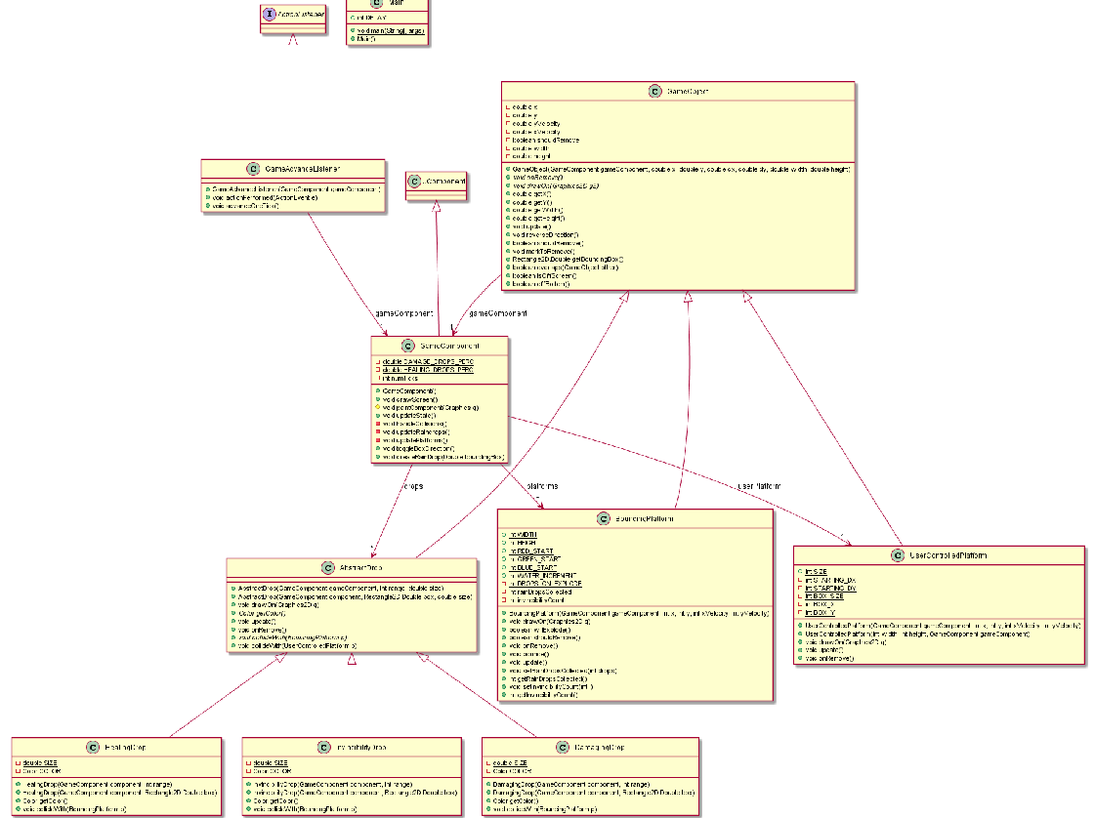
Information
Overload!

Slide 22
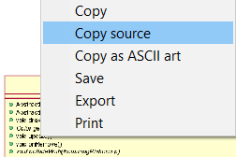
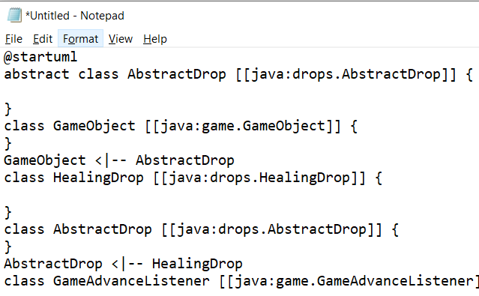
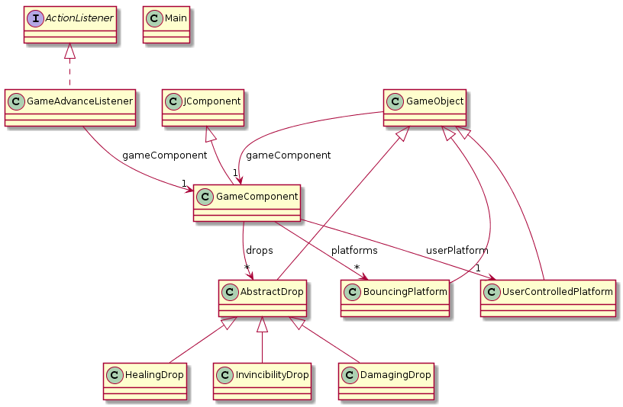
<- Copy UML source and
then remove extra ->

Slide 23
