Slide 1
Miscellaneous – Debugging
Debugger & JUnit Tests
The git projects for today are:
PracticeObjectIntroAndMisc
PracticeSolutionObjectIntroAndMisc

Slide 2

How to identify a problem in your code?
When you run your code, and you do not pass all the tests...
What can you do?
Try re-running the exact same code
Do miracles happen for you? (...It’s OK we have all done it...)
Try changing code randomly and see if it helps?
(do you like the Infinite monkey theorem? ->)
Try to think through through the code and see what goes wrong?
This is HARD! But tracing out on paper can be very helpful!
There are better, more powerful and much FASTER approaches
Notes:
What ideas do you have? Type them into the chat!

Slide 3
How to identify a problem in your code?
Better, more powerful and much FASTER approaches
Read the error messages when there are test cases
Examples of errors? How do we see them?
Examine the test cases that fail
What is the INPUT? What SHOULD the output be?
“When in doubt, print it out!”
System.out.println("myVar: " + myVar );
Arrays.toString( arr)
Classes? -> obj.toString()
For the love of Java... Use the Debugger!
no code modification/commenting required!

Slide 4
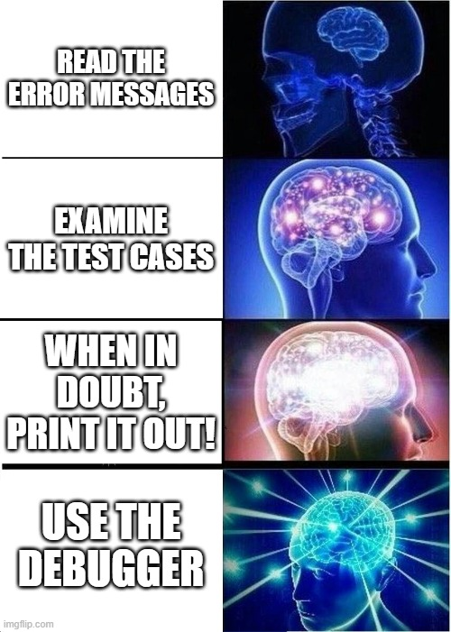
How to identify a problem in your code?
Want to make your own CSSE220 meme? Send it to me this week!

Slide 5
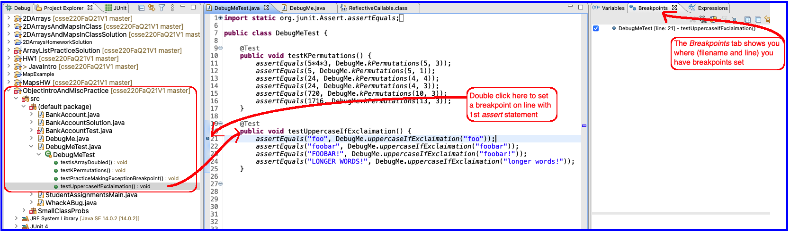
Setting Breakpoint
Set a breakpoint on the line where a test case fails!
Then you can pause the execution of the program and WATCH what goes wrong.

Slide 6
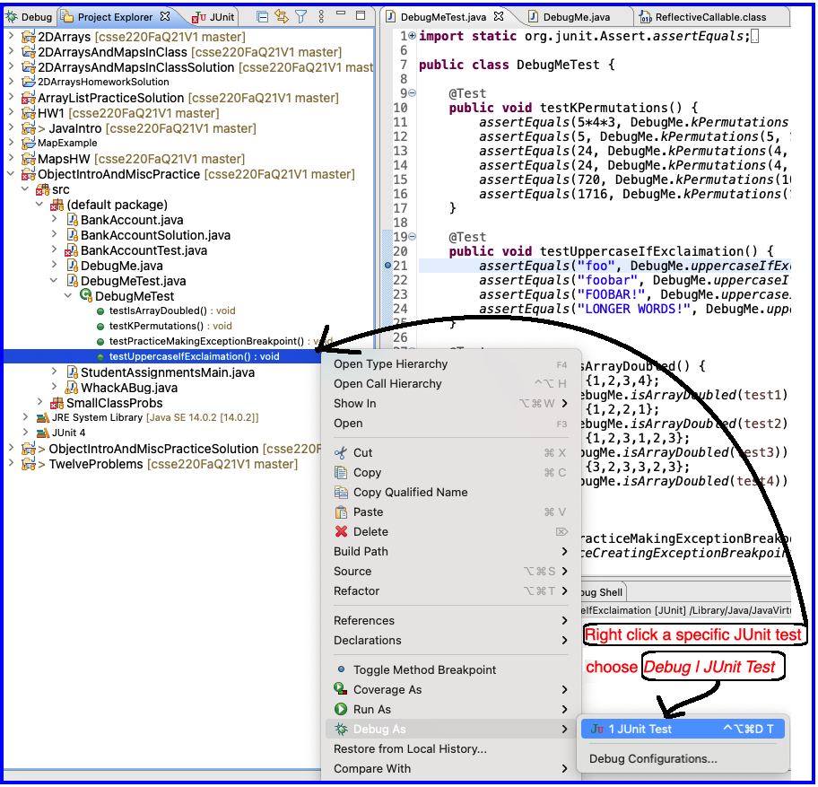
Running in Debug Mode

Slide 7
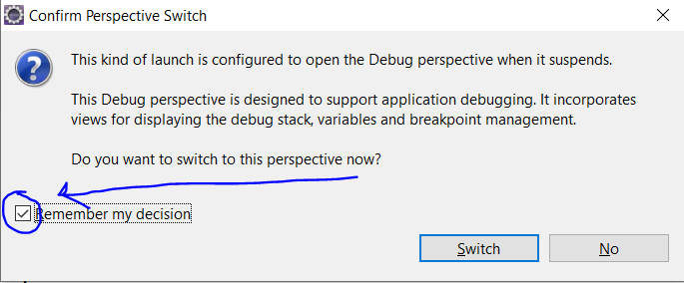

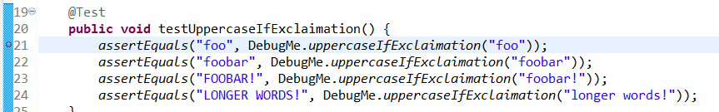
Scary first steps…
Notes:
Send 220 memes via email this week and maybe I’ll add it to the slide deck next week...

Slide 8

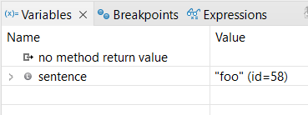
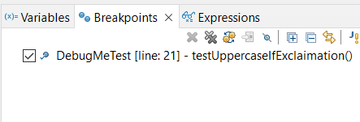
The Debugger Up Close
Java Perspective
Debugging Perspective

Slide 9
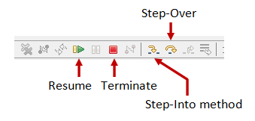
Debugging—Demo
Debugging Java programs in Eclipse:
Set a breakpoint where you want to start
Launch using the bug icon
Single stepping: step over and step into
Inspecting variables
Notes:
[Demonstrate the techniques in Eclipse by solving a problem or two from DebugMeTest together, give them time to answer the quiz question, then have them complete DebugMeTest.]
[You can also point them to WhackABug to get more practice when running a Java Application instead of JUnit)]
DebugMeTest make sure to demo:
uppercaseIfExclaimation which ends up showing the gotcha “string are immutable” in two slides

Slide 10
Debugger Controls Up Close
Step Into
method
Step Over
method
Step Return (Out)
Resume
(until next break point or complete)
Suspend
Terminate
Notes:
CAREFUL- if you do not stop the running debugger, you can have multiple instances running and the debugger variables you see might be from a different running

Slide 11


ALWAYS (1) stop the debugger AND (2) clear it when done!
Even after you click the red STOP SQUARE, if you ran it multiple times before, you have to repeatedly clear it (or restart Eclipse)
Indicates that the program is still running
Notes:
CAREFUL- if you do not stop the running debugger, you can have multiple instances running and the debugger variables you see might be from a different running

Slide 12
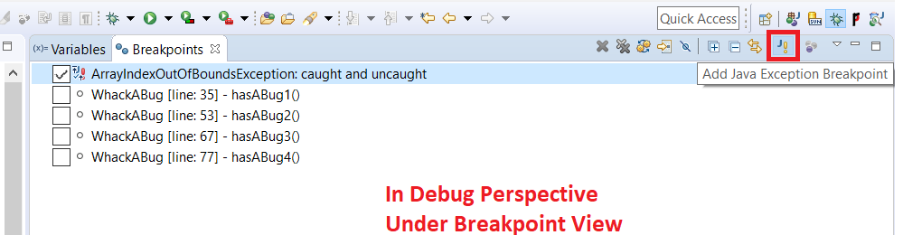
Exception Breakpoint
Very useful when an exception is happening but you don’t know where or why
Exception Tab
Exclamation point button
Find the exception type you want
Add a breakpoint
Notes:
Only spend time on this if you want to show the DebugMeTest examples, in particular the final test which you can use to demonstrate this approach.

Slide 13
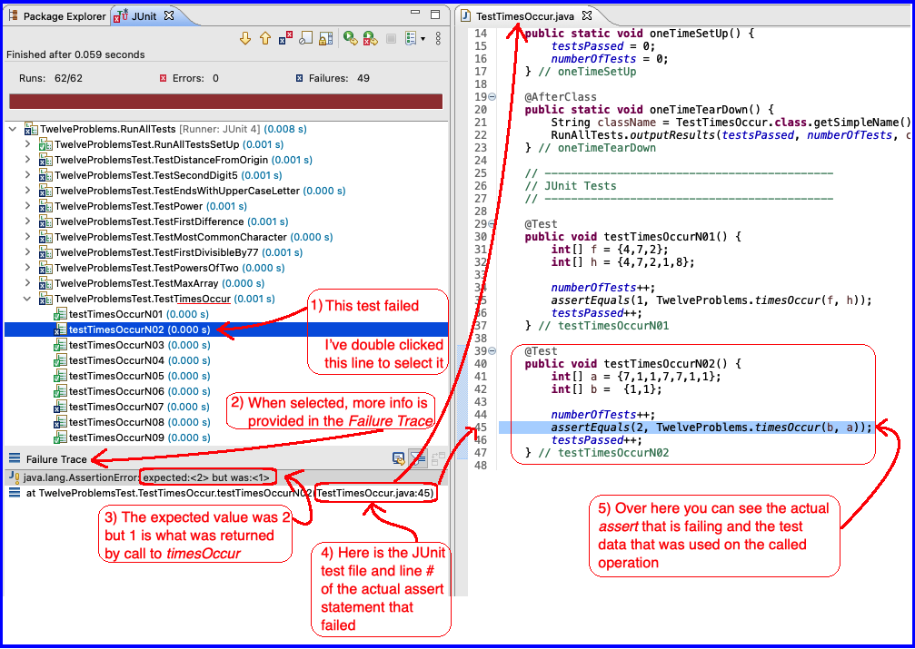
Interpreting a JUnit Test Failure

Slide 14
Important gotcha: Strings in java are immutable
No method on the string class will modify the content of a String variable
All methods instead return a reference to a new String object
String newSentence = sentence.toUpperCase();
Declare a new String variable
Have new variable catch the returned String
Notes:
uppercaseIfExclaimation ends up showing this

Slide 15
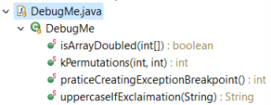





Debugging Practice!
Try to use the debugger to find the bug in isArrayDoubled
If you have time, also kPermutations
You can also practice catching an Exception
Notes:
isArrayDoubled is a good example where the .equals comparison
fails because it is not implemented properly in the default .equals method.
Without using the debugger, it could be pretty hard to track down the
specific problem that is occurring.

Slide 16
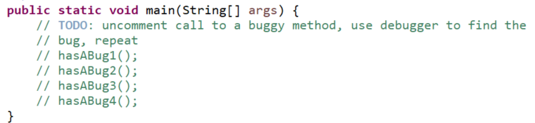
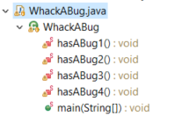
More Debugging Practice!
Can be called on a main method as well!
Use this for extra practice
Set breakpoint on main
method calls ( hasABug1() ) and then step into methods to see what goes wrong!

Slide 17
Optional Opportunities
At the discretion of the professor
There may be incentive points offered
As suggested on the following slides

Slide 18
Incentive Points Opportunity #1
Complete these practice debugging problems
Write a summary of how you caught each bug
Be sure to list:
What line did you “catch” unexpected behavior?
What was unexpected about the behavior?
What did you determine from this?
Write a summary of what you learned
Email it to me and complete the incentive form on Moodle

Slide 19
Incentive Points Opportunity #2
When you have some spare time, as our in-class TA to “quiz you” on the use of the debugger
You will have 5-10 minutes to resolve a bug introduced
This is worth a small number of incentive points (+2), but more importantly will make sure you understand how to use the debugger

