Slide 1
CSSE 220
Linked List Implementation
The git projects for today are:
PracticeLinkedListSimple
PracticeLinkedListSimpleSolution
Notes:
Doing everything in LinkedListSimple today
Quiz given in next slide

Slide 2
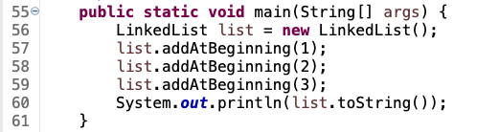
Quiz
Get into pairs
Look at/run the code in LinkedList.java main
Draw a box-and-pointer diagram of what’s happening in the main code.
To figure it out, you’ll have to look at the LinkedList constructor and addAtBeginning.
If you’ve forgotten how to do box-and-pointer diagrams, checkout the next slide
Q1
Notes:
This diagram is their quiz for the day

Slide 3
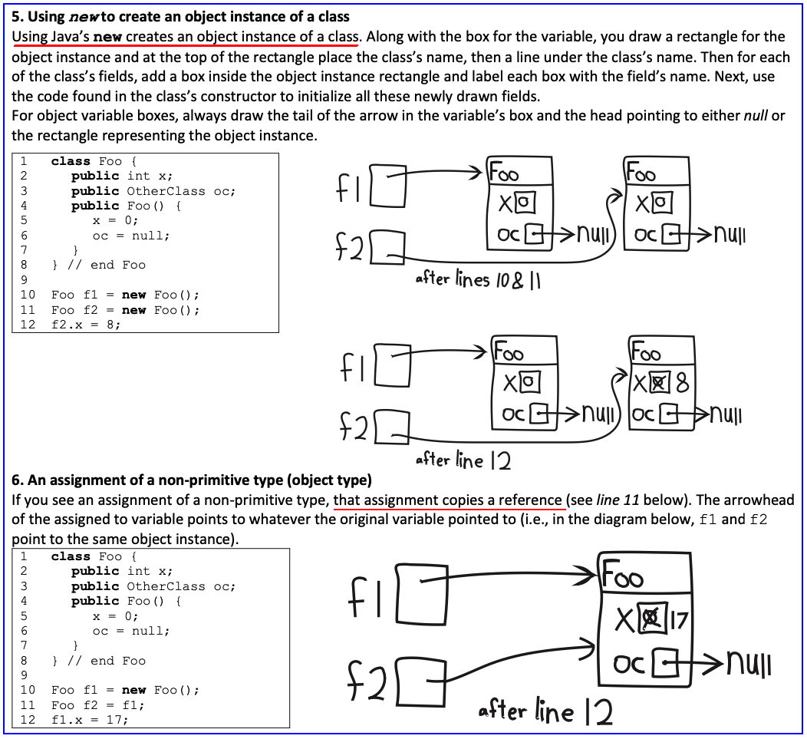

Slide 4
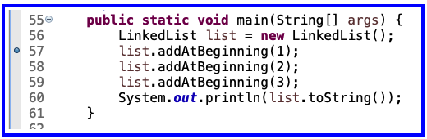
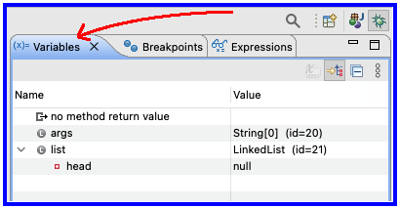
Optional - Now Walk Through Together
Set a breakpoint at first addAtBeginning
Execute in the debugger
Step over and keep an eye on debugger’s Variables tab

Slide 5
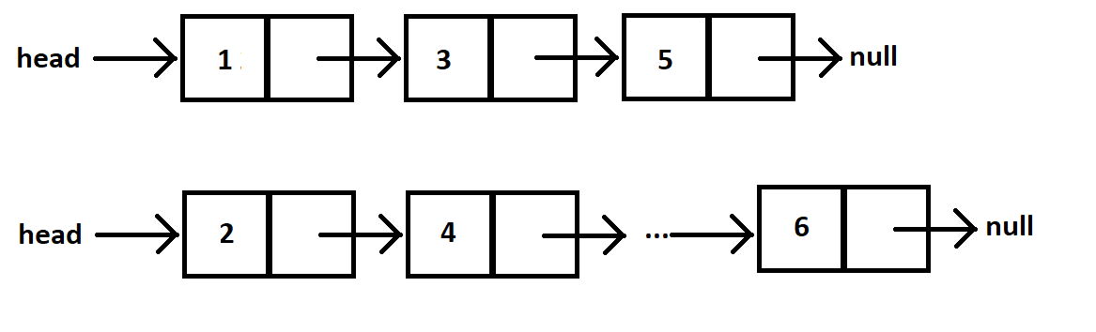
Shorthand Diagramming Notation
Using pictures will be extremely helpful
We can use System.out.println( this ) to see what the current list looks like (does it match diagram?)

Slide 6
Loops in Arrays vs. LinkedLists
int[] nums = ……
for (int k = 0; k < nums.length; k++) {
// do stuff with
// arbitrary element nums[k]
}
Equivalent in while loop
int k = 0;
while ( k < nums.length ) {
// do stuff with
// arbitrary element nums[k]
k++;
}
LinkedList list = ……
//Another Day!
Node current = this.head;
while ( ? ) {
//do stuff with
//arbitrary element
?
}
For an array, use a ‘for’ because we know exact length of array at the outset.
This is known as a definite loop

Slide 7
Loops in Arrays vs. LinkedLists
int[] nums = ……
for (int k = 0; k < nums.length; k++) {
// do stuff with
// arbitrary element nums[k]
}
LinkedList list = ……
Node current = this.head;
while ( current != null ) {
// do stuff with
// arbitrary element
current.value++;
current = current.next;
}
For linked lists, use a ‘while’ because we do not know exact length of a linked list at outset.
This is known as an indefinite loop

Slide 8
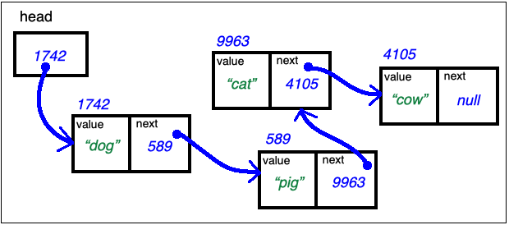
Traverse Linked List Stop at the End
LinkedList list = …… current's values:
Node current = this.head; _1742_____________
while ( current.next != null ) { __________________
// do stuff with __________________
// arbitrary element __________________
current = current.next; __________________
} // end while
current.next = new Node(vToAdd, null); // adds new node at end

Slide 9
Traverse Linked List With Trailer
LinkedList list = …… current trailer:
Node trailer = null; _0__________
Node current = this.head; _1742_______ ____________
while ( current != null ) { ____________ ____________
// do stuff w/ node values ____________ ____________
trailer = current; ____________ ____________
current = current.next; ____________ ____________
} // end while

Slide 10
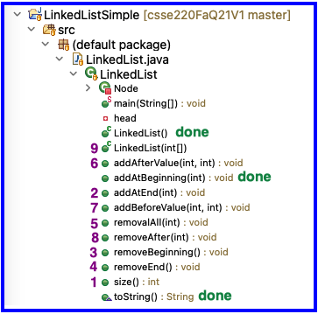
Solve the Other Problems in LinkedListSimple
Look at toString to get an idea of how to do size, then go from there
Recommended order
Get help if you get stuck!

Slide 11
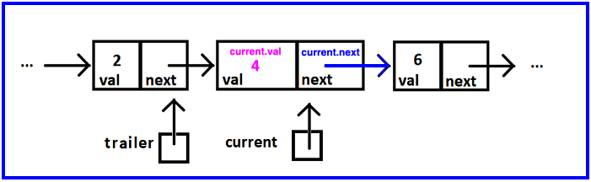
Reminder: Shorthand Diagramming Notation
Use arrows:
To represent the references stored in:
a node’s next
the variables current, and trailer
To connect the list’s nodes

Slide 12
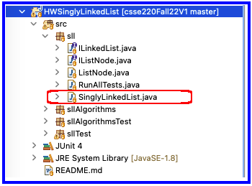
Homework
SinglyLinkedList
Requires you to implement a SinglyLinkedList
Additional algorithm questions which make use of the SinglyLinkedList

Slide 13
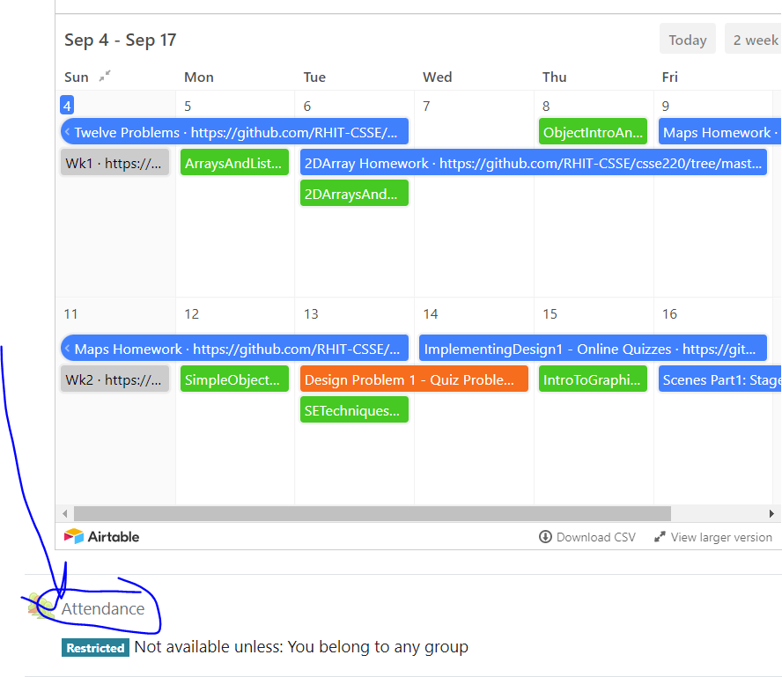
Data Structures + BiG-O Notation
CSSE 220
Understanding the engineering trade-offs when storing data
The git projects for today are:
PracticeLinkedListSimple
PracticeLinkedListSimpleSolution
Notes:
If students get through things quickly we can move into this material in the first hour, but if not- that is OK, we have the next class period to go through it and give them time to work on the rest of the quiz and the homework problems.

Slide 14
Data Structures
We need efficient ways to store data based on how we’ll use it
"How we'll use it" = algorithms used to access/update data stored in the data structure
The main theme for the rest of the course
Notes:
Q: Have to move all the other elements up or down to make/use room. O(n)

Slide 15
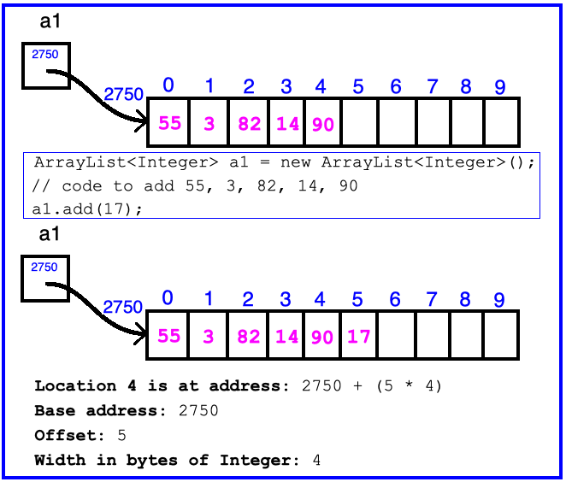
ArrayList Data Structure in Java
Fast addition to end of list Requires 1 multiplication and 1 addition to compute address
Notes:
Q: Have to move all the other elements up or down to make/use room. O(n)

Slide 16
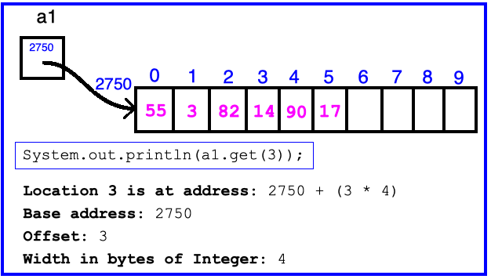
ArrayList Data Structure in Java
Fast access to any existing position Requires 1 multiplication and 1 addition to compute address
Notes:
Q: Have to move all the other elements up or down to make/use room. O(n)

Slide 17
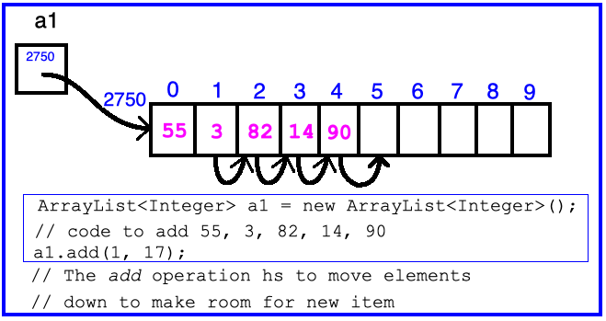
ArrayList Data Structure in Java
Slow inserts to and deletes from middle of list
Notes:
Q: Have to move all the other elements up or down to make/use room. O(n)

Slide 18
Big-O Notation
Describes the limiting behavior
How slow it can possibly run?
Describes the worst case
Used for Classifying Algorithm Efficiency
“O” for “Order”
O(n) → said as “Order n”
O(n^2) → said as “Order n-squared”

Slide 19
Big-O Notation (continued)
Don’t Care About Constants
O(2n + 7) → O(n)
Don’t Care About Smaller Powers
O(6n^2 + 7n) →O(n^2)
Algorithm grows asymptotically no faster than n^2
If constant value, we say O(1) → “Order 1”
O(48) → O(1)
Q2
Notes:
We care about which part of the expression grows the fastest as n, the input size, grows.

Slide 20
ArrayList Performance (Revisited)
Fast addition to end of list:
Fast access to any existing position – O(1) (like array)
Keep extra capacity for list growth
Fast access includes items in capacity not yet filled – O(1)
Capacity management is best left for CSSE230
Slow inserts to and deletes from middle of list
Can get to insert/delete location quickly
For insert, shift all items right to accommodate - O(n)
For delete, shift all items left to fill gap – O(n)
Q3

Slide 21
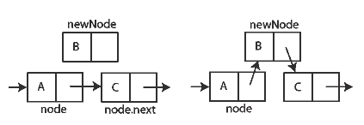
Another List Data Structure
What if we have to add/remove data from a list frequently?
LinkedLists support this:
Fast insertion and removal of elements
Once we know where they go
Slow access to arbitrary elements
data
data
data
data
null
data
Insertion, per Wikipedia
Q4-5
Notes:
- Examples: employee list, music play list
Sketch a linked list on the board for “two more weeks” (quiz #3)
Then show insertion and deletion.

Slide 22
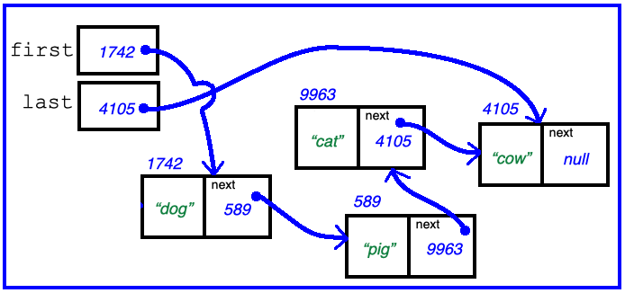
Big-O LinkedList<E> Methods?
void addFirst(E element) _____________
void addLast(E element) _____________
E getFirst() _____________
E getLast() _____________
E removeFirst() _____________
E removeLast() _____________
Notes:
Big-Oh of each?
All of the operations perform as could be expected for a doubly-linked list.
Thus, these operations all take O(1) time.

Slide 23
Homework
SinglyLinkedList
Requires you to implement a SinglyLinkedList
Additional algorithm questions which make use of the SinglyLinkedList
Will give you remaining class time to work on it
If you complete it, work on the project!

