Slide 1
CSSE 220
Course Evaluations

Slide 2
Course Evals
We will give you time to complete these in class NOW
I will leave the room and give you time to finish them
Someone can message me on Teams when you are all done

Slide 3
Student Evaluations
The Institute treats Evals very seriously
Faculty treat them very seriously too...usually reading them multiple times
Be as honest and detailed as you can
Tell us what topics that to you were most exciting or useful
Then list your ideas for what you believe would improve CSSE220 for future quarters
Notes:
3

Slide 4
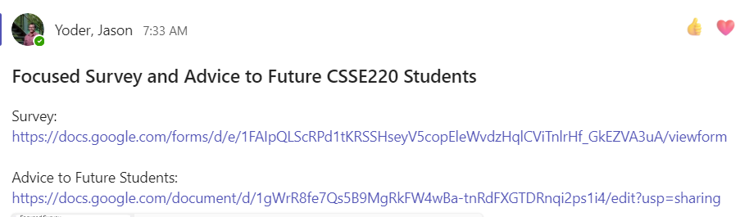
After Evaluations
Focused Google Form Survey
Separate from course evals
I am asking for a student opinion/perspective
Will post on Teams channel
Project Work time
Practice using Project (next slide)
I will return once everyone is done and go over Final Exam details
Notes:
YODER - I use this, but you can decide if you want to or not.
Can update this if there are other things you would like students to do.
4

Slide 5
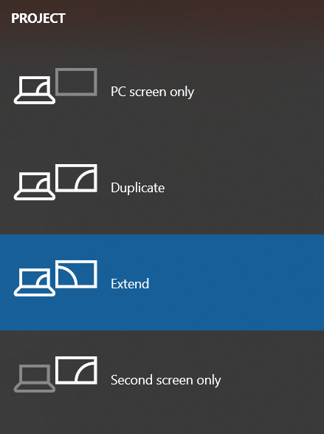
Practice Running Slides
Chance to test your laptop on the projector
Practice using the screens and audio
Make sure recorded videos play properly
If you want speaker notes, practice using the “extended mode”
Press Windows + “P” to get this menu ->

