Slide 1
Making a Runnable JAR
CSSE220 - Final Project

Slide 2
How to Demo/Share Your Project with Others
You can share your source code and have people run it themselves
Often people want to just RUN your program
You can export your Eclipse project to share as a standalone file
Java has executables called JARs that can be run from anywhere that supports Java
Your code runs on a Virtual Machine that is translated to whatever hardware the host machine is running
Running your code easily on many platforms is called Portability and is one great feature of Java

Slide 3
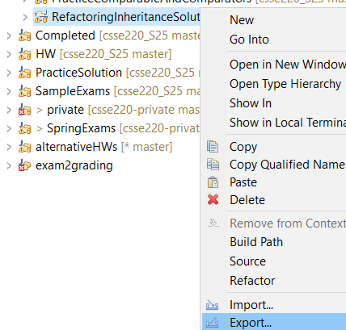
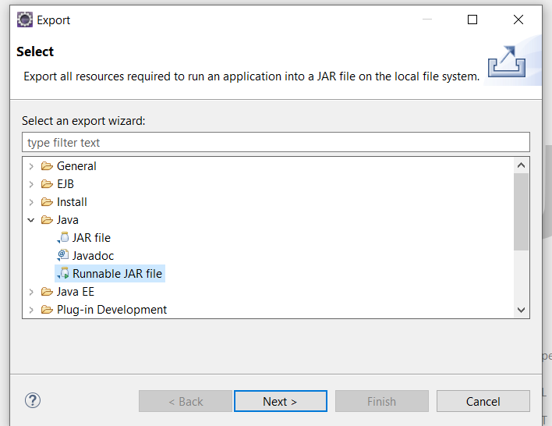
How To Do This in Eclipse
Right Click ->
Export
Java ->
Runnable JAR File

Slide 4
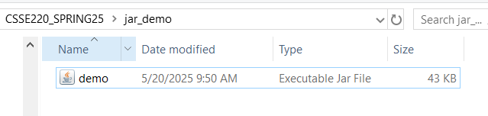
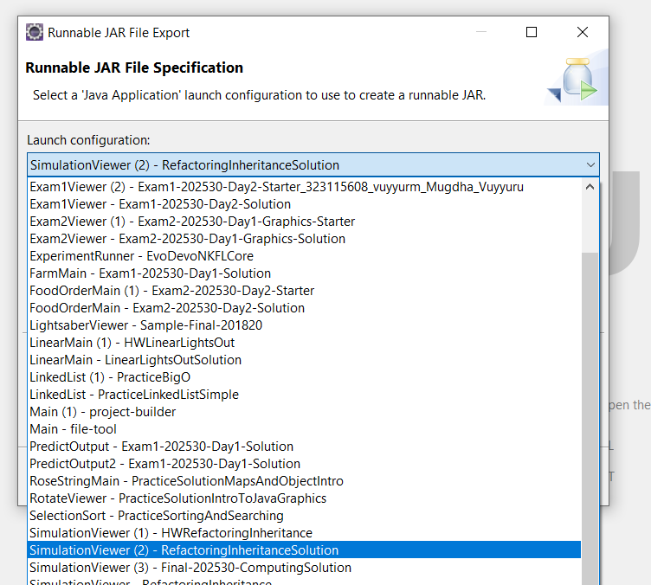
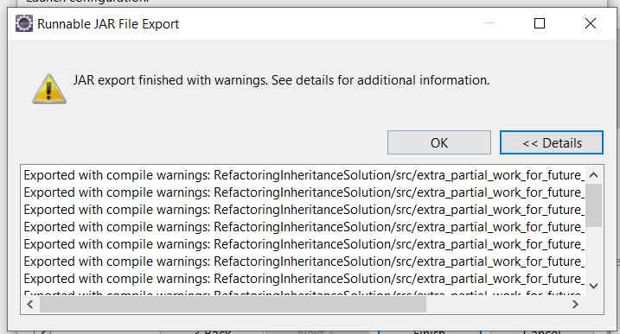
If you have run the final project you should be able to select it to run here.
Don’t worry about warnings…

Slide 5
Gotchas
Watch out for local file paths
Make sure that you use relative paths (/XYZ… )
Using absolute paths (“C:/Users/yoder1/…”) will not work on other machines!

Slide 6
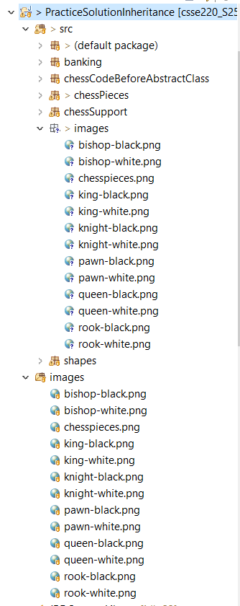
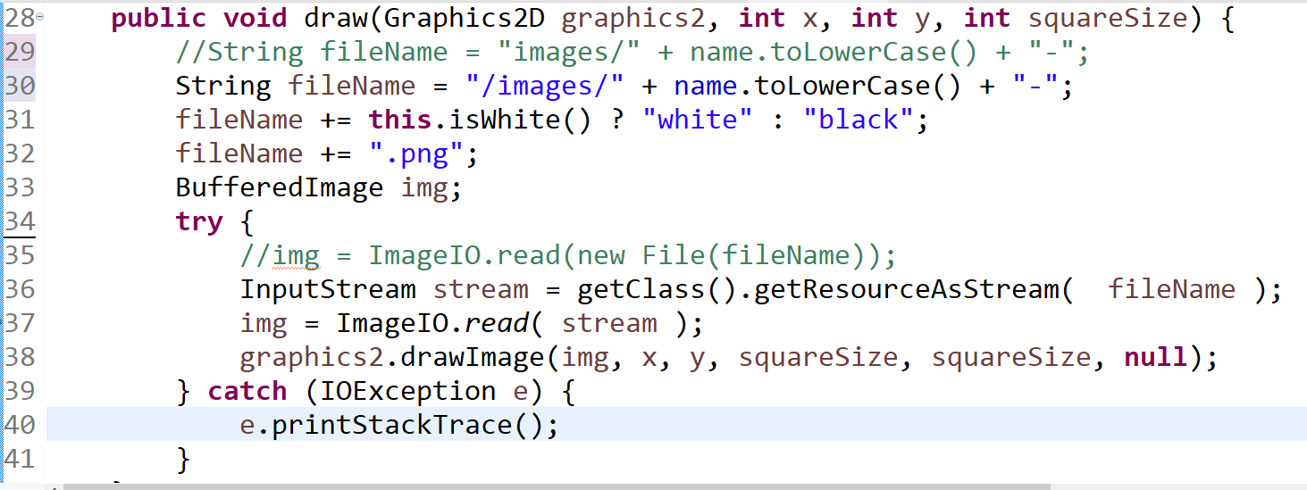







Simplest way to make sure you have access to all your resources (images/audio/etc) is to copy them into the src folder.

Slide 7
Demo Code – ChessPiece.java
//String fileName = "images/" + name.toLowerCase() + "-";
String fileName = "/images/" + name.toLowerCase() + "-";
fileName += this.isWhite() ? "white" : "black";
fileName += ".png";
BufferedImage img;
try {
//img = ImageIO.read(new File(fileName));
InputStream stream = getClass().getResourceAsStream( fileName );
img = ImageIO.read( stream );
graphics2.drawImage(img, x, y, squareSize, squareSize, null);
} catch (IOException e) {
e.printStackTrace();
}

