Slide 1
CSSE 220
Exceptions
The git projects for today are:
PracticeFilesAndExceptions
PracticeFilesAndExceptionsSolution
Notes:
1

Slide 2
Exception – What, When, Why, How?
What:
Used to signal that something in a called operation has gone wrong
When:
An error has occurred that cannot be handled in a called operation
Why:
It breaks the execution flow and passes exception up the call stack to the calling operation

Slide 3
Exception – How?
Java code for throwing an exception: throw new EOFException(“Missing column”);
Java code for handling (catching) an exception:
try {
// Caller makes call(s) to operation(s)
// that can throw an exception(s)
}
catch (ExceptionType ex) {
// Caller code that attempts to recover
// from the exception
} // end try
Q5
Notes:
Try to read from file when the file does not exist
3

Slide 4
Exception Handling – How?
When you write code in the catch part of a try-catch block, you can attempt to:
Recover from the error discovered in the caller
Not recover, and have the app exit gracefully, e.g., close all open scanners, files, etc., then exit the app
Q5
Notes:
Try to read from file when the file does not exist
4

Slide 5
What happens when no exception is thrown?
If this line is successful
Scanner s1;
try {
s1 = new Scanner(new File(“test.txt”);
// code for reading lines
} catch (IOException ex) {
JOptionPane.
showMessageDialog("File not found.");
} finally {
s1.close();
} // end try-catch-finally
Code continues on
The catch never executes
This runs after code in try completes
Execution Progression: try block, then finally block
Notes:
5

Slide 6
What happens when exception is thrown?
Scanner s1;
try {
s1 = new Scanner(new File(“test.txt”);
// code for reading lines
} catch (IOException ex) {
JOptionPane.
showMessageDialog("File not found.");
} finally {
s1.close();
} // end try-catch-finally
If this line throws exception
Code after exception never executes
Code in catch is executed next
After catch is executed, this runs
Execution Progression: try block, catch block , then finally block
Notes:
6

Slide 7
When exception is not handled?
public String readData(String filename)
throws IOException {
Scanner s1 = new Scanner(new File(filename));
// code for reading lines
s1.close();
}
main -> readAllFiles -> readData
If this line throws exception
Client code after the call
does not execute
If exception is unhandled in readData, then it bounces to
the calling method, and then on up the call stack to main
If main does not catch it, then program crashes with
an exception error
Notes:
7

Slide 8
Two Kinds of Exceptions
Checked exceptions: compiler checks that calling code has try-catch to catch the exception
Used for expected problems – e.g., opening files
Unchecked exceptions: compiler lets us ignore these if we want
Used for fatal or avoidable problems
Are subclasses of RunTimeException or Error

Slide 9
A Tale of Two Choices
Dealing with checked exceptions
Can propagate the exception
By declaring that our method will pass any exceptions along… public void loadGameState() throws IOException
Used when our code isn’t able to rectify the problem
Can handle the exception
Used when our method can rectify the problem
By including a try-catch in our method
Q6
Notes:
IOException Signals that an I/O exception of some sort has occurred. This class is the general class of exceptions produced by failed or interrupted I/O operations.

Slide 10
Handling Exceptions
Use try-catch statement:
try {
// potentially “exceptional” code
} catch (ExceptionType var) {
// handle exception
}
Related, try-finally for clean up:
try {
// code that requires “clean up”
} // then maybe some catch blocks
finally {
// runs even if exception occurred
}
Can repeat this catch part for as many different exception types as you need.
Q7
Notes:
When having multiple catch statements be sure to move from more specific to more general.
It is helpful to know the more specific type of exception as it may have features unknown as more a general type of exception.
The first catch that matches the type will be the only one that excecutes
10

Slide 11
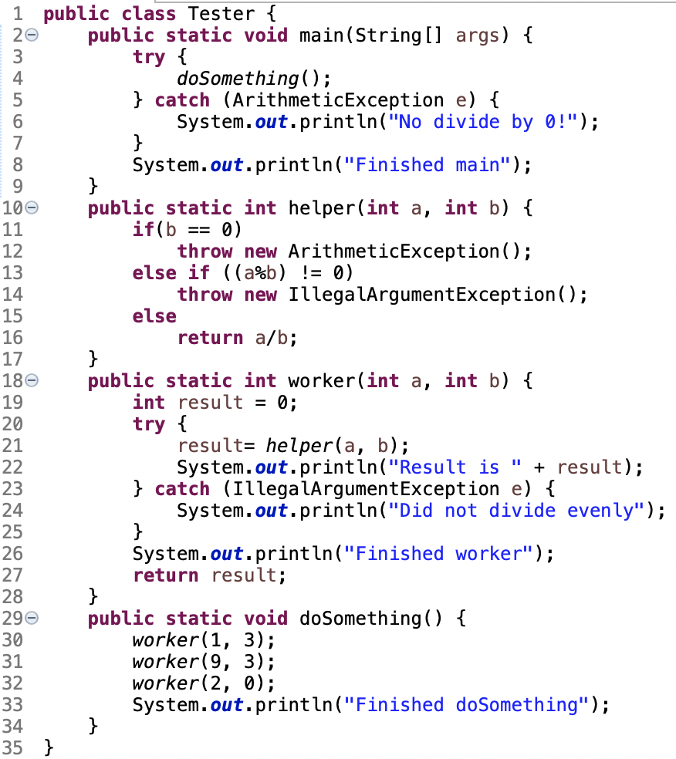
Quiz Today:
What does this output?
Notes:
0:28-0:35 work time
0:36-0:40 walkthrough part of the solution (use ink drawing mode to draw on the PPT screen)
11

Slide 12
Exception Activity – Part 1
Look at the code in FileAverage, focusing on the use of exceptions
Solve the problems in FileBestScore
Be sure to read the instructions carefully:
* 1. Cheating players sometimes do more than 4 rounds. The program should
* print a warning when a cheating player is uncovered - but continue the
* computation ignoring the cheating player.
*
* Do this by making the function computeTotal throw a IllegalArgumentException
* when given a cheating record. computeBestScore should catch the exception,
* print a warning, and continue the computation.
*
* 2. If the user enters an invalid file name, the program crashes. Instead the
* program should say that the file does not exist and let the user enter a new
* name (as many times as necessary). Catch a FileNotFoundException in main to
* do this.
Notes:
0:41-0:49
Get them started on this BEFORE starting break
Walk through how the code operates in FileAverage with them
Explain what happens in FileBestScore and ask them to work on it during the second hour.
1:20 – give 20 minutes of classtime to try to resolve these before working through solution with them.

Slide 13
Exception Activity – Part 2
We delayed processing the exception so we could report the player’s name (more than just that someone cheated)
What if we wanted to report the player’s name AND how badly they cheated?
This requires us to pass such information as data stored inside the exception object. To do this, let’s make a new class: TooManyScoresException
When we create one we can define the number of actual and allowed scores and then create a method to report that information as needed

Slide 14
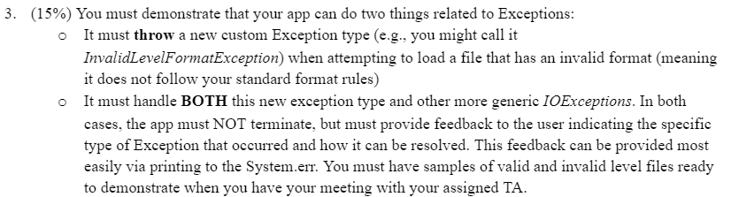
From Milestone 1 Requirements
You may want to brainstorm with your team.
What kind of exceptions should occur?
What should happen when they occur?

