Slide 1
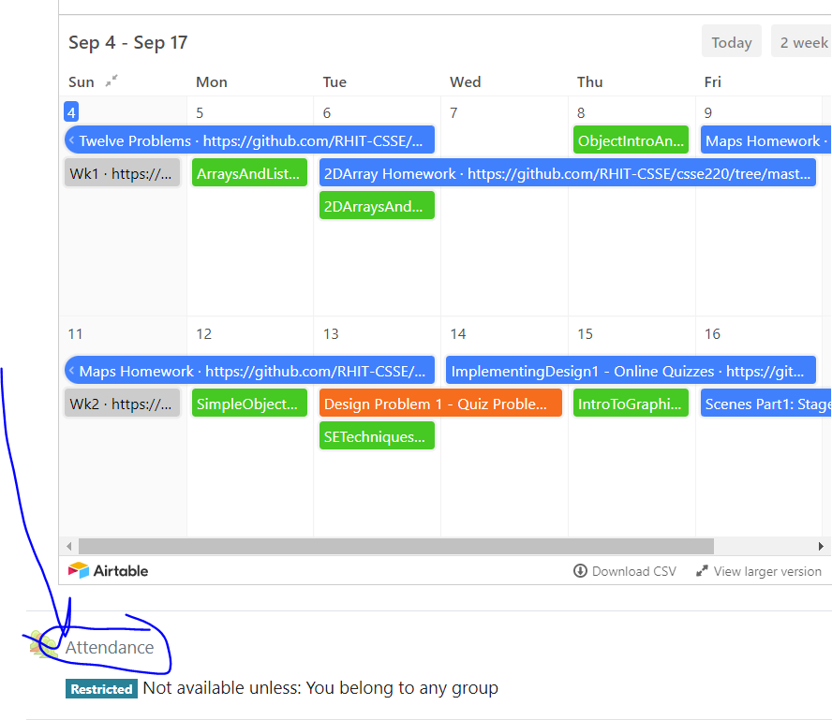
CSSE 220
Attendance password
is written on the board
Big-O and Data Structures
The git projects for today are:
PracticeBigO
PracticeSolutionBigO
The Quiz for today is:
BigOQuiz
Notes:
Timing: Plan to finish by the end of the first hour so they can work on the HW or project in the second hour
Good day to use:
https://rosepseudorandom.web.app/
Doing everything in LinkedListSimple today
Quiz given in next slide

Slide 2
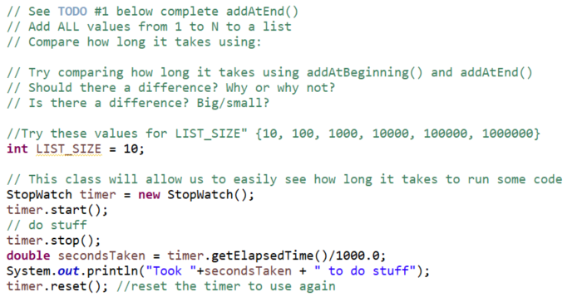
addAtEnd vs. addAtBeginning
Open up LinkedList.java in simple
Let’s see how long it takes to add 100,000 numbers to a LinkedList…
Notes:
Code is in the solution. Try to add using addAtEnd FIRST and then addAtBeginning second.
Ask students to guess which will take longer/short- how much shorter longer?
Develop solution from the day before
if (this.head == null) {
this.head = new Node(value, null);
// return; //// omit this line intentionally to show an error and use debugger <- or just provide the correct solution to save time
}
Node current = this.head;
while (current.next != null) {
current = current.next;
}
//current.next is null
current.next = new Node(value, null);

Slide 3
Data Structures
We need efficient ways to store data based on how we’ll use it
"How we'll use it" = algorithms used to access/update data stored in the data structure
The main theme for the rest of the course

Slide 4
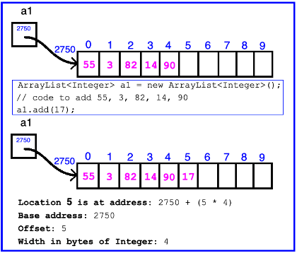
ArrayList Data Structure in Java
Fast addition to end of list Requires 1 multiplication and 1 addition to compute address
Notes:
Very fast to add to end of list.
Q: How fast?
A: It does not matter how long the list is (N does not matter)

Slide 5
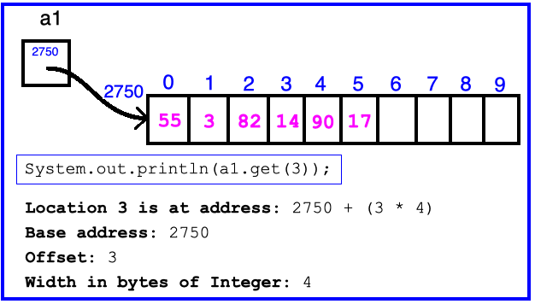
ArrayList Data Structure in Java
Fast access to any existing position Requires 1 multiplication and 1 addition to compute address
Notes:
Very fast access in list.
Q: How fast?
A: It does not matter how long the list is (N does not matter)

Slide 6
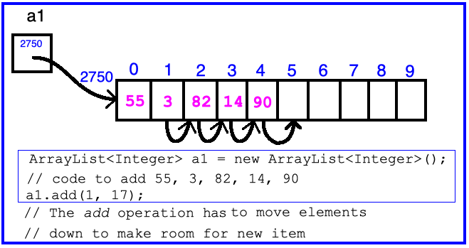
ArrayList Data Structure in Java
Slow inserts to and deletes from middle of list
Notes:
Q: How slow is it to insert?
A: Because you have to move all the other elements up or down to make/use room. Twice as long twice as many shifts O(N)

Slide 7
Big-O Notation
Describes the limiting behavior
How slow it can possibly run?
Describes the worst case
Used for Classifying Algorithm Efficiency
“O” for “Order”
O(n) → said as “Order n”
O(n^2) → said as “Order n-squared”
Notes:
How to define fast and slow more precisely

Slide 8
Big-O Notation (continued)
Don’t Care About Constant Coefficients
O(2n + 7) → O(n) Note: f(n) = 2n + 7 = 2n¹ + 7n⁰
Don’t Care About Lower Order Terms
O(6n² + 7n¹) →O(n²)
Algorithm grows asymptotically no faster than n²
If constant value, we say O(1) → “Order 1”
O(48) → O(1)
Q2
Notes:
We care about which part of the expression grows the fastest as n, the input size, grows.

Slide 9
ArrayList Performance (Revisited)
Fast addition to end of list:
Fast access to any existing position – O(1) (like array)
Keep extra capacity for list growth
Fast access includes items in capacity not yet filled – O(1)
Capacity management is best left for CSSE230
Slow inserts to and deletes from middle of list
Can get to insert/delete location quickly
For insert, shift all items right to accommodate - O(n)
For delete, shift all items left to fill gap – O(n)
Q3

Slide 10
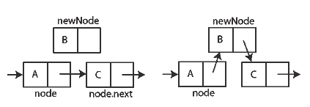
Another List Data Structure
What if we have to add/remove data from a list frequently?
LinkedLists support this:
Fast insertion and removal of elements
Once we know where they go
Slow access to arbitrary elements
data
data
data
data
null
data
Insertion, per Wikipedia
Q4-5
Notes:
- Examples: employee list, music play list
Sketch a linked list on the board for “two more weeks” (quiz #3)
Then show insertion and deletion.

Slide 11
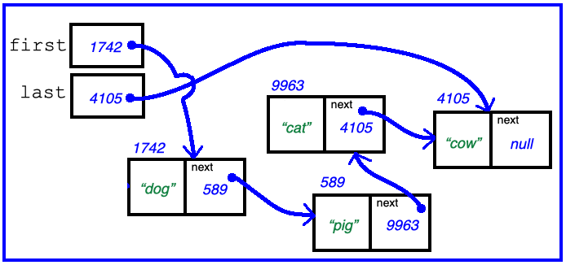
Big-O LinkedList<E> Methods?
O(1)
void addFirst(E element) _____________
void addLast(E element) _____________
E getFirst() _____________
E getLast() _____________
E removeFirst() _____________
E removeLast() _____________
O(1)
O(1)
O(1)
O(1)
O(N)
HWSinglyLinkedList
LL adds this!
Notes:
Big-Oh of each?
All of the operations perform as could be expected for a doubly-linked list.
Thus, these operations all take O(1) time. – except for remove last (which is O(N) since you must iterate through to get to the second to the last element

Slide 12
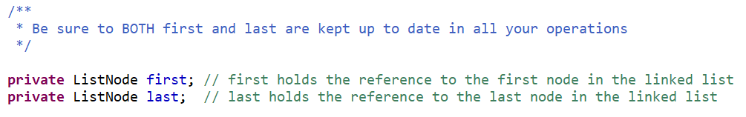
Homework
SinglyLinkedList
Requires you to implement a SinglyLinkedList
Additional algorithm questions which make use of the SinglyLinkedList
Will give you remaining class time to work on it
If you complete it, work on the project!

Slide 13
Handout
Complete add (addAtEnd)
Consider the different values of index and sized lists
Useful as a guide when doing HW
HW is an individual assignment
Rest of time is for you to either work on HW or project

Slide 14
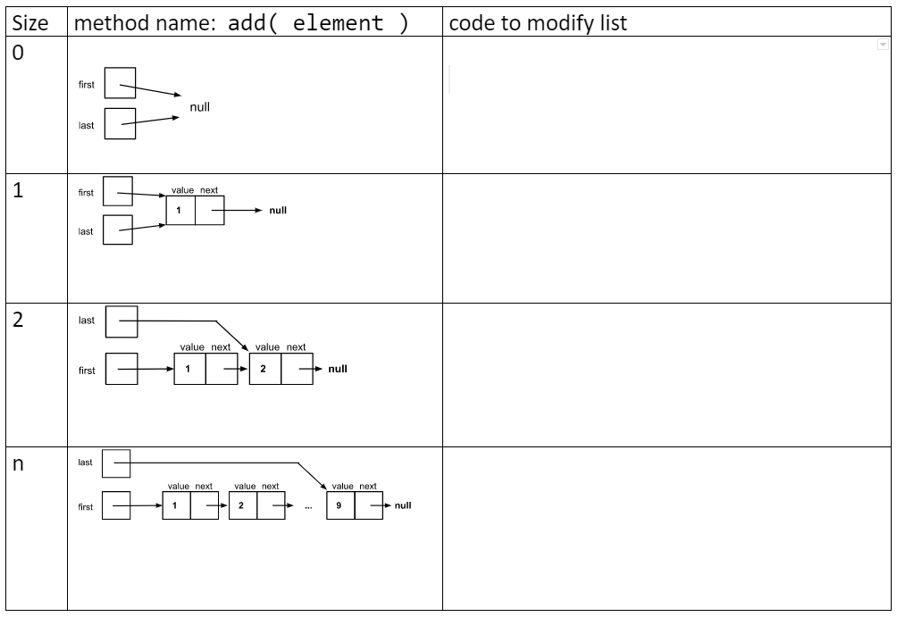
https://docs.google.com/document/d/1FWKXXsPkspazmlhgMj5qN4ieynd1-1galuou2j09VyA/edit

Slide 15
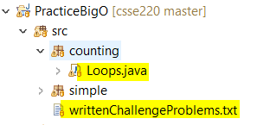
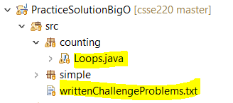
Extra Practice
Good preparation for CSSE230
Good preparation for Final Exam Questions
Good way to confirm understanding of Big O

