Slide 1
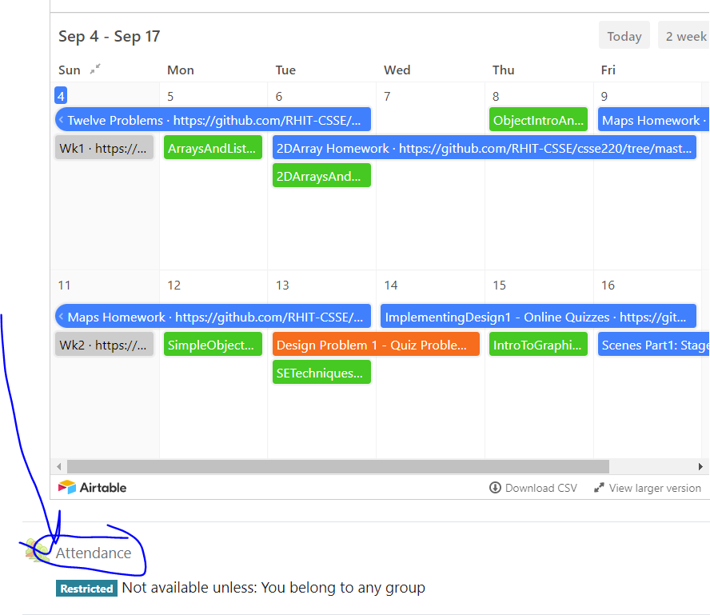
CSSE 220
Attendance password
is written on the board
Object Oriented Design Principle #4:
Minimizing Dependencies
Coupling and Cohesion
There are NO git projects for today. Have paper/plantUML ready!
Quiz for today is:
CohesionAndCouplingQuiz

Slide 2
Design Problem 2 Solution, next HW: Implementing Design Problem 2
https://github.com/RHIT-CSSE/csse220/tree/master/Homework/HWVaporSalesManager
Notes:
Instructor:
csse220-private\HomeworkProjects\DesignProblems\Slides

Slide 3
Partner for ID2
If you are working with a partner for the “Paired” part of Implementing Design Problem 2:
Decide how you plan to communicate with each other: email, Teams, txt, etc
Pick a time you both agree to complete the “Individual” part of Implementing Design 2 so that you can both be ready to work together
Find times you could work together
INSTRUCTOR
Insert Teams Here

Slide 4
Today’s topics
Minimize dependencies between objects when it does not disrupt usability or extendability
Tell don't ask
Don't have message chains
Two related Object-Oriented Design terms:
coupling
cohesion

Slide 5
Principles of Design (for CSSE220)
Make sure your design allows proper functionality
Must be able to store required information (one/many to one/many relationships)
Must be able to access the required information to accomplish tasks
Data should not be duplicated (id/identifiers are OK!)
Structure design around the data to be stored
Nouns should become classes
Classes should have intelligent behaviors (methods) that may operate on their data
Functionality should be distributed efficiently
No class/part should get too large
Each class should have a single responsibility it accomplishes
Minimize dependencies between objects when it does not disrupt usability or extendability
Tell don't ask
Don't have message chains
Don't duplicate code
Similar "chunks" of code should be unified into functions
Classes with similar features should be given common interfaces
Classes with similar internals should be simplified using inheritance

Slide 6
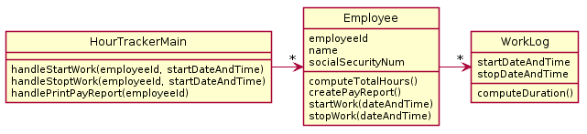
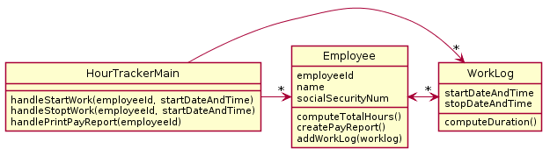
Employee Hour Tracker Problem: A system tracks employee hours at a particular company. Every time any employee starts work and stops work, the system must log it so the employee can be paid correctly and so management knows who was working when. The system must also print out a weekly pay report for each employee which includes total hours, the employee's name, social security number, and employee id.
Less Dependencies Solution
More Dependencies Solution

Slide 7
In less dependencies, Employee “insulates” HourTrackerMain from the existence of the WorkLog class. This means changes in the way WorkLog works cannot affect Employee. Similarly, changes in Employee cannot affect WorkLog.
The less dependencies solution is also simpler. Employee fully “owns” all its own data. In more dependencies, the worklog is edited without employee’s knowledge.
Less Dependencies Solution
More Dependencies Solution
HourTrackerMain “knows” about WorkLog, creates one, then calls addWorkLog

Slide 8
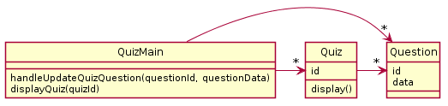
Oftentimes you cannot remove dependencies without breaking functionality though.
Here there are 3 dependencies
QuizMain to Question
QuizMain to Quiz
Quiz to Question
None can be removed w/o breaking functionality

