Slide 1
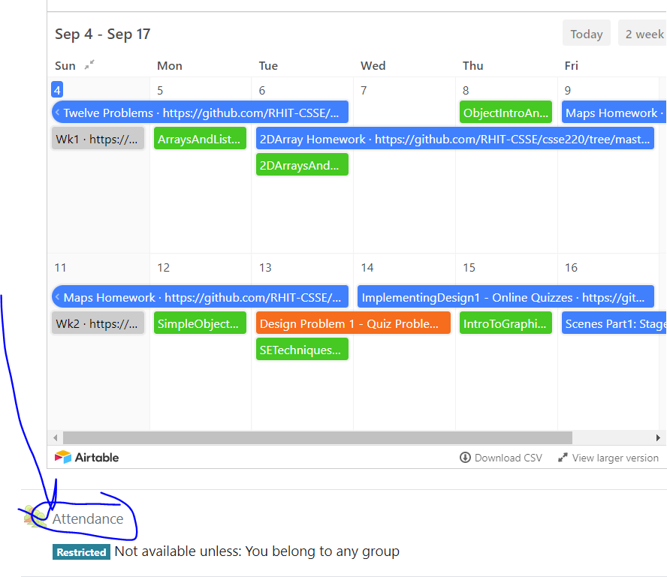
CSSE 220
Attendance password
is written on the board
Collision Handling without instanceof
The git projects for today are:
PracticeInheritanceDesign
PracticeSolutionInheritanceDesign
The Quiz for today is:
CollisionHandling(DesignInheritance)Quiz

Slide 2
The specific problem
Missiles can collide with the Hero.
Hero can collide with coins to collect them.
Hero can collide with Barriers.
Bonus: Hero’s bullets collide with Missiles?
So many collisions! How do we handle them all?

Slide 3
Handling Collisions in General
Many ways it can be done
Good design principles
Make it easy to use and extend code
Functional but bad design principles
Use what is known as: type predicated code:
if (“instanceof, getClass(), getType()” ==/equals) if (gameObject instanceof DamagingDrop) { ... }
Type predicated code is OUTLAWED in your project design!
i.e., your design and implementation must not use these at all!

Slide 4
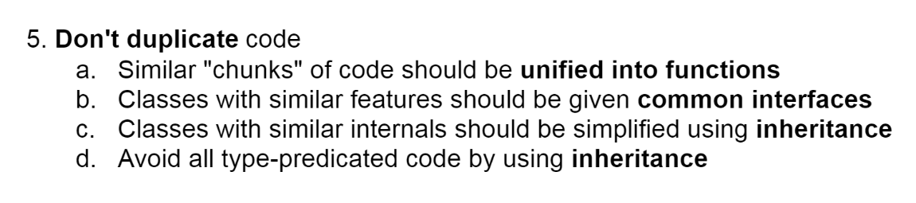
Final OODP #5
Let’s unpack this phrase: type predicted code
Type = the specific class
Predicated = conditionally dependent upon
If you are using a condition to check the type of an object to decide what to do, you are using type predicated code.
Note: Creating a field in your classes (e.g., String type=“Enemy”) is NOT fixing the problem, you are still using type predicated code!

Slide 5
Live Coding
Let’s consider a simulator with collisions
More Raindrops More Platforms
Run Main.java
Notes:
Run the game and explain what is happening

Slide 6
Extend Functionality
Implement an InvincibilityDrop
makes a BouncingPlatform invincible for 50 ticks
drops should not affect platforms when invincible
color should be Yellow
size should be 20
absorbed by UserControlledPlatform like others
Notes:
Explain that we want to consider how hard/easy it would be to extend this codebase
to provide the functionality of a new type of drop

Slide 7
GameComponent.java
Let’s look how collisions are handled
Where would changes in code need to happen?
Look for examples of “type predicated code”
Why is this hard to use/extend?
Notes:
Go through the file and point out the really ugly code because of how hard it is to understand and how many places you would have to make changes.

Slide 8
Collision Chart
When do collisions happen?
 | UserPlat | BouncePlat | DamageDrop | HealDrop
UserPlat
BouncePlat
DamageDrop
HealDrop

Slide 9
Collision Chart
When do collisions happen?
 | UserPlat | BouncePlat | DamageDrop | HealDrop
UserPlat |  |  | X | X
BouncePlat |  |  | X | X
DamageDrop | X | X
HealDrop | X | X

Slide 10
Collision Chart
When we have multiple objects which interact with the same object, we can use inheritance to help us make a design to deal with the collisions. We should have the classes which differ provide the functionality to deal with the collisions.
 | UserPlat | BouncePlat | DamageDrop | HealDrop
UserPlat |  |  | X | X
BouncePlat |  |  | X | X
DamageDrop | X | X
HealDrop | X | X

Slide 11
Collision Chart
When we have multiple objects which interact with the same object, we can use inheritance to help us make a design to deal with the collisions. We should have the classes which differ provide the functionality to deal with the collisions.
So in this case, the different drops (and InvincibilityDrop) differ in how they affect the platform. Thus, we can could create an abstract class and require an implementation of the collideWith(BouncingPlatform) method. Similarly, we can provide a collideWith( UserControlledPlatform) method, this will allow us to put the code in the drop classes and make the processing MUCH cleaner as we will see.

Slide 12
Text-based Live Coding
We could take the whole hour to refactor this code in the GUI
Instead, we want to give you more time to complete a quiz and work on the project
We will cover the essence using a text-based version of collision handling
Notes:
See script in
ClassMaterials\CollisionHandling\EclipseProjects\text_based_script_inheritance_design.txt

Slide 13
Text-based Live Coding
Instead of having a physical simulation we will just say that different objects have a random chance of colliding
When they collide certain things will print to the screen
We can show how to use Inheritance to rewrite this code
It accomplishes the same thing, but with less time and easier to follow
Notes:
See script in
ClassMaterials\CollisionHandling\EclipseProjects\text_based_script_inheritance_design.txt

Slide 14
GUI Live-coding
There are videos (Panopto) showing the full refactoring process on the GUI application
You are welcome to watch those videos to see the progression yourself
We also have the full solution available in
PracticeInheritanceDesignSolution
Notes:
At this point go through the script and make all the changes. If time allows let students try to implement the InvincibilityDrop on their own

Slide 15
PracticeInheritanceDesignSolution
Let’s load the solution run it so you can see it
Then you are welcome to review the coded solution
It has some additional complexity, but the core changes are the same
The solution has ZERO type predicated code

Slide 16
Design Activity
Quiz Today

Slide 17
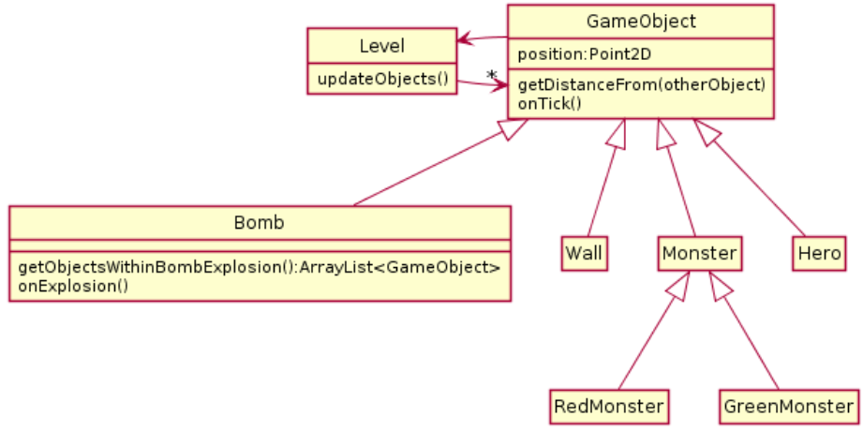
In the game Bomberman, everything has special behavior if caught in a bomb explosion. Heroes die and restart the level, monsters are killed and score points, walls are destroyed, and bombs explode themselves. In the design below, the Bomb class has an onExplosion method which handles this behavior and (you can assume) works correctly.

Slide 18
Collision Code
for(GameObject g : getObjectsWithinBombExplosion()) {
if(g instanceof Bomb) {
// bomb specific code
}
if(g instanceof Wall) {
//wall specific code
}
//pattern continues...
}
1. What is wrong with the design?
2. Propose a new design that does not have the problem you identified in #1. You only need include in your UML diagram classes that are *different* from their version in the given diagram. Also include a sample for what the analogous code on onExplosion looks like
Notes:
F23: Got to this point by 0:45
Give five minutes plus break to work on the quiz
Have students work in groups of 2 or 3 to answer these

Slide 19
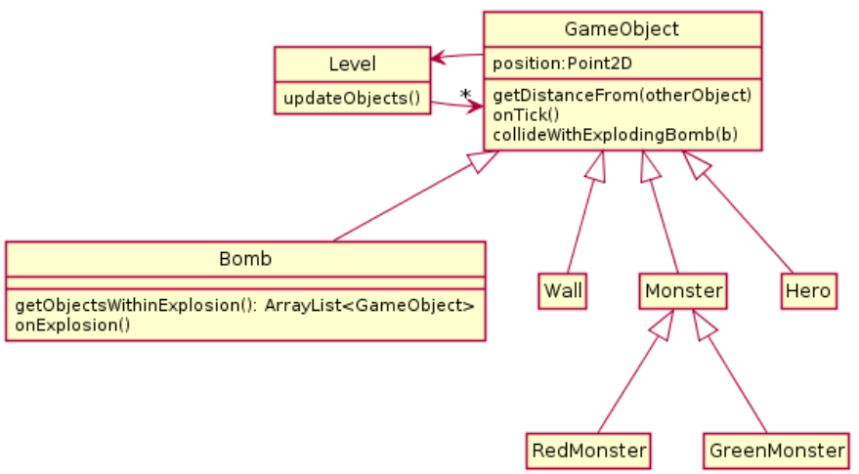
A Solution

Slide 20
Each subclass will process the effects of a collision inside of the collideWithExplodingBomb method. No instanceof is required. Additionally, the code to handle collisions can be done inside onExplosion as before:
for(GameObject g : getObjectsWithinBombExplosion()) {
g.collideWithExplodingBomb(this);
}
Each subclass will deal with handling the class specific effects of being hit by a bomb

Slide 21
Team Project
Work time
Be sure everyone is getting a chance to drive.

Slide 22
Platforms and Drops
What if we wanted Platforms to collide as well?
 | UserPlat | BouncePlat | DamageDrop | HealDrop
UserPlat |  | X | X | X
BouncePlat | X | X | X | X
DamageDrop | X | X
HealDrop | X | X
Notes:
Advanced only if time allows, solution (takes some slightly different conventions)

Slide 23
Platforms and Drops
AbstractPlatform and AbstractDrop
Subclasses implement
collideWith(AbstractPlatform)
 | UserPlat | BouncePlat | DamageDrop | HealDrop
UserPlat |  | X | X | X
BouncePlat | X | X | X | X
DamageDrop | X | X
HealDrop | X | X

Slide 24

Double/Multiple Dispatch
Another advanced technique
Helps especially when you want to store all objects in a single list
Requires some boilerplate code
Trade-offs as with many design choices
When many different things are interacting with many different things
Additional slides and project available to see
Notes:
Optional slides Part3 not required

