Slide 1
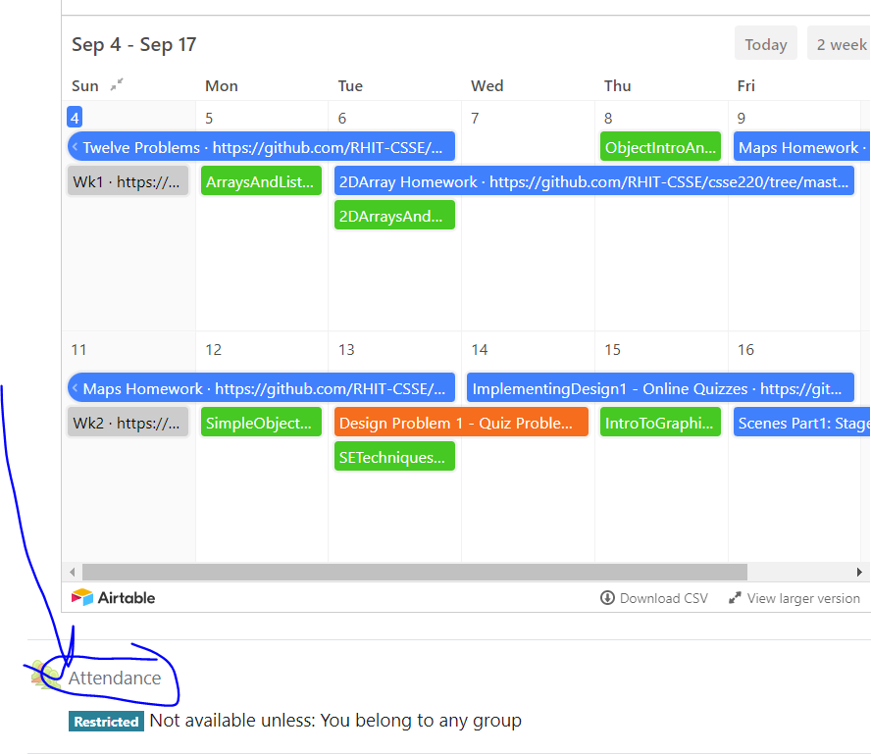
CSSE 220
Attendance password
is written on the board
Interface Review
The git projects for today are:
PracticeEventBasedProgramming
PracticeEventBasedProgrammingSolution
The Quiz today is:
EventBasedProgrammingQuiz
Notes:
Bring hardcopy of BreakfastMain from EventBasedProgrammingSolution.
Stay focused. No time for tangents. Give them time to work at the end.

Slide 2
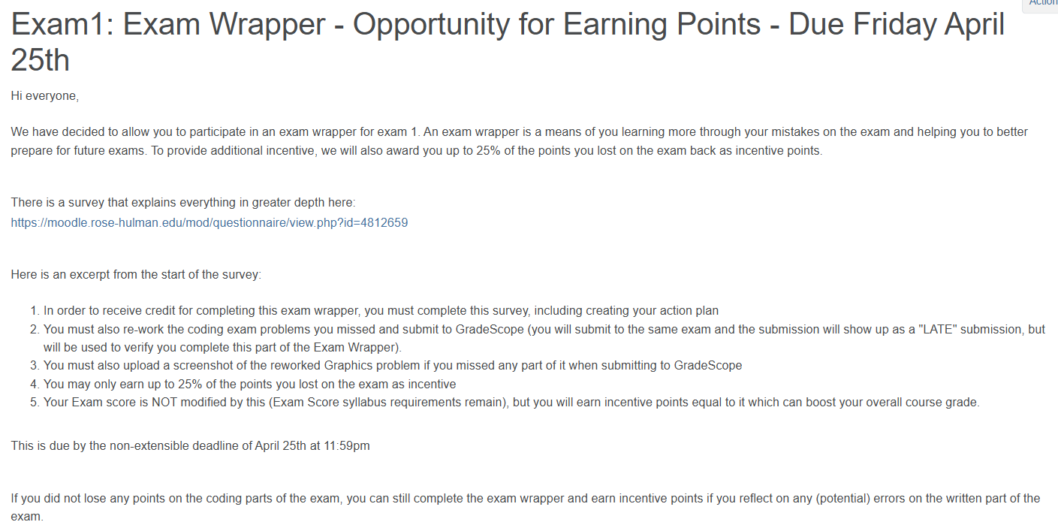
Exam 1 Wrapper

Slide 3

Education Research

Slide 4
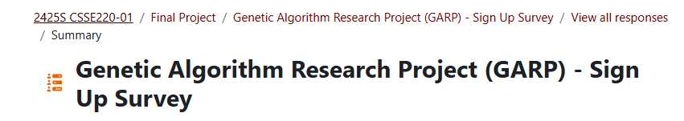
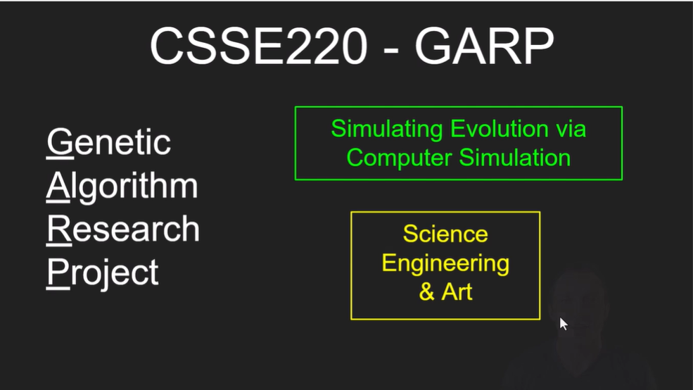

Slide 5
Interfaces - Review
Interfaces are contracts
Any class that implements an interface MUST provide an implementation for all methods defined in the interface.
Interfaces represent the abstract idea (and what it can do):
Weighable objects (return weight in lbs)
NumberSequences (get the next number, reset)
Pet (Can be eatFood, can tell if eating, can tell name)
Classes represent the concrete idea (how it does it):
Country, Bank Account
AddOne, PowersOfTwo.
Dog, Cat, Fish

Slide 6
Polymorphism! (A quick intro)
Etymology:
Poly → many
Morphism → shape
Polymorphism means: An Interface can take many shapes.
A Pet variable could actually contain a reference to a Cat object, a Dog object, or a Fish object
Notes:
If you find it helpful you can ask:
If I run “Pet p = new Dog();”
What is the type? (confusion… Both?)
There is a declared (Pet) and actual (Dog) type.

Slide 7
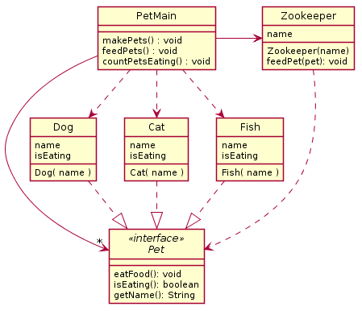
Pet Interface Example
Method makePets()
still must directly call
constructor for Dog,
Cat, and Fish
That’s why we have
the 3 dependency arrows
Method feedPet()
calls eatFood() from Pet
That’s why we have
this dependency arrow
One object List<Pet> in PetMain
Notes:
Now that we have developed an interface, let’s implement the changes in code.

Slide 8
Polymorphic method calls
In the following call to eatFood: myPet.eatFood();
If variable myPet contains a reference to a:
Dog object, then Dog’s eatFood()will be called
Cat object, then Cat’s eatFood()will be called
Fish object, then Fish’s eatFood() will be called
Your code is well designed if:
You don’t need to know which eatFood implementation is called (i.e., the Dog's, Cat's, or Fish's)
The end result is the same. (“myPet eats”)
Q5

Slide 9
Interfaces – Review (continued)
Declared type is Pet
The specific method to use at runtime is decided by late-binding
Pet myPet = new Dog();
myPet.eatFood();
Pet is the declared type of myPet. This fact is used at compile time to determine if calling eatFood is legal
Dog is the instantiation type of myPet. This fact is used by Java at runtime to make sure Dog's eatFood() gets called
Instantiated type is Dog

Slide 10
Finish the sentence
Using interfaces can help reduce _______ between classes.
Coupling
Cohesion
Encapsulation
Polymorphism
We need interfaces for event-based programming in Java.
Notes:
Correct answer is Coupling, also dependencies would be a good answer

Slide 11
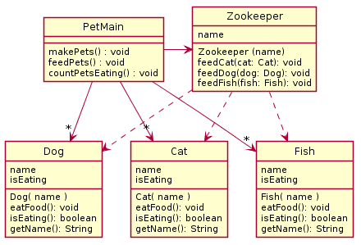
Less Coupling with Interface Version

