Slide 1
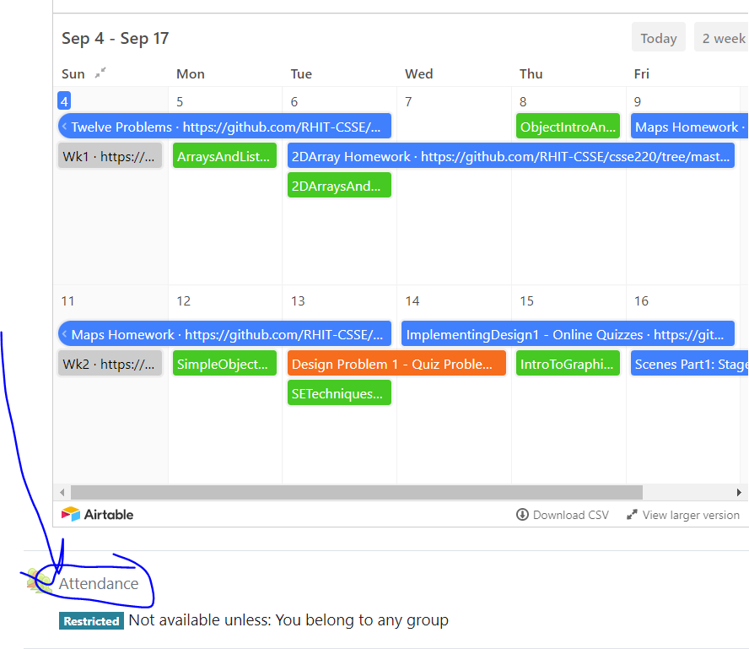
CSSE 220
Attendance password
is written on the board
Part 1 Review:
Access Levels, UML Diagramming Details
The git projects for today are:
PracticePolymorphism
PracticePolymorphismSolution
The Quiz for today is:
PolymorphismQuiz
Notes:
Bring code for all the classes in PracticeSolutionPolymorphism that have TODO items.
Highlight the TODO items so you can keep moving.

Slide 2
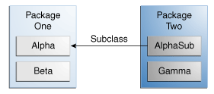
Access Levels: Review
Modifier | Class | Package | Subclass | World
public | Y | Y | Y | Y
protected | Y | Y | Y | N
no modifier | Y | Y | N | N
private | Y | N | N | N
Notes:
This can be used to help demonstrate that instance variables/methods INSIDE Alpha will be accessible by various other classes

Slide 3
Access Levels: Review
Modifier | Alpha | Beta | Alphasub | Gamma
public | Y | Y | Y | Y
protected | Y | Y | Y | N
no modifier | Y | Y | N | N
private | Y | N | N | N
Notes:
This can be used to help demonstrate that instance variables/methods INSIDE Alpha will be accessible by various other classes

Slide 4
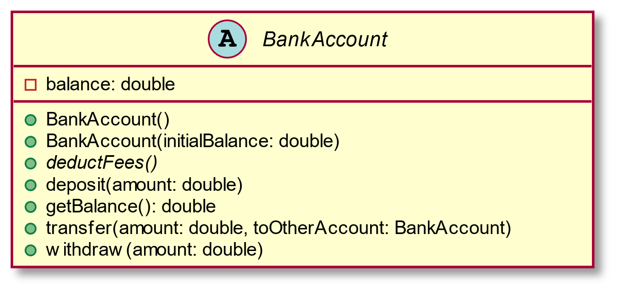
Abstract Class Example - UML
As appears in class diagram
UML code for abstract class
abstract class BankAccount {
-balance: double
+BankAccount()
+BankAccount(initialBalance: double)
+deposit(amount: double)
+getBalance(): double
{abstract}+deductFees()
+transfer(amount: double, toOtherAccount: BankAccount)
+withdraw(amount: double)
}

Slide 5
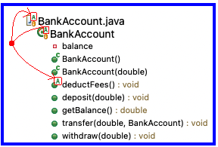
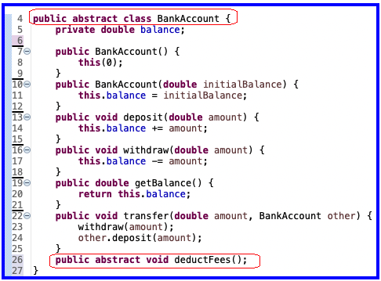
Abstract Class Example - Eclipse
Eclipse Package Explorer
Java code for abstract class

Slide 6
UML Class Diagram Review
Inheritance, Associations, and Dependencies

Slide 7
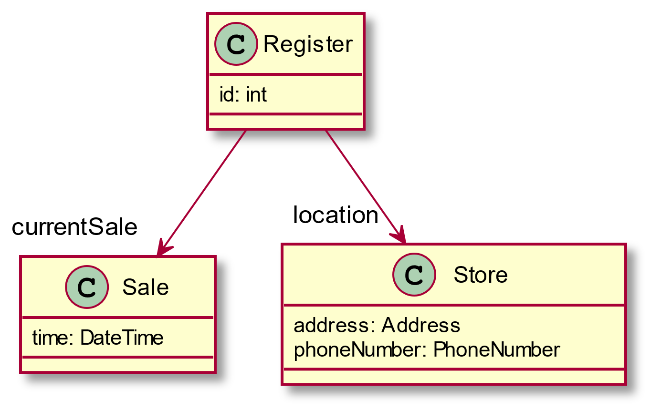
Recall UML: Associations
Solid line, open arrowhead = “has-a”
Answer me this:
Register has how many fields?
What are their names?
PlantUML code for placing field name at arrowhead:
Register -down->"currentSale" Sale
Register -down->"location" Store
Notes:
Showing Sale & Store attributes as associations visually emphasizes relationships important in object collaboration
[How many attributes does Register have? 3
What are their names? Id, currentSale, and location]

Slide 8
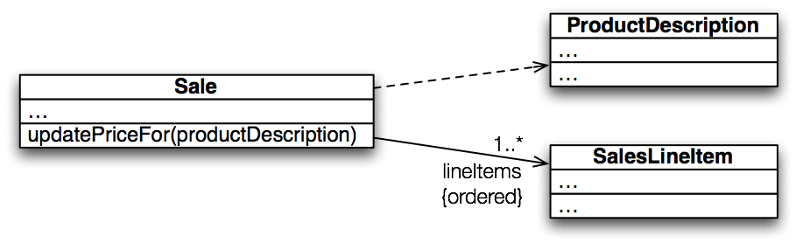
Recall UML: Dependencies
Dependency lines are dashed
Field association lines are solid
Use association lines only when an item is stored as a field. Solid = stronger rel.
Two types of open arrowheads: open and closed
Notes:
A dependency is a “using relationship” that states a change in specification of one thing may affect another thing that uses it
>>>On board (and quiz): global variable, parameter, local variable, static method call
[Which of these are we showing here? Parameter]
• labels

Slide 9
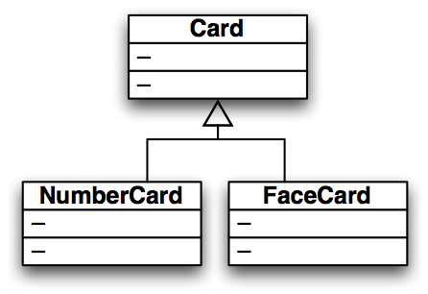
Recall UML: Inheritance
Generalization (superclass)
Specialization (subclass)
Closed arrowhead = “is-a”. Two types: solid line= inherits, dotted line = implements. Solid = stronger rel.

