Slide 1
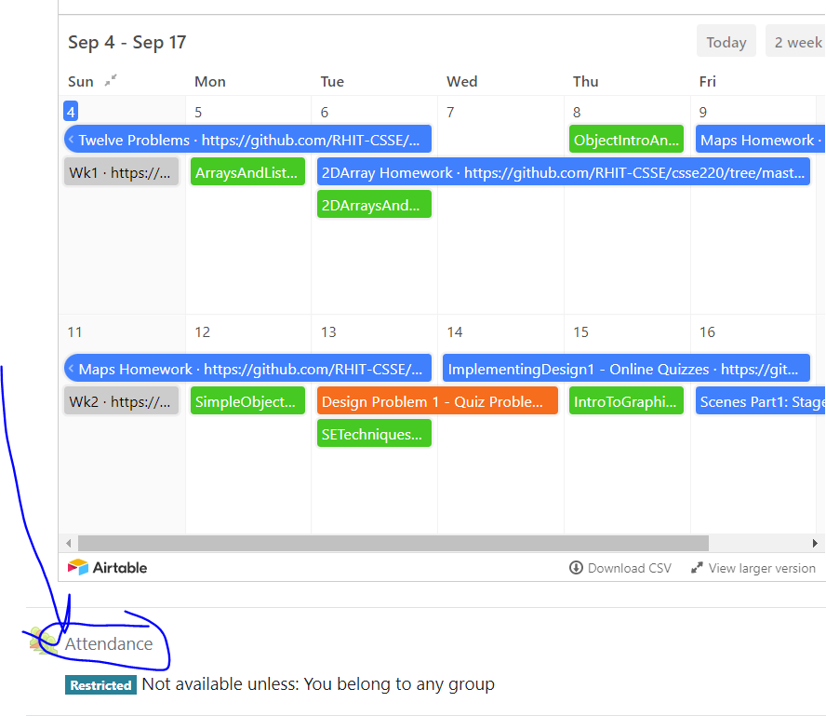
CSSE 220: Object Design
Attendance password
is written on the board
Part 1 of Many
Also Class Diagrams
The git projects for today are:
PracticeFirstOODesign
PracticeFirstOODesignSolution
The Quiz for today is
SETechniquesQuiz
Notes:
We ask them to draw the Quiz Question 2 UML on paper FIRST and then
Later in class we teach them how to use plantUML to convert it
You will have trouble having enough time to get to the Cards problem,
but leave that as an outside of class exercise

Slide 2

Review: Static vs. Instance Variables
Static
Belongs to the CLASS
Does NOT require any objects to be created
NOT related to any specific object
CANNOT use the keyword this
The main method is static
Instance
Belongs to an INSTANCE or specific object
Requires creating a specific object since it pertains to a specific object
CAN use the keyword this
The main method is NOT an instance method

Slide 3
Designing Classes
Programs typically begin as abstract ideas – "I want Twitter, for dogs"
These ideas form a set of requirements (i.e., what a user wants)
How to do requirements analysis is the subject matter of CSSE371
In CSSE220, you are given the requirements and asked to build the software system based on these requirements
A set of requirements must be transformed into a software design
How to do this transformation is the subject of our SE Techniques series that begins today
Often this process encompasses: 1) proposing designs and then 2) iteratively refining them into something that might work
It's super important to work out as many problems in the design phase prior to the software development phase – in the long run this saves large amounts of time, cost, and pain

Slide 4
Designing Classes
We propose designs, then iteratively refine them into something workable
Many bad ideas in the process
as we iteratively define the design, we’ll end up tossing them out
We don’t want to implementing bad ideas in code!
It’s too time and resource costly!
Need better way to determine if it’s an incomplete/inconsistent solution
We need a way to communicate/think concretely about these half-baked program approaches
We need a diagram language!
Can be put together with reasonable cost (time/energy)
We can test out idea for solutions
Helps us eliminate the incomplete/inconsistent approaches early

Slide 5
Tools of the Trade - Diagramming
Class Diagrams (UML)
UML – Unified Modeling Language
This is a diagramming language unspecific or unconnected to any specific programming language
UML supports many different types of diagrams
CSSE220 will be using the class diagramming language i.e., think Java classes
CSSE 37X courses make use of the other types of diagrams

