Slide 1
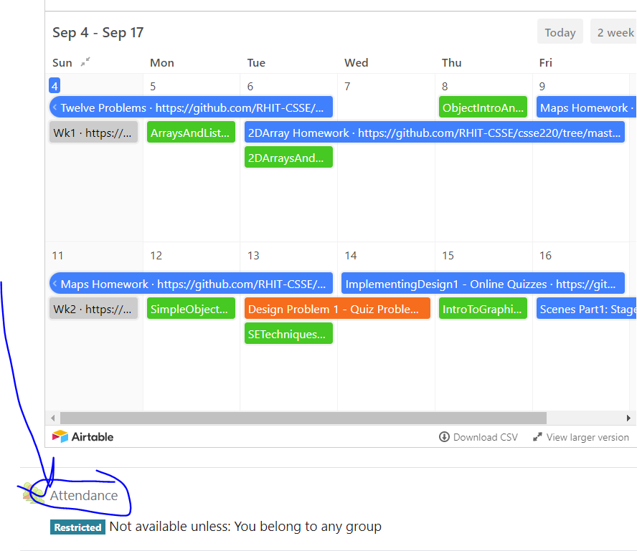
CSSE 220
Attendance password
is written on the board
Sorting Algorithms
Algorithm Analysis and Big-O
Searching
The git projects for today are:
PracticeSortingAndSearching
PracticeSortingAndSearchingSolution
The Quiz for Today is:
SortingQuiz
Notes:
Bring a few playing cards or preferably BIG LETTERS or BIG NUMBERS.
Bring a copy of the yellow pages. Make sure the page numbers on the “Searching” slide are correct.

Slide 2
Questions?

Slide 3
What is sorting?
Let’s see…
Notes:
Odd term, "sorting". Knuth: He was sort of out of sorts from sorting that sort of data.
My boss ordered me to order a new tape drive so we can order our data several orders of magnitude faster.

Slide 4
Why study sorting?
At least 5 well-known algorithms that have the same functionality:
Selection (Covered Today)
Insertion sort (Covered Today)
Merge sort (Covered Next Class)
Quick sort
Heap sort
Can do an analysis of each algorithm and compare the results
Sorting is done every day all the time – think of the results of a google search
Notes:
[see story on next hidden slide]

Slide 5
Course Goals for Sorting: You should…
Be able to describe basic sorting algorithms:
Selection sort – O(N²)
Insertion sort – O(N²)
Merge sort – O(N * log₂(N))
Know the run-time efficiency of each
Know the best and worst case inputs for each

Slide 6
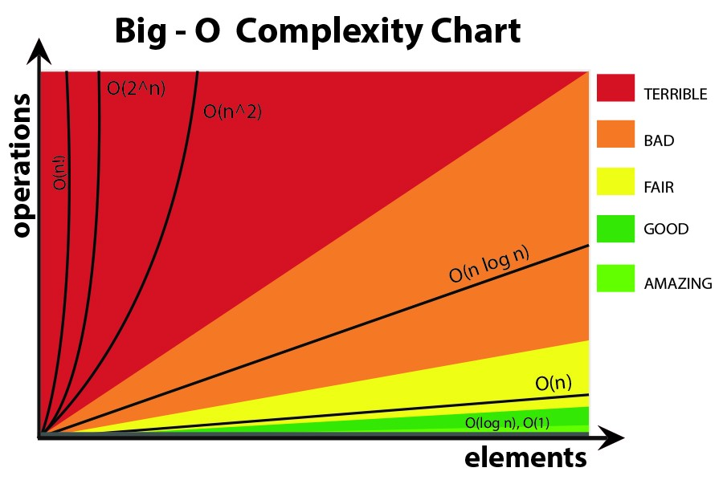
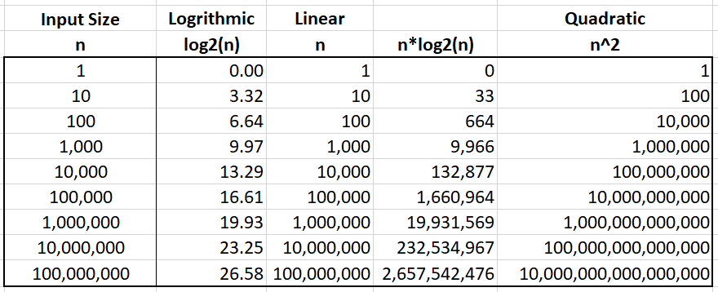
Sorting Terminology:
Non-decreasing: use ≥
Non-increasing: use ≤
Notes:
reversed

Slide 7
Selection Sort
Basic idea:
Think of the list array as having a sorted part (at the beginning) and an unsorted part (the rest)
Find the smallest value in the unsorted part
Move it to the end of the sorted part (making the sorted part bigger and the unsorted part smaller)
Repeat until unsorted part is empty
Notes:
Review algorithm with a few of the cards or preferably the BIG LETTERS or big numbers
Look at sortAndSearch.SelectionSort(), briefly explain use of generic methods.
Takeaways:
Start iterating from index 0 (firstUnsortedIndex)
Smallest remaining starts with value at index 0;
When smallest remaining element is found, swap with value at index from outer loop (firstUnsortedIndex).

Slide 8
Selection Sort
Basic idea:
Think of the list array as having a sorted part (at the beginning) and an unsorted part (the rest)
Find the smallest value in the unsorted part
Move it to the end of the sorted part (making the sorted part bigger and the unsorted part smaller)
Repeat until unsorted part is empty

Slide 9
Profiling Selection Sort
Profiling: collecting data on the run-time behavior of an algorithm
In Eclipse, determine how long does selection sort take on:
10,000 elements?
20,000 elements?
…
80,000 elements?
Q1
Notes:
[Plot data on whiteboard after they’re done]
[Or use Excel]
https://docs.google.com/spreadsheets/d/19V1f8brgzNm9bcj1giJqIg5MVgJjqbOTsFt9p6tBq_o/edit#gid=0

Slide 10
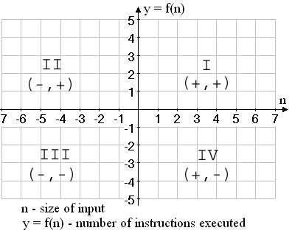
Performance Analysis Basics
Come up with a math function f(n) such that it does the following:
input: n = size of the problem to be solved by the algorithm
output: y = f(n) - the number of instructions executed
Only care about Quadrant I

Slide 11
Analyzing Selection Sort
Analyzing: calculating the performance of an algorithm by studying how it works, typically mathematically
Typically we want the relative performance as a function of input size
Example: For an array of length n, how many times does selectionSort() call compareTo()?
Look at number of times compareTo() is called as a shortcut way to determine the Big-O
Q2-Q7
Notes:
- Remember Shlemiel. His technique worked well for small inputs (i.e., short roads), but got worse and worse.
Handy fact is animated. Note that we can derive the fact for even n by working outside in.
Have them work on Q2-6. Solve Q7 together on board.
After solving, ask: For very large n, what term of solution matters most? What term grows fastest? Do the other terms contribute much to the growth of the function?

Slide 12

Summation Notation & Facts
$$\sum_{k=0}^{n−1}{k= ?}$$
$$\sum_{k=0}^{n−1}{k=0+1+2+…+n −1}$$
$$\sum_{k=0}^{n−1}{k= \frac{n∗ \left(n−1\right)}{2}}$$
Open form
Closed form
Induction is used to prove this

Slide 13

Summation Notation & Facts
$$\sum_{k=1}^{n}{k= ?}$$
$$\sum_{k=1}^{n}{k=1+2+…+n}$$
$$\sum_{k=1}^{n}{k= \frac{n∗ \left(n+1\right)}{2}}$$
Open form
Closed form
Induction is used to prove this

Slide 14
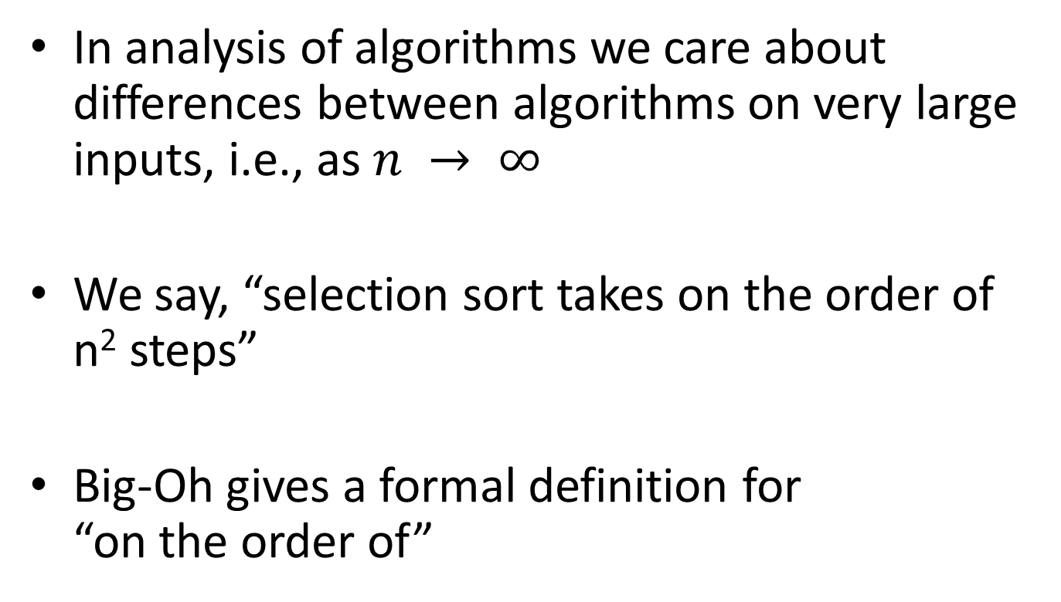
Big-Oh Notation
In analysis of algorithms we care about differences between algorithms on very large inputs, i.e., as $n → ∞$
We say, “selection sort takes on the order of n² steps”
Big-Oh gives a formal definition for “on the order of”
Q8

Slide 15
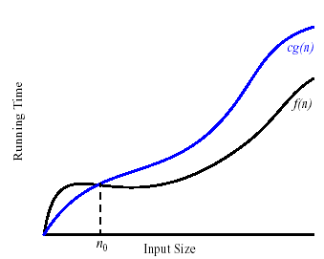
Formally
We write f(n) = O(g(n)), and say “f is big-Oh of g”
if there exists positive constants c and n₀ such that
0 ≤ f(n) ≤ c g(n) for all n > n₀
g is a ceiling on f
Notes:
Can pick an example expression for this and work out on board if you like, but not needed in CSSE220 to do this

