Slide 1
CSSE 220
Project Reminders
Notes:
1

Slide 2
Some independent learning required
We do not teach you how to do certain things:
Use the keyboard (Arcade Game)
Browse to find files (GARP)
You may use Google/etc. to learn how to.
We want you to demonstrate learning independently
We hope this gives you confidence to learn other things as well (adding music, animation, etc.)
Some hints:
ArcadeGame (KeyListener, “focus”)
GARP (JFileChooser)

Slide 3

Milestone Due Soon!
Make sure to meet as a whole team to stay in sync
Should be sure it is scheduled (Driver)
Should be sure there is an agenda (Navigator)
Should be sure there are minutes taken (Reviewer)
Make sure to track your time
Required to help track contributions to project
Make sure to complete in your Milestone Report
Review responsible to submit it
Parts of report should be completed by Driver/Nav
The Milestone Report is Submitted via GradeScope
It provides a link to the template for you to complete the report.

Slide 4
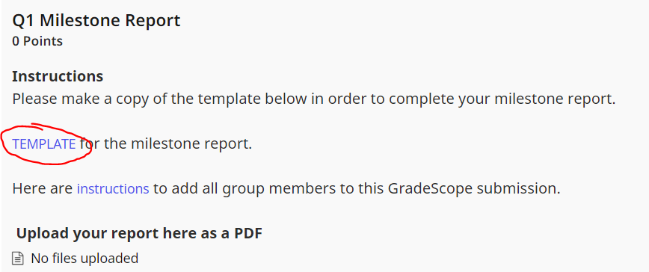
Milestone Due Soon!

Slide 5
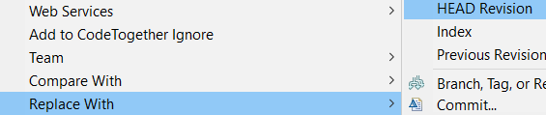
Git Workflow Reminders
Team->Pull (gets code from GitHub)
Edit (make local changes)
Team->Commit (add a message)
Team->Pull (to be safe and get latest version)
Team->Push (puts code on GitHub)
IF you get an error during step #1
File conflicts with FileX.java
Then IF you don’t care about .java on your computer and want the version on GitHub you can:
Right Click on FileX.java ->Replace With-> HEAD Revision

Slide 6
Rejected “Non-Fast Forward”
Your code is out of sync with the remote repo
- i.e. You are at version V2, and it is at version V3
You need to get the latest version of the code in your repo BEFORE you can Push, thus:
FIRST be sure to do a
Team->Pull

Slide 7
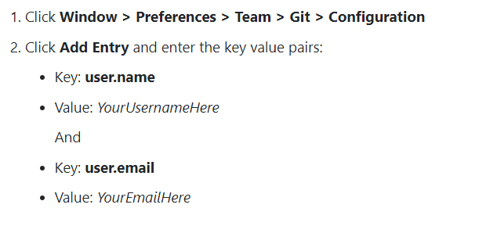
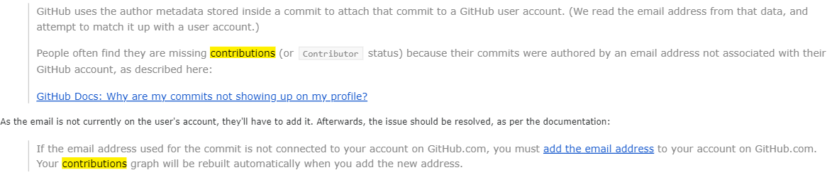
Why are my contributions not showing up on my profile?
https://docs.github.com/en/account-and-profile/setting-up-and-managing-your-github-profile/managing-contribution-settings-on-your-profile/why-are-my-contributions-not-showing-up-on-my-profile#your-local-git-commit-email-isnt-connected-to-your-account

Slide 8
Meetings with your TA
Team must schedule a meeting with the TA
Schedule it as soon as you finish each Milestone
If you have trouble communicating with the TA let your instructor know right away!
During the TA meeting
Have your report ready
Have your program ready to demo
Each person should be participating (based on role)
There can be flexibility within roles

Slide 9
Project advice
When done with Milestone1 (or beyond)
Add “final Milestone1 Commit”
To your commit message so graders will know to check out that version
Build an end-to-end solution
Build the next thing you can TEST
Don’t focus on cool graphics and other extra items early in the project, focus on basic functionality
Complete the milestone and keep moving forward!

