Slide 1
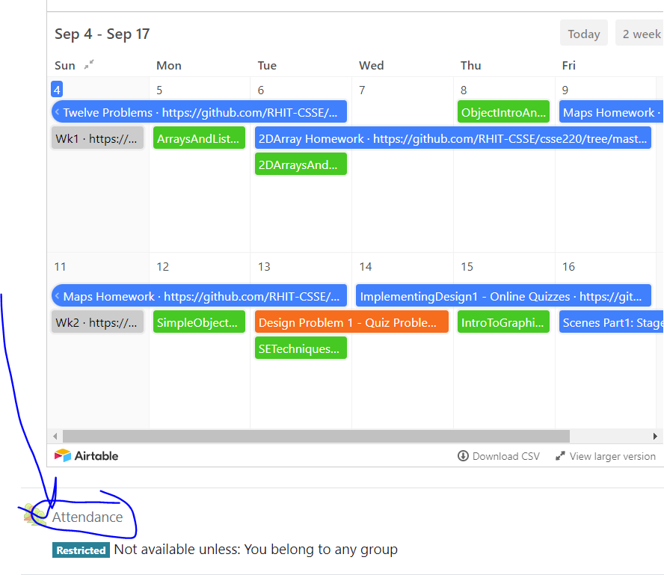
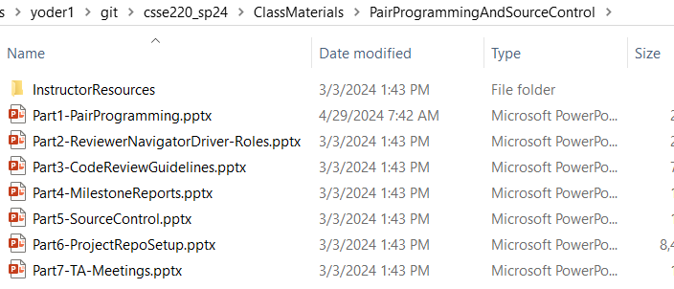
CSSE220 Final Project Tools: Pair Programming and Source Control 101
Attendance password
is written on the board
Quiz Today is
SourceControlAndPairProgrammingQuiz
No projects other than the final code repo
Notes:
We want to introduce roles, answer questions, and then let them work on their project and meet with their TA.

Slide 2
Agenda
Pair Programming
Tester, Reviewer, Navigator, Driver Roles (Teams of 3-4)
Reviewer Guidelines
Milestone Reports
Source Control Overview
Project Repo Setup Guide
TA Meetings

Slide 3
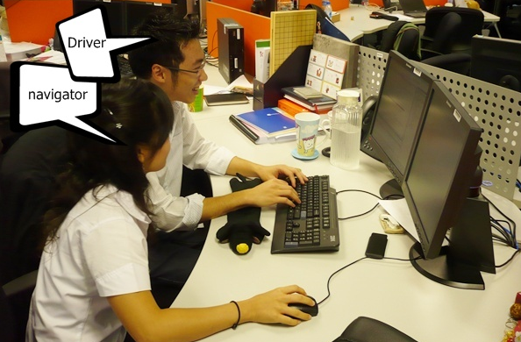
Pair Programming (Normally)
Working in pairs on a single computer
The driver, uses the keyboard, talks/thinks out-loud
The navigator, watches, thinks, comments, and takes notes
Person who really understands should start by navigating
Enable the pair to produce higher quality code than that produced by the sum of their individual efforts
Reduces number of errors
Saves time in the long run
Notes:
Emphasize: Person who really understands should start by navigating (true for our DNR plan as well)

Slide 4
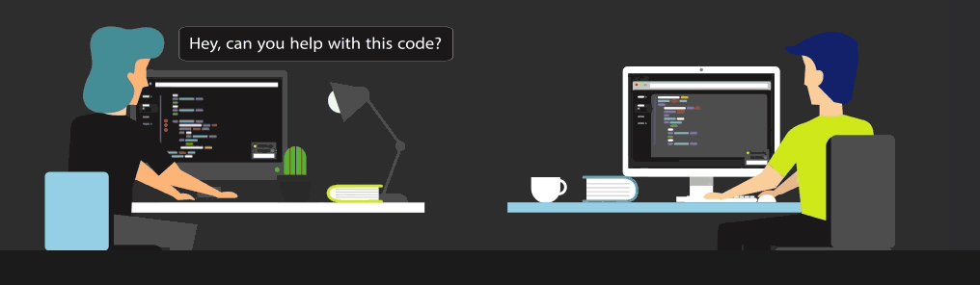
Pair Programming (Remotely)
Working in pairs on two different, remote computers
The driver, uses the keyboard, talks/thinks out-loud
The navigator, watches, thinks, comments, and takes notes
Person who really understands should start by navigating
To allow the navigator to see what driver is doing, you must use some kind of tool such as
Screen sharing via MS Team (or Zoom/etc)
https://www.codetogether.com/ Eclipse plugin allows you to work together through a browser
If you have trouble sharing screens because of internet bandwidth issues or find it too clunky:
the https://www.codetogether.com/ Eclipse plugin might be a good tool for you and your partner to use
You could do a phone call or audio only call via MS Teams
Similarly, remote pair programming enables the pair to produce higher quality code than that produced by the sum of their individual efforts
Driver
Navigator
Notes:
Emphasize that there is only code on one computer, which can be helpful as we will need later.

Slide 5
Things to DO
Meet Regularly – setup times when you will regularly work on the project
Talk – not a minute should go by when you are not communicating
Listen – each partner should be fully involved in the project
Rotate Roles – change roles to gain new perspectives and share the work
Be Patient – It’s a virtue, by explaining yourself, you help yourself learn
Respect – everyone has something to offer
Take Breaks – When you return, you may notice something you missed
Prepare – Do any preliminary work ahead of time (not code)
Have Fun – Working with someone else can be a lot more fun!
Discuss as a team: How well have you done these so far?
Notes:
These might seem like common sense, but they are critical to mention!

Slide 6
Things NOT to do
Don’t: Force your opinion as the only option
Always assume your partner(s) may have equally good ideas to contribute!
Don’t: Be intimidated
You know more than give yourself credit for!
Don’t: Be Quiet
Don’t be afraid to speak up if you don’t agree with your partner(s)!
Don’t: Suffer in Silence
If you have a problem with your partner(s), let your TA or professor know right away!
Discuss as a team: Have you had any bad experiences related to these in a team in the past?
Notes:
These might seem like common sense, but they are critical to mention!

