Slide 1
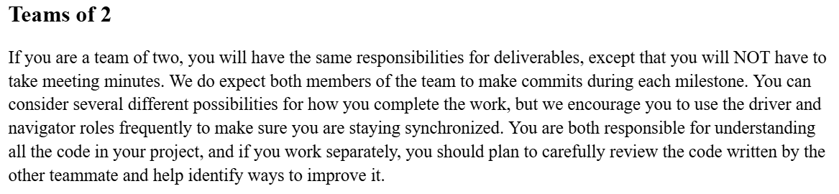
RND+T – Reviewer, Navigator, Driver, Tester

Slide 2
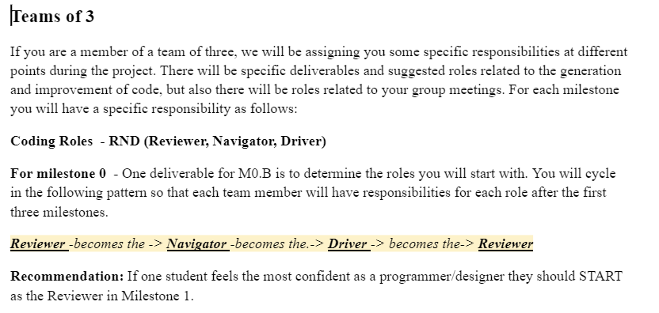
RND+T – Reviewer, Navigator, Driver, Tester

Slide 3
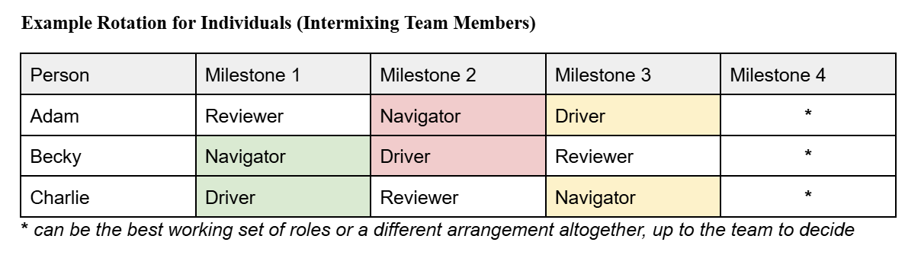
Rotations for Teams of 3

Slide 4
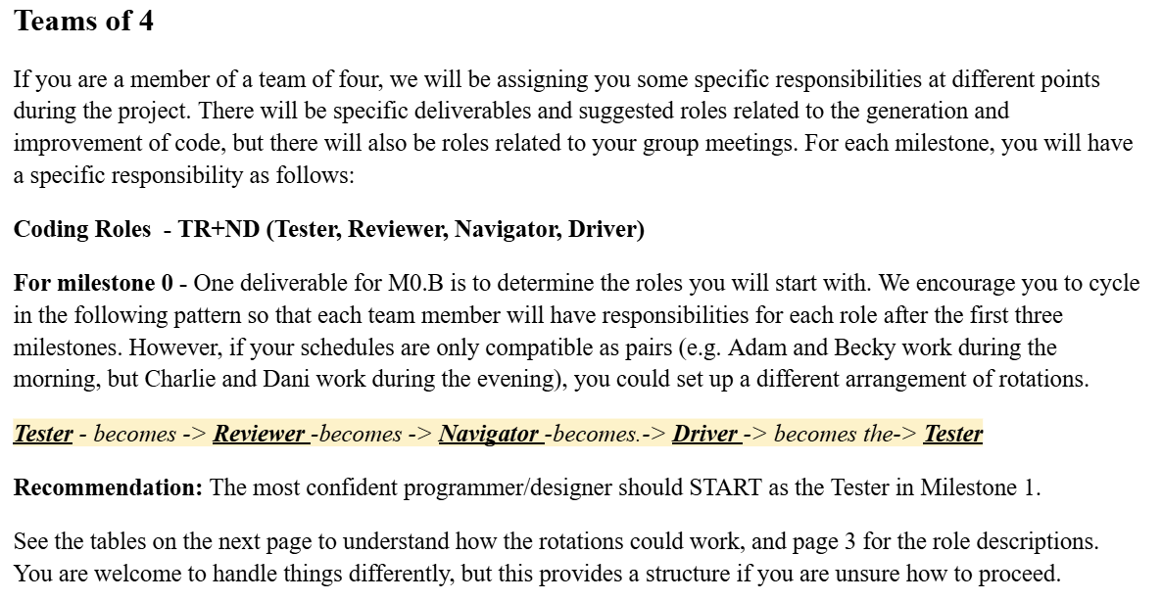
RND+T – Reviewer, Navigator, Driver, Tester

Slide 5
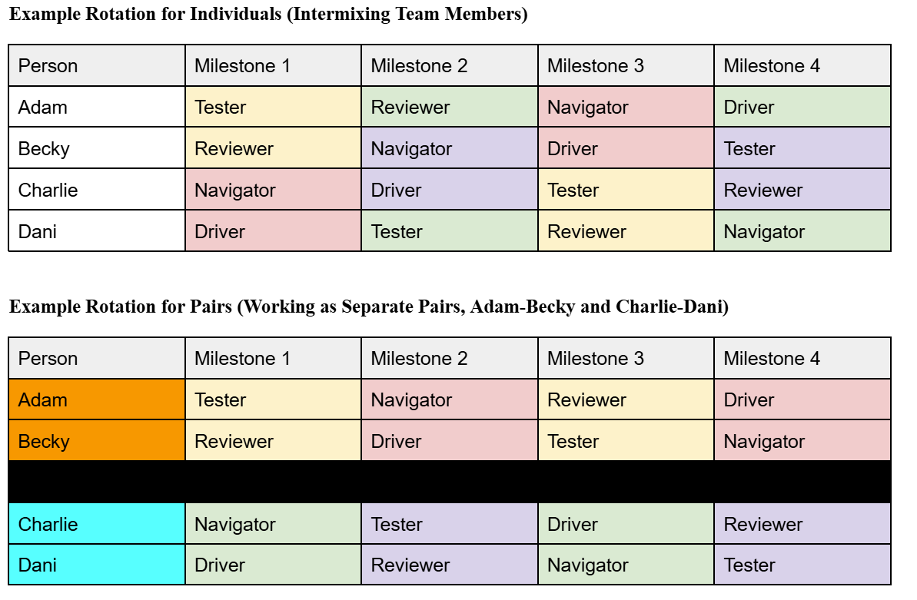
Possible Rotations for Teams of 4

Slide 6
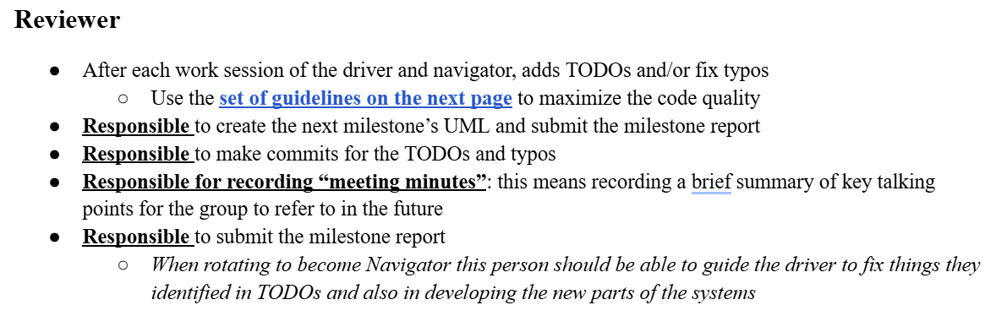

Reviewer

Slide 7
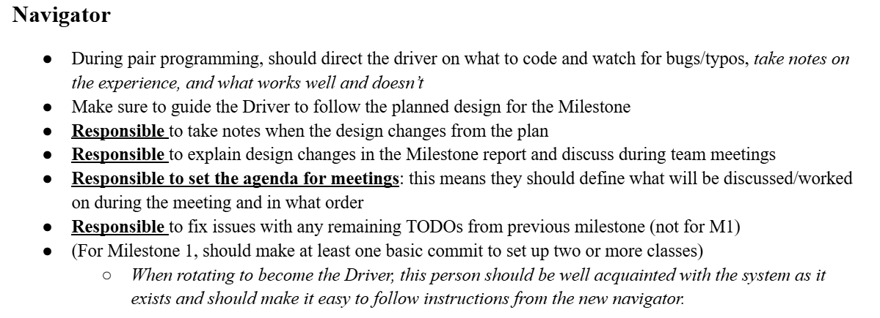

Navigator

Slide 8
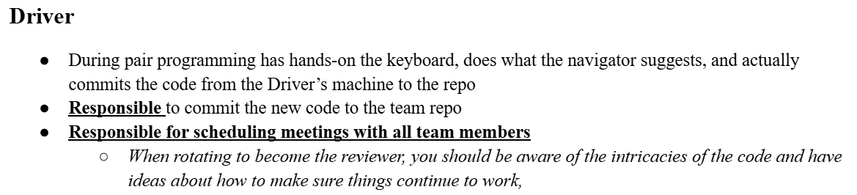

Driver

Slide 9
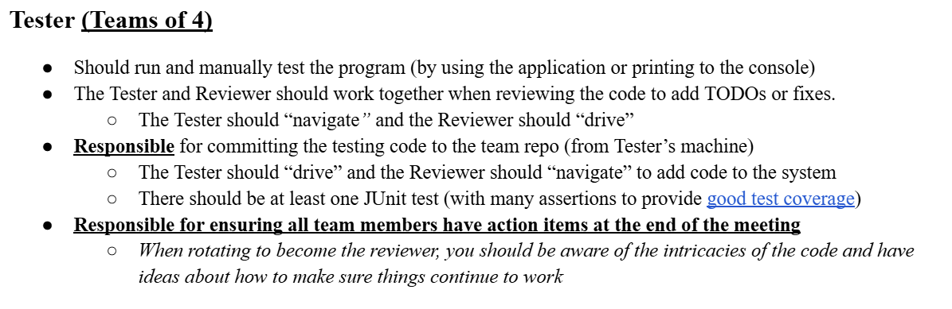

Tester (Teams of 4)

