Slide 1
Agenda
Pair Programming
Tester, Reviewer, Navigator, Driver Roles (Teams of 3-4)
Reviewer Guidelines
Milestone Reports
Source Control Overview
Project Repo Setup Guide
TA Meetings

Slide 2
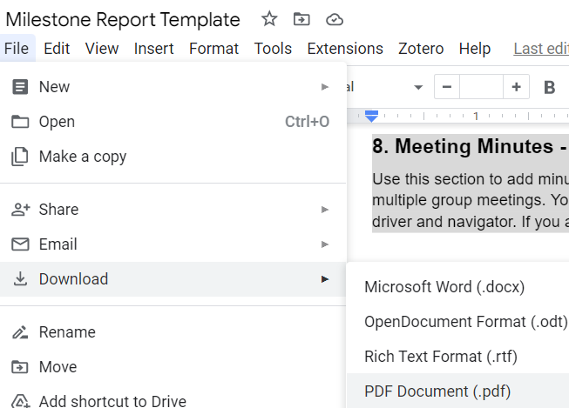
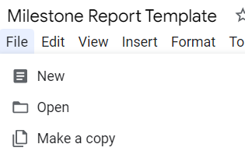




Milestone Reports
You will make a copy of this Google doc and use it to generate a PDF which you will submit to GradeScope for milestones
https://docs.google.com/document/d/1tsipgXLDyp_IEPoPnmeA7I2aA2Ev9VLnmEqVDER1DHA/edit
Next Slide Gives High-Level Overview

Slide 3
Components of the Milestone Report
1. Overall Progress
2. Individual contributions
3. Originally Planned UML for this Milestone
4. Final State of UML for this Milestone
5. Discussion of changes to design
6. UML for next Milestone
7. Reflection on what the team did well and how it can improve
8. Meeting Minutes - Whole Team
Use this section to add minutes from all meetings.
Feel free to use this template repeatedly for multiple group meetings.
You do not have to keep minutes for coding sessions with only the driver and navigator.
If you are a team of size two you do NOT have to complete this section.
9. Testing
10. Optional (BONUS) Video Demo

Slide 4
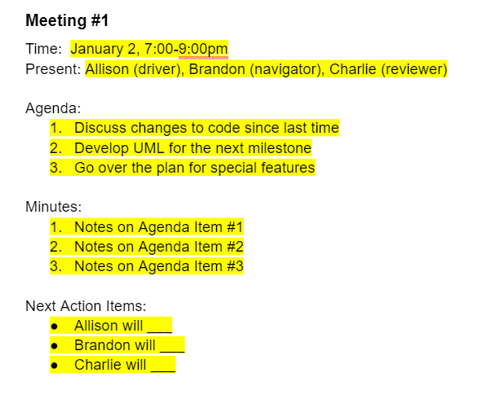
Example of Meeting Minutes

Slide 5
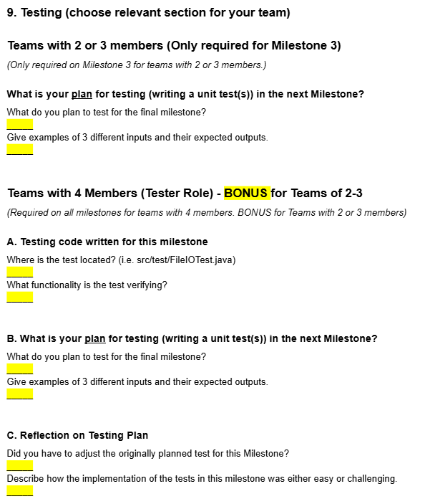
Testing for Teams of 2 or 3 Member

Slide 6
Testing for Teams with 4 Members

