Slide 1
Agenda
Pair Programming
Tester, Reviewer, Navigator, Driver Roles (Teams of 3-4)
Reviewer Guidelines
Milestone Reports
Source Control Overview
Project Repo Setup Guide
TA Meetings

Slide 2
If a team of developers is collaborating on a project why can't you use something like Dropbox to keep in sync?
Question:

Slide 3
If a team of developers is collaborating on a project why can't you use something like Dropbox to keep in sync?
Question:
Answers:
If two people are editing different files at once it is likely to break the code
If two people edit the same file it is easy for one save to destroy changes made by an earlier save

Slide 4
Source control is syncing help for developers
Your changes are broken into "chunks" called commits that can change multiple files at one time on a local copy
You only sync with the shared repository when you intend to
Source controls system allows you to go back to any historical version
The source control system will prevent you from accidentally destroying someone else changes by overwriting files they changed

Slide 5
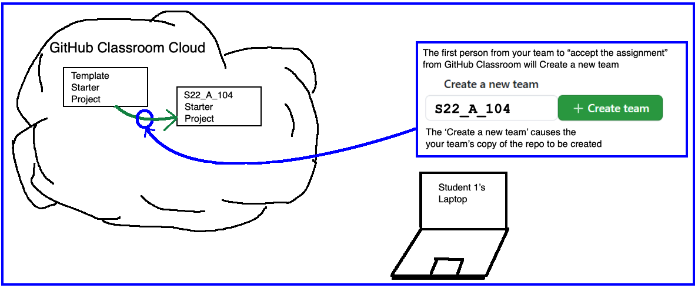
The FIRST student should do this and CREATE the team with the proper name from the Team/TA Spreadsheet
The SECOND/THIRD/FOURTH team members should JOIN the team that the first student created.
When this team is created, then a code repository (repo) is generated automatically
This new code repo is where you will be storing your code for the final project.

Slide 6
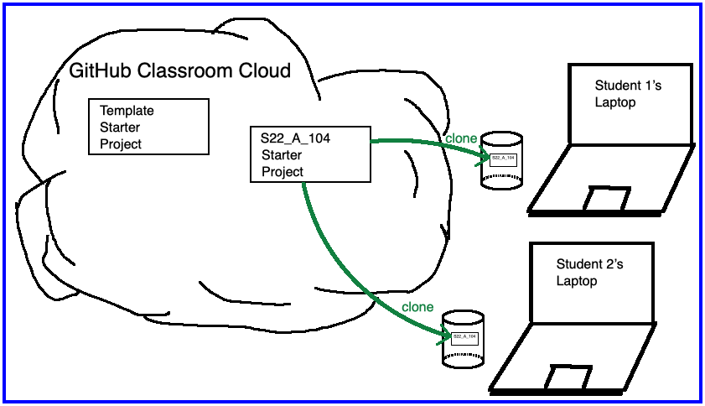
The code repo you created and team members joined is located in the GitHub “Cloud”
You will CLONE the repo locally, which means you copy the files to your laptop
You will make changes and PUSH them back into the GitHub “Cloud” for safe keeping and to share with teammates

Slide 7
Team Version Control
Version control tracks multiple versions
Enables old versions to be recovered
Allows multiple versions to exist simultaneously
Always:
Pull BEFORE working
Make changes (Edit)
Commit changes with a good message
Pull AGAIN before committing
Push
Communicate with teammates so you don’t edit the same code simultaneously
Pair programming ameliorates this issue ☺
Q2
Notes:
QUIZ QUESTION 2
If you only use one computer then this will never happen.

Slide 8
Git basic workflow
Before you start work, you PULL, syncing your local system with any changes other developers have made to the shared repository since you last worked
On your local copy, you add some code, make a feature, etc.
Commit your changes with a good commit message
You PULL again just in case something else go updated when you were working (i.e. your partner made a change)
When you are finished, you combine all your changes into a PUSH that makes changes to the shared repository

Slide 9
Programming Code Edits Visualized
Github.com repo
Main.java
David (Driver)
Natalie (Navigator)
Clone
Github.com repo
Main.java
David (Driver)
Main.java
Natalie (Navigator)
Main.java
Edit + Commit
Github.com repo
Main.java
David (Driver)
Main.java
Level.java
Natalie (Navigator)
Main.java
Push
Github.com repo
Main.java
Level.java
David (Driver)
Main.java
Level.java
Natalie (Navigator)
Main.java
Github.com repo
Main.java
Level.java
Pull
David (Driver)
Main.java
Level.java
Natalie (Navigator)
Main.java
Level.java
Notes:
Update before editing or committing to make sure you don't get out of sync with changes made by others (like your instructor, or later your teammates).

Slide 10
Team Version Control Simple Workflow
git clone
(one time)
Pull and
Commit often!
Pull BEFORE editing!
Pull
Edit +
Commit
Push
Pull
Pull BEFORE pushing!
Notes:
Update before editing or committing to make sure you don't get out of sync with changes made by others (like your instructor, or later your teammates).

Slide 11
What if Two+ People Edit the Same Code?
Math.java
Alice edits sqrt method
Bob edits sqrt method
Alice commits and pushes changes
Bob attempts to commit and push changes
ERROR
Source control system cannot
resolve multiple changes on the
same code, Bob should have
updated and resolved conflicts
before committing.
Updated Math.java

Slide 12
Git more complicated workflow
Before you start work, you PULL, syncing your local system with any changes other developers have made to the shared repository since you last worked
On your local copy, you add some code, make a feature, etc.
You try to COMMIT and PUSH, but it fails because your code was not up to date
On the PUSH, git usually gives an error reading: ''not fast forward"
So, you PULL again
On your local system, git potentially marks several of the code files to be in conflict, you fix the conflicts in your code by making more edits
You test your code
You stage the changed files (ADD)
You COMMIT and PUSH

Slide 13
Fixing conflicts – what it looks like
SomeFile.java
SomeCode
>>>>>>>>> HEAD
YourCode();
==========
TheirCode();
<<<<<<<<<<
MoreCode
You will see eclipse errors – do not get weirded out
Realize that you are merging two branches of the code
Edit the code to fix the problems
Do not forget to test

Slide 14
To Reduce the Occurrence of Conflicts
Always PULL before you begin coding
Quickly COMMIT->PULL->PUSH after you finish
Pair program so each member of the team is not modifying the same code in two DIFFERENT local copies at the same time
https://www.codetogether.com/ Eclipse plugin allows you to both edit, but it is only linked to ONE local set of files.

Slide 15
Git Problem Resolution Guide
How to update to latest version of code when you don’t care about your local changes (i.e. Team->Pull gives a “'not fast forward“ error)
Replace With-> HEAD and then Pull (removes all local changes)
Still unable to Pull?
Simply delete project and re-clone
Want to revert to an earlier commit? Simplest way:
clone the repo again as a new project (use a different name for new project)
checkout the version you want (How to go to previous commits in eclipse and egit)
Dr. Holly's Guide on How to Checkout the Git History
copy the files you want from this new project into your original and then commit + push
delete the new project since you don't want to get them mixed up

Slide 16
If you want to do pair programming remotely
Code Together works well
Two people both have access to edit the code on one computer
The next two slides provide a visual guide
It shows how to use Git effectively with this approach

Slide 17
Code Together Workflow
Driver initiates a CodeTogether session and shares it with Navigator
git clone
(one time, both Driver and Navigator)
Pull
(Driver’s computer)
Navigator connects and then watches and gives feedback via phone/conference call
Navigator: Pull
(files are now on Driver, Navigator, AND github.com)
Driver: Push
(files are now on Driver and github.com)
Driver + Navigator work together to make progress and then save their files AND commit
(only on Driver’s computer)
Pull
Notes:
Update before editing or committing to make sure you don't get out of sync with changes made by others (like your instructor, or later your teammates).

