Slide 1
Meeting with TA as time allows
Feedback on your UML
You can ask general questions
You can ask for advice
If you have not defined your TRND roles yet, do that now!
TA should your first point of contact to ask questions or request extensions
If you have trouble contacting your TA let your instructor know

Slide 2
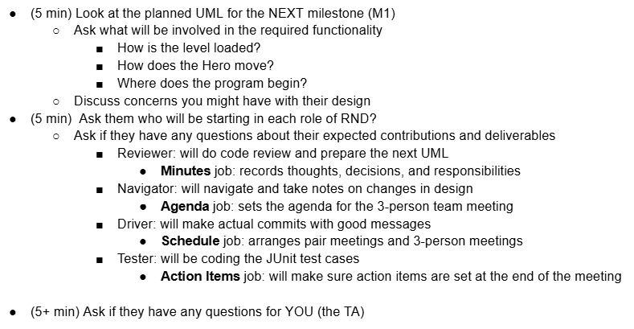
Meeting (Milestone 0) with your TA
Get Prepared:
Have your UML pulled up and ready to go over details with the TA

Slide 3
Next Meeting (Milestone 1-4) with your TA
Driver (~2 min)
1. Overall Progress
2. Individual contributions
Navigator (~2 min)
3. Originally Planned UML for this Milestone
4. Final State of UML for this Milestone
5. Discussion of changes to the design
Reviewer (~8 min)
6. UML for next Milestone
Discuss the planned UML for the next Milestone
Ask how each requirement will be provided in the code
7. Reflection on what the team did well and how it can improve
Discuss the ideas for improvements with the team
8. Meeting Minutes - Whole Team
Tester (~2 minutes)
9. Ask them to explain and demonstrate their current unit test.
Review the Commit Records (~3 min)
Functionality (~3 min)
Questions
Agenda and Plan
Make sure you are ready to show the TA everything you are responsible for
Must have UML for current and next milestone (in the Milestone Report)
Have your code ready to run
Have your git commits ready to show

Slide 4
Project Advice
When done with Milestone1 (or beyond)
Add “final Milestone1 Commit”
To your commit message so graders will know to check out that version
Build an end-to-end solution
Build the next thing you can TEST
Don’t focus on cool graphics and other extra items early in the project, focus on basic functionality
Complete the milestone and keep moving forward!

