Slide 1
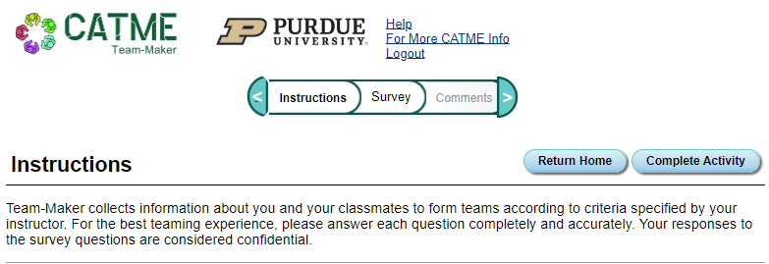
CATME
Look for an email (check spam)

Slide 2
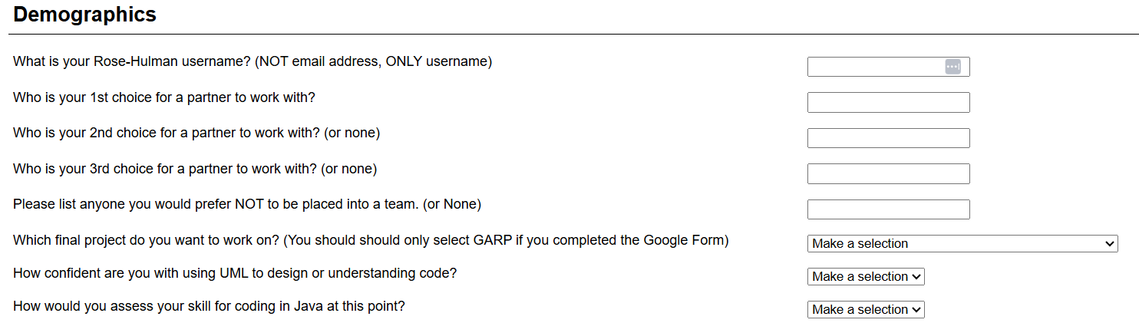
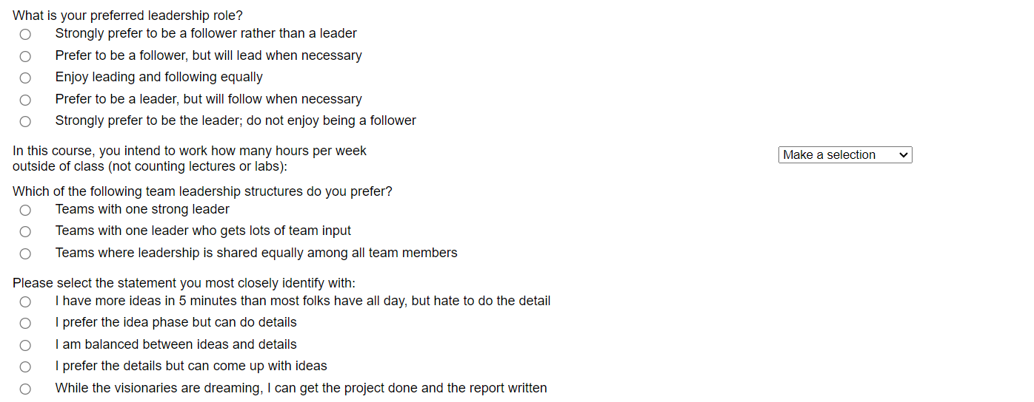






Slide 3
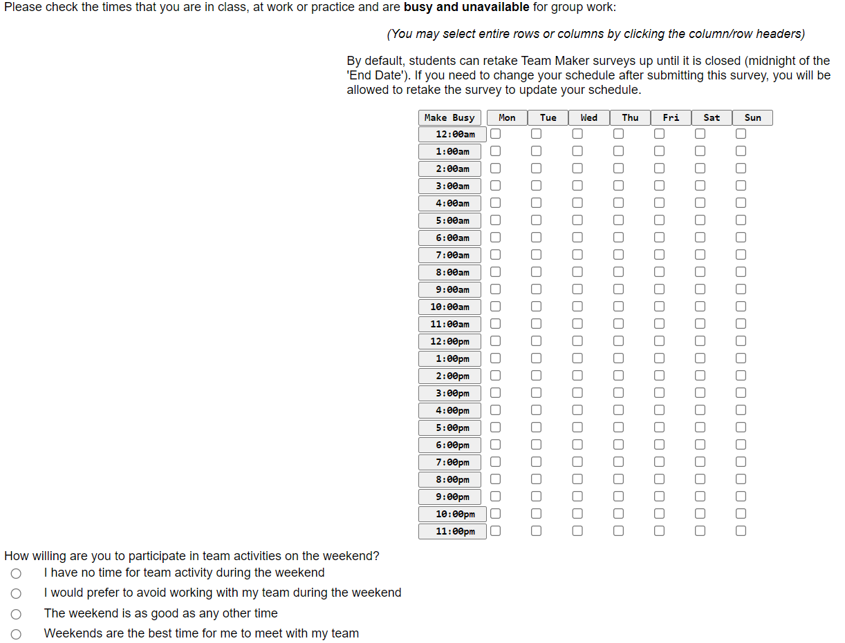

Slide 4
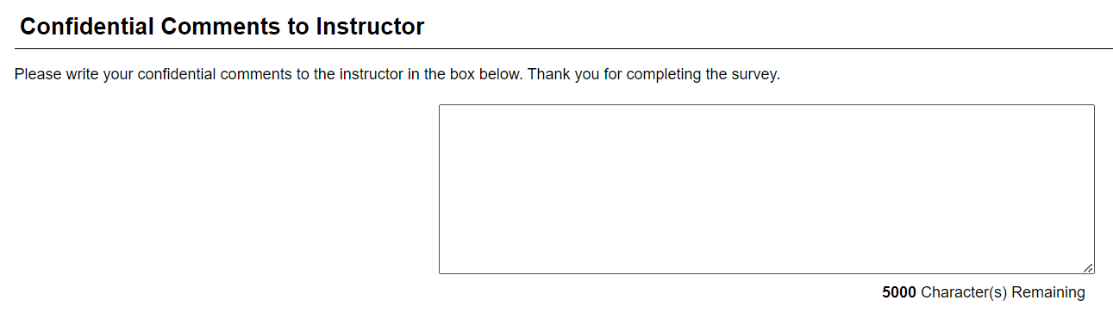
If you have any extra info to share, do it here:
If you are considering dropping the course for any reason
If you have an event or anticipate needing to be away from campus
If you have any health or personal matters that may influence you

Slide 5
We will plan to form teams soon!
Make sure to complete surveys!
2 pairs may be combined to be a team of 4
3 students requesting each other can be a team of 3

