Slide 1
Note
These Slides are duplicates of Slides from the ClassMaterials/MergeSort/Slides
If the instructions differ, you should ask your instructor for clarification
These were added here for convenience for students looking for presentation guidelines

Slide 2
CSSE 220
Presentation Details

Slide 3
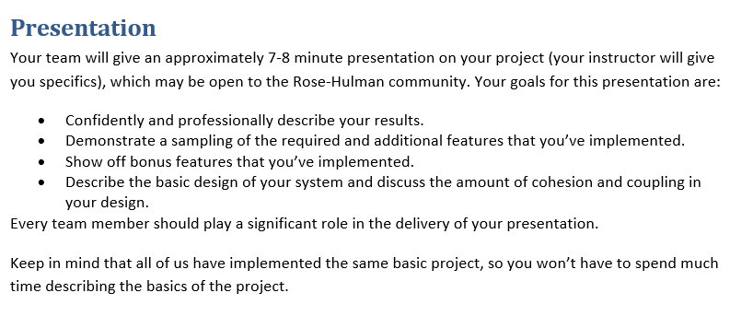
From the project specification document (ArcadeGame.docx)
Recommended:
Script your live demo and follow the script during presentation
Or, prerecord you live demo and insert recording into slides
Notes:
Dress 1 step up form your normal dress level

Slide 4
Your Presentations - Specifics
7 minutes long (Rehearse! Aim to be within 30 seconds +/- )
~3 min. Showing off your extra features
Preferably record a video!
Live demo is “Acceptable” (but beware Murphy’s law!)
~2 min. Explaining your overall design (major classes, NOT all)
“Coupling/Cohesion” or other “Good/Bad” aspects of design
Discuss OODP explicitly in your presentation
OK to say your design is BAD and what you would do differently
~2 min. Design decision, feature implementation, or tricky bug
Be explicit in stating your “Special Item” (decision/feature/bug)
Be careful about code examples (good – but in moderation)
Be sure to include prepared slides usually including diagrams
Be sure to EXPLAIN the item, not just mention it!
Notes:
4

Slide 5
From the project specification document (GARP Spec.)
7. Presentation
Your team will give an approximately 7-8 minute presentation on your project (your instructor will give you specifics), which may be open to the Rose-Hulman community. Your goals for this presentation are:
Confidently and professionally describe your results
Give a very short introduction to the basic idea of your evolutionary simulator
Demonstrate a sampling of the required and additional features that you’ve implemented
Explain and show the results of any new experiments you conducted
Explain your success/progress/failure to reproduce the result from the scientific paper - As applicable relate this to your code’s reusability and extensibility
Describe the basic design of your system and relate any or all of the 5 OODPs as they apply to your code
Every team member should play a significant role in the delivery of your presentation.
Again: Keep your explanation of the basic idea of a genetic algorithm very short (60 seconds max!)

Slide 6
From the project specification document (GARP Spec.)
I would expect the following approximate lengths of time for different parts:
1 minute: introduction yourself, your simulator, and the basic idea of the project
1-2 minutes: Demonstrate the basic functionality of your simulator including how a user can change parameters at run-time
1-2 minutes: Describe the basic design of your system and relate any or all of the 5 OODPs as they apply to your code (please use simplified UML diagrams as show here @7:00)
2-3 minutes: Explain at least 1 of your ORIGINAL fitness functions OR ORIGINAL experiments, show the results of simulation and your interpretation of those results
1-2 minutes: Explain your success/progress/failure to reproduce the result from the scientific paper from M4, even if you did not succeed you can still relate this to your code’s reusability and extensibility
- For example, perhaps you had a great deal of trouble refactoring your code to try to reproduce the M4 Scientific paper result, what ways could your design be improved to make this easier?

Slide 7
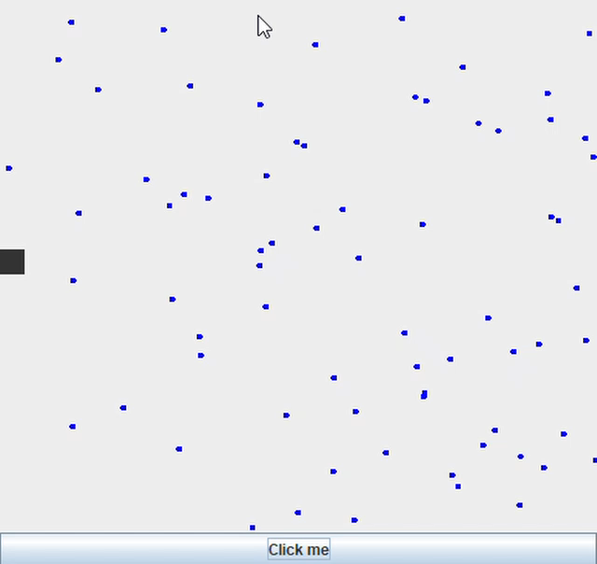
How to Make Screen Recordings
Link: record your screen on Windows 10 using Game Bar (Windows Key + g)
https://www.businessinsider.com/how-to-record-screen-on-windows-10

Slide 8
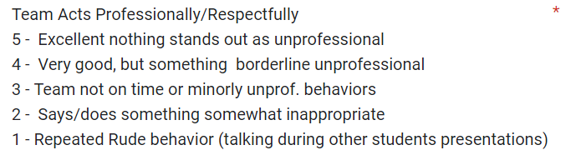
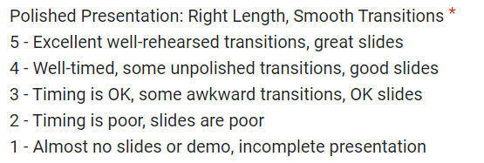
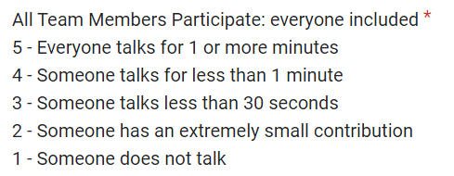
Rubric for Scoring Presentations

Slide 9
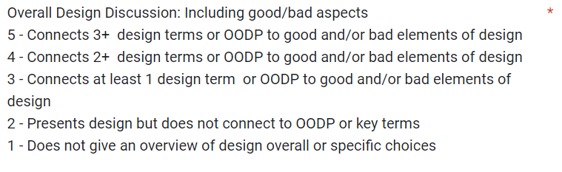
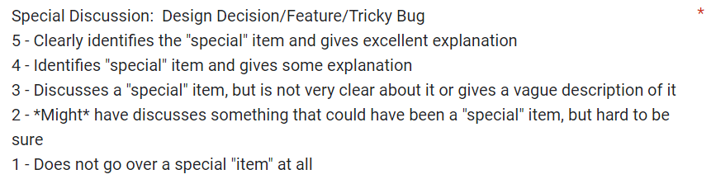
Rubric for Scoring Presentations

Slide 10



Student Voted Awards!
+5 Incentive Points Each!
Experiment Explanation for GARP

Slide 11
CSSE 220
Eclipse PlantUML Plugin
Notes:
No quiz today.
Bring printouts from the MergeSortSimpleSolution.

Slide 12
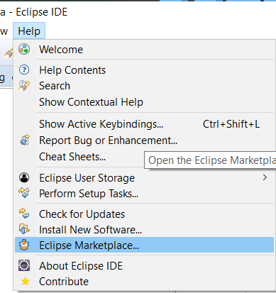
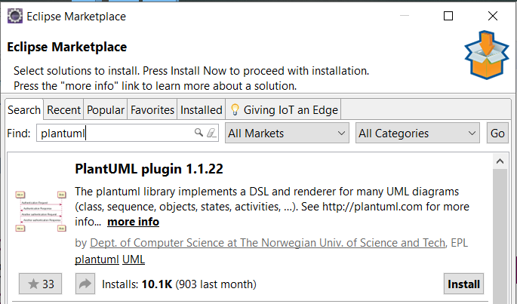
PlantUML Eclipse Plugin
https://plantuml.com/eclipse

Slide 13
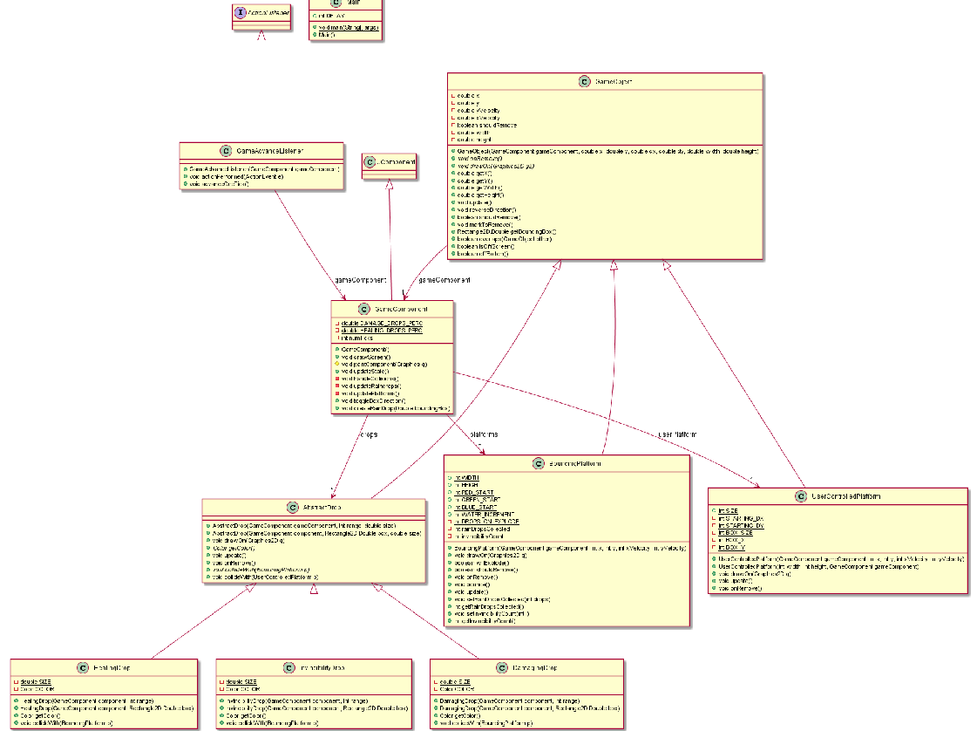
Information
Overload!

Slide 14
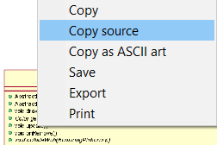
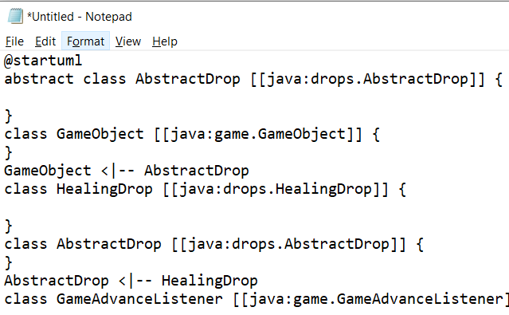
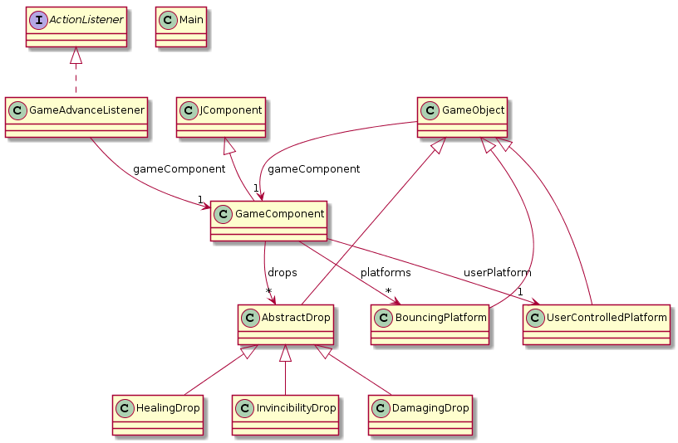
<- Copy UML source and
then remove extra ->

Slide 15
