Slide 1
CSSE 220
Attendance password
is written on the board
Comparable/Comparator
The git projects for today are:
PracticeComparableAndComparators
PracticeSolutionComparableAndComparators
PracticeSolutionChessJARDemo
This Quiz for today is:
ComparableAndComparatorsQuiz
Notes:
This is course evals day, you can start with course evals or get them started on exercises and then do course evals.
Bring printouts from the PracticeSolutionComparableAndComparators
The function package is only extra practice, to streamline things it works best to just do a couple of examples within the comparing package
This is mostly for exposure to using these in practice and connecting OO ideas

Slide 2
Today’s Plan
How to use Java’s sort functions:
Comparable (make a type comparable)
Comparator (use an object to do comparing)
Course Evaluations
Project work time

Slide 3
How to Sort in Java
For arrays:
Arrays.sort(myArray);
For ArrayLists or other stuff:
Collections.sort(myArrayList)
For stuff like Strings and ints, the expected sorting is already built in. But what if you have a new class you want to sort?

Slide 4
When Your Object is Sortable
You should implement the Comparable<YourObjectType> interface
You need to implement 1 method: int compareTo(other)
Requirements: compares data like .equals(),
but returns an integer such that:
a.compareTo(b) < 0 when a < b
a.compareTo(b) > 0 when a > b
a.compareTo(b) == 0 when a == b.
Section 10.3 of your text has more details
Notes:
Work on comparable.Rectangle example with class.
Complete TODO #1 and TODO #2 in Rectangle
Have students complete comparable.Person
They should complete TODO #1 and TODO #2 in Rectangle

Slide 5
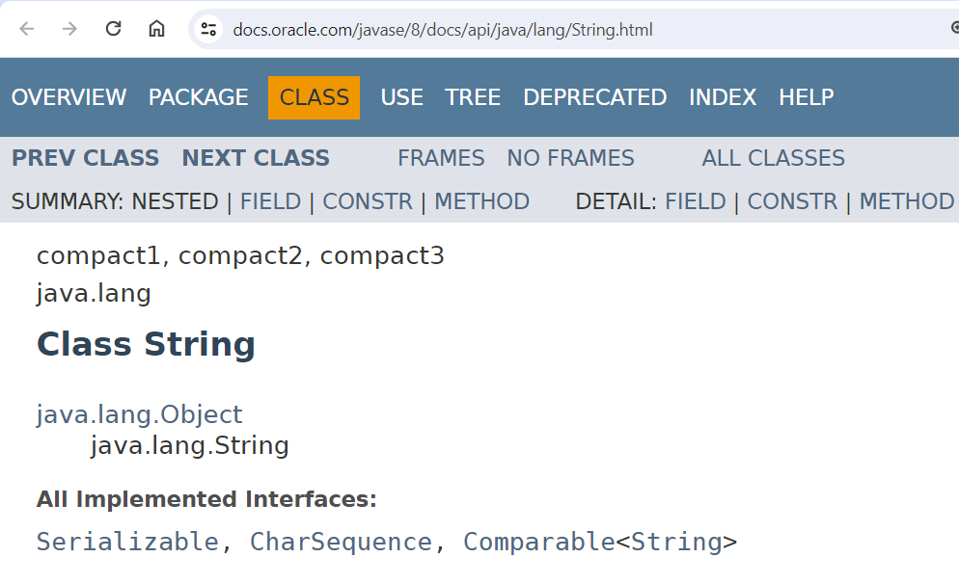
Any useful information here?
Notes:
Show this slide when students are trying to figure out how to check if two Strings are in order or not.
Much easier to just use the built-in compareTo method in the String class than setting up your own custom String order
method.

Slide 6
A Sort of a Different Order
Java libraries provide efficient sorting algorithms
Arrays.sort(…) and Collections.sort(…)
But suppose we want to sort by something other than the “natural order” given by compareTo()
Look at the ugly code duplication if the way to sort is embedded in the sort (next slide)!
Notes:
The behavior of compareTo() is described in the Comparable interface.

Slide 7
Code duplication again!
Sort by length of string
Sort by second character
public void sortV1(String[] a1) {
final int n = a1.length;
for (int j= 0; j< n - 1; j++) {
int indexOfSmallestLeft = j;
String smLeft = a1[indexOfSmallestLeft];
for (int k = j + 1; i < n; i++) {
if (a1[k].length() < smLeft.length()) {
indexOfSmallestLeft = k;
smLeft = a1[k];
} // end if
} // end for
a1[indexOfSmallestLeft] = a1[j];
a1[j] = smLeft;
} // end for
} // sortV1
public void sortV2(String[] a1) {
final int n = array.length;
for (int j= 0; j< n - 1; j++) {
int indexOfSmallestLeft = j;
String smLeft = array[indexOfSmallestLeft];
for (int k = j + 1; i < n; i++) {
if (a1[k].charAt(1) < smLeft.charAt(1)) {
indexOfSmallestLeft = k;
smLeft = a1[k];
} // end if
} // end for
a1[indexOfSmallestLeft] = a1[j];
a1[j] = smLeft;
} // end for
} // sortV2
Here are the only lines of code that are different
So close! Can we let the “way to sort” be a parameter to the method?
Notes:
Might want to ask them to identify the sort. (This is selection sort.)

Slide 8
Solution: Function Objects
Objects defined to just “wrap up” functions so we can pass them to other (library) code
For sorting we can create a function object that implements Comparator
Arrays.sort(people, new ByAgeComparator())
What goes into the ByAgeComparator class?
Let’s try it!
Notes:
Complete TODO#3 for RectangleDriver
Have students complete TODO #3 for PersonDriver
Comparator is also an interface, like Comparable. Comparator declares the compare() function while Comparable declares the compareTo() function.
Comparators are primarily used for collection objects to tell them how to order their elements.

Slide 9
Anonymous Class Examples
String[] colors = new String[] {"red", "orange", "yellow", "green", "blue", "indigo", "violet"};
Arrays.sort(colors);
System.out.println("Sort [default]: " + Arrays.toString(colors));
Comparator<String> bySecondLetter = new Comparator<String>() {
@Override
public int compare(String s1, String s2) {
char first = s1.charAt(1);
char second = s2.charAt(1);
return first - second;
}
};
Arrays.sort(colors, bySecondLetter);
System.out.println("Sort [second letter]: " + Arrays.toString(colors));
Comparator<String> byFirstEPosition = new Comparator<String>() {
@Override
public int compare(String s1, String s2) {
int first = s1.indexOf("e");
int second = s2.indexOf("e");
return first - second;
}
};
Arrays.sort(colors, byFirstEPosition);
System.out.println("Sort [first e position]: " + Arrays.toString(colors));
Notes:
Similar to anonymous ActionListeners, we can create anonymous comparators:
Complete TODO#4 for RectangleDriver
Have students complete TODO #4 for PersonDriver

Slide 10
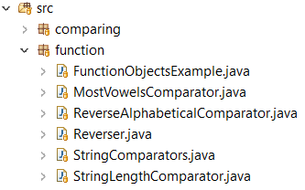
Extra Comparator Practice
See function package for additional practice
Uses a variety of different comparators
Notes:
Not enough time to do this and let them work on project
They will be focused on the project at this point in the quarter
Extra example In the function package

Slide 11



Reminder: Student Voted Awards!
+5 Incentive Points Each!

