Slide 1
Making a Runnable JAR
CSSE220 - Final Project
The git project for this part is:
PracticeSolutionChessJARDemo
Your Final CSSE220 Project Repo

Slide 2
How to Demo/Share Your Project with Others
Can share your source code (forces people to compile/run)
Easier to share a RUNNABLE file
You can EXPORT your Eclipse project as a Runnable file
Java uses JARs that can be run from anywhere with Java support
Code runs on a Virtual Machine that is translated to whatever hardware the host machine is running
Portability (write once run everywhere) is one great features of Java

Slide 3
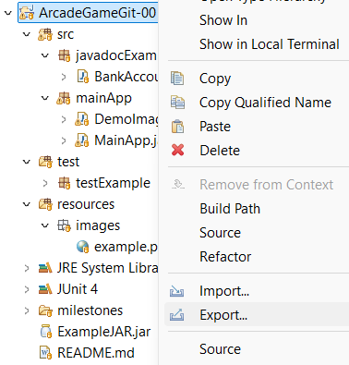
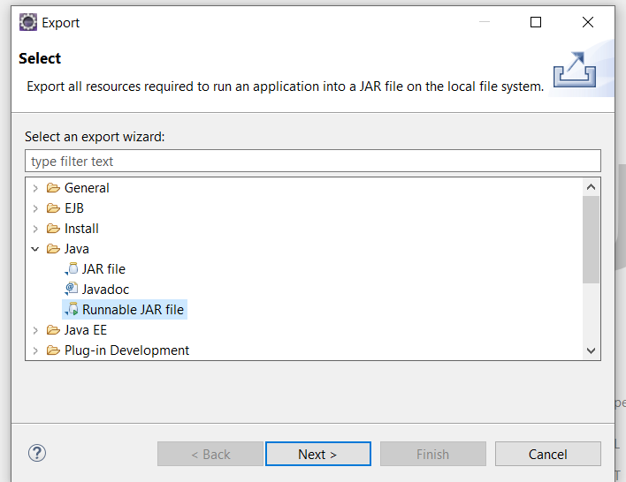
How To Do This in Eclipse
Right Click ->
Export
Java ->
Runnable JAR File

Slide 4
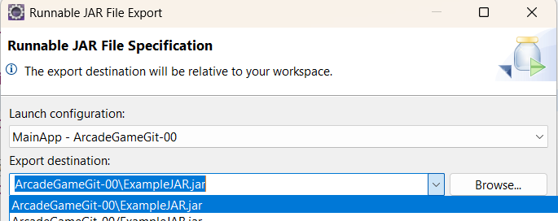
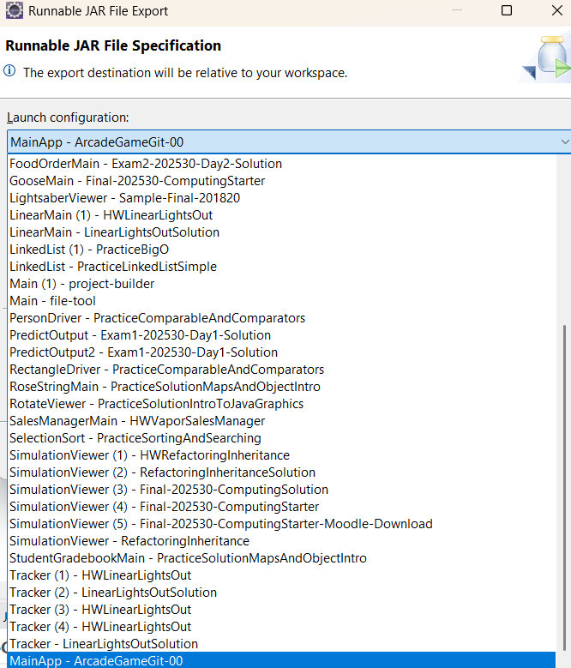
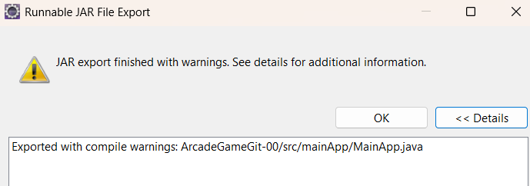
If you have run the final project you should be able to select it to run here.
Don’t worry about warnings…

Slide 5
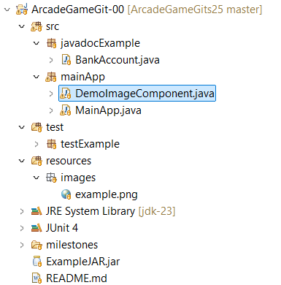
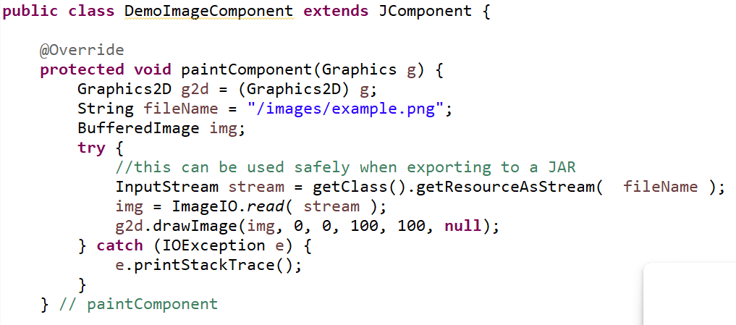



Example In Starter Repo

Slide 6
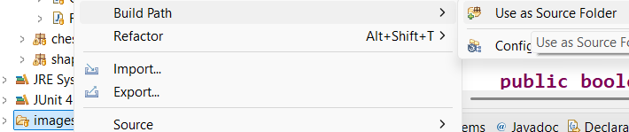
Added folders but they aren’t on the build path?
Add the images folder to the build path (.classpath)
Right click on the Folder->Build Path->Use as Source Folder
Now the files are considered part of the root and you don’t need to reference the folder (in our examples we use resources/images):
String fileName = "/" + name.toLowerCase() + "-";

Slide 7
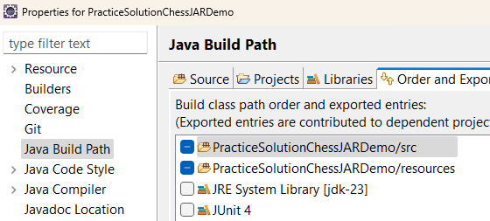
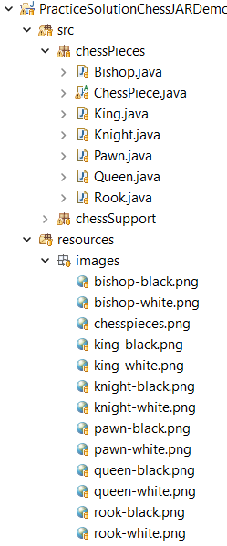
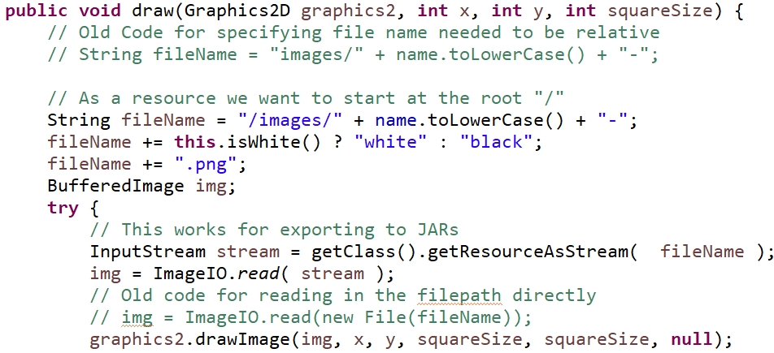



Make sure you have a source folder (e.g. resources)
and add all files into it (images/audio/etc.)

