Slide 1
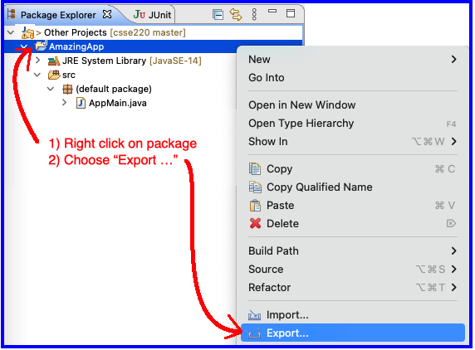
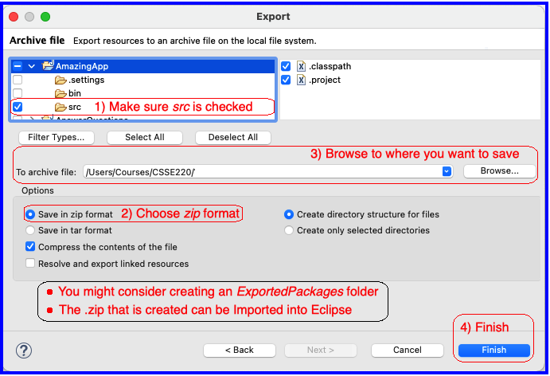
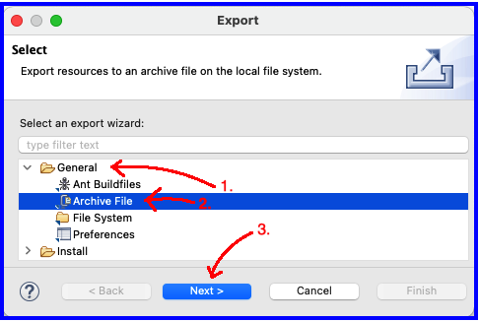
Right click | Export – Step 1
Exporting Eclipse Pkg to a .Zip
Export Dialog Archive - Step 3
Export Dialog Select - Step 2

