Slide 1
2D Arrays – What, When, Why, How?
What:
Think of them as an array of arrays
… or as a grid with rows & columns
When:
Represent 2 dimensional data
Game Boards
Tables
Multiple lists of items
Etc.
Notes:
What does it mean when I write down?
int[] (an array of type int)
OR
___[] (an array of some? type )
Is int[] a type? yes
What is does this mean?
int[][] (an array of int arrays!)

Slide 2
2D Arrays – What, When, Why, How?
Why:
Match your data representation as closely as possible to the real-world
How:
char[][] ticTacToe = new char[3][3];
Retrieving data
ticTacToe[0] → accesses the first char[]
ticTacToe[1][2] → accesss the 2nd row's 3rd column

Slide 3

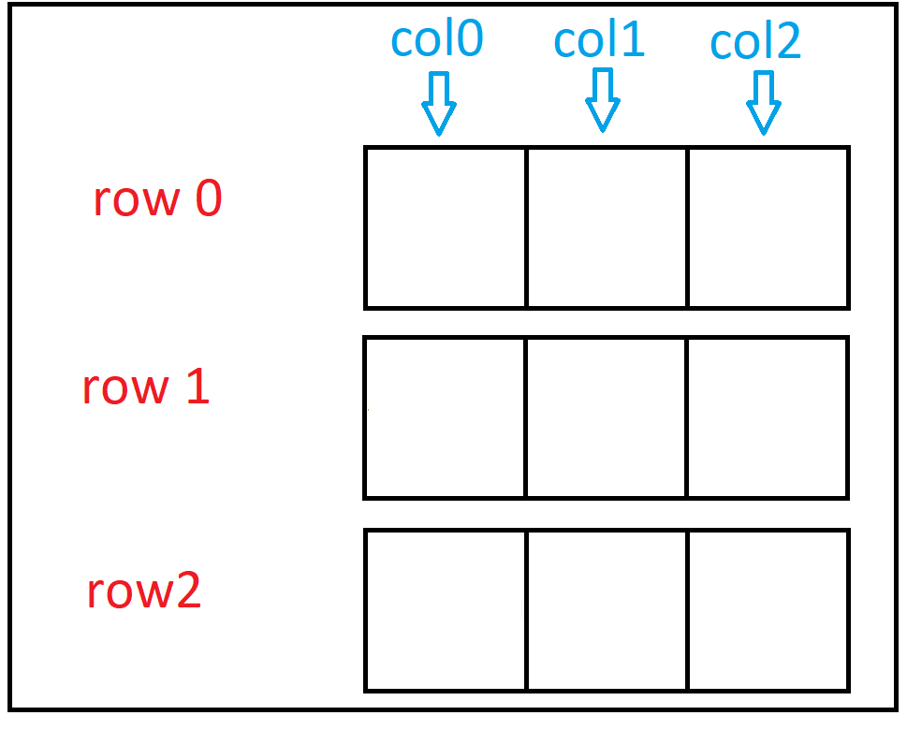
Creating a 2D char array

Slide 4
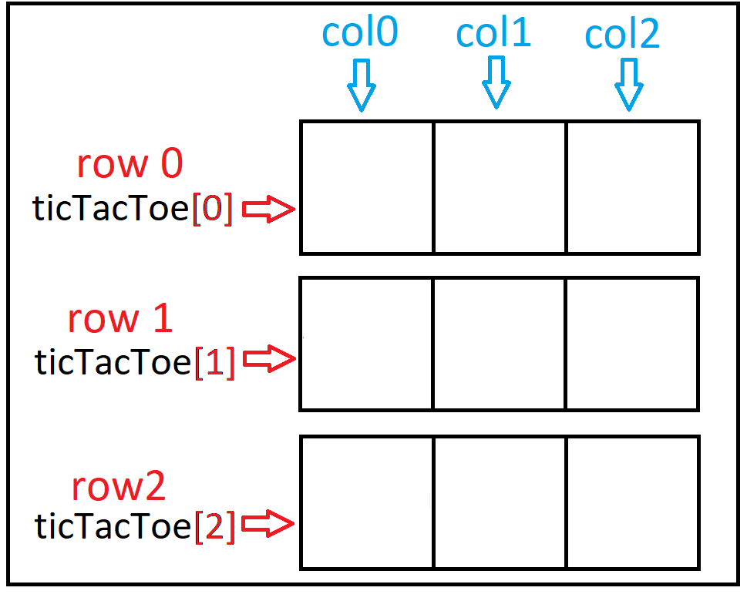
Creating a 2D char array

Slide 5
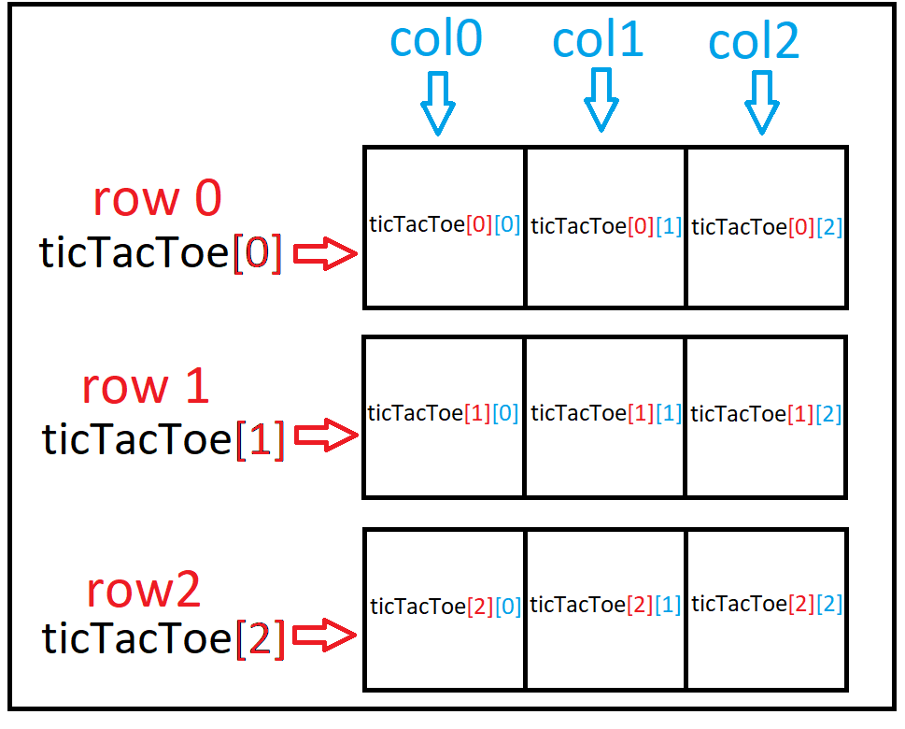
Creating a 2D char array

Slide 6
Creating a 2D char array
ticTacToe[ row ] [ column ] -> refers to individual cell

Slide 7
Creating a 2D char array
ticTacToe[ 1 ][ 1 ] = ‘X’;

Slide 8
Creating a 2D char array
ticTacToe[ 1 ][ 1 ] = ‘X’;
X

Slide 9
Creating a 2D char array
ticTacToe[ 0 ][ 1 ] = ‘O’;
X

Slide 10
Creating a 2D char array
ticTacToe[ 0 ][ 1 ] = ‘O’;
O
X

Slide 11
Creating a 2D char array
ticTacToe[ 2 ][ 2 ] = ‘X’;
O
X

Slide 12
Creating a 2D char array
ticTacToe[ 2 ][ 2 ] = ‘X’;
O
X
X

Slide 13
Creating a 2D char array
ticTacToe[ 0 ][ 0 ] = ‘O’;
O
X
X

Slide 14
Creating a 2D char array
ticTacToe[ 0 ][ 0 ] = ‘O’;
O
O
X
X

Slide 15
Creating a 2D char array
ticTacToe[ 2 ][ 0 ] = ‘X’;
O
O
X
X

Slide 16
Creating a 2D char array
ticTacToe[ 2 ][ 0 ] = ‘X’;
O
O
X
X
X

Slide 17
Creating a 2D char array
ticTacToe[ 2 ][ 1 ] = ‘O’;
O
O
X
X
X

Slide 18
Creating a 2D char array
ticTacToe[ 2 ][ 1 ] = ‘O’;
O
O
X
X
O
X

Slide 19
Creating a 2D char array
ticTacToe[ 0 ][ 2 ] = ‘X’;
O
O
X
X
O
X

Slide 20
Creating a 2D char array
ticTacToe[ 0 ][ 2 ] = ‘X’;
O
O
X
X
X
O
X

Slide 21
2D array dimensions
int[][] numArray = new int[2][4];
// rows, cols
int rows = numArray.length;
int cols = numArray[0].length;

Slide 22
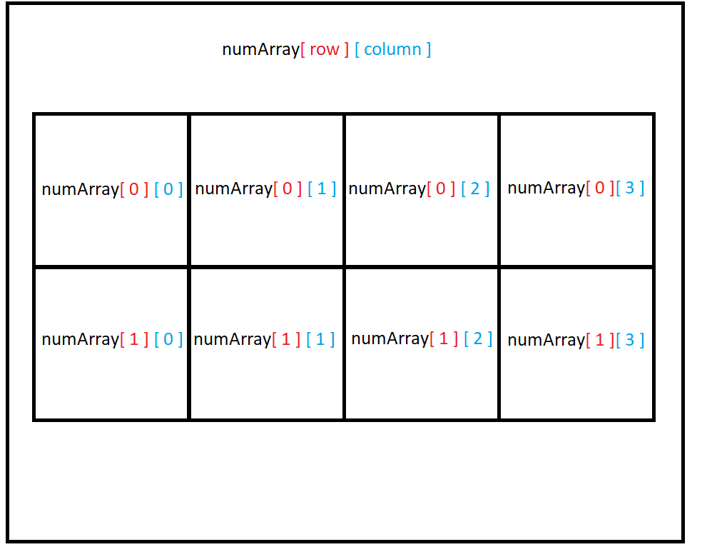
2D array dimensions
2 rows
4 columns

Slide 23
Iterate by rows through 2D array?
int[][] numArray = new int[2][4];
int rows = numArray.length;
int cols = numArray[0].length;
int count = 0;
for (int r = 0; r < rows; r ++) {
for (int c = 0; c < cols; c++) {
numArray[r][c] = count;
count ++;
} // end for
} // end for

Slide 24
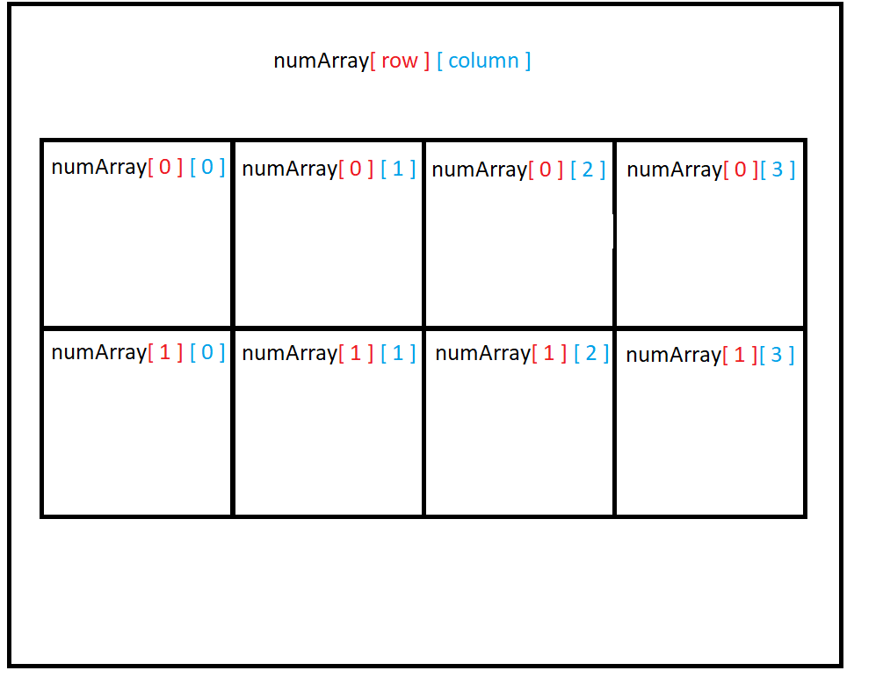
Order of iteration – by rows?
int[][] numArray = new int[2][4];
int rows = numArray.length;
int cols = numArray[0].length;
int count = 0;
for (int r = 0; r < rows; r ++) {
for (int c = 0; c < cols; c++) {
numArray[r][c] = count;
count ++;
} // end for
} // end for
0
1
2
3
4
5
6
7

Slide 25
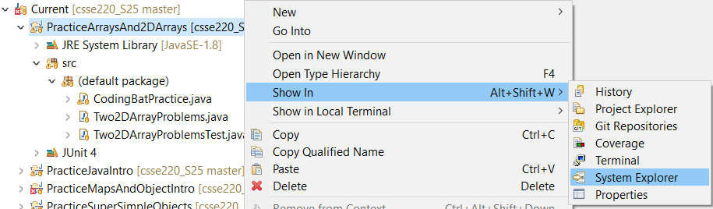
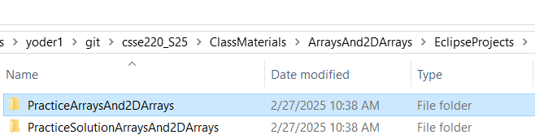
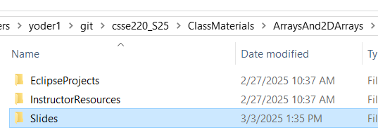
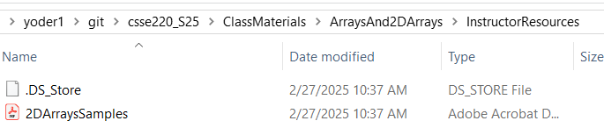





2D Arrays
1
2
3
4
Notes:
Once groups are finished, ask them to work on the array problems from git
Once enough groups are finished, review the quiz questions and refer students to the cheat sheet

Slide 26
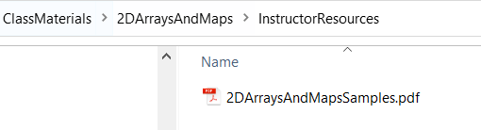
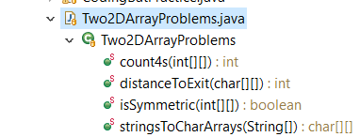
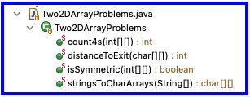
2D Arrays
Read through the 3 2D Array sample problems make sure you understand how they work
2DArraysAndMapsSamples.pdf
Then use the code as an example to answer the 2D Array quiz questions (on Moodle)
Then do the 2d sample problems in the in-class exercise for today
Post ANY questions to Piazza even including code since this is purely collaborative exercise and the solution code is available to you
Please look to help answer questions other students post
Notes:
Once groups are finished, ask them to work on the array problems from SVN
Once enough groups are finished, review the quiz questions and refer students to the cheat sheet

