Slide 1
Critical Logistics
You have 2 homework assignments in the very near future
You have the FirstDayQuiz to complete
To see all assignment due dates, look at the Airtable view on Moodle (next slide)
We will only go over the course policies if we have time, but they are covered in the "Course Policies" page link on Moodle
Notes:
Airtable in moodle

Slide 2
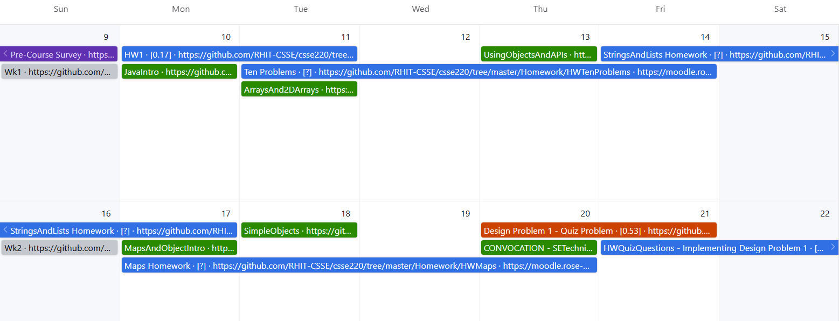
Airtable View on Moodle
DUE:
Last
Day
DUE:
Last
Day
DUE:
Last
Day
DUE:
Last
Day

Slide 3
Agenda
Critical logistics
We write some java code
Conditionals
Loops

Slide 4
Let’s write hello world together
Notes:
JAY: I suggest actually writing some code out on the board - things to note:
{ } enclose code in blocks – Eclipse highlights them for you
Special words have different colors
Semicolons are required
Capitalization matters and is important

Slide 5
A First Java Program
In Java, all variable and function definitions are inside class definitions
main is where we start
public class HelloPrinter {
public static void main(String[] args) {
System.out.println("Hello, World!");
}
}
System.out is Java's standard output stream. This is the variable called out in the System class.
System.out is an object from the PrintStream class. PrintStream has a method called println( ).
Q6
Notes:
Argument for main is not optional. Must be there.

Slide 6
HelloPrinter.java
To run a Java program:
Right-click the .java file in Package Explorer view
Choose Run As → Java Application
Introduce yourself to your neighbor and change the program to say hello to them
Introduce an error in the program
See if you can come up with a different error than your neighbor
Fix the error that your neighbor introduced
Notes:
Discuss errors and error messages

Slide 7
In Class Coding
You can do this in pairs or on your own. There are 3 files:
ConditionalExamples.java
LoopProbs.java
Each file contains several solved functions and several unsolved functions. Understand the code in the solved functions, and then use that code to help you write the unsolved functions.
If you have a problem that you can’t quickly debug, or need a hint – call me or the TA over
Test your code to ensure you’re right
In ConditionalExamples.java, modify “main” to call your new functions with test values (print to see results)
For LoopProbs.java, run the LoopProbsTest.java file as Junit Test

Slide 8
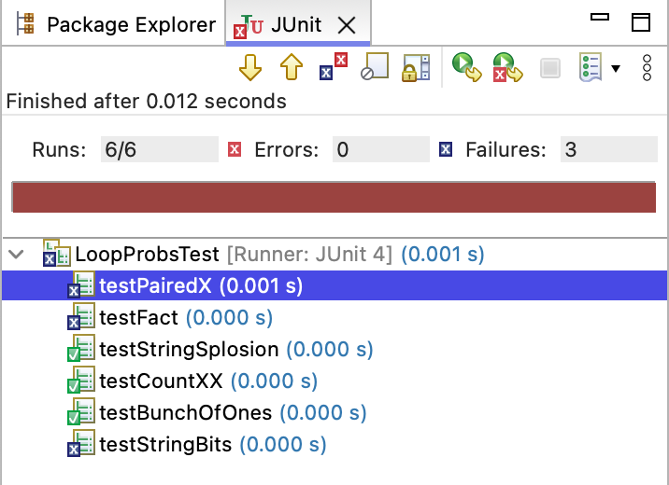
Running as App vs. JUnit
When running as an application, the first thing that runs is the “main” method
When running as a Junit Test all tests run:
Green Check means success
Blue X means tests failed
Red X means Exception (Error)

Slide 9
What are Types?
All variables in Java have a “type”
Describes the data that can be stored in a variable
short/int/long – whole numbers only
float/double – numbers with decimals
boolean – true or false
char – a single text character
Classes (later) – Class names are also types, let you define your own, more complex, types

Slide 10
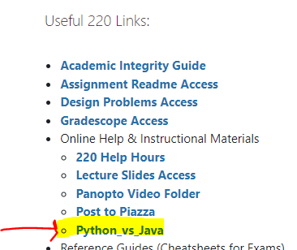
Review Loops: while & for Loops
While loop syntax: Similar to Python
while (condition) { statements
}
For loop syntax: Different from Python
for (initialization ; condition ; update) { statements
}
In both cases, curly braces optional if only one statement in body; but be careful!
Notes:
Point students to Python vs Java features linked from session 1 of course schedule.

Slide 11
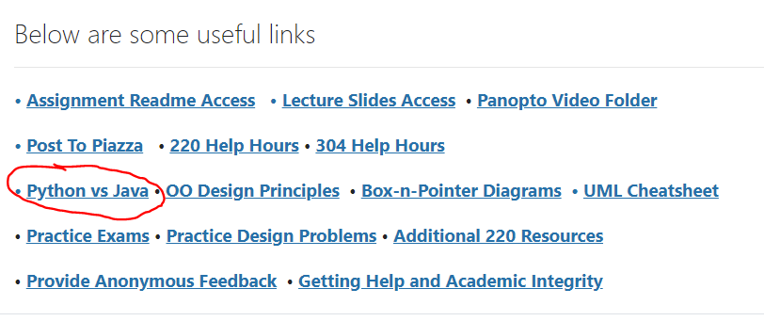
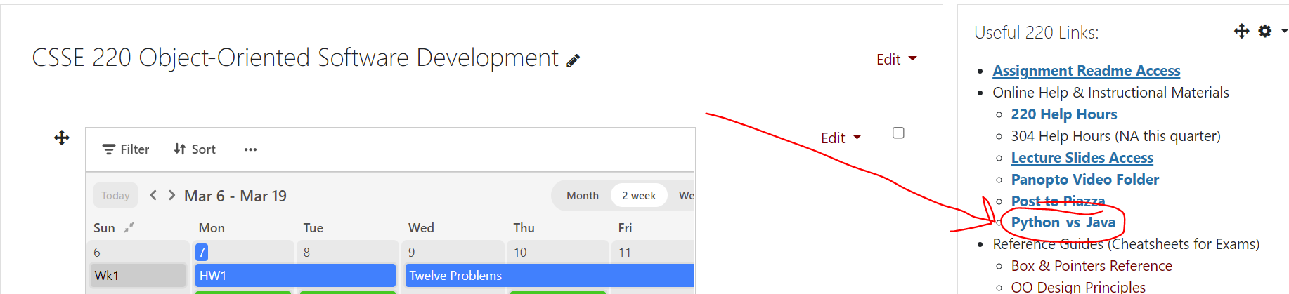
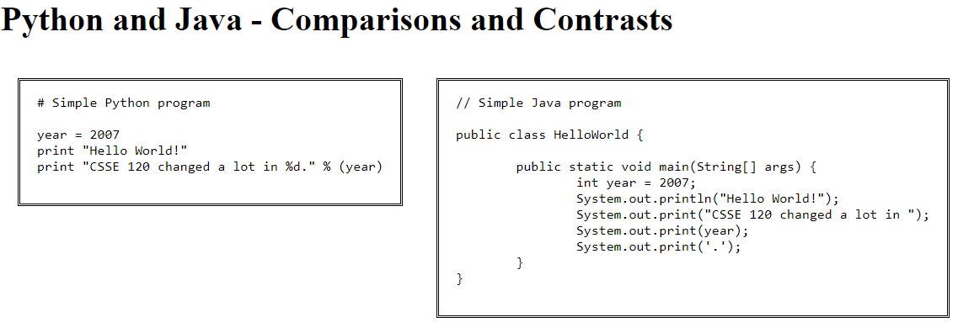
Java vs. Python

Slide 12
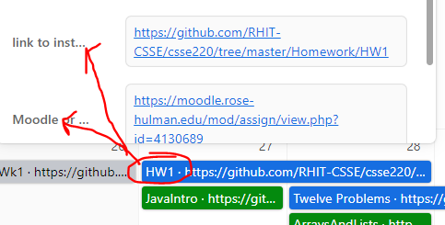
How to submit homework assignments
You'll submit your .java files via GradeScope
There's instructions in the Homework section of the course Moodle (linked in Airtable too)
Helpful:
Python vs Java features link

Slide 13





Deadlines
You should AIM to complete these early, start working on them the day they appear on the Calendar
However, if exceptional circumstances arise, I will ask you to complete a form requesting an extension.

Slide 14
HW1 due soon, see Moodle/Gradescope FirstDayQuiz is due tonight! (It is your responsibility to keep up with the schedule) Post on Piazza or email me if you have any questions

Slide 15
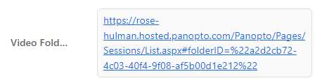
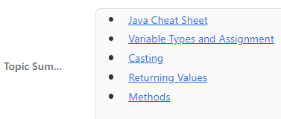

Reminder: Useful Links in Airtable
Pre-recorded lectures of content. Useful for reviewing confusing material, when you miss part or all of a class.
Various Topic Summaries for CSSE220 Topics. Useful for checking your understanding, review daily material preparing for exams.
Direct link to the Moodle Quiz for the Day

